Slide 1
A Case Study of a Shunt and Preexisting Series Simultaneous Fault
Eric Johnson
Dominion Energy South Carolina
Luke Booth and Joe Perigo
Schweitzer Engineering Laboratories, Inc.
© 2025 Dominion Energy and SEL

Slide 2
Outline
Introduce system, fault, and misoperation
Review root-cause analysis of misoperation
Discuss an open-phase detection method
Explain first-principles approach that aids in determining simultaneous faults

Slide 3
Key takeaways
Learn clues that may indicate certain simultaneous faults
Understand an open-phase detection method
Realize phase-domain analysis is optional modern tool

Slide 4
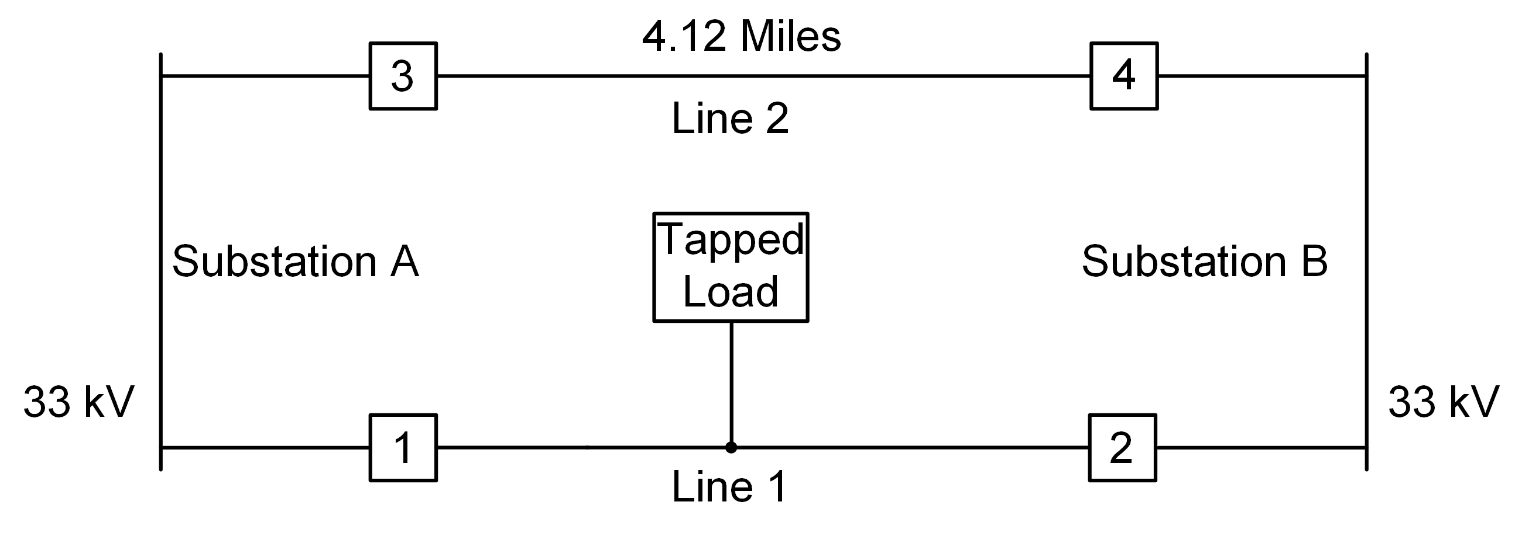
System one-line diagram

Slide 5
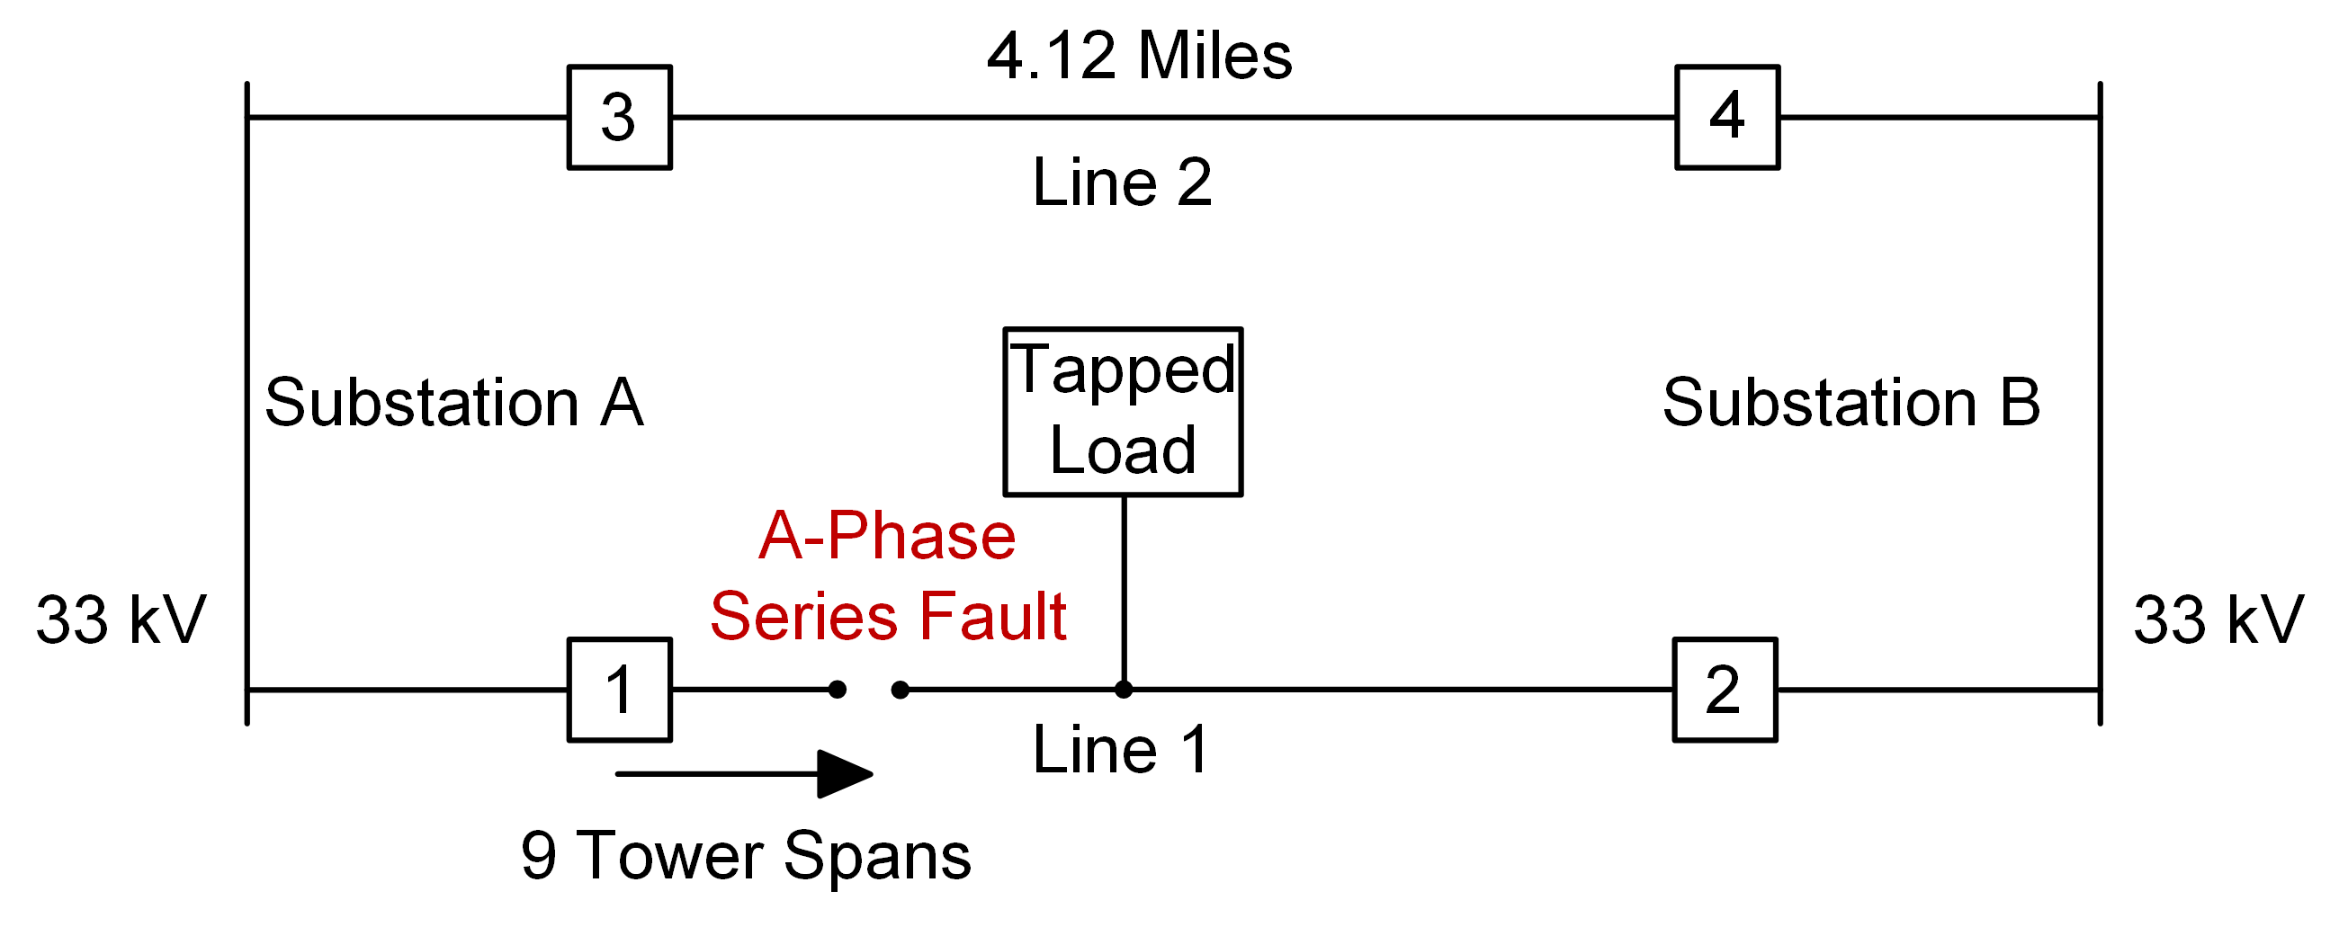
System one-line diagram unknown series fault

Slide 6
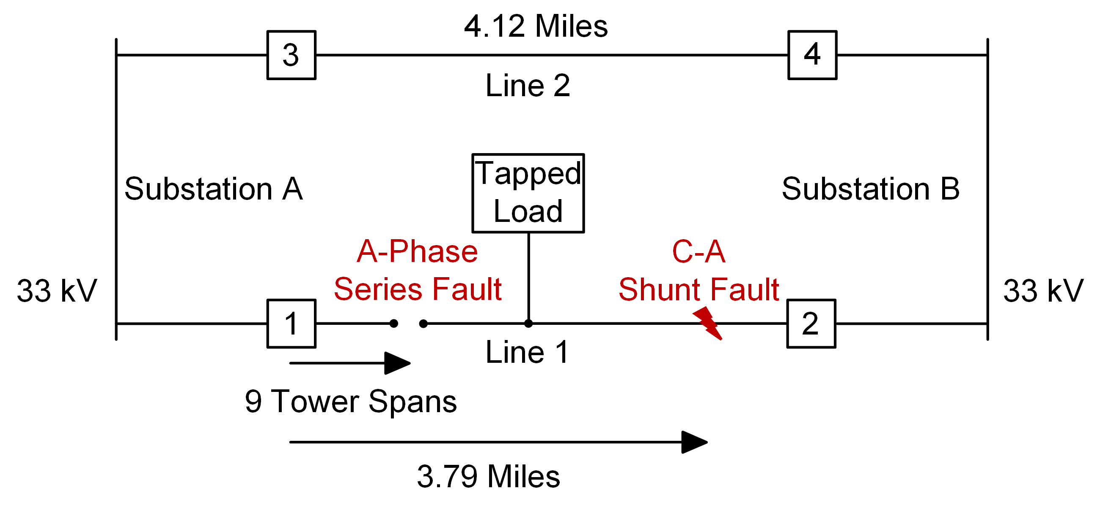
System one-line diagram simultaneous fault

Slide 7
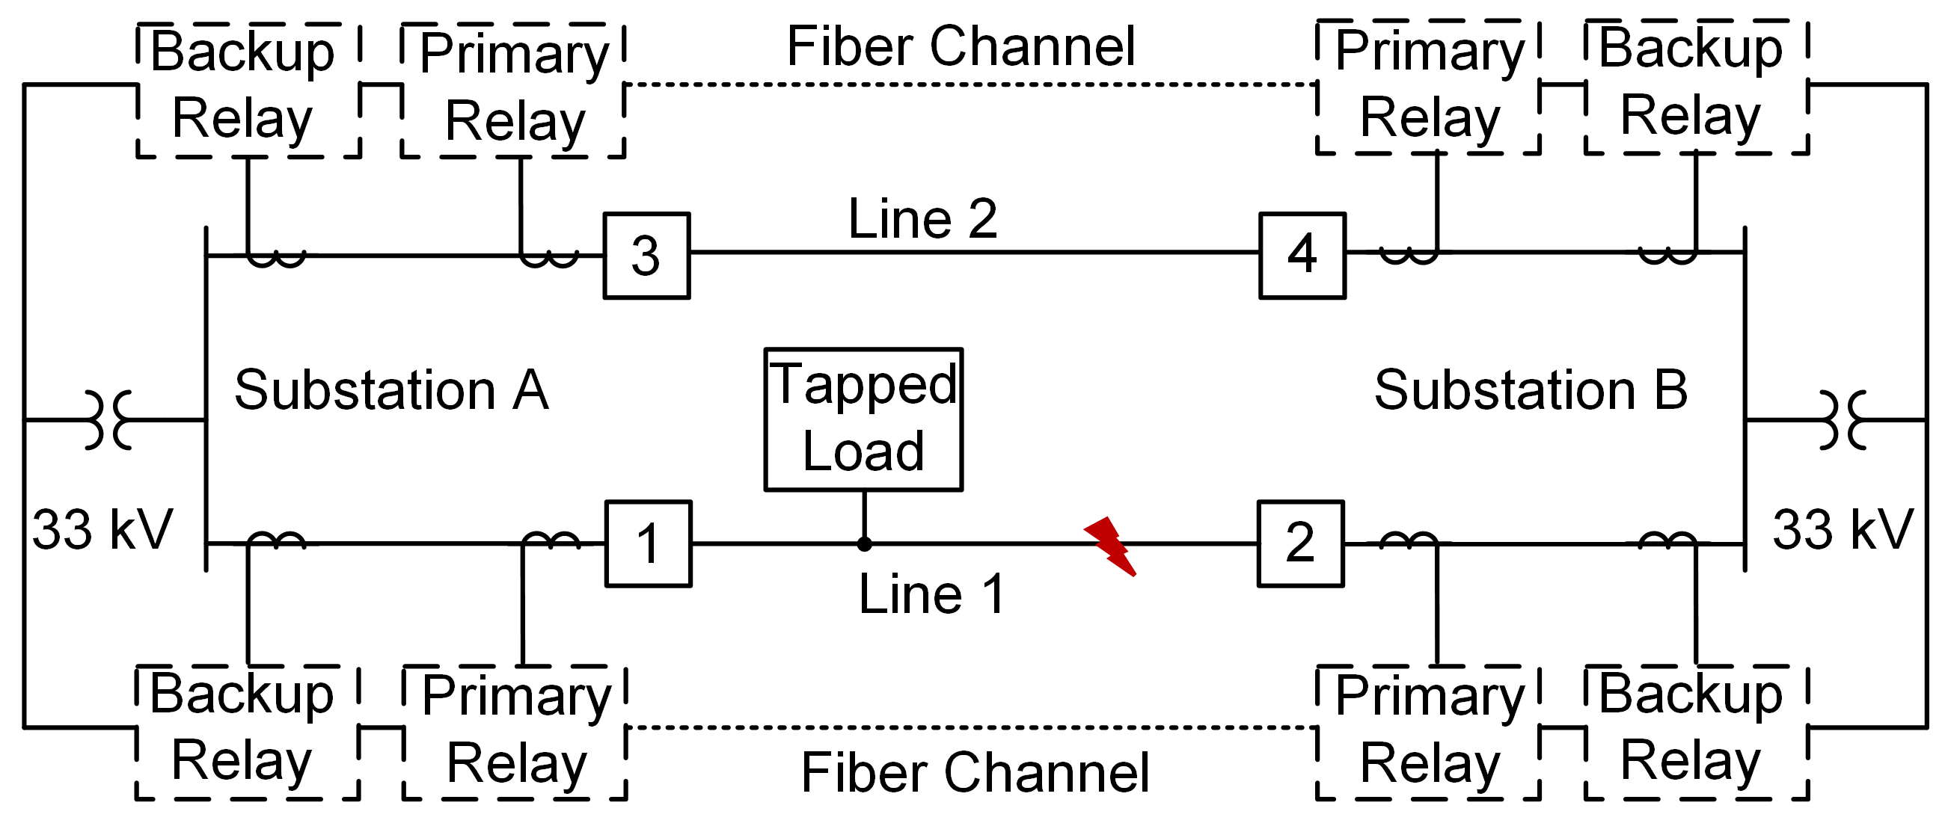
One-line diagram initial analysis
21
87
87

Slide 8
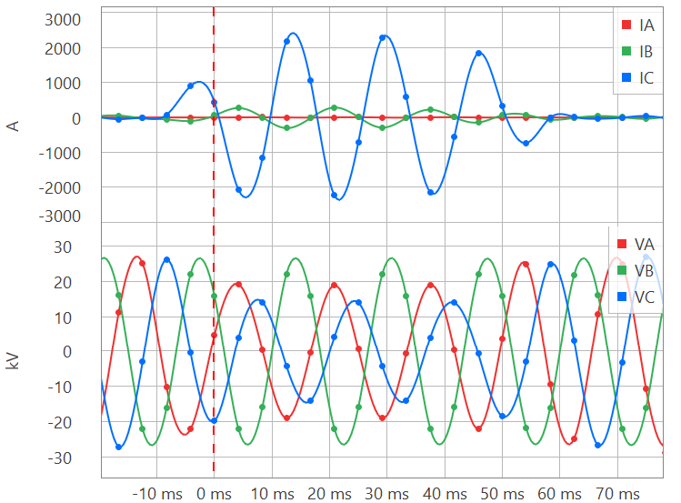
Breaker 1 oscillography
Observations
C-phase current drastically increased
A-phase current is flat
A-phase and C-phase voltage decrease
Note: System is ACB phase rotation

Slide 9
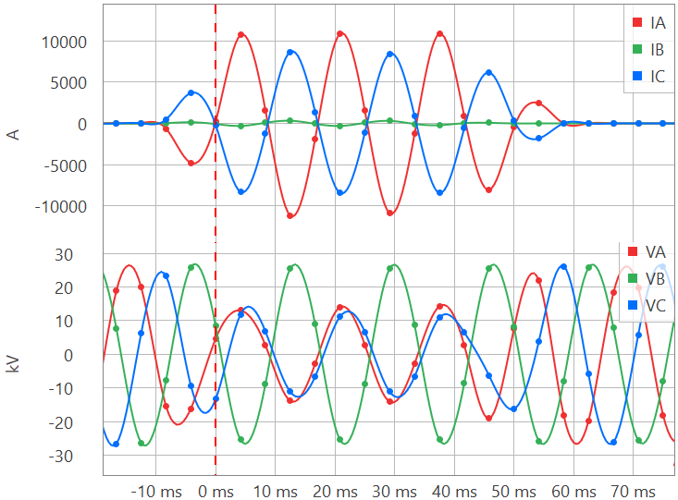
Breaker 2 oscillography
Observations
A-phase current increases more than C-phase current
A-phase and C-phase voltages move toward each other
A-phase voltage is greater than C-phase voltage

Slide 10
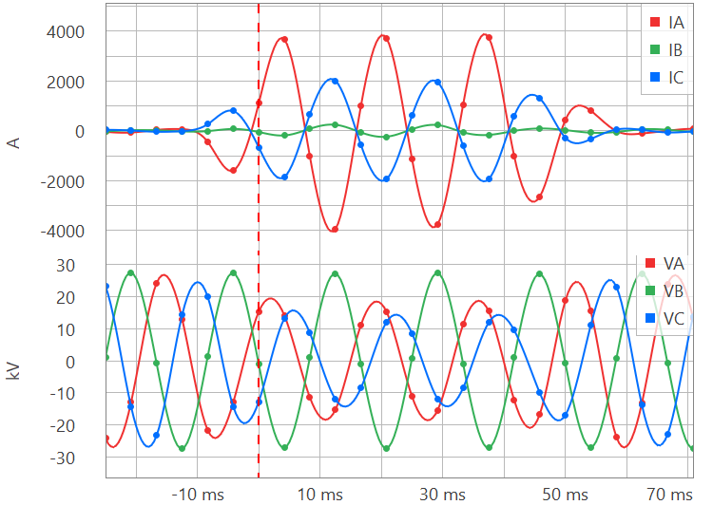
Breaker 3 oscillography
Observations
A-phase current is significantly higher than C-phase current
A-phase voltage is greater than C-phase voltage

Slide 11
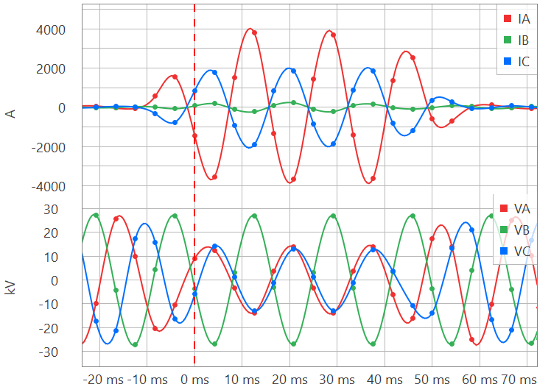
Breaker 4 oscillography
Observations
A-phase current is significantly higher than C-phase current
Because A-phase current is higher than C-phase, zero-sequence current is present

Slide 12
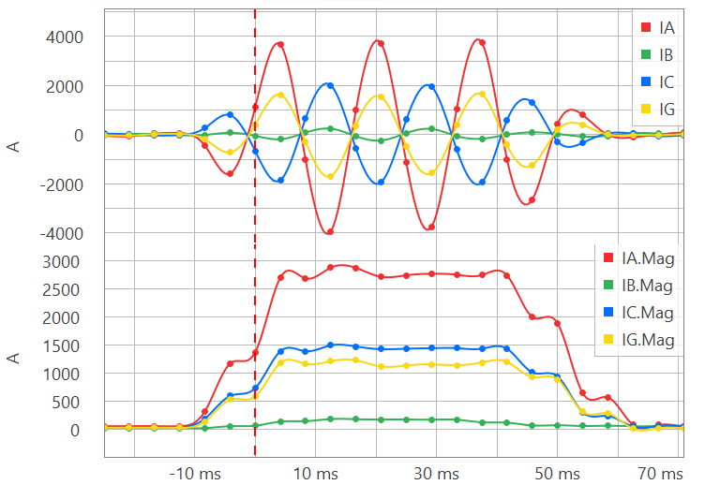
Breaker 3 primary relay residual current
Relays’ Responses
Primary relay momentarily enabled ground distance elements
Primary relay quadrilateral ground Zone 1 element operated on A-phase
Backup relay did not enable ground distance elements and did not operate

Slide 13
Clues during fault to investigate
A-phase current of Breaker 1 is flat
Can the CT secondary leads be shorted?
It is unlikely that two sets of CTs are compromised
What was the state of the current pre-fault?

Slide 14
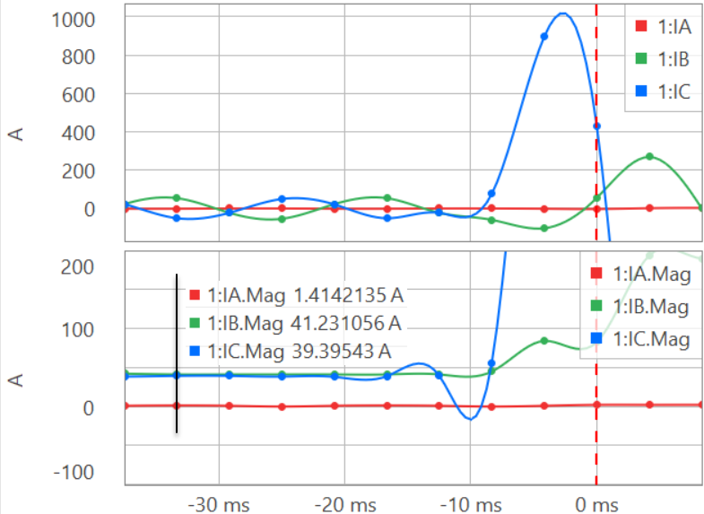
Pre-fault current Breaker 1 on Line 1
Observation
A-phase current is nonsinusoidal and close to zero

Slide 15
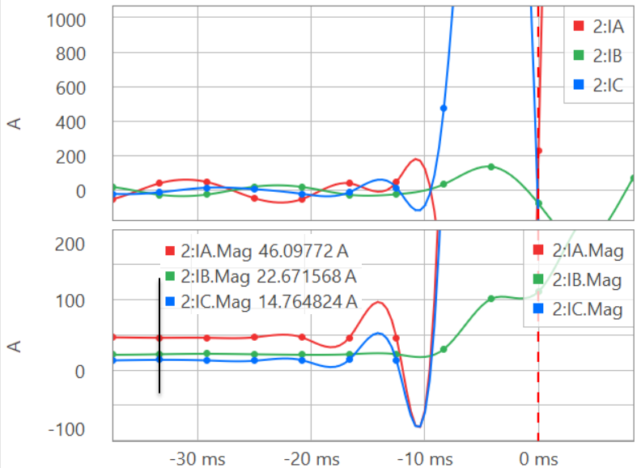
Pre-fault current Breaker 2 on Line 1
Observation
A-phase current is sinusoidal and has primary current flowing

Slide 16
Clues during fault to investigate
A-phase current of Breaker 1 is flat
Can the CT secondary leads be shorted?
It is unlikely that two sets of CTs are compromised
What was the state of the current pre-fault?
Asked field personnel to verify state of CTs

Slide 17
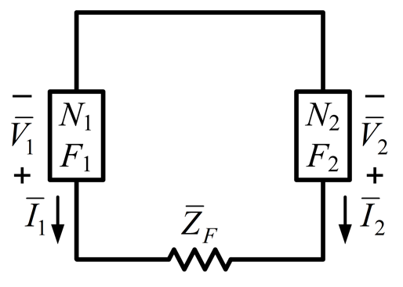
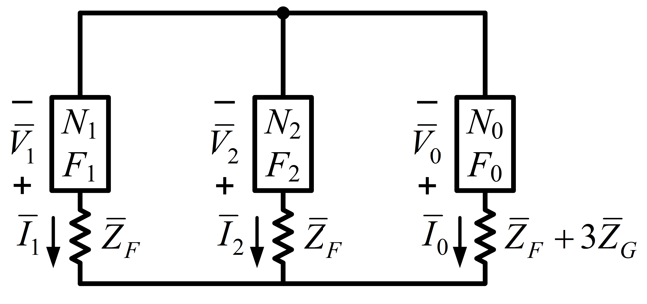
Clues during fault to investigate
A-phase voltage is not depressing more than C-phase
Is this a phase-to-phase fault or phase-to-phase-ground fault?
Sequence network connections
Phase-to-phase fault
Phase-to-phase-ground fault

Slide 18
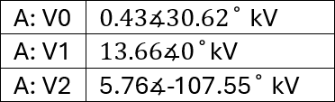
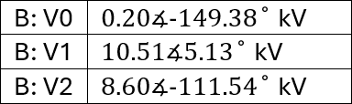
Bus sequence voltages

Slide 19
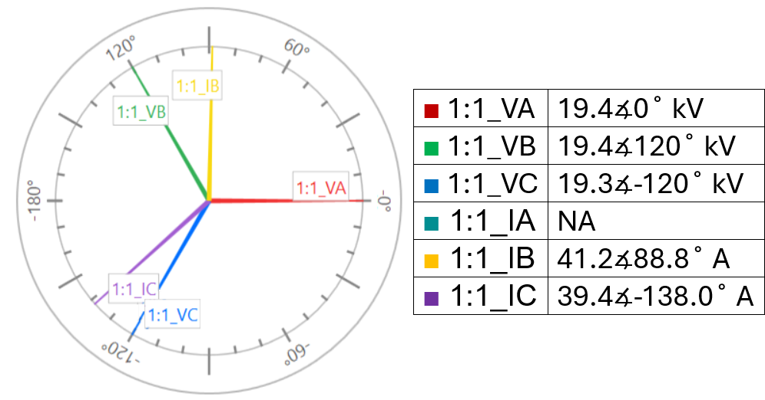
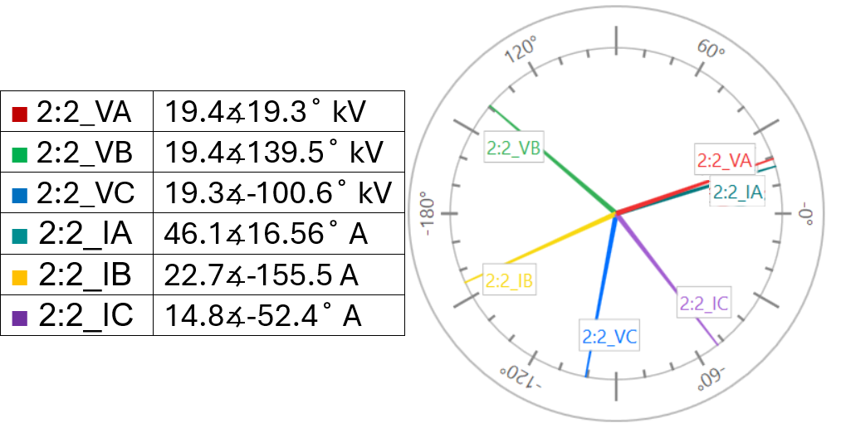
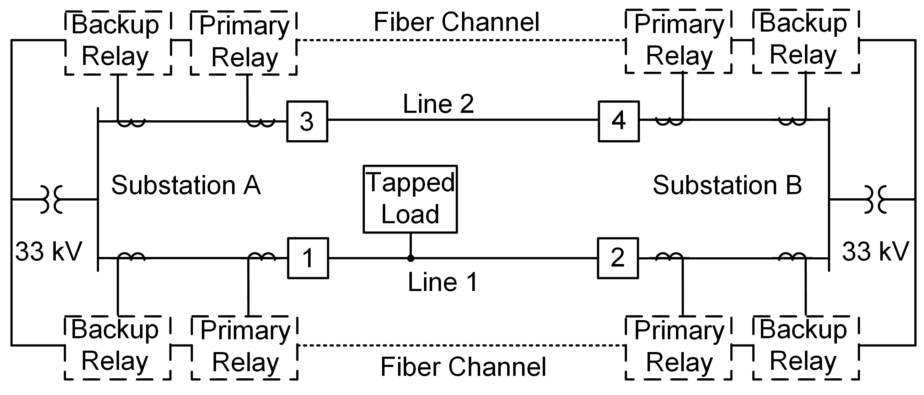
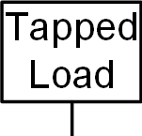
Pre-fault voltages and current on Line 1

Slide 20
Known simultaneous fault condition

Slide 21
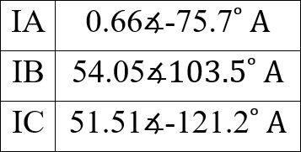
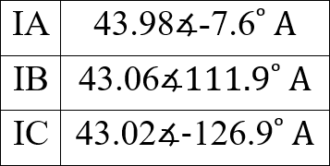
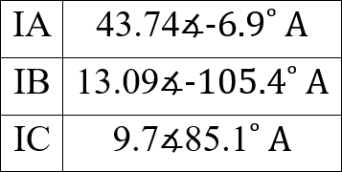
Metered current on Line 1
Vector sum of Breaker 1 and 2 currents

Slide 22
Open-phase detection – negative-sequence to positive-sequence ratio comparison
to

Slide 23
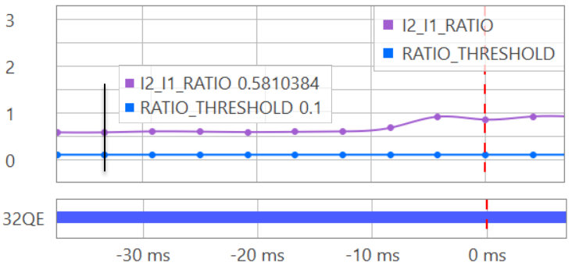
Primary relay I2/I1 pre-fault comparison result

Slide 24
Circuit analysis for simultaneous faults
Brief discussion of symmetrical components
Return to first principles – phase components
Circuit modeling
Simulation results

Slide 25
Symmetrical components
Development in early-to-mid-1900s
Advancement for faulted circuit analysis
Applicable to simultaneous faults, but…

Slide 26
Phase components
Kirchhoff’s voltage law (KVL) developed in mid-1800s
Requires modeling mutual coupling
Linear algebra can be pain point
But, in 2025, we have modern computing tools!

Slide 27
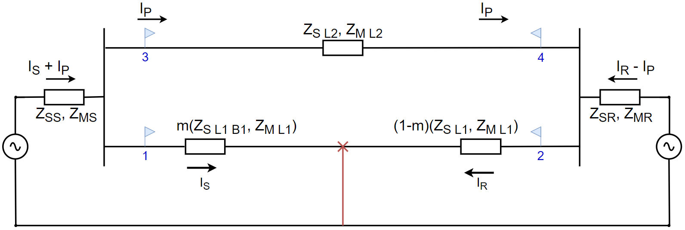
Developing the circuit model

Slide 28
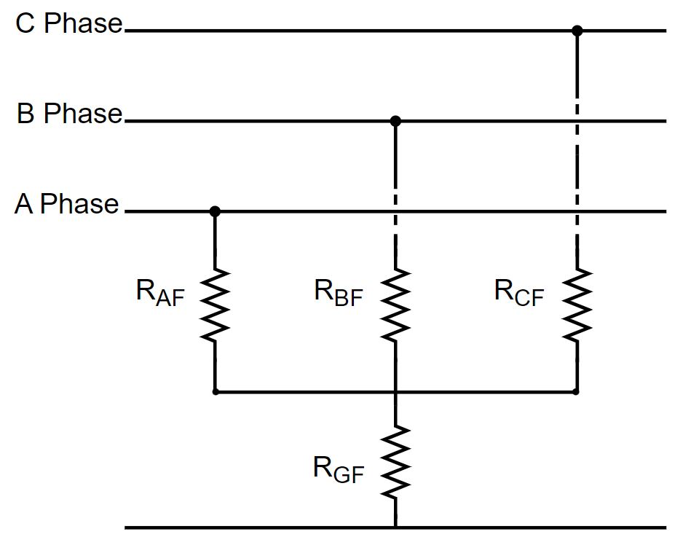
Developing the circuit model

Slide 29
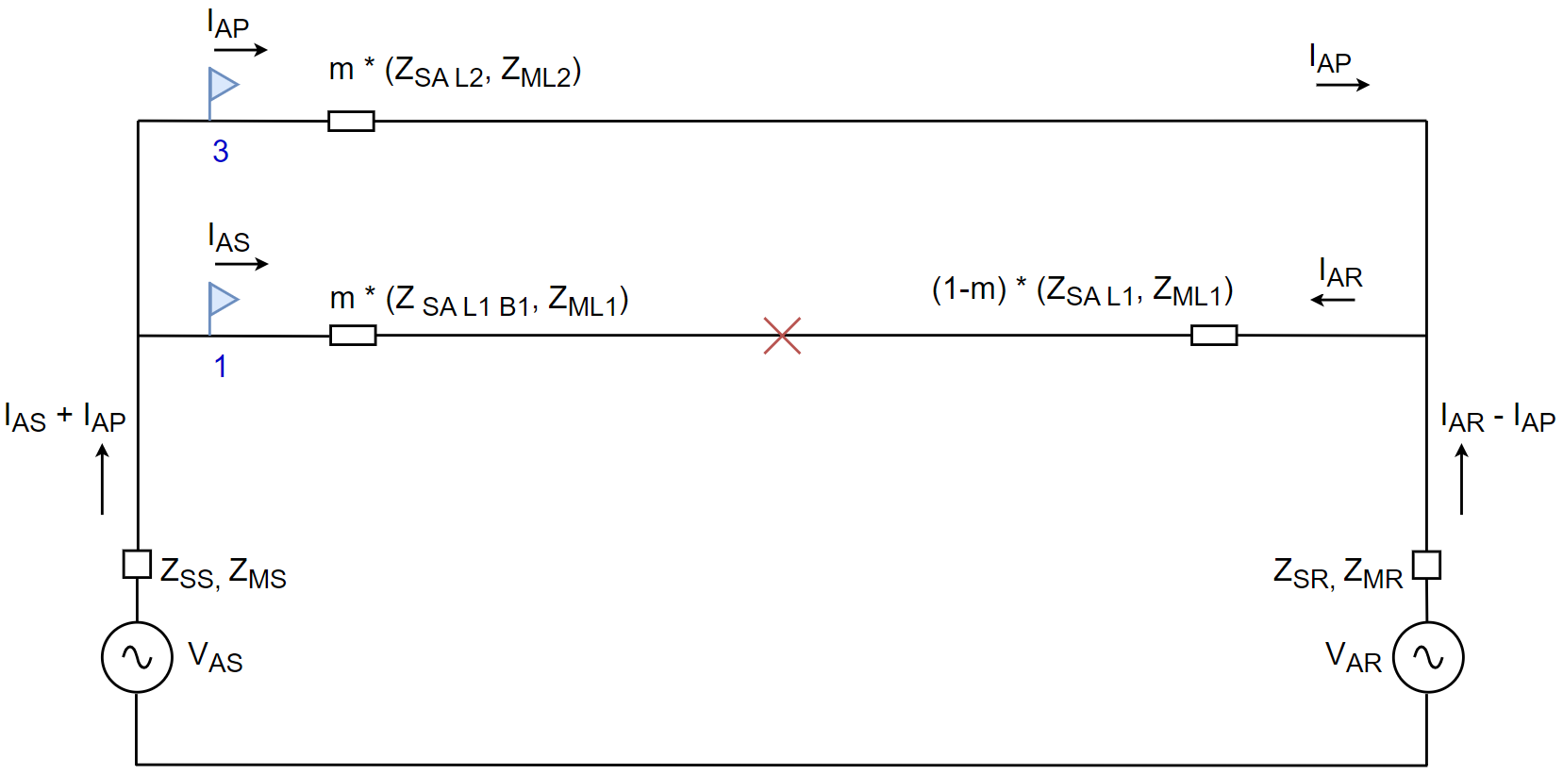
Developing the circuit model

Slide 30
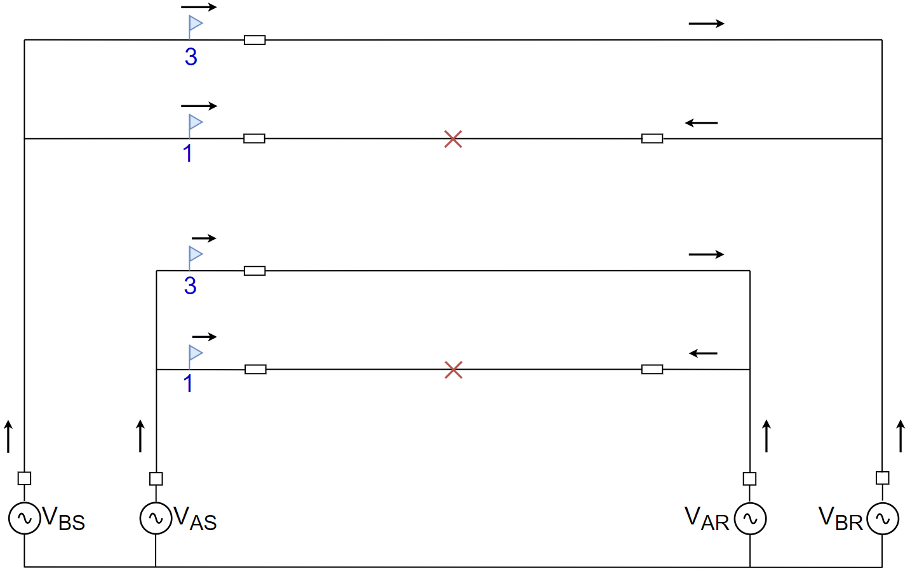
Developing the circuit model

Slide 31
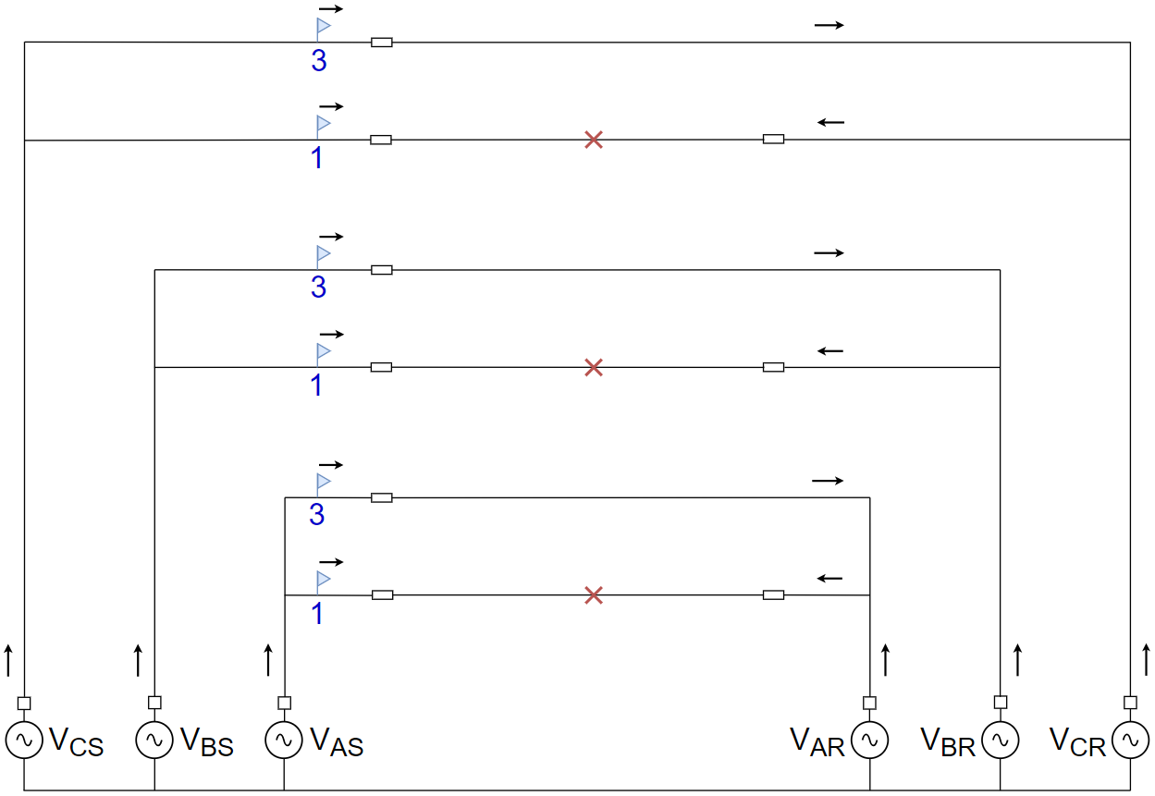
Developing the circuit model

Slide 32
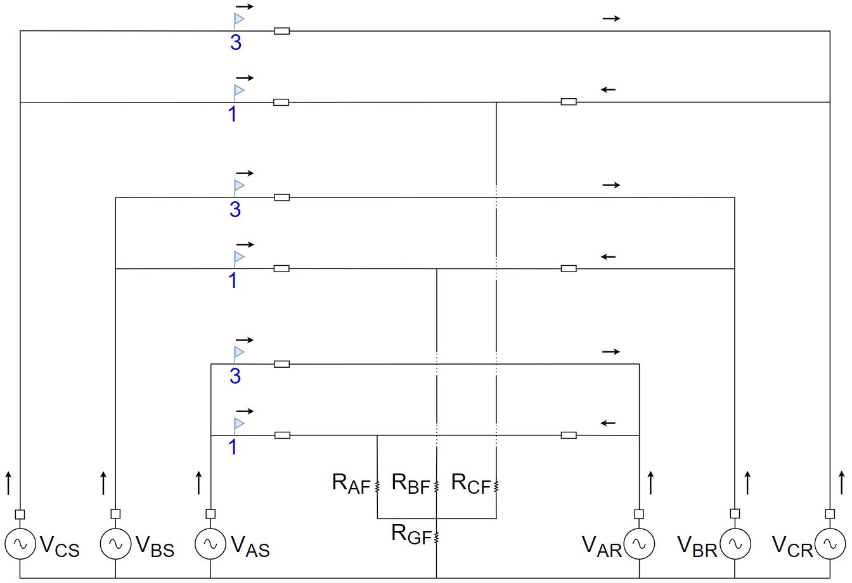
Developing the circuit model

Slide 33
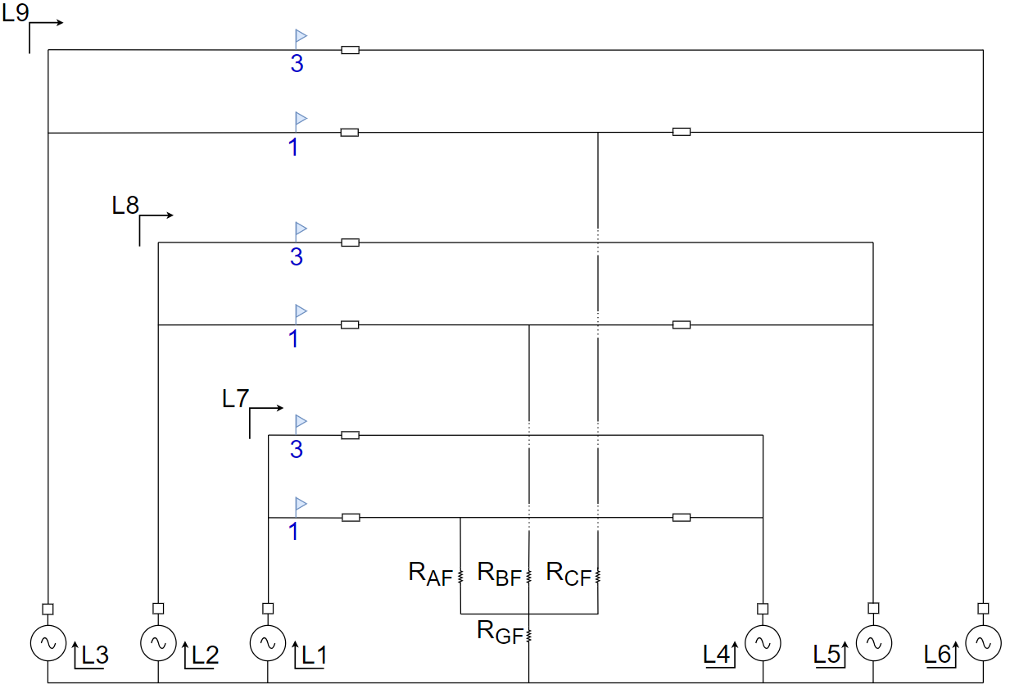
Developing the circuit model

Slide 34
Developing the circuit model
$$\left[Voltage\right]= \left[Impedance\right]\left[Current\right]$$
Known
Known
Unknown

Slide 35
Developing the circuit model
$$\left[Current\right]= {\left[Impedance\right]}^{−1}\left[Voltage\right]$$
Unknown
Known
Known

Slide 36
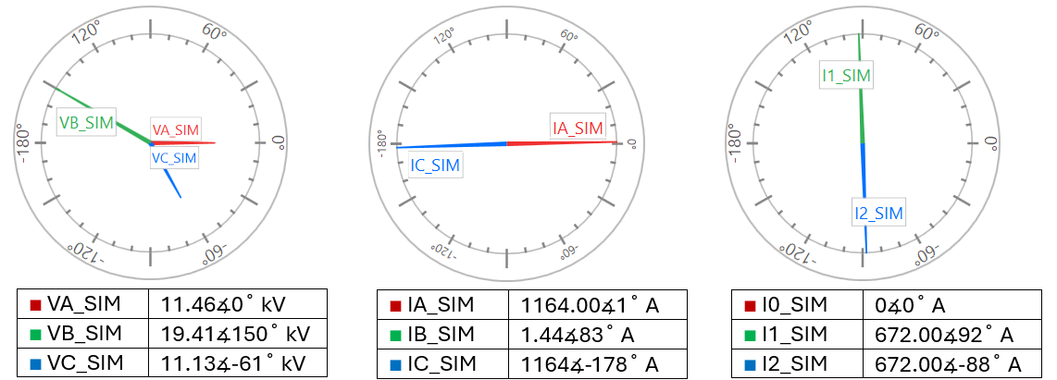
Simulation results for C-A phase fault

Slide 37
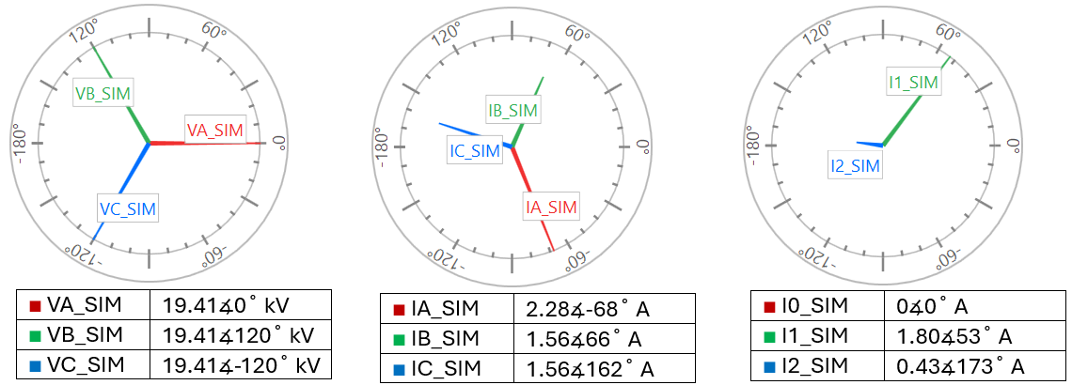
Simulation results for A-phase series fault

Slide 38
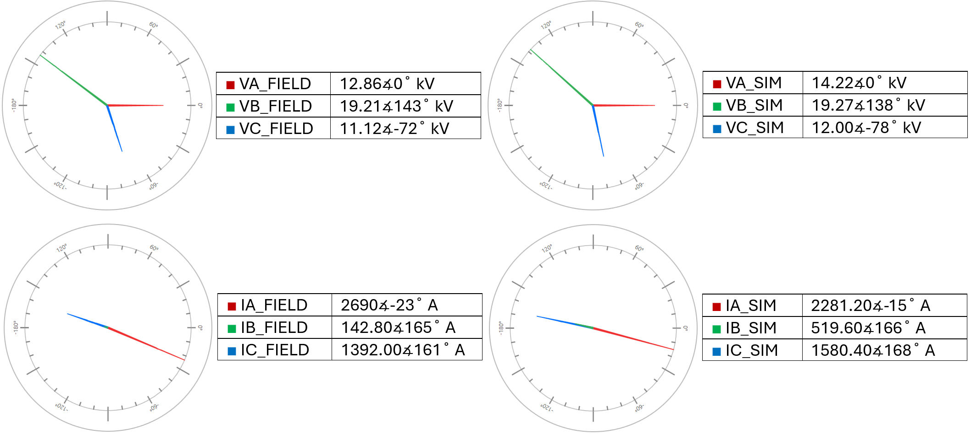
Simultaneous fault

Slide 39
Key takeaways
Learn clues that may indicate certain simultaneous faults
Understand an open-phase detection method
Realize phase-domain analysis is optional modern tool

Slide 40
Questions?

