Slide 1
A Collection of Bedtime Stories for Protection Engineers - Volume 1
Ed Chen – Consolidated Edison Company of New York, Inc.
Jay (Jianzhuang) Huang – Consolidated Edison Company of New York, Inc

Slide 2
Introduction
Consolidated Edison Company of New York, Inc. (Con Edison) is one of the largest investor-owned utilities in the world.
Established in 1823
Provides electric, gas and steam services to 10 million people
Owns 94,000 miles of underground cable and 34,000 miles of overhead conductors.
Transmission & sub-transmission systems at three different voltage levels: 345kV, 138kV & 69kV.
Distribution systems at three different voltage levels: 33kV, 27kV and 13kV.

Slide 3
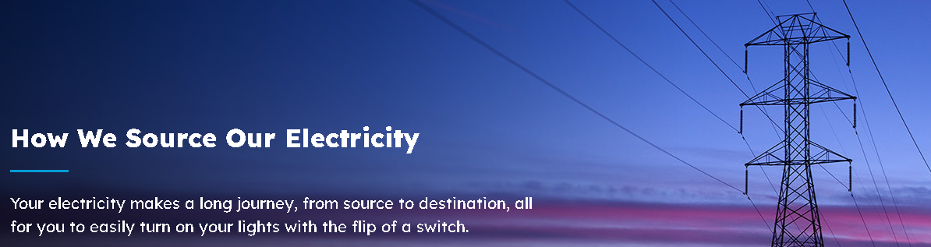
Our Objectives
Con Edison’s power system & protection system design are both unique due to the geography of its service territory.
Sharing to our peers on our:
Unique system events
Root cause analysis
Short/Long term solutions
Lesson Learns

Slide 4
Highlights & Lesson Learns of Event #1 & #2
Event #1 (87L Misoperated on Phantom Secondary Current)
87L element associated with a transmission line misoperated on external ground fault. Damaged insulation was found in one of the GIS enclosure CT, that supplied current to the relay that misoperated.
Primary equipment maintenance (damaged insulation was found in one of the GIS enclosure CT)
Event #2 (Multi-relays Misoperation on Single External Fault)
Multiple pilot wire schemes misoperated on external ground fault, due to pilot wires relays out of calibration, and suspected rise in ground mat voltage affected the pilot-wires and/or the relay case of the supervisory relay during the external fault.
Secondary equipment maintenance & proactive plan to upgrade outdated electromechanical relaying scheme

Slide 5
Highlights & Lesson Learns of Event #4 & #5
Event #4 (A Bad Direction Determination caused by Transformer LTC Failure)
67 phase element associated with a transformer low-voltage side had an undesired operation during reverse reactive power flow, during its LTC failure.
Understand the different directional element design from different relay manufactures, keep a good balance between Dependability vs Security.
Event #5 (Misoperation of a 5 year old 87L Scheme on External Fault 3-Buses Away )
After a breaker in-kind replacement, an 87L element misoperated during an external phase-to-phase fault, due to CTs being swapped.
Enhance design peer check, communication between engineers & designers, commissioning process and testing, Differential Load reading in relays.

Slide 6
Event #3
A Series of System Faults Caused by an “Undead” in the Power System

Slide 7
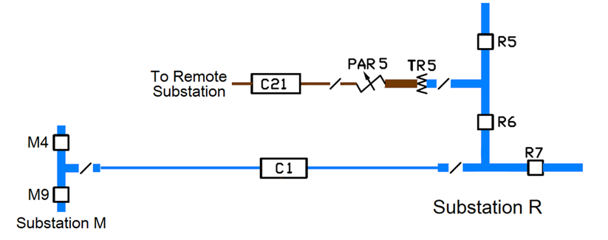
Event Description
345kV Line C1 tripped open in spring of 2023
Bkrs M4, M9 & R7 tripped open
Bkrs R5 & R6 were previously open for commissioning new 138kV Line C21 (Remote end open also)

Slide 8
Event Description
Operator at Substation R was on orders associated with Line C21 (to close the disconnect switch)
Arcing at the disconnect switch right before Line C1 tripped open

Slide 9
Relay Targets
Line C1 differential relays
TR5 (Auto Transformer) differential relays
PAR5 (Phase Angle Regulator / Phase-Shifting Transformer) differential relays

Slide 10

Field Reports
Phase A surge arrestor located between TR5 & PAR5 had failed
Phase C fault was found at Bkr R6 at Line C1 side
A loose nut was found at Breaker R6 that caused phase C to be connected & energized even after R6 switched open

Slide 11
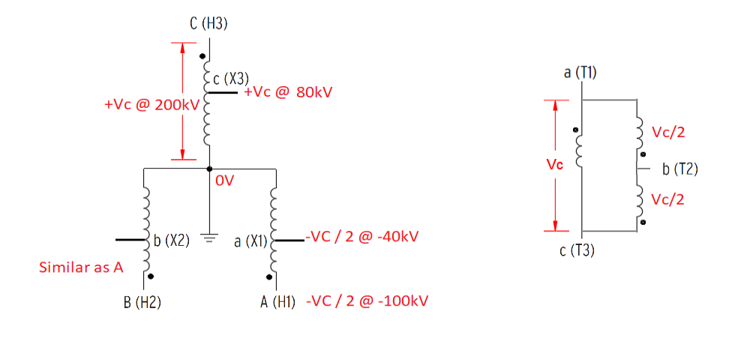
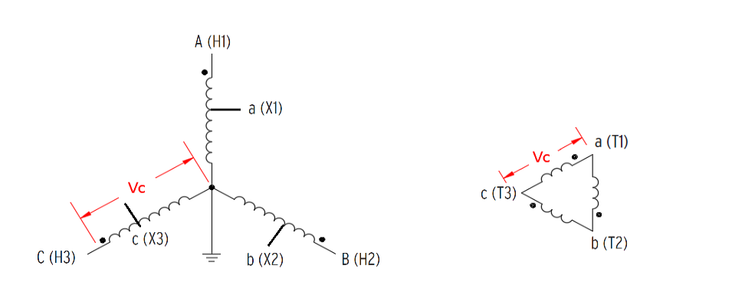
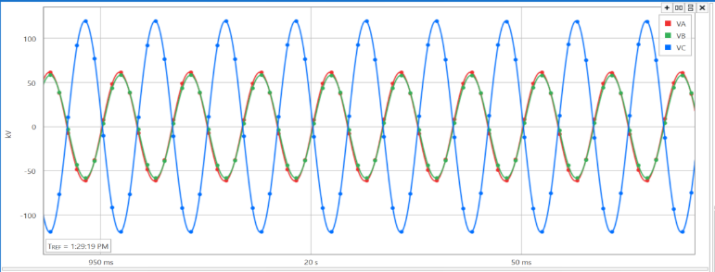
C- Phase Voltage Created Two “Undead” Voltages

Slide 12
Prior to the Event
TR5 & PAR5 were energized through Phase C of Bkr R6
Line C21 was dead since disconnect switch and remote end were opened
Operator tried to close the disconnect switch without knowing the section was LIVE since Vab was used for system indication

Slide 13
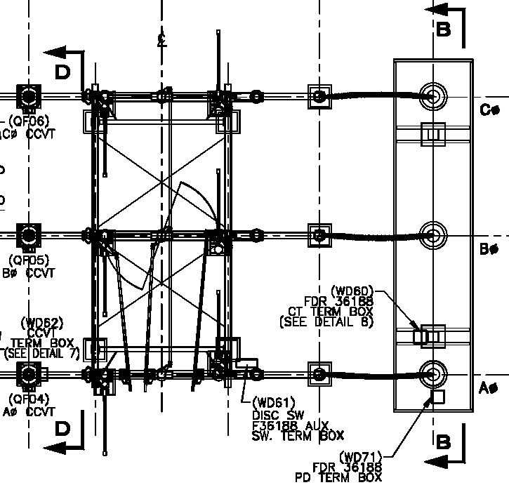
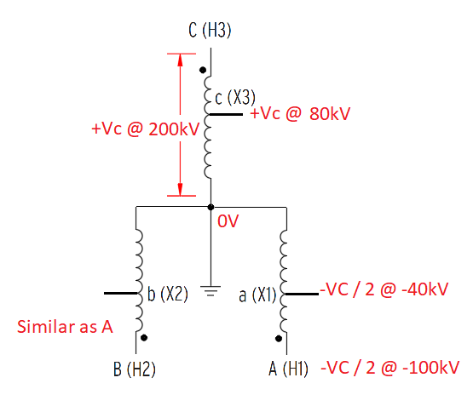









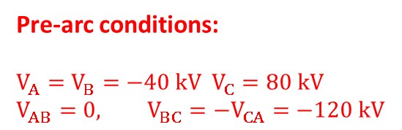
Arcing Between B & C
VCA = 120kV
Pre-arc conditions:
$V_{A}=V_{B}=−40 kV$ $V_{C}=80 kV$
$$V_{AB}=0, V_{BC}=−V_{CA}=−120 kV$$
VBC = -120kV
VAB = 0V

Slide 14
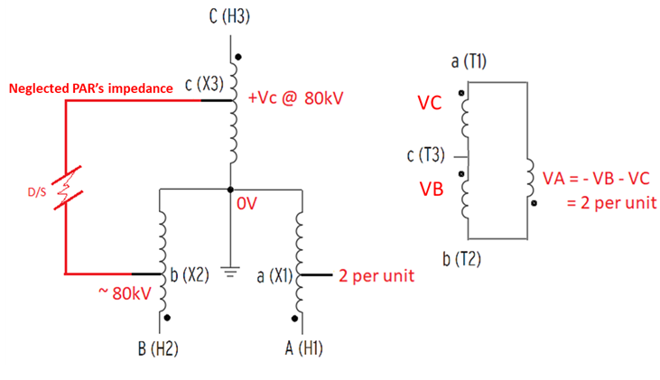
B-C Arcing Elevated A Phase Voltage

Slide 15
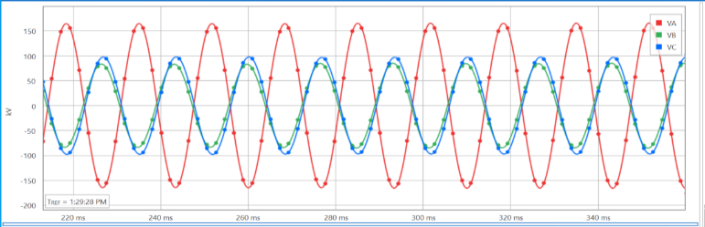
B-C Arcing Elevated A Phase Voltage

Slide 16
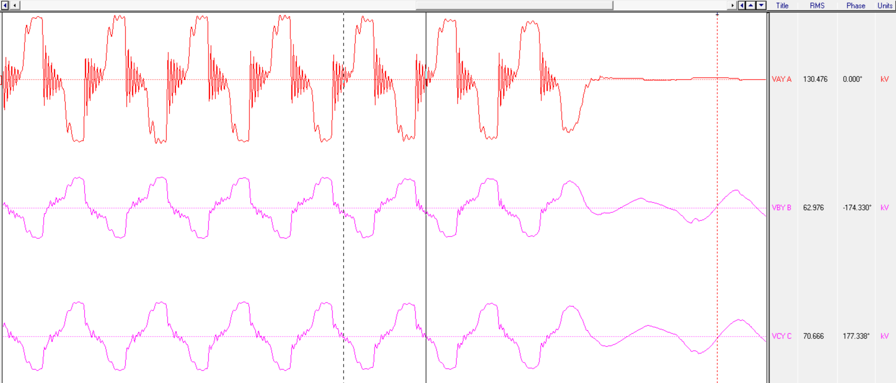
B-C Arcing Elevated A Phase Voltage (Unfiltered)

Slide 17
Phase A Surge Arrester Failed
Over voltage caused Phase A surge arrester located between TR5 & PAR5 failed, resulted in Phase A to ground fault.

Slide 18
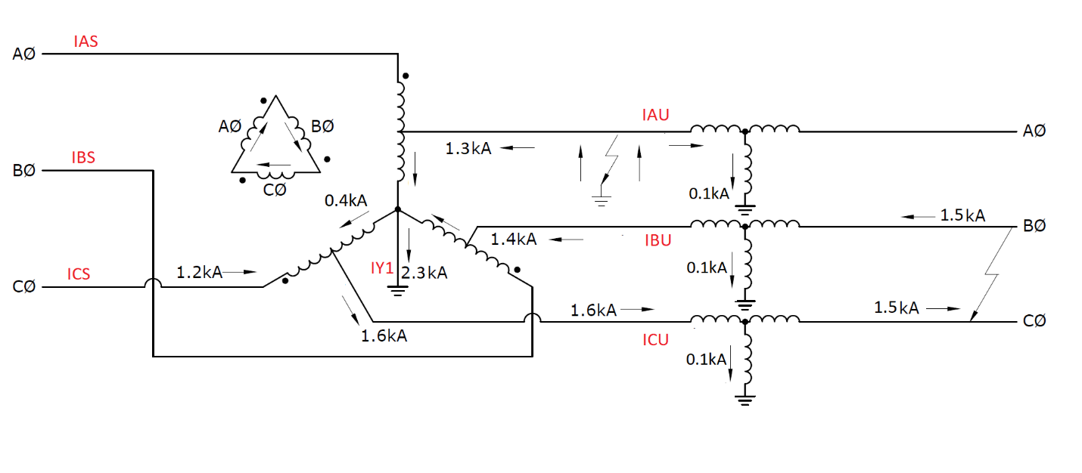
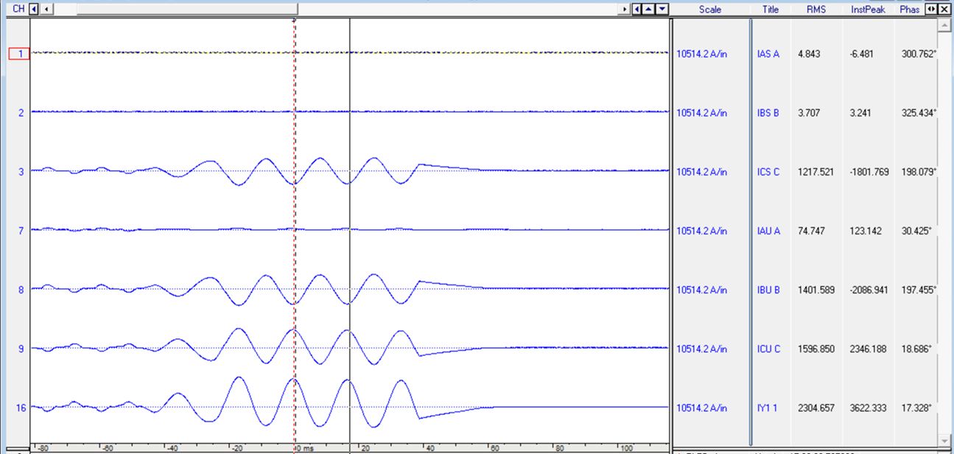

Current Flow during Surge Arrester Failure
TR5:

Slide 19
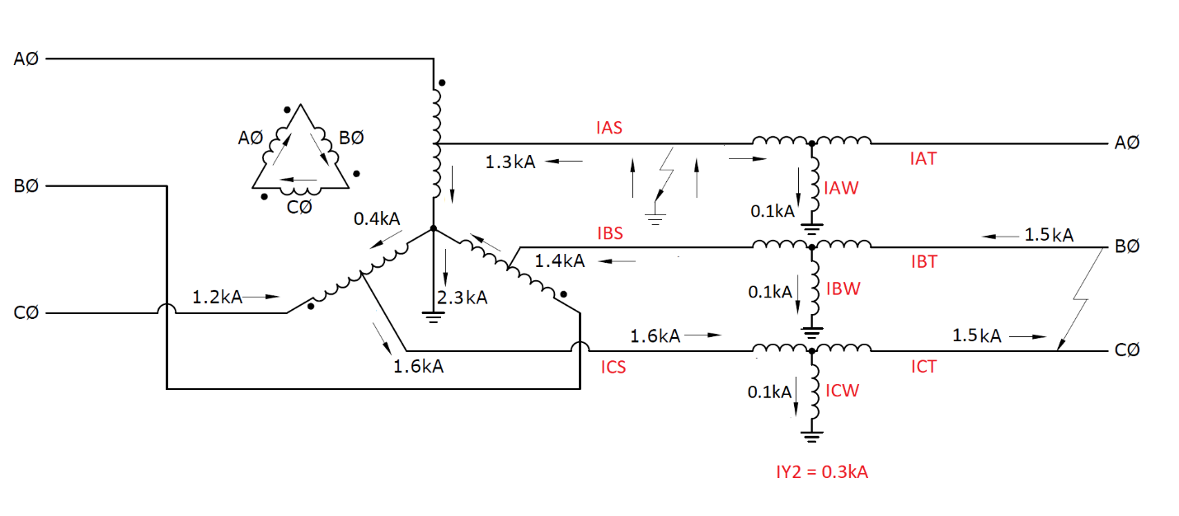
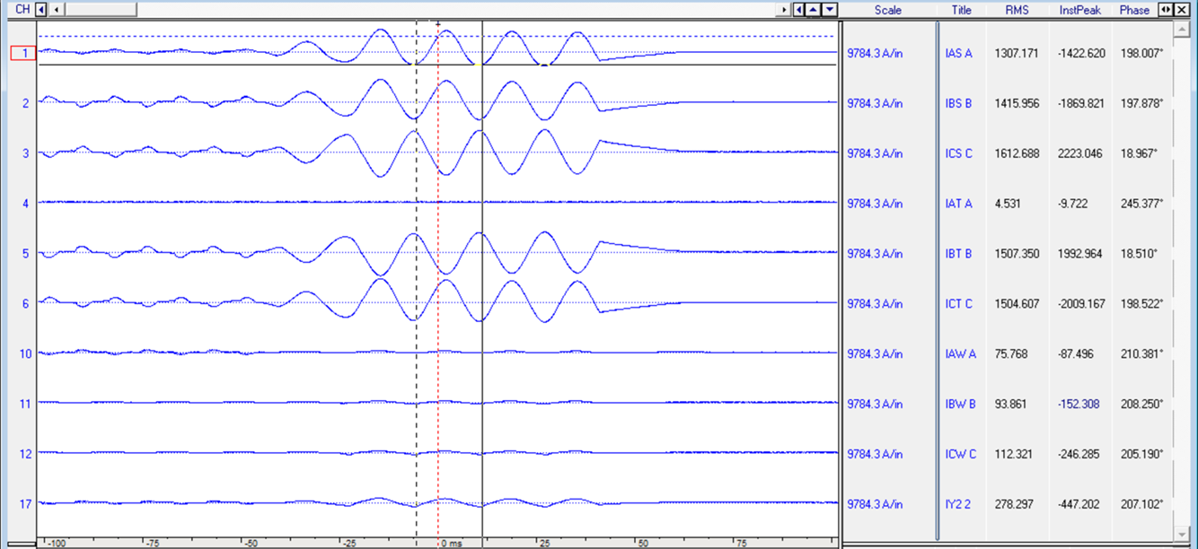

Current Flow during Surge Arrester Failure
PAR5

Slide 20
Relay Operations during Surge Arrester Failure & B-C Arcing Fault
Both TR5 & PAR5 differential relays tripped
Line C21 relays did not trip even though arcing occurred within zone of protection:
87L (supervised by fault detector) did not trip since fault current (1.5k A) is below fault detector pickup (2.4k A)
Zone 1 distance backup element did not trip since Loss of Potential was asserted prior to arcing

Slide 21
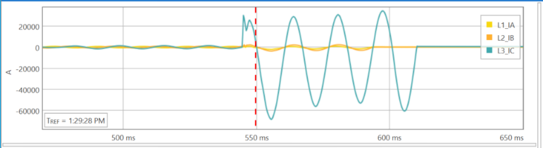
C-Phase Fault at Bkr R6 Couple Cycles Later

Slide 22
Lesson Learns
One issue of this event was using phase to phase voltage for system monitoring that gave the incorrect indication
It would be safer and more reliable to use all three phase voltages for system monitoring
Fault detector settings for 87L of Line C21 relays seem to be too high, it's desired to lower the pickup to below the fault current of this event

Slide 23
