Slide 1
Harmonics in the Power Grid, An Introduction
Prepared By: Theo Laughner – Lifescale Analytics
Bruce Warmack – Oak Ridge National Laboratory

Slide 2
Outline
Introduction
Measurement
Effects
Limits / Standards
Case Studies
Conclusions

Slide 3
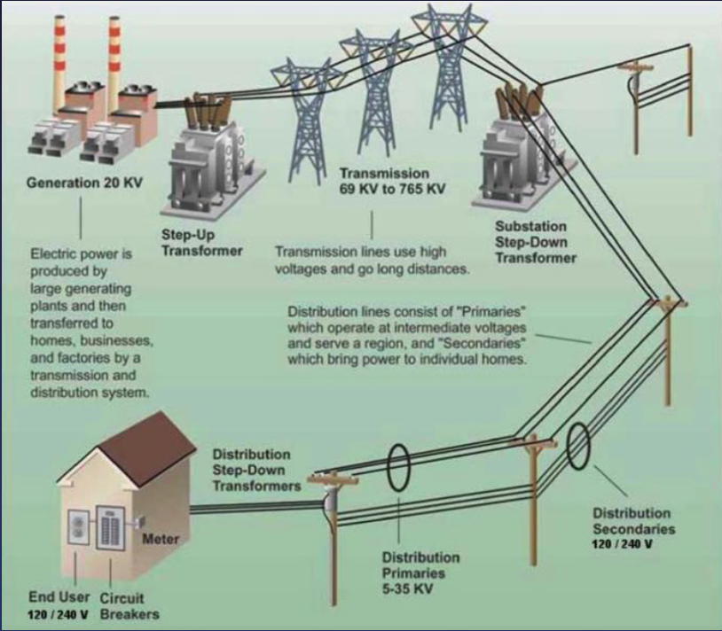
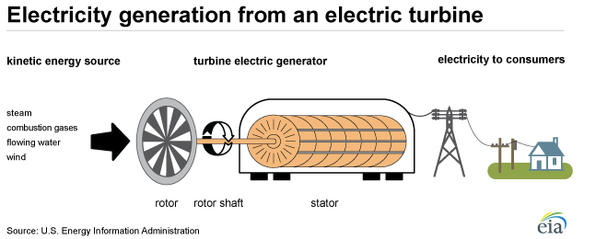
Introduction – Traditional Grid
Harmonic
Sources

Slide 4
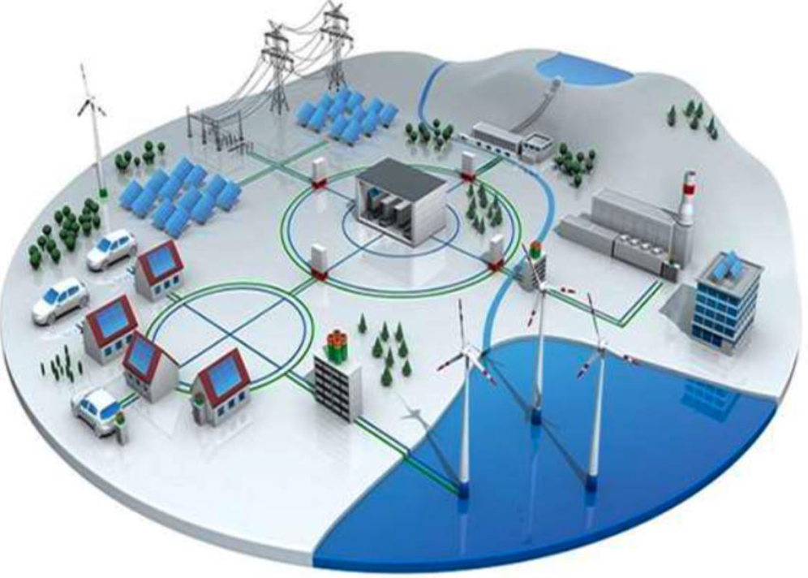
Introduction – Contemporary Grid
Harmonic
Sources

Slide 5
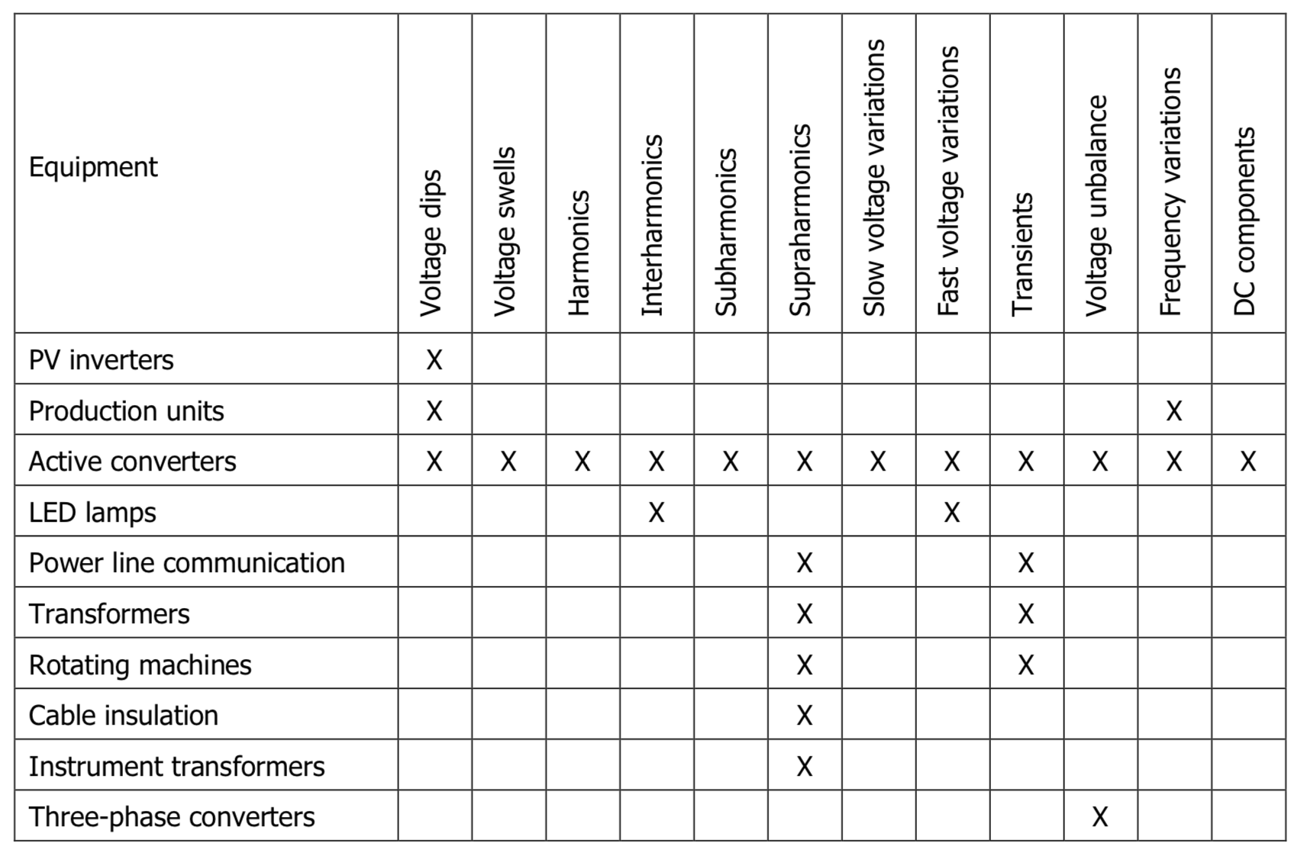
Introduction - Sources

Slide 6



Introduction - Harmonics
60 Hertz - Normal
2nd Harmonic – Negative Sequence
Creates Heating in Motors and Transformers
3rd Harmonic – Triplen – Zero Sequence
Flow in the neutral, in phase on all 3 phases.
Total Harmonic Distortion -
Provides a sense of the overall distortion.

Slide 7
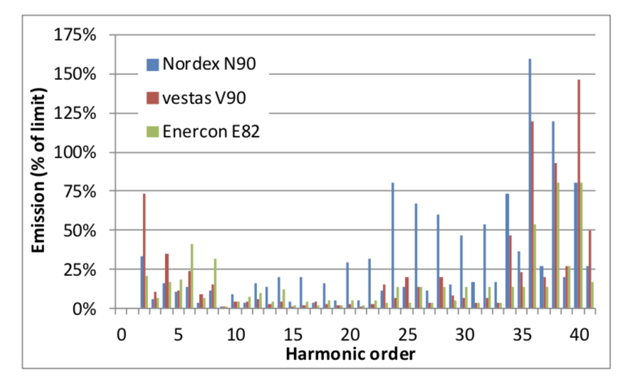
Introduction – Spectra
Turbine 1
Turbine 2
Turbine 3

Slide 8
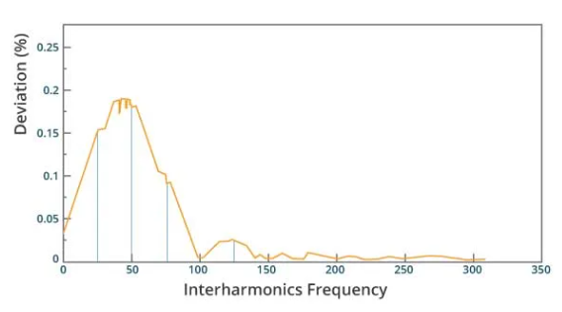
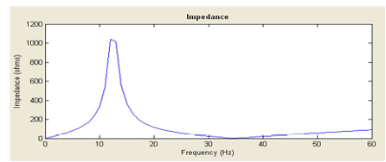
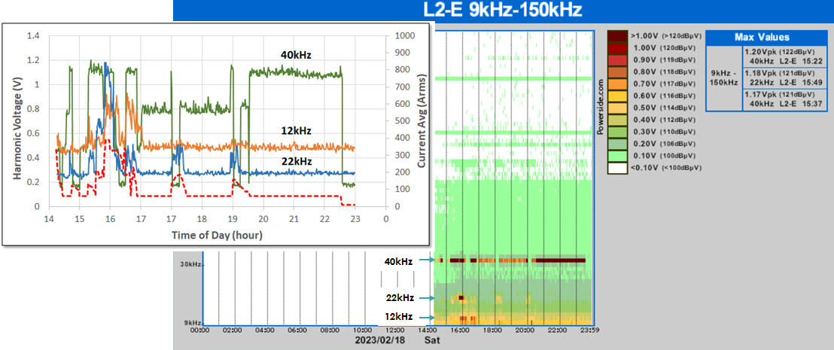
Introduction – Inter, Sub, Supra Harmonics

Slide 9
Introduction – Inter, Sub, Supra Harmonics

Slide 10
Introduction – Inter, Sub, Supra Harmonics

Slide 11
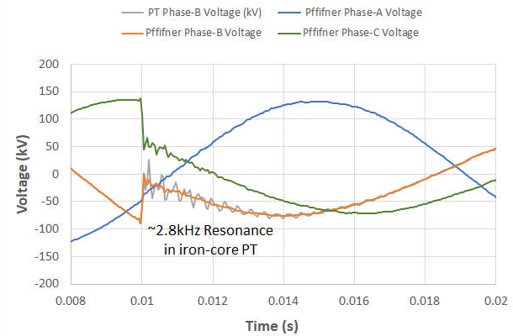
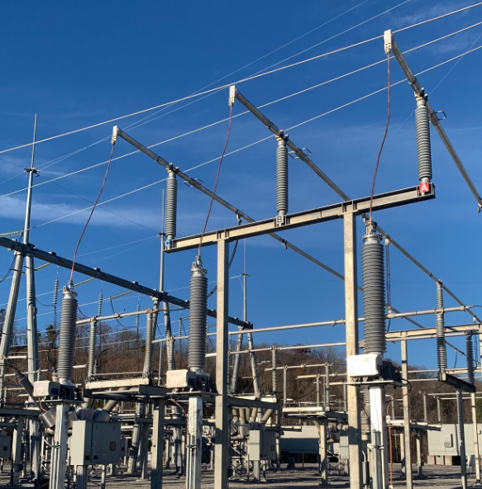
Measurement – Frequency Response

Slide 12
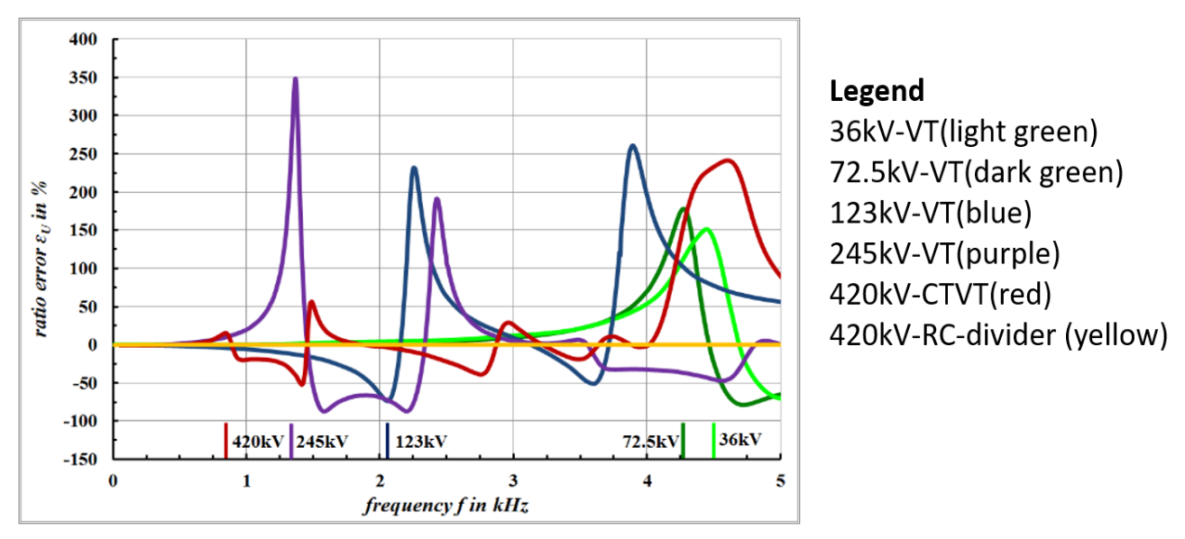
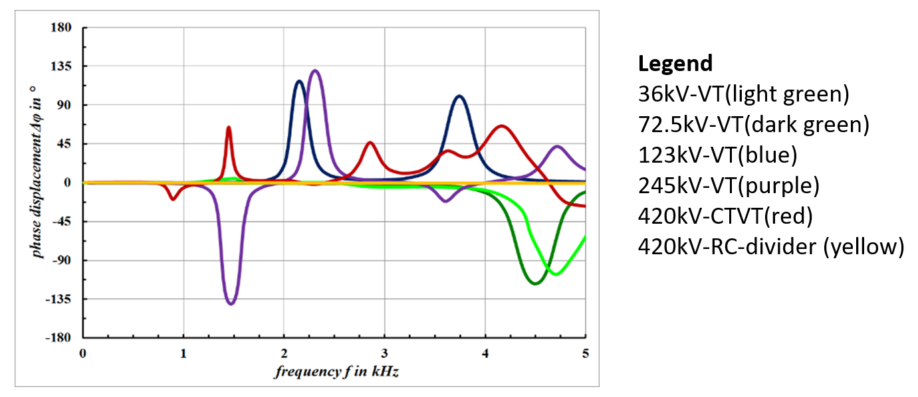
Measurement – Magnitude Phase Errors

Slide 13
Measurement - Sampling Rate

Slide 14
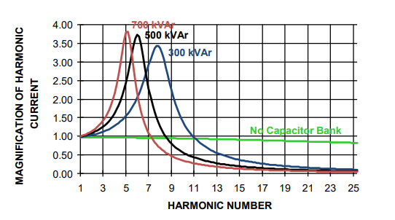
Effects - Power Systems
Capacitor fuse blowing
Circuit breakers tripping
Transformer overheating at less than full load
Audible Noise

Slide 15
Effects – Grid Connected Equipment
Motor overheating – which reduces motor life
Equipment malfunction
Capacitor or transformer failure
Fuses blowing
Breakers tripping unnecessarily
Reduced transformer capacity
Clocks running fast
High neutral currents which can result in stray voltages
Telephone interference

Slide 16
Limits / Standards – IEEE 519
IEEE Standard for Harmonic Control in Electric Power Systems
The scope of the document is to establish recommended limits for distortion at the point of common coupling (PCC) between sources and loads. The standard also points to IEEE Std 1547 or IEEE Std 2800 for current distortion limits at inverter-based resource (IBR) installations. The standard leverages IEC 61000-4-7 for establishing how measurements should be made and specifies the limits to be applied at various voltage levels.
Table 2 - Voltage Distortion Limits Over Time (%)
PCC Bus Voltage | <= 1kV |  | 1 - 69 kV |  | 69 - 161 kV |  | > 161 kV
Year / Limit | Individual | THD | Individual | THD | Individual | THD | Individual | Total
1992 | 3 | 5 | 3 | 5 | 1.5 | 2.5 | 1 | 1.5
2014 | 5 | 8 | 3 | 5 | 1.5 | 2.5 | 1 | 1.5
2022 | 5 | 8 | 3 | 5 | 1.5 | 2.5 | 1 | 1.5

Slide 17
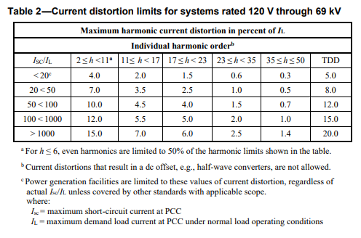
Limits / Standards – IEEE 519

Slide 18
Limits / Standards – IEC 61000-4-7
Testing and measurement techniques – General guide on harmonics and interharmonics measurements and instrumentation, for power supply systems and equipment connected thereto
The scope of the document is to define measurement instrumentation in accordance with emission limits given in other standards (e.g., IEEE 519). The standard applies to frequency ranges up to 9 kHz and is applicable to both 50 and 60 Hz systems.
Class I
Precise Measurement
Class II
Survey Grade
Filtering
Grouping
Smoothing

Slide 19
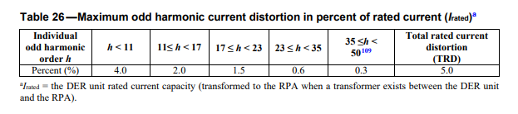
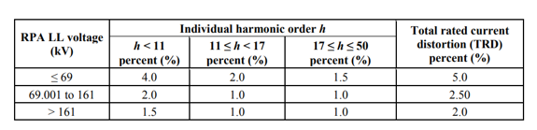
Limits / Standards – Distributed Energy Resources (DER)
IEEE 1547 - Distribution
IEEE 2800 - Transmission
IEEE Standard for Interconnection and Interoperability of Distributed Energy Resources with Associated Electric Power Systems Interfaces
No voltage distortion limit
Uses RPA instead of PCC
Uses TRD instead of TDD
Uses Rated I instead of Demand I
Excluded Pre-existing distortion
IEEE Standard for Interconnection and Interoperability of Inverter-Based Resources (IBRs) Interconnecting with Associated Transmission Electric Power Systems
No voltage distortion limit
Uses RPA instead of PCC
Uses TRD instead of TDD
Uses Rated I instead of Demand I
Excluded Pre-existing distortion

Slide 20
Limits / Standards – IEEE 1409
Guide for Technology Methods for Power Quality Improvement in Electric Power Systems
The scope of the document is to provide an overview of approaches for mitigating power quality issues including harmonics.
The guide suggests a few different harmonic compensation devices:
The static shunt compensator (STATCOM) combines voltage source inverters with a standard distribution shunt transformer. This approach is capable of injecting high frequency waveforms to cancel the current harmonics generated by non-linear loads.
The static var compensator (SVC) combines a thyristor-controlled reactor or a switched capacitor to turn on the reactive element with fine grained detail. In some cases, the SVC will include a fixed set of capacitors to provide additional harmonic filtering.

Slide 21
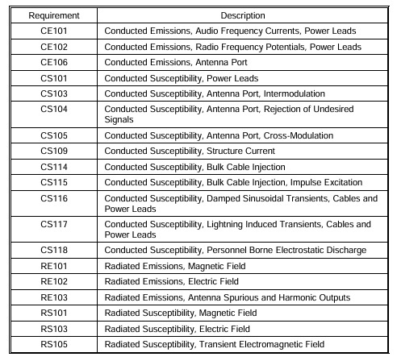
Limits / Standards – MIL-STD-461
REQUIREMENTS FOR THE CONTROL OF ELECTROMAGNETIC INTERFERENCE CHARACTERISTICS OF SUBSYSTEMS AND EQUIPMENT
The Department of Defense (DoD) interface standard establishes requirements for the control of electromagnetic interference (EMI) for systems deployed by the DoD. It specifies conducted and radiated emission limits as well as susceptibility of equipment. The standard specifies testing emissions at several frequency ranges starting at 30 Hz and continuing above 1 GHz. The standard also requires susceptibility testing from 30Hz to 40 GHz.

Slide 22
Limits / Standards – Others
ANSI C63.4 - American National Standard for Methods of Measurement of Radio-Noise Emissions from Low-Voltage Electrical and Electronic Equipment in the Range of 9 kHz to 40 GHz
The scope of the document is to provide methods, instrumentation, and facilities for measurement of radiated emissions (rather than conducted emissions) in the 9 kHz to 40 GHz range. The standard applies to all sizes of devices and can apply to a single device (e.g., cell phone) or groups of devices (e.g., servers in a data center).
IEEE P473 - Recommended Practice for an Electromagnetic Site Survey (10 kHz to 40 GHz)
The scope of the document is to provide guidance on measuring noise between 10 kHz and 40 GHz.

Slide 23
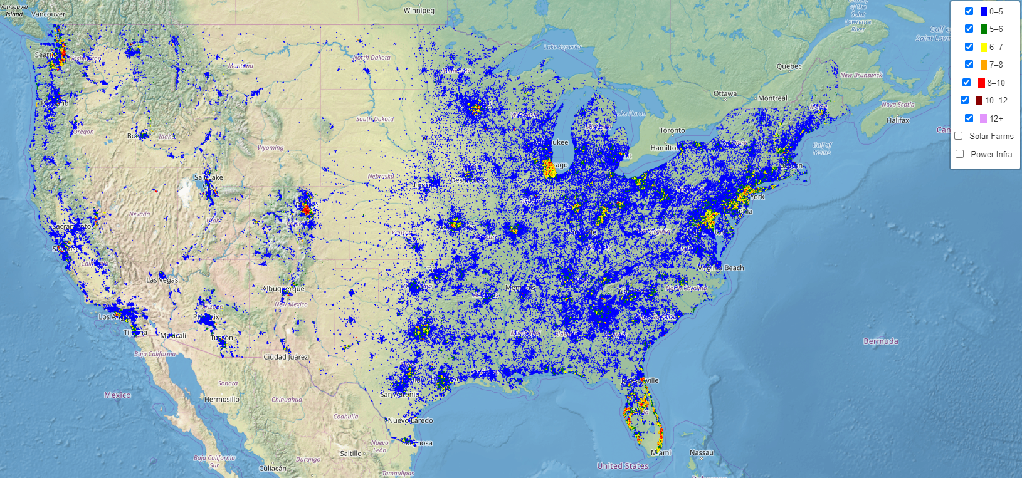
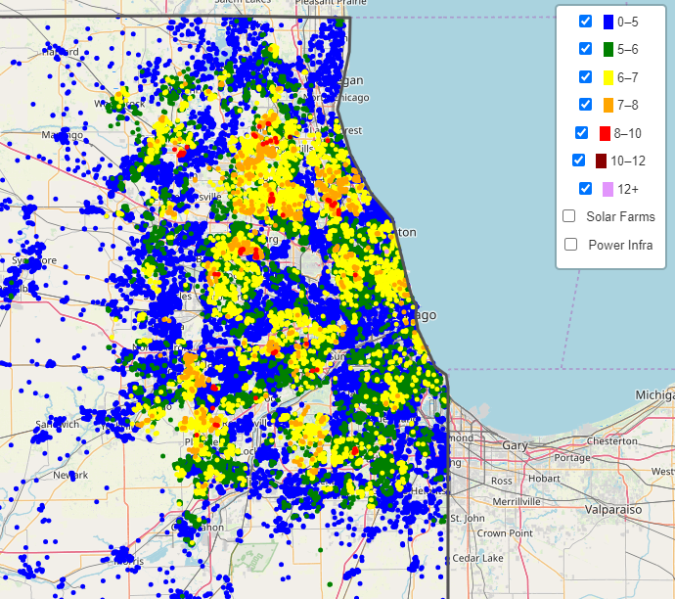
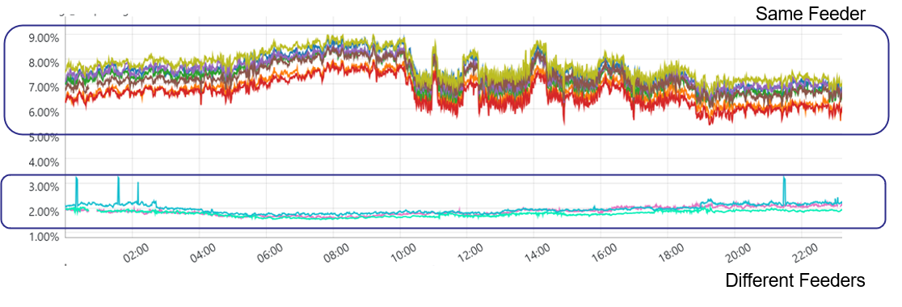
Case Studies - Distribution

Slide 24
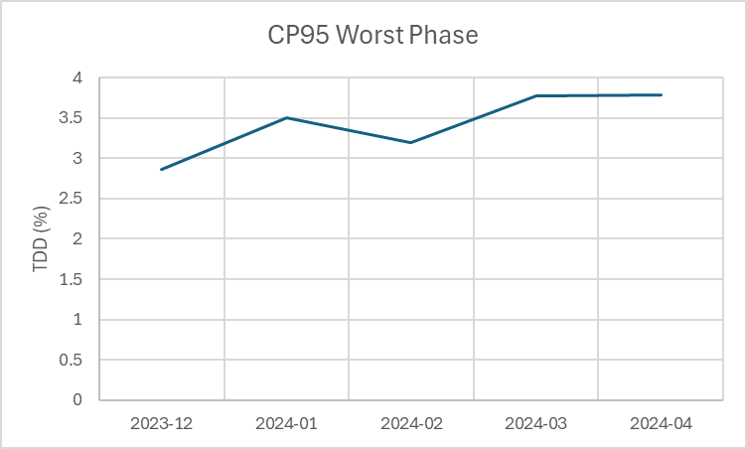
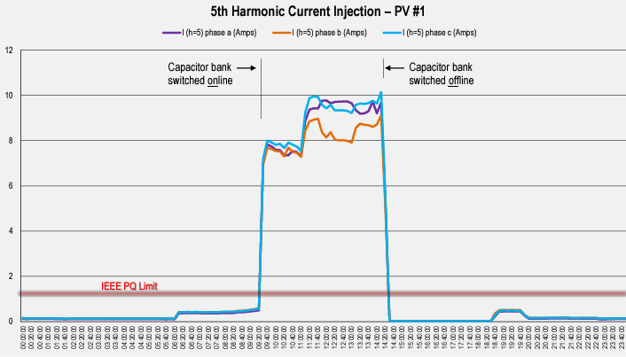
Case Studies – EV Charging / Renewables
EV Charging
PV

Slide 25
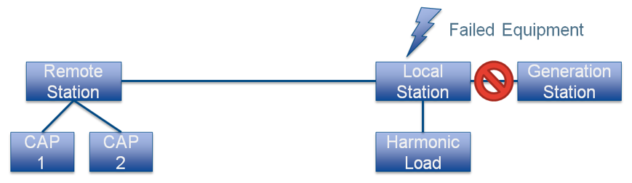
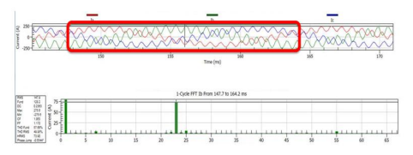
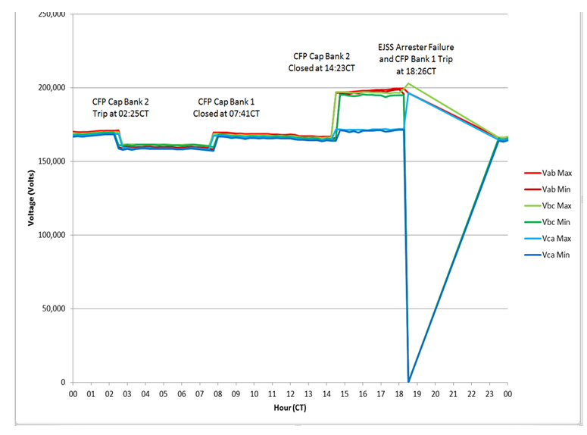
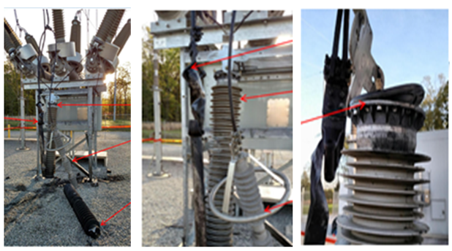
Case Studies - Transmission

Slide 26
Presentation Summary
Grid changes have resulted in more frequent harmonic study and mitigation opportunities.
Accurate measurement starts with the sensors and ends at the analysis tool.
Limiting harmonic distortion is important for reliable operation of ALL equipment connected to the grid.
Standards / limits need to be correctly applied.
Mitigation technologies exist.
Costs of harmonics are hard to quantify.

