Slide 1

Analysis of 115kv Circuit Switcher Damage During A Normal Switching Operation
Joshua Joseph Dan Hasenwinkel Irene Y Lu Song Ji

Slide 2
Speaker Background – Dan Hasenwinkel, PE
BSEE from Rose-Hulman Institute of Technology in Terre Haute, Indiana.
MSEE from Clemson University in Clemson, South Carolina
Power System Engineering focus.
Registered Professional Engineer in New York State.
IEEE member since the audio compact disc was introduced.

Slide 3
Speaker Background – Dan Hasenwinkel, PE
Principal Engineer, Protection Policy and Support at National Grid NY.
Group Responsibilities
FERC standards compliance
Disturbance analysis
Cybersecurity in substation environments
Maintains existing protection standards
Provides technical assistance/counseling to field forces and other engineering groups.
Areas of Expertise
Protection Engineering
Substation engineering and design
Grounding
Computer applications for power system analysis
IT project management
Portfolio planning

Slide 4
Agenda
01 | Disturbance Investigation
02 | Description of Delameter Station and its Supply Circuits
03 | Sequence of Events
04 | Substation Equipment Damage
05 | IED Records
06 | Ferroresonance Occurrence Description
07 | Ferroresonance Simulation in EMTP
08 | Conclusion & Questions

Slide 5
Disturbance Investigation
Substation IED recorded 4.5 PU overvoltage on 115kV bus
Substation equipment damaged during the overvoltage event or failed in the next three months:
115kV circuit switcher
Capacitor voltage transformer (CVT)
Surge arrestors on both sides of the transformer
Ensure it doesn’t happen again

Slide 6
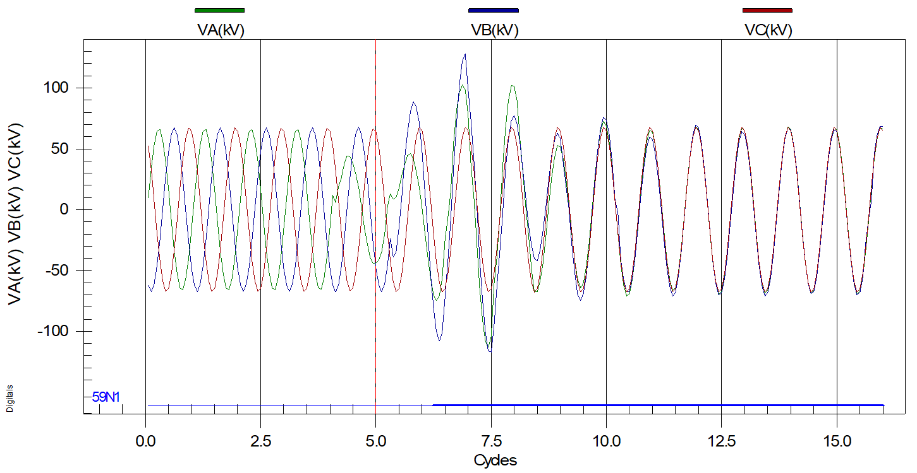
IED Record – 115kV side 59NT relay

Slide 7
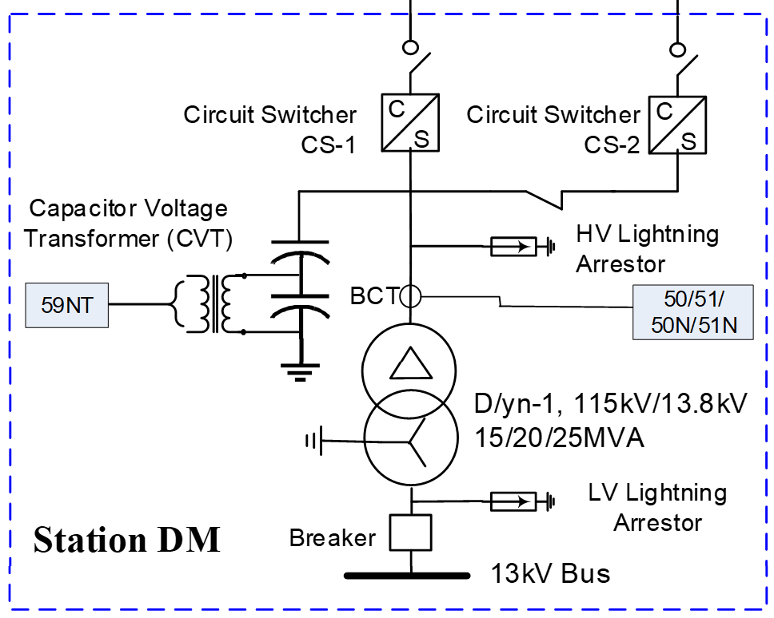
Event Description
L1
L2
Normal supply L2 tripped and locked-out.
Successful ATO to L1
Manual make parallel and transfer back to L2 resulted in transformer low-side main breaker opening due to standing 115kV 59N
Transformer didn’t lockout by design
CS-2 on fire
Notes:
59NT recently added

Slide 8
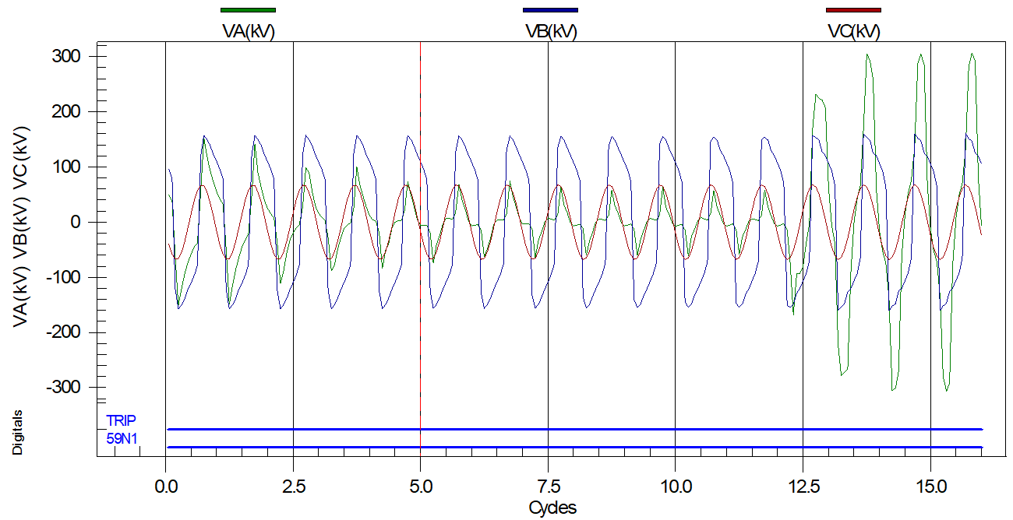
IED Records – 59NT relay standing trip

Slide 9
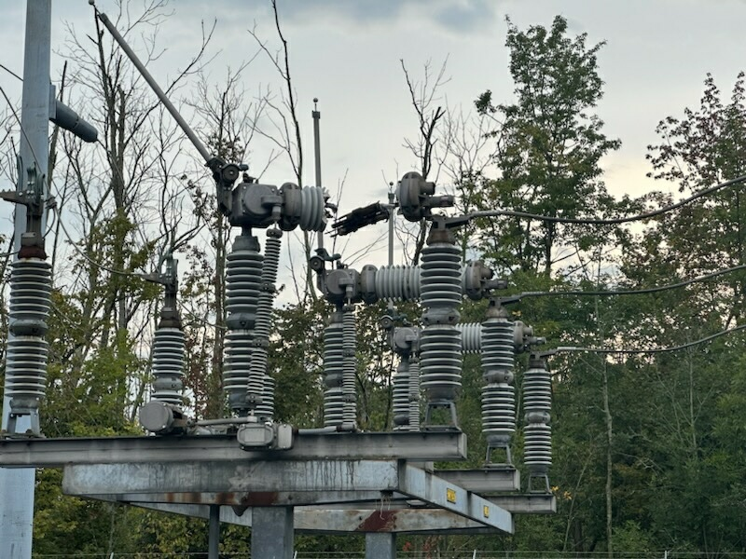

Slide 10
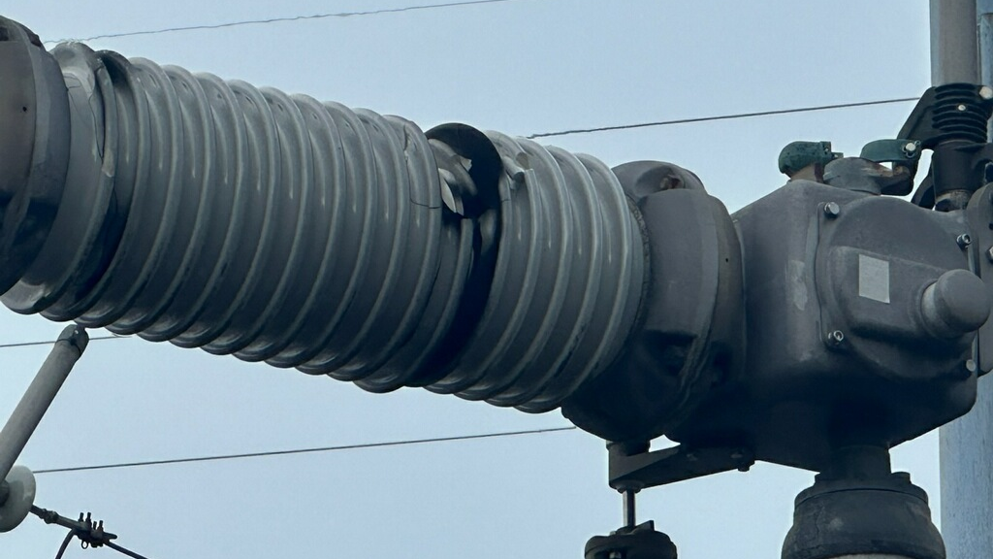

Slide 11
Substation Equipment Damage
Traveling Operator found 115kV circuit switcher CS-1 was on fire with severely damaged A & B phase interrupters.
59N target and trip, LOP for 15 minutes
L1 & L2 remained in service during the switching at Station DM.
No triggered events from line relays or DFRs at either source.

Slide 12
Substation Equipment Failures Months Later
CCVT Failure
High-side surge arrestor failure
Low-side surge arrestor failure

Slide 13
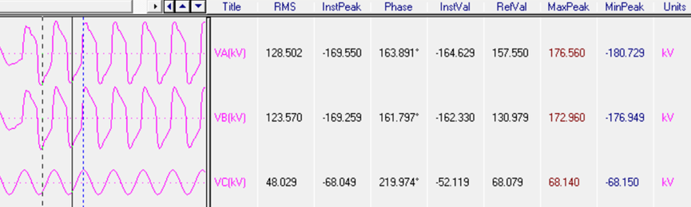
Overvoltage Failures for CVT, Arrestor
Normal RMS value line to ground should be 66.4 – 69.7kV (100%-105%)
Nominal peak value should be 93.0 – 97.6kV
Two phases of the transformer at 200% of nominal values.

Slide 14
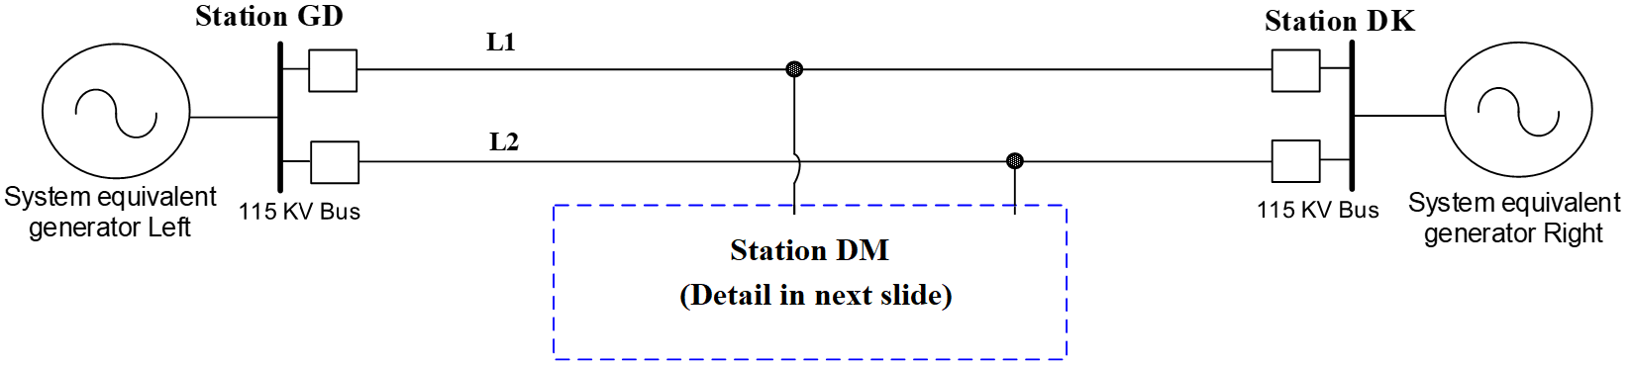
System Description
115kV L1 & L2 energized, double circuit towers total length is 45mi ~70km
7 other tapped stations, some with low-side energy sources

Slide 15
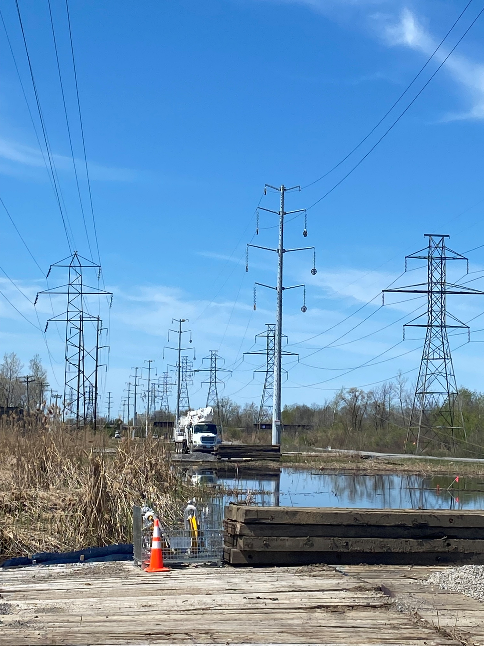
System Confounding Changes
L1 L2 rebuilt for 15 mi. from GD from L1 4/0 ACSR 6/1 to 795 ACSR 45/7
taller double circuit steel monopole structures
some sections w/ 34.5kV underbuild

Slide 16
R/X diagram from terminal near rebuilt area
Notes:
Point out dog leg in impedance in rebuilt segment. Mention x/r ratios, loss of resistance

Slide 17
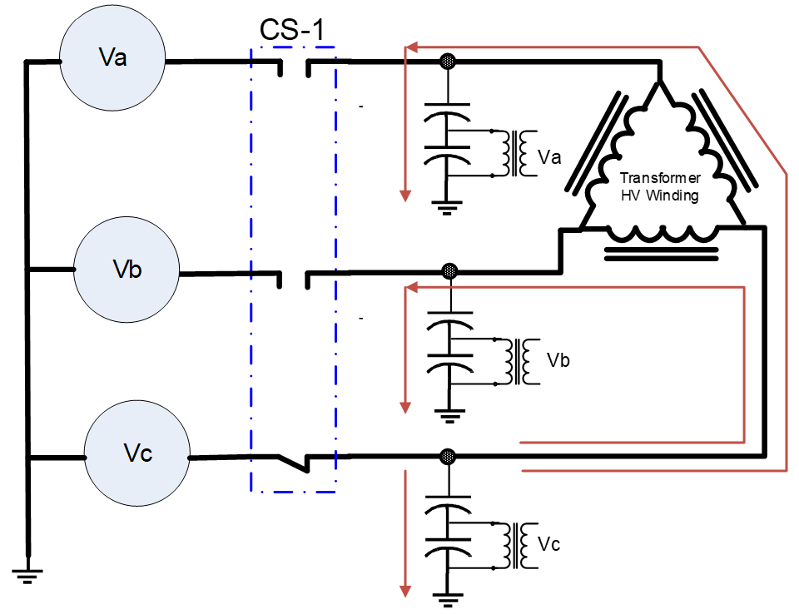
Voltage distributions over transformer HV winding and CVTs from single phase energization.

Slide 18
Notes:
Excess contact resistance heating explosively pressurized SF6 interrupting bottle.

Slide 19
So Many Questions
If it was 115kV ferroresonance, did it damage the circuit switcher or was it initiated by the circuit switcher failure to close all phases?
Ferroresonance is a rare phenomenon, did it really occur on the 115kV bus or is it only in the secondary voltages
Can we recreate the event in a model of the system that would show the same results?
Why didn’t the line protection trip?
One-off or a design weakness?
Notes:
Was the lack of a connection from the station ground grid to the new takeoff towers’ ground rods the cause
Could these switching events breaking parallel at the station been problematic for some time

Slide 20
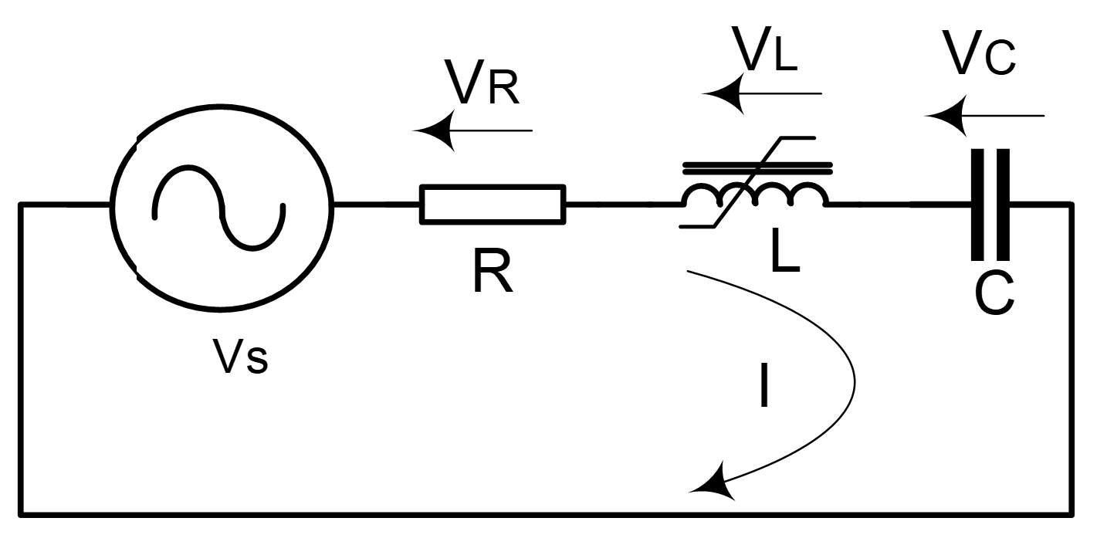
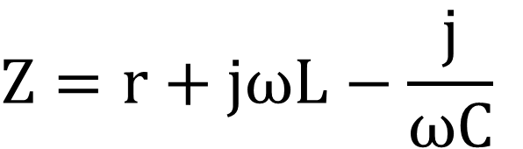
Ferroresonant Circuits
Nonlinear behavior of an iron core inductor initiated by a switching event can cause a ferroresonance event
Simple series resonant circuit.
$$Z=r+jωL−\frac{j}{ωC}$$
Notes:
Resonance is present if the imaginary part of the impedance, Z, becomes zero.
Occurs at resonant frequency equal $1/\sqrt{LC}$.
At resonant frequency, impedance of series circuit is small, and is determined only by the value of resistance, R.

Slide 21
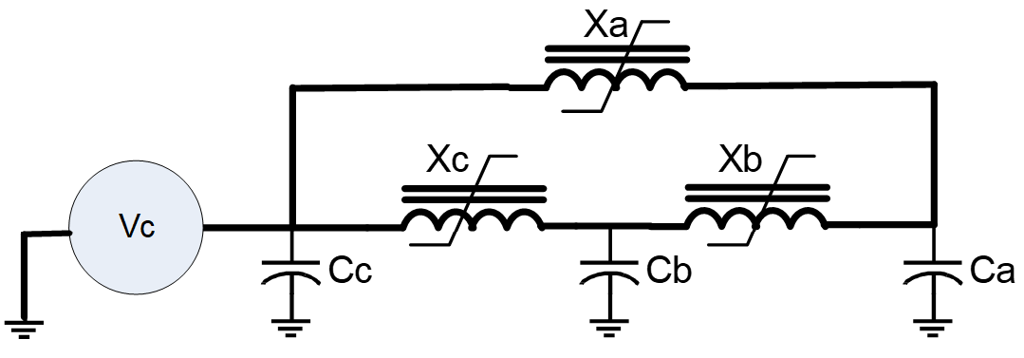
Ferroresonance Occurrence Circuit
Simplified ferroresenonace circuit at Station DM.

Slide 22
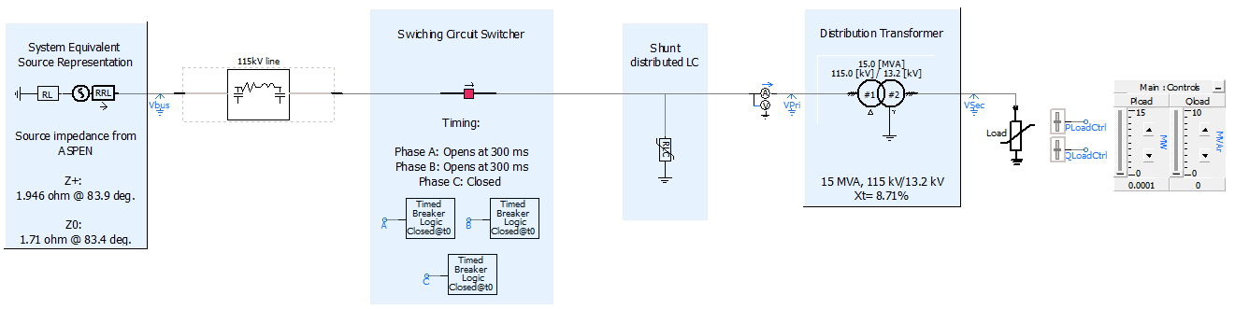
Ferroresonance Simulations in EMTP program
Notes:
Thevenin equivalent circuit from ASPEN short circuit.
Poles of circuit switcher independently controlled.
A&B poles opened during simulation.
Lumped shunt LC circuit used on transformer HV terminals representing parameters of:
CVTs
Surge Arrestors
Stray Capacitance.
Constraints:
Bus voltages at source stations not affected during ferroresonance event.
Crest magnitude of overvoltage at DM transformer HV terminal was 4.5 PU.
Longitudinal voltage difference across the opened interrupter main contacts was 7.0 PU in simulation (ensuring dielectric breakdown and arcing discharge across the open contacts).

Slide 23
Ferroresonance Simulations in EMTP program
Notes:
Thevenin equivalent circuit from ASPEN short circuit.
Poles of circuit switcher independently controlled.
A&B poles opened during simulation.
Lumped shunt LC circuit used on transformer HV terminals representing parameters of:
CVTs
Surge Arrestors
Stray Capacitance.
Constraints:
Bus voltages at source stations not affected during ferroresonance event.
Crest magnitude of overvoltage at DM transformer HV terminal was 4.5 PU.
Longitudinal voltage difference across the opened interrupter main contacts was 7.0 PU in simulation (ensuring dielectric breakdown and arcing discharge across the open contacts).

Slide 24
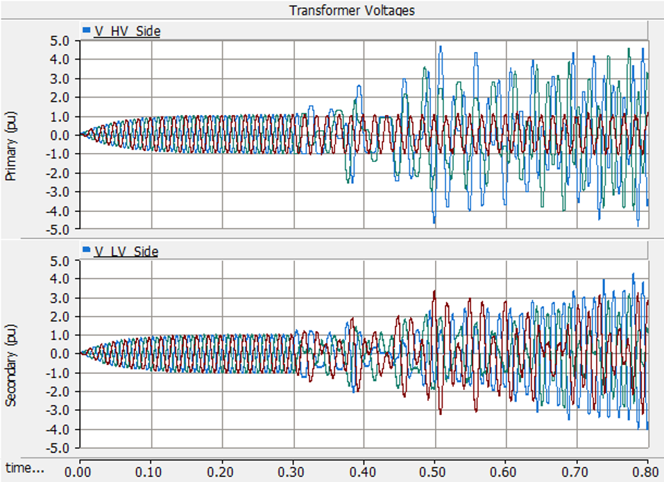

Slide 26
Disturbance Conclusion
Inadvertently energizing unloaded transformer in non-3-phase state resulted in Ferroresonance.
Inductive and capacitive equipment under Ferroresonance may experience temporary overvoltage.
Affecting life span and performance of equipment.
Power supply for Ferroresonance circuit need to be opened in timely manner.
Delameter Zones of Protection Worked as Designed
Notes:
The rare failure mechanism and the location of the circuit switchers as line switches contributed to the failure mode.
The Ferroresonance condition created no current path to ground or current or voltage disturbance at the remote stations until a piece of equipment failed from overvoltage stress.
Teleprotection and extended single phase condition relaying could remotely trip the line breakers but is not recommended.

Slide 27
Now What?
Resistive load added to secondary #2 in a broken delta configuration
Ground connection restored
Connected multifunction relays to bus voltages and transformer windings for data capture in case of a repeat occurrence
January scheduled switching event recreation had clean three phase transfer and minimal transients

Slide 28
Now What?
Additional surge arrestors being installed on takeoff structures
Transformer dissolved gas schedule sampling frequency increased
Preliminary Engineering was already underway for the station due to area load growth. New layout is expanded to match current distribution standard station layout which includes line switches and separate circuit switchers for transformer protection.

Slide 29
