Slide 1
Application of Discrete Wavelet Transform to the Analysis of a Submarine Cable Trip
Dean Sorensen, Song Ji, Dan Benoit – National Grid USA

Slide 2
Faulted System Under Study
A 13.2kV island distribution system served from two interconnection points on the mainland by two 46kV undersea cables.
2024-04-30: On otherwise uneventful, fair-weather day, #1 cable [L-Ave to C-Street] tripped via 1990’s vintage 87L (charge comparison) scheme for apparent AB fault.
Issues to Discuss
No other protection targets like backup 21/21N.
Fault data limited to “temporary” portable DFR at L-Ave.
No DTF data generated. Limited fault duration (~3/4 cy) and limited DFR record resolution (5.76kHz sample rate).

Slide 3
Tripping Event Details
These breakers were tripped by the 4606 cable 87L relays at Lothrop and Candle St.
The zone of protection includes everything between the L-Ave 50 BKR (excluding the reactors) and the C-Street 46T1 GIS BKR.
So where is the fault?
  46kV L-Ave Station Bus?
  30+ miles of buried land and undersea cable?
  C-Street 46kV cable terminations, GIS breaker switchgear, or the cable from breaker to stepdown XFMR?

Slide 4
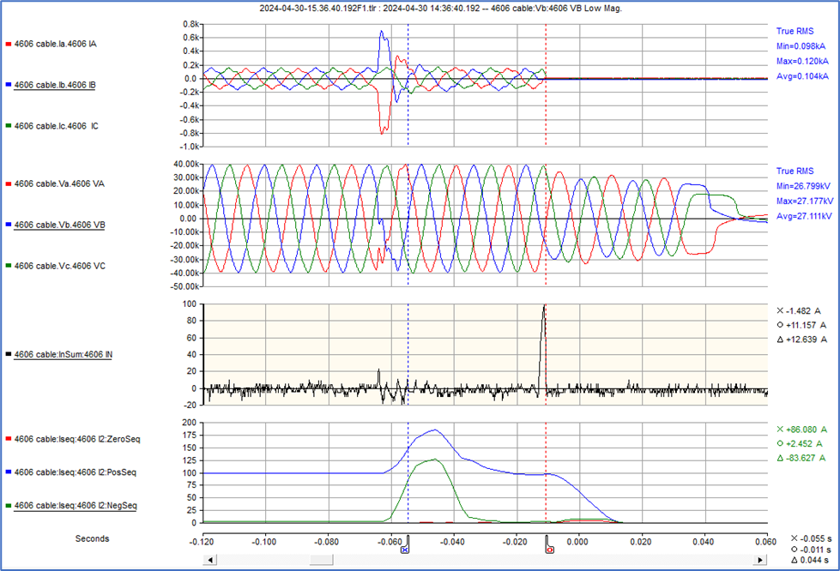
Lone Record from “Temporary” L-Ave Portable DFR
AB fault. No ground involvement.
¾-cycle fault duration then currents return to pre-fault load current levels.
Breaker interrupts load current about 2-½ cycles after fault self clears.

Slide 5
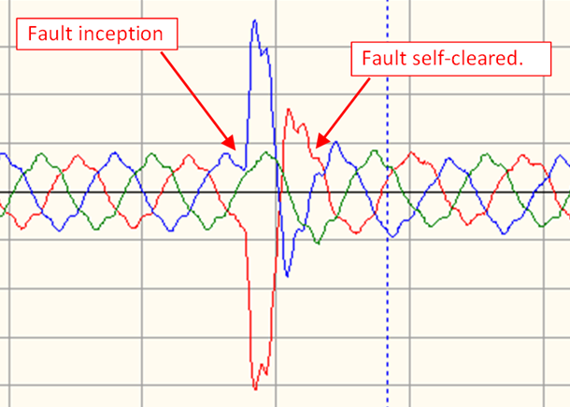
Let’s look a little closer
AB fault not involving ground cannot occur in any of the underground or undersea cable.
¾-cycle fault duration with self-clearing at a current peak rather than a current zero as expected for a breaker interruption. After that, post-fault current returns to a normal balanced load current.
Breaker interrupts load current about 2-½ cycles after the fault self-clears.
Fault current amplitude only about triple pre-fault load current suggesting a high fault impedance.
All of this suggests a partial discharge (PD) arcing event, some sort of dielectric breakdown.

Slide 6
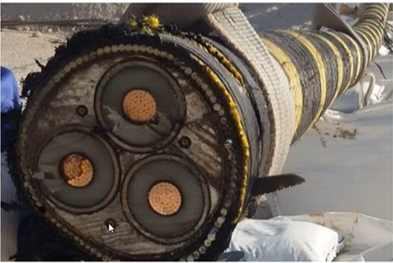
Our First Operations Team Call: Bad News and Good News
Bad News: I can’t tell you where the fault is – Groan!
Good News: I can tell you where the fault is not – Yea!
  Not in any of the 3+ miles of underground land cable between L-Ave Sub and beach landing.
  Not in the 25+ miles of undersea cable from beach landing to the island.
Conjectured later the fault most likely to be in the C-Street GIS breaker switchgear. Supported by discovery of arc products in SF6 gas samples and by partial discharge (PD) testing.

Slide 7
Facing the Limits of Resolution and Fourier Transform
While a conventional analysis of the DFR data was helpful it didn’t tell us definitively where the fault was.
Recognized that with low sampling rate (5.76kHz) we are limited to resolving frequencies up to 2.88kHz (48th harmonic). Not sufficient to see fine details of arcing or PD activity.
Recognized that with the limited fault duration (~3/4cy) Fourier analysis is unhelpful.
Even with the low upper limit on frequency resolution we wondered if a wavelet decomposition of the fault waveform would give us more or better details on the signal composition.

Slide 8
Extra Light Fourier Analysis Review
Continuous periodic signal with finite energy and infinite duration resolves to
  a series of single frequency signals in the time domain, described as
  an infinite algebraic series with discrete magnitude and angle values in the frequency domain.

Slide 9
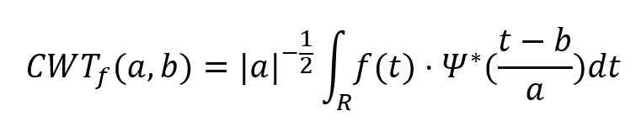
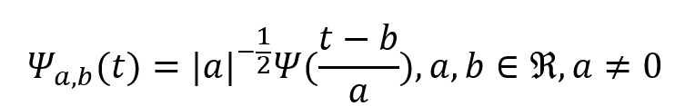
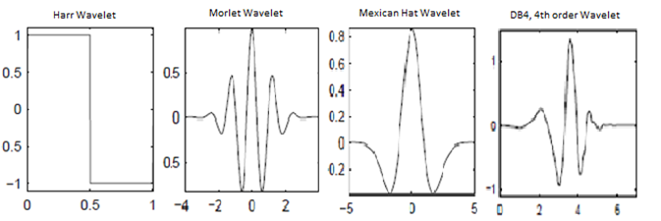
Light Intro to Wavelets – Continuous Transform (CWT)
The term wavelet comes from the French word ondelette meaning little wave. It is a short oscillation.
CWT is the convolution of a signal f(t) with a selected basis (or mother) wavelet function Ψ_{a,b}(t) where a and b are scale (dilation) and translation (position) factors, respectively.
To the right are some commonly used basis/mother wavelet functions.
These basis wavelets can be described as sets of orthogonal functions (having sine and cosine terms). This explains the conjugate term Ψ* in the convolution integral.

Slide 10
Light Intro to Wavelets – CWT Convolution Integral
Graphically speaking, convolution involves sliding/translating a selected basis wavelet Ψ_{a,b}(t) across the signal of interest f(t) while pointwise multiplying and summing the results.
That’s effectively like viewing the latter through the lens of the former.
The results of the CWT are a set of wavelet coefficients Cx, which are a function of scale and position.
The objective is to learn about the frequency composition across time.

Slide 11
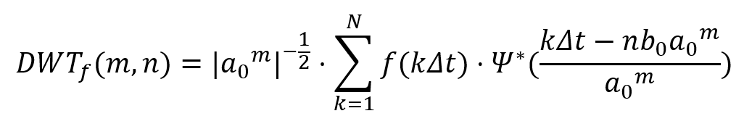

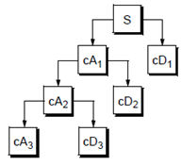
Light Intro to Wavelets – Discrete Transform (DWT)
DWT is more computationally efficient for sampled data than CWT.
The signal function f(t) becomes f(kΔt) where the sample number k=1,2, … , N and Δt is the sampling interval.
Factors a and b are also discretized where a₀ and b₀ are fixed real positive values while m and n are positive integers.
DWT is implemented using a 2-channel filter generating output signals A and D.
Basing scales on a power of 2 (dyadic transform with a₀=2 and b₀=1) separates S into logarithmic frequency bands as shown by the decomposition tree (far right).

Slide 12
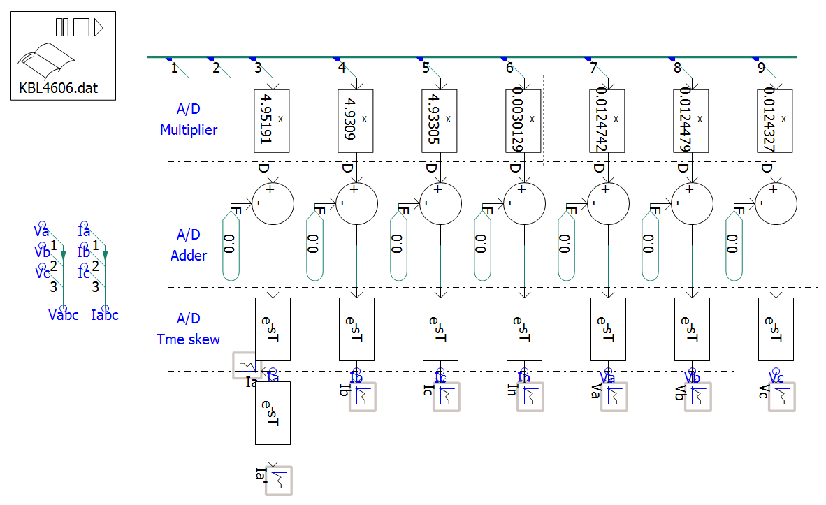
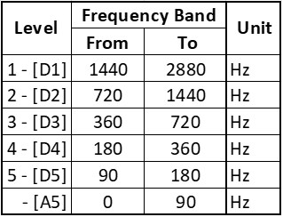
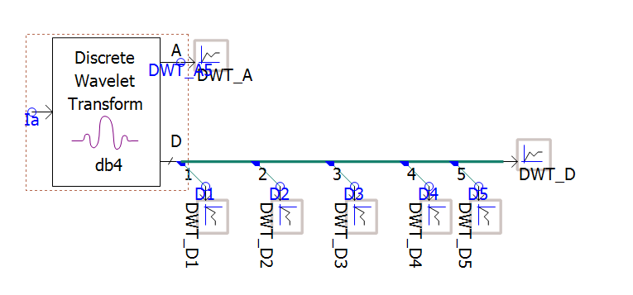
DWT Decomp of DFR Record Using Popular EMT Software
Read and process our COMTRADE data file into V_{ABC} and I_{ABCN} signals.
Decompose I_{A} into 5 frequency bands using 4th order Daubechies (db4) basis wavelet.

Slide 13
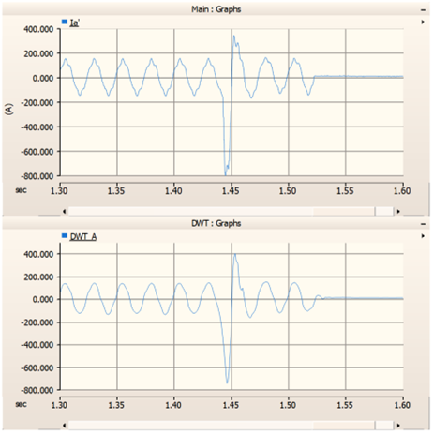
DWT Decomposition of I_{A} From DFR Record
Being low pass filter outputs, think of approximation coefficients A₁₋₅ as the smooth parts of the decomposition signals.
Only A₅ is available from this particular EMT software’s DWT model for 5-level decomposition.
A₅ appears as a smoothed version of I_{A} exactly as expected.
Observation: A₅ indicates the 60Hz component of fault current more than doubles the load current. This is consistent with 87L relay tripping given relay responds to fundamental frequency.
Original I_{A}
Approx A₅
0-90Hz
H = 0 – 1.5
Note: DWT introduces a time lag, so plotted I_{A} is time shifted +39.6ms to align with DWT output signals.

Slide 14
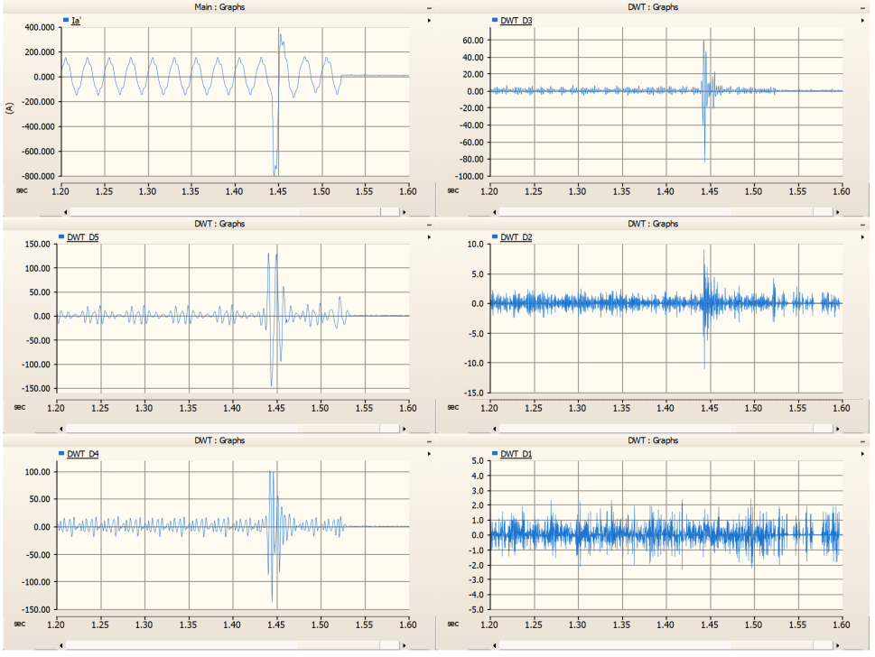
DWT Decomposition of I_{A} From DFR Record
Detail D₃
Being high pass filter outputs, think of detail coefficients D₁₋₅ as the fine-scale, or rough edges and noise parts of the signal.
D₅: 10A load → 125A fault amplitude.
D₄: 10A load → 100A fault.
D₃: 3A load → 50A fault.
D₂: 1A load → 4A fault.
D₁: 0.75A load with no variation during fault.
Original I_{A}
360-720Hz
H = 6-12
90-180Hz
H = 1.5 - 3
Detail D₂
Detail D₅
720-1440Hz
H = 12-24
1440-2880Hz
H = 24-48
Detail D₄
180-360Hz
H = 3 - 6
Detail D₁

Slide 15
Conclusions and Lessons Learned
DWT analysis did not provide a definitive correlation with uncovered PD activity. However, it gave us greater detail than was available with Fourier analysis tools, so it proved to be valuable.
  It allowed us to differentiate load current harmonics from fault harmonics.
  It showed the fault current was largely composed of harmonics.
It was recommended that higher end DFRs (more storage and higher sampling rate) be installed at all three substations serving the island power system. The criticality and expense of both the undersea cables and the GIS switchgear provides suitable justification. Higher sampling rates may prove beneficial for improving analysis of higher harmonic frequencies during faults.
It may also be suitable to replace older numerical charge-comparison type differential (87L) relays with relays capable of travelling wave fault location. PD activity may produce travelling waves detectable by these relays if not for tripping, then at least for recording and maybe alarming.

Slide 16
References and Questions
Michel Misiti, Yves Misiti, Georges Oppenheim, Jean-Michel Poggi, Wavelet Toolbox for Use with MATLAB: User’s Guide, Version 1, The MathWorks, Inc., March 1996.
Manitoba Hydro International, Ltd., PSCAD V5 Application Help, Discrete Wavelet Transform (DWT), March 28, 2023.
Robi Polikar, The Wavelet Tutorial: The Engineer's Ultimate Guide to Wavelet Analysis, Rowan University, https://users.rowan.edu/~polikar/WTtutorial.html.
Peter Barrett Bryan, Wavelet Convolution: Basic Principle, Medium.com, May 25, 2022, https://peterbbryan.medium.com/wavelet-convolution-basic-principle-52fc3d71c4e6.
Song Ji, Irene Lu, Cory Carlson, Dean Sorensen, Using Discrete Wavelet Transform Technique to Investigate High Impedance Fault and Protection Application Strategy at National Grid, Georgia Tech Protective Relaying Conference, May 2025.

