Slide 1
Application of EPRI PREMS II System to Solve Difficult Distribution and Customer Side Issues
James Owens, Eric Auel, Travis Turnbull, Ed Kaminski, Tony Murphy
EPRI, Dominion Energy, Atlantic City Electric, TVA
“Making the Invisible, Visible”

Slide 2
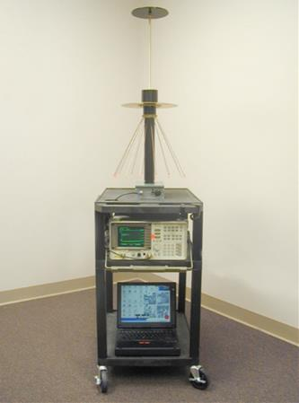
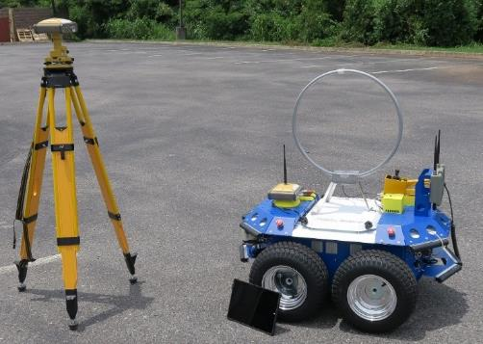
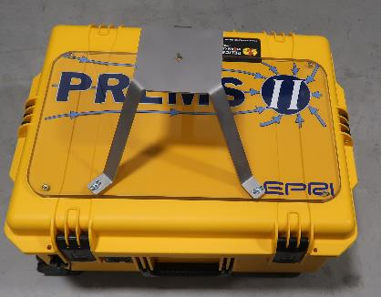
Background on the EPRI PREMS System
Original EPRI Portable Radiated Emissions Measurement System (PREMS)
Developed and used in the early 2000’s for hospital scans
Big Autonomous Mobile Measurement Platform (BAMMP)
PREMS II
PREMS
BAMMP
PREMS II

Slide 3
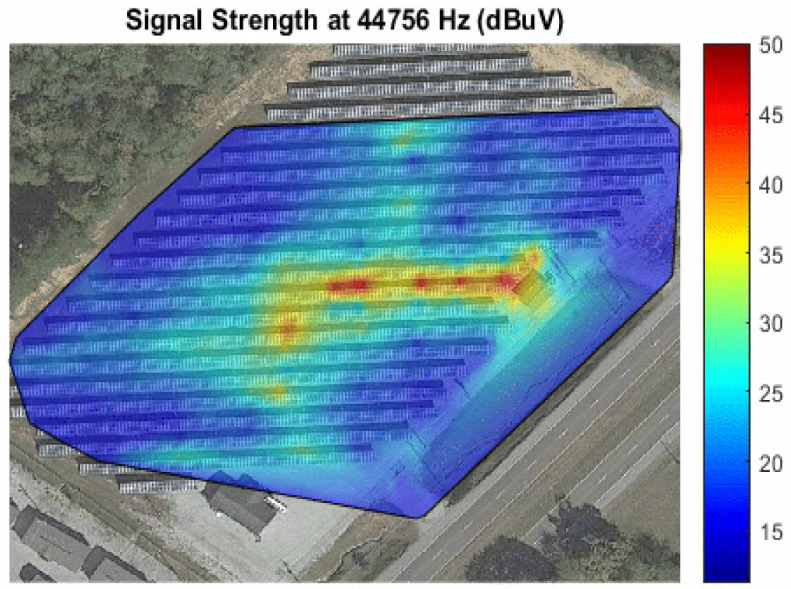
Animated Heatmap (30 kHz to 842 kHz)
More Interference Near Inverters and Nearby Panels at Lower Frequencies
Less Interference Above 240 kHz
Radiated Emissions from this PV Installation: Start: ~30kHz End: ~180kHz
Other Broadcast Signals Seen: AM Longwave: Signal: ~ 76kHz Signal: ~189 kHz
AM Medium Wave Local Radio Stations:
WRJZ - AM 620kHz
Talk Radio- AM 760kHz
dBuV Scale

Slide 4
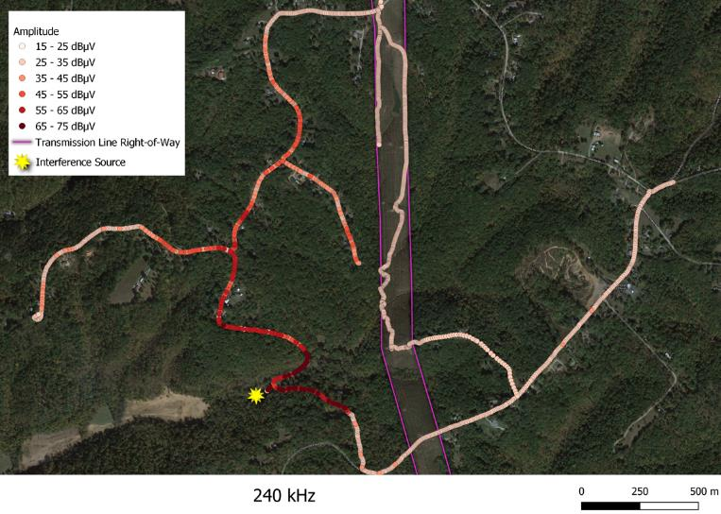
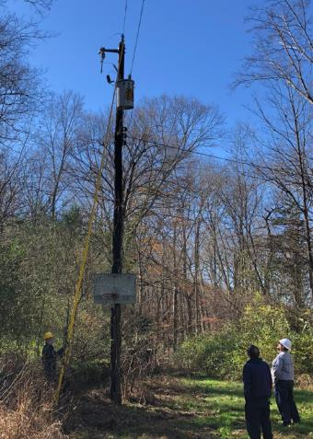
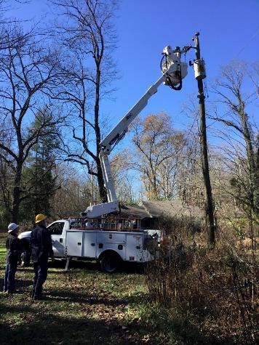
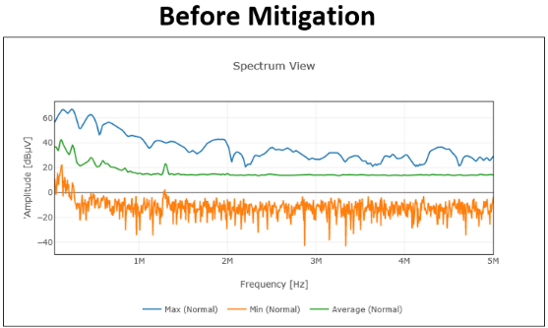
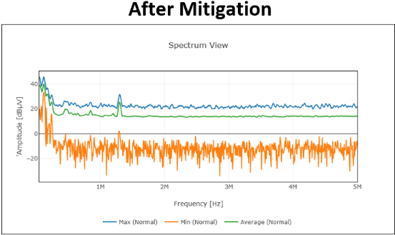
Protype PREMS II Findings
DSL signal disruption
56 residential customers impacted
Impact lasted 7 months before being resolved
EPRI discovered the source in 1.5 days with the PREMS II
Source #1 cracked insulator, and source #2 a damaged pole-mounted XFMR

Slide 5
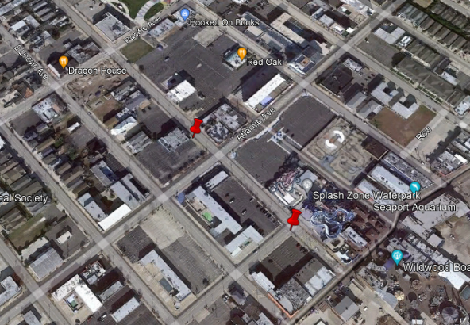
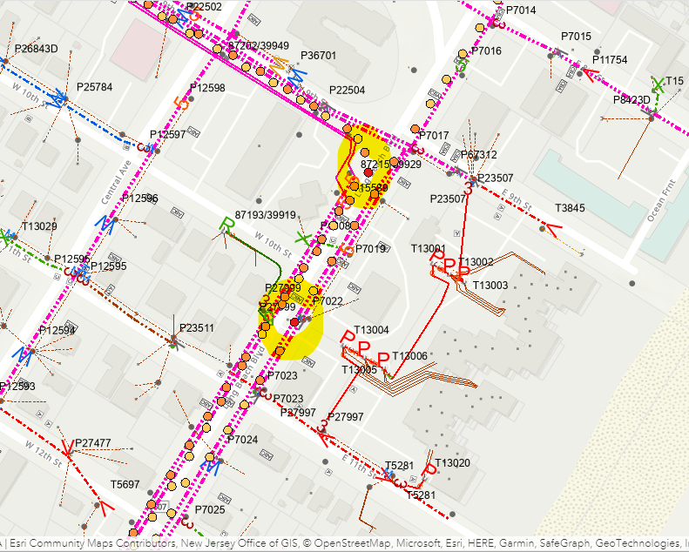
Utility User PREMS II Case Study #1
Sight inspections verified with thermal camera imagery
One location was noted as having a bad primary splice which burnt down before repairs could be made, and another separate location was noted as having a bad secondary connection on a three-phase bank
Highlighted circles correspond to bad connections for feeder gateways
PREMS operator was able to scan an entire 18-mile feeder in about 4 hours and identified ~12 areas for further investigation

Slide 6
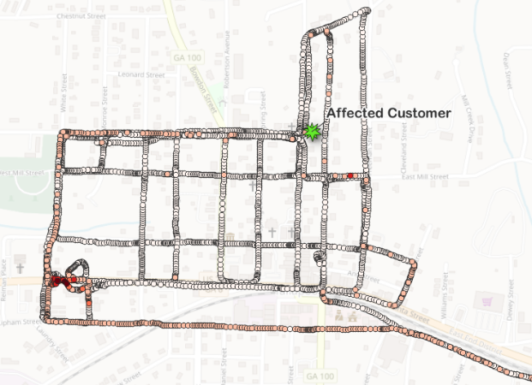
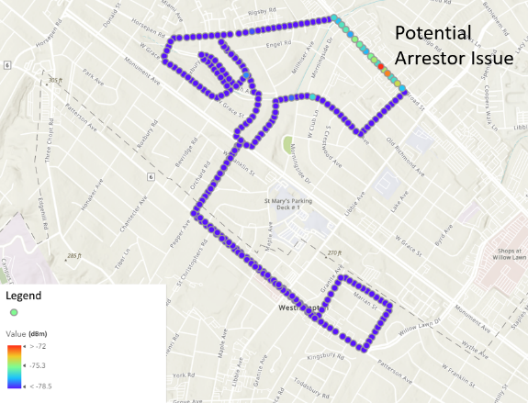
Utility User PREMS II Case Study #2
Ham radio operator was reporting an interference signal in the 50MHz range near his home
Utility was aware of an issue in a particular area, but they could not pinpoint the source
50MHz Scan
160MHz Scan

Slide 7
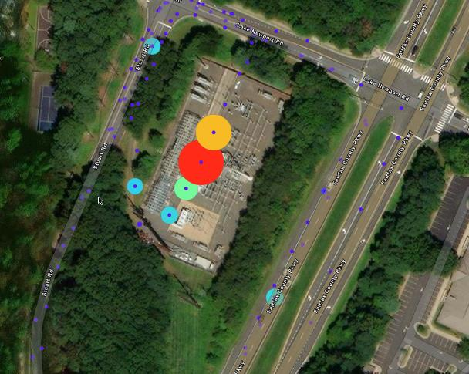
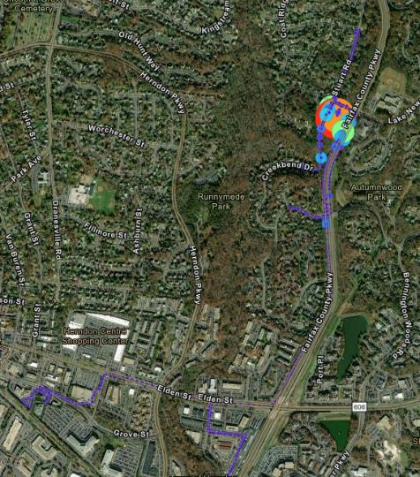
Utility User PREMS II Case Study #3
Ham radio operator noted a strong interference impacting his communications
Utility inspector used a different type of spectrum analyzer and mini RFI locator, but had no luck finding the source
While using the PREMS II, a radius sweep of ½ mile detected several small sources
A sweep 1.5 - 2 miles away located a large interference signature being created by a lightning arrestor
Leads on 3-arrestors were lifted and the interference signal was immediately cleared
12 – 15 other noise sources have been found and mitigated due to reporting by ham radio operators
Another investigation located a cell tower as a possible source of noise interference for another customer complaint
During a 2023 investigation, an elevated noise signature was detected in a substation, and the thought was that it was due to something in the Control House.
The substation crew was asked to help in the investigation.
After the crew was involved the noise vanished and hasn’t returned.

Slide 8
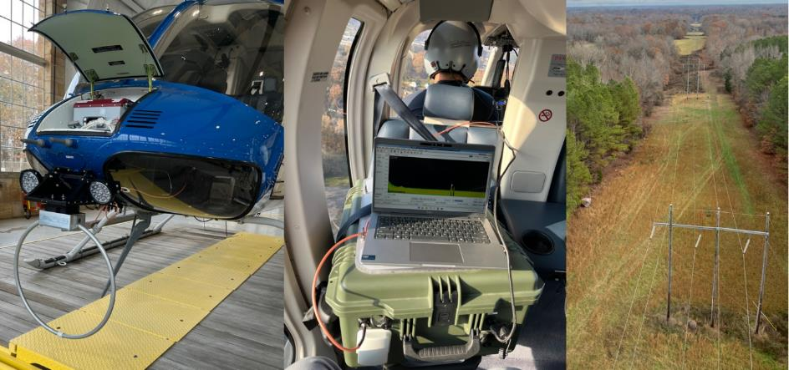
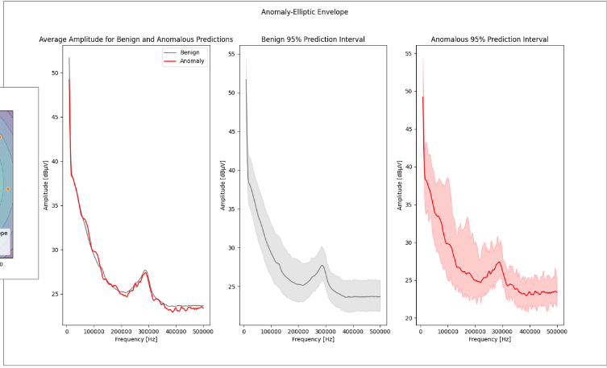
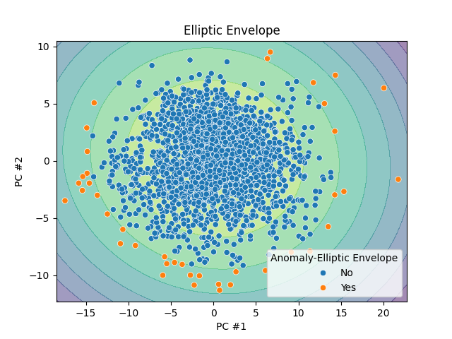
Current Research Project: PREMS II use with Helicopter
Test flights over Transmission lines
Goal was looking for line or tower related emission issues that could be indicative of future failures or issues
Large sets of frequency data were was taken
EPRI used two ‘Machine Learning’ algorithm methods:
Elliptic Envelope method
Local Outlier Factor (LOF) method

Slide 9
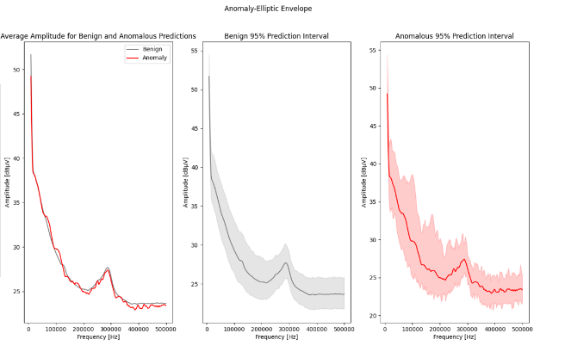
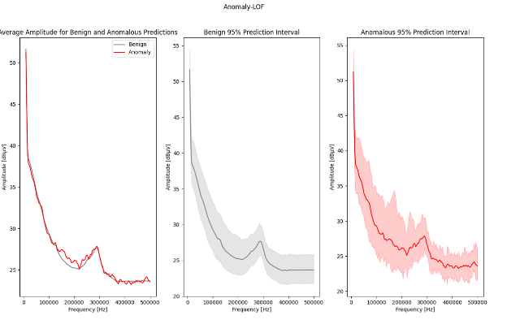
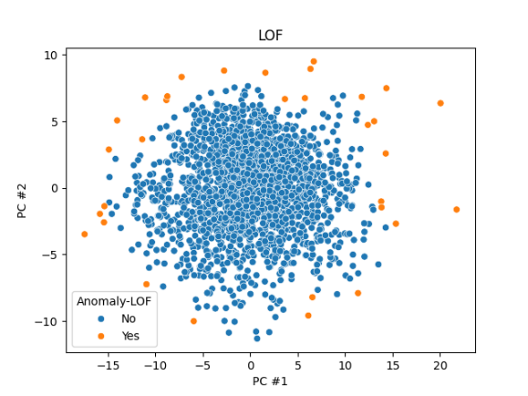
Current Research Project: PREMS II use with Helicopter (Cont.d)
Elliptical Envelope Method
Local Outlier Factor Method

Slide 10
Questions
James Owens, CEM, CPQ Sr. Team Lead, PQ Services E&SES EPRI, 942 Corridor Park Blvd, Knoxville, TN 37932 Desk: 865.218.8101 jowens@epri.com
PREMS System Overall

