Slide 1
Case Study - Consolidating Monitoring with Protection
Mike Ramlachan, Craig Wester - GE Vernova

Slide 2
Introduction
Dive into History – Establishing Requirements for Disturbance Monitoring
PRC-002 and it’s many revisions
Monitoring Requirements
SOE/SER
TRF/FR
DDR
Managing Monitoring Requirements
Centralized
De-Centralized
Distributed
Monitoring Evolution
PRC-028
Using a Relay to Meet Requirements
Possible?
Stimulate discussion

Slide 3
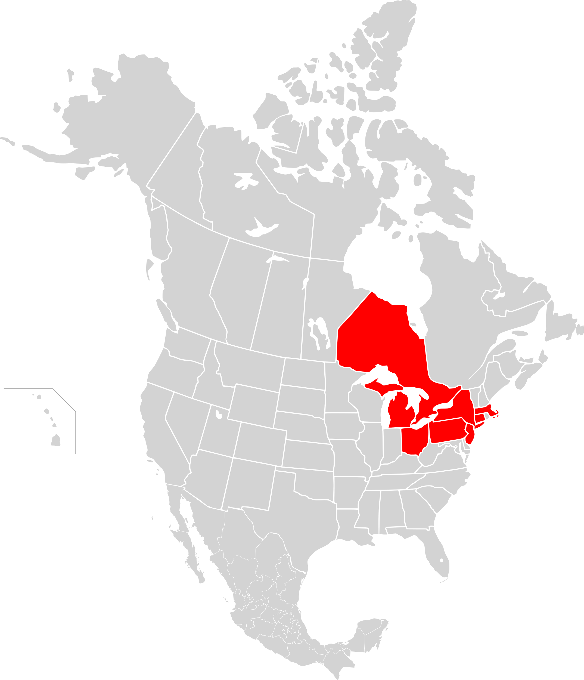
August 14th, 2003 – North East Backout
Affecting parts of
NJ/NY/CT/PA/MA/VT/OH/MI/Ontario/Quebec
Approximately 50 million people
Took up to 4 days to fully restore power
NERC task force established to investigate
“NERC investigators labored over thousands of data items to synchronize the sequence of events, much like putting together small pieces of a very large puzzle. That process would have been significantly improved and sped up if there had been enough synchronized data recording devices”

Slide 4
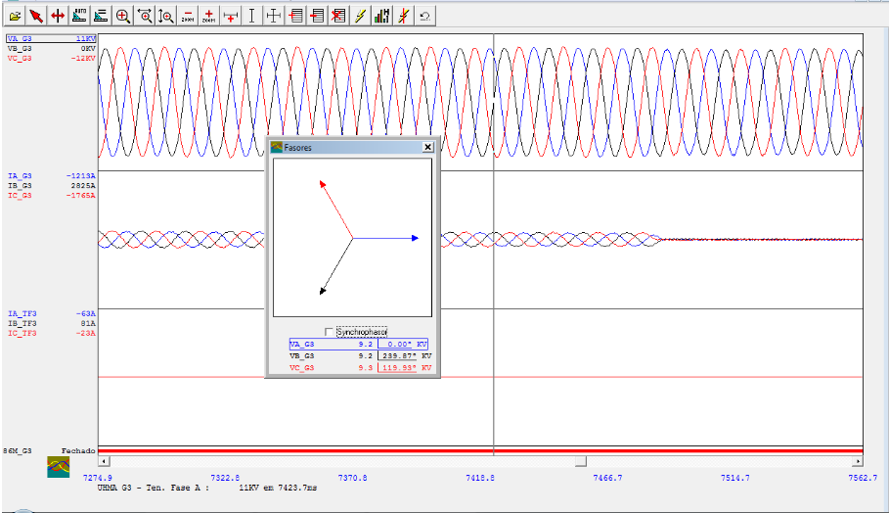
Monitoring Requirements Established
PRC-002-1 (2006)
Disturbance Monitoring Equipment (DME) Requirements
PRC-018-1 (2006)
Mandate DME installation and reporting of data per regional requirements
PRC-002-2 (2014)
Consolidation of PRC-018-1 and PRC-002-1
Requirement for BES operators
Enforceable by FERC
Not a Standard but a requirement
Ensure adequate data is available for analysis of bulk electric system disturbances

Slide 5
Disturbance Monitoring Requirements
Sequence of Events (SOE)
Fault Recording (FR) or Transient Fault Recording (TFR)
Dynamic Disturbance Recording (DDR)
Time synchronization accuracy
Sampling rate for FR and DDR
Data retention
Multifunctional Digital Fault Recorder
Time Synchronization
Communications
Traveling
Wave
Recorder
Waveform
Recorder
Disturbance
Recorder
Sequence- of-events (SOE)
Power
Quality
PMU
Continuous
Fault
Recorder
CT/VT Acquisition
Transducer Acquisition
Binary I/O

Slide 6
Managing Requirements with Centralized Architecture
Advantages
Data captures simultaneously
Common platform
Suitable for small/medium S/S
Disadvantages
Directly wired requirement
Extensive copper wiring
Complicated for large S/S
DFR
I, V
Protective Relay Triggers
Device Statuses
Other Signals
Requires considerable design, construction and commissioning to implement and maintain

Slide 7
Managing Requirements with De-Centralized Architecture
Advantages
Installed close to signal source
Simplified installation
Suitable for large S/S
Disadvantages
Communication can be proprietary
Synchronization required across data acquisition units (DAU)
DFR
DAU
DAU
DAU
DAU
I, V, Protective Relay Triggers, Device Statuses, Other Signals
I, V, Protective Relay Triggers, Device Statuses, Other Signals
I, V, Protective Relay Triggers, Device Statuses, Other Signals
I, V, Protective Relay Triggers, Device Statuses, Other Signals
Ideal for large transmission substations and capability for future expansion

Slide 8
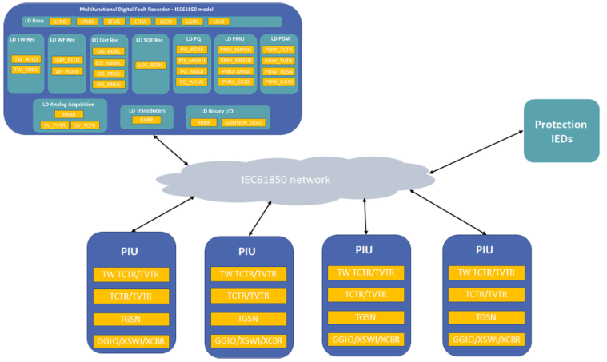
De-Centralized Architecture in Digital Substation
Advantages
IEC 61850 Standard
Non-proprietary
Ideal for Digital Substations
Simple
Disadvantages
Brownfield
IEC Process Interface Units (PIU) stream sample values (SV) to DME/Relays etc

Slide 9
IEC 61850 DME Modeling
Multifunctional Digital Fault Recorder – IEC61850 Model
LD Base
PIU
LLN0
LPHD
LTMS
LTIM
LCCH
LGOS
LSVS
TW TCTR/TVTR
LD TW Rec
LD WF Rec
LD Dist Rec
LD SOE Rec
LD PQ
LD PMU
LD POW
TCTR/TVTR
TW_RFLO
IMP_RFLO
DIS_RDRE
SOE_RDRE
PQ_RDRE
PMU_MMXU
POW_TCTR
TGSN
TW_RDRE
WF_RDRE
DIS_MMXU
PQ_MMXU
PMU_MMXN
POW_TVTR
GGIO/XSWI/XCBR
DIS_MSQI
PQ_MSQI
PMU_MSQI
POW_TGSN
DIS_MHAI
PQ_MHAI
PMU_GGIO
POW_GGIO
LD Analog Acquisition
LD Transducers
LD Binary I/O
RABR
RABR
RBDR
SV_TVTR
SV_TCTR
GOOSEIN_GGIO

Slide 10
Managing Requirements with Distributed Architecture
Advantages
Installed close to signal source
Simplified installation
Cost effective
Disadvantages
Phasor Measurement Unit (PMU) or similar requirement for DDR
Synchronization needed and required across all devices
Complicated architecture
Data Concentrator
PDC
Ethernet Switch
DFR
PAC
Relay
PAC
Relay
PAC
Relay
I, V, Protective Relay Triggers, Device Statuses, Other Signals
I, V, Device Statuses, Other Signals
I, V, Device Statuses, Other Signals
I, V, Device Statuses, Other Signals
Option for Brownfield installations to minimize operational impact and cost

Slide 11
Monitoring Evolution
NERC Project 2021-04 created to evaluate and modify PRC-002 in 2 Phases
Phase 1 – notification of data and identify BES owners needing the data
Establish clarity around stations with multiple owners BES equipment
R1 and R5 enhanced
R13 added – offering flexibility to meet requirements
PRC-002-4 adopted in early 2023
Phase 2 – address gaps as identified by the inverter-based resource (IBR) performance task force (IRPTF)
IRPTF concerned criteria not adequate for IBR resources and many will fall out of scope
IBR requirements removed from PRC-002
New PRC-028-1 established to address IBRs
PRC-002-5 and PRC-028-1 adopted in October 2023
PRC-002 requirements might not be adequate as the power system evolves

Slide 12
Can Modern Relays meet Requirements
PRC-002-5 and PRC-028-1 may potentially increase need for additional DMEs
SOE – Possibly Capable
FR – Not Capable
Triggered record length of 3 minutes
C37.232 (COMNAME)
PRC-028-1 requirement of 128 samples per cycle
DDR – Not Capable
Recording of up to 10 days
Data Retention an issue – lack of adequate storage

Slide 13
Conclusions
Current generation of relays cannot meet all requirements
Storage (data retention) deficiency
Storage cost have drastically come down in the last decade
Should not be a technical or economic roadblock for next generation relays
Sampling rate deficiency
Some relays on the market today are capable of sampling rates of 128 s/c
Virtualization/Containerization helps
Separation of real time and non-real time processes

Slide 14
Thank You
Questions?

