Slide 1
Enhancing Grid Stability through Reactive Power Support from Inverter-Based Resources (IBRs)
Luis Rosa-Rivera, Furkan Ilgin, Alexander Freeman, Genesis Alvarez, Gerald Warchol
Dominion Energy

Slide 2
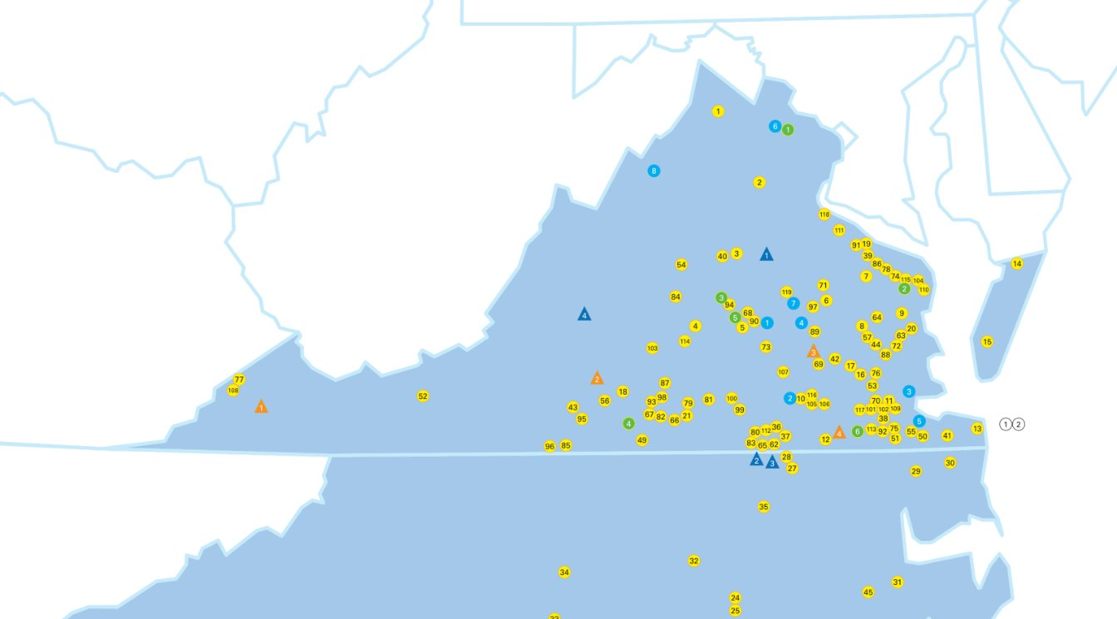
Dominion Energy current IBR portfolio​
Dominion Energy's current renewable energy portfolio includes more than 3,301 megawatts of clean energy
8,816 MW of solar in operation and under active development
586 MW of storage in operation and under active development
2.6 GW of offshore wind under construction
Notes:
Dominion Energy already has a very significant IBR portfolio, mainly PV generation. Currently, we have more than 3 gigawatts of renewables located in our territory between Virginia and North Carolina. And this map shows the location of all of the transmission-connected sites, which are mostly found in the eastern. We have a total of 8.8 GW of solar energy, which includes both operational and actively developing solar projects. Under active development project are projects that are Dominion owned and developer owned projects. Dominion has 586 MW of energy storage which also include the storage in operation and under development. Lastly, we have 2.6 GW of offshore wind that is currently under construction.

Slide 3
Grid Transformation & Security Act
In 2018, the Virginia Legislature passed the Grid Transformation & Security Act
Among other things, it established a battery pilot program, with up to 30 MW of energy storage qualifying for the pilot project if certain grid support functions are met (improve grid reliability, improved integration of different renewable resources, deferred equipment upgrade investments in transmission or distribution)
Notes:
-The Virginia Grid Transformation and security act of 2018 establishes a path to investing in long-term, sustainable energy technologies and grid modernization. The law prioritizes investment in renewable energy. This established a battery pilot program with up to 30 MW of energy storage that improves grid reliability and deferred equipment upgrade investments in transmission or distribution. For instance, by installing a Battery Energy Storage System (BESS) near a substation transformer, you can defer upgrading the transformer. The BESS stores energy during periods of low demand and releases it during peak demand, thereby reducing the load on the transformer. Which delays the need for upgrading the transformer to handle a higher capacity.

Slide 4
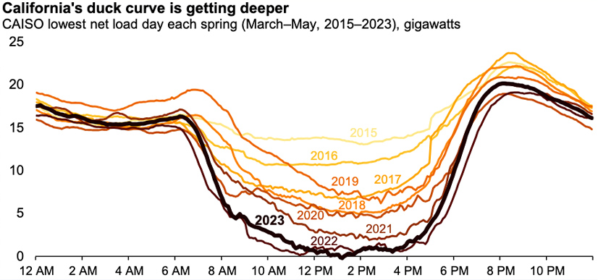
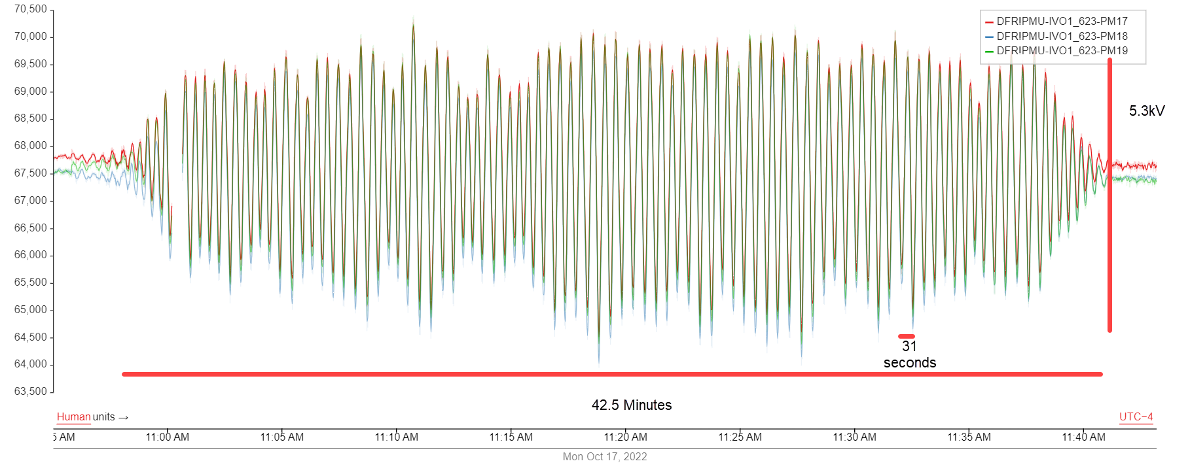
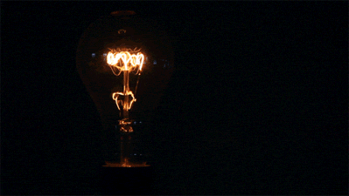
Emerging challenges
Voltage oscillations
High harmonic currents
Voltage Flicker
Protection challenges
Reverse power flow
Duck Curve
Voltage oscillation caused by PPC
Voltage Flicker
Notes:
→The increase of IBRs on our system can introduce many challenges. Inverters can introduce voltage oscillations, high harmonics currents and other power quality issues such as voltage flicker.
IBRs can also cause Protection Challenges due to the lack of negative and zero sequence current contribution. Also, reverse power flow is a challenge.
If you start backfeeding a large magnitude of generation back to the transmission system, you can damage equipment; it can be a safety concern and it can affect the grids stability by causing fluctuations in the voltage level.
Another future concern is the potential impact of weather on creating a Duck Curve or causing nighttime DER drop-offs, which can lead to frequency issues. Although our situation is not as severe as California's Duck Curve, the increasing amount of DER makes it crucial to prepare in advance.
- Safety concern in the event there’s an outage an your backfeeding to the grid a worker can get hurt.
If you start backfeeding a large magnetiude back to the transmission system, you can damage equipment; it can be a safety concern in the event there’s an outage an your backfeeding to the grid a worker can get hurt. Also, this can affect grid stability by causing fluctuations in the voltage levels, which can affect the reliability of the grid. Another future concern we can be with the weather could create a Duck Curve or night time DER drop off can cause a frequency issues. At the moment we don’t have that issue but in Europe we did see the blackout that happen in a couple weeks ago in Spain or Portugual.
An issues we are seeing, is unwanted dynamics being generated by some IBR sites which spread across the system and have the capacity to impact other generation and/or customers.
A lot of these things are directly related to the controls schemes employed at the inverter level and in the power plant controller, or to the interaction of the two.
The detection of these issues often starts from our system operators which see localized voltage or power oscillations which differ from other phenomena that they are more accustomed to. So, they notify other groups in our organization to provide insight into what is happening and how to react to it.
On this slide I have two examples of voltage oscillations which were caused by IBRs and I will say upfront that while for some of these we have been able to track down the issue, for others we still don’t quite understand the cause.
So, in the plot on the right you can see an oscillation that can be observed in the voltage and reactive power signals, but not in the active power. In this specific case, what was happening was a badly setup control system which had a significant communication delay in the automatic voltage regulator and caused the plant to start hunting and cause the voltage oscillation.
The other example, the bottom right

Slide 5
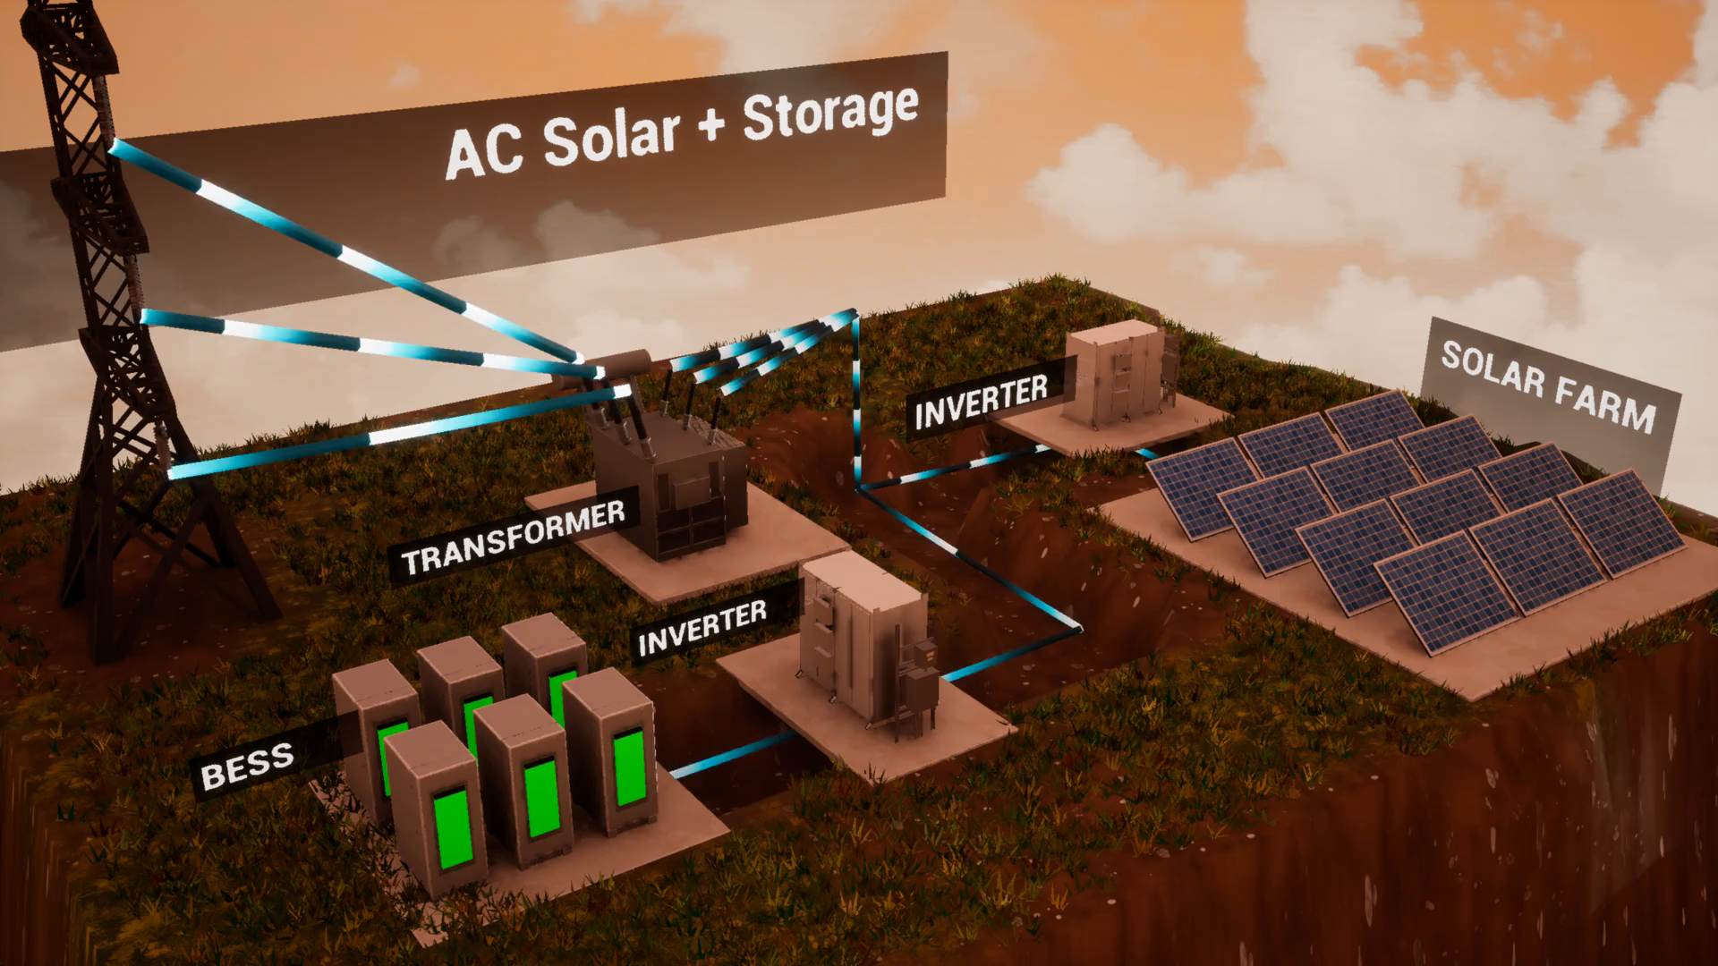
Background
Battery Pilot project will study the prevention of solar backfeeding onto the transmission grid
Batteries store excess solar energy produced during the day. This stored energy can be utilized during periods of low solar output or at night
Improved grid reliability and integration of different types of renewable resources
Deployed a 2 MW / 4 MWh AC coupled lithium-ion BESS
  Grid Following Inverter (GFL)
Notes:
→Like I mentioned before due to the gris transformation act we decided to install a battery pilot project to study the prevention of solar backfeeding onto the transmission grid
→Here in the animation, you can see how during the day excess amount of solar generation will be charging the BESS and at night the battery will support the load.
This project deploys a 2 MW / 4 MWh AC coupled lithium-ion.
BESS project seeks to accomplish the following objectives from Va. Code § 56-585.1:6 A: (i) improved reliability of electrical transmission or distribution systems; and (ii) improved integration of different types of renewable resources.
Currently this battery is connected to a grid following inverter but it does have the capability to do grid forming
Grid Forming capabilities → will need to update the protection in the event we want to use grid forming

Slide 6
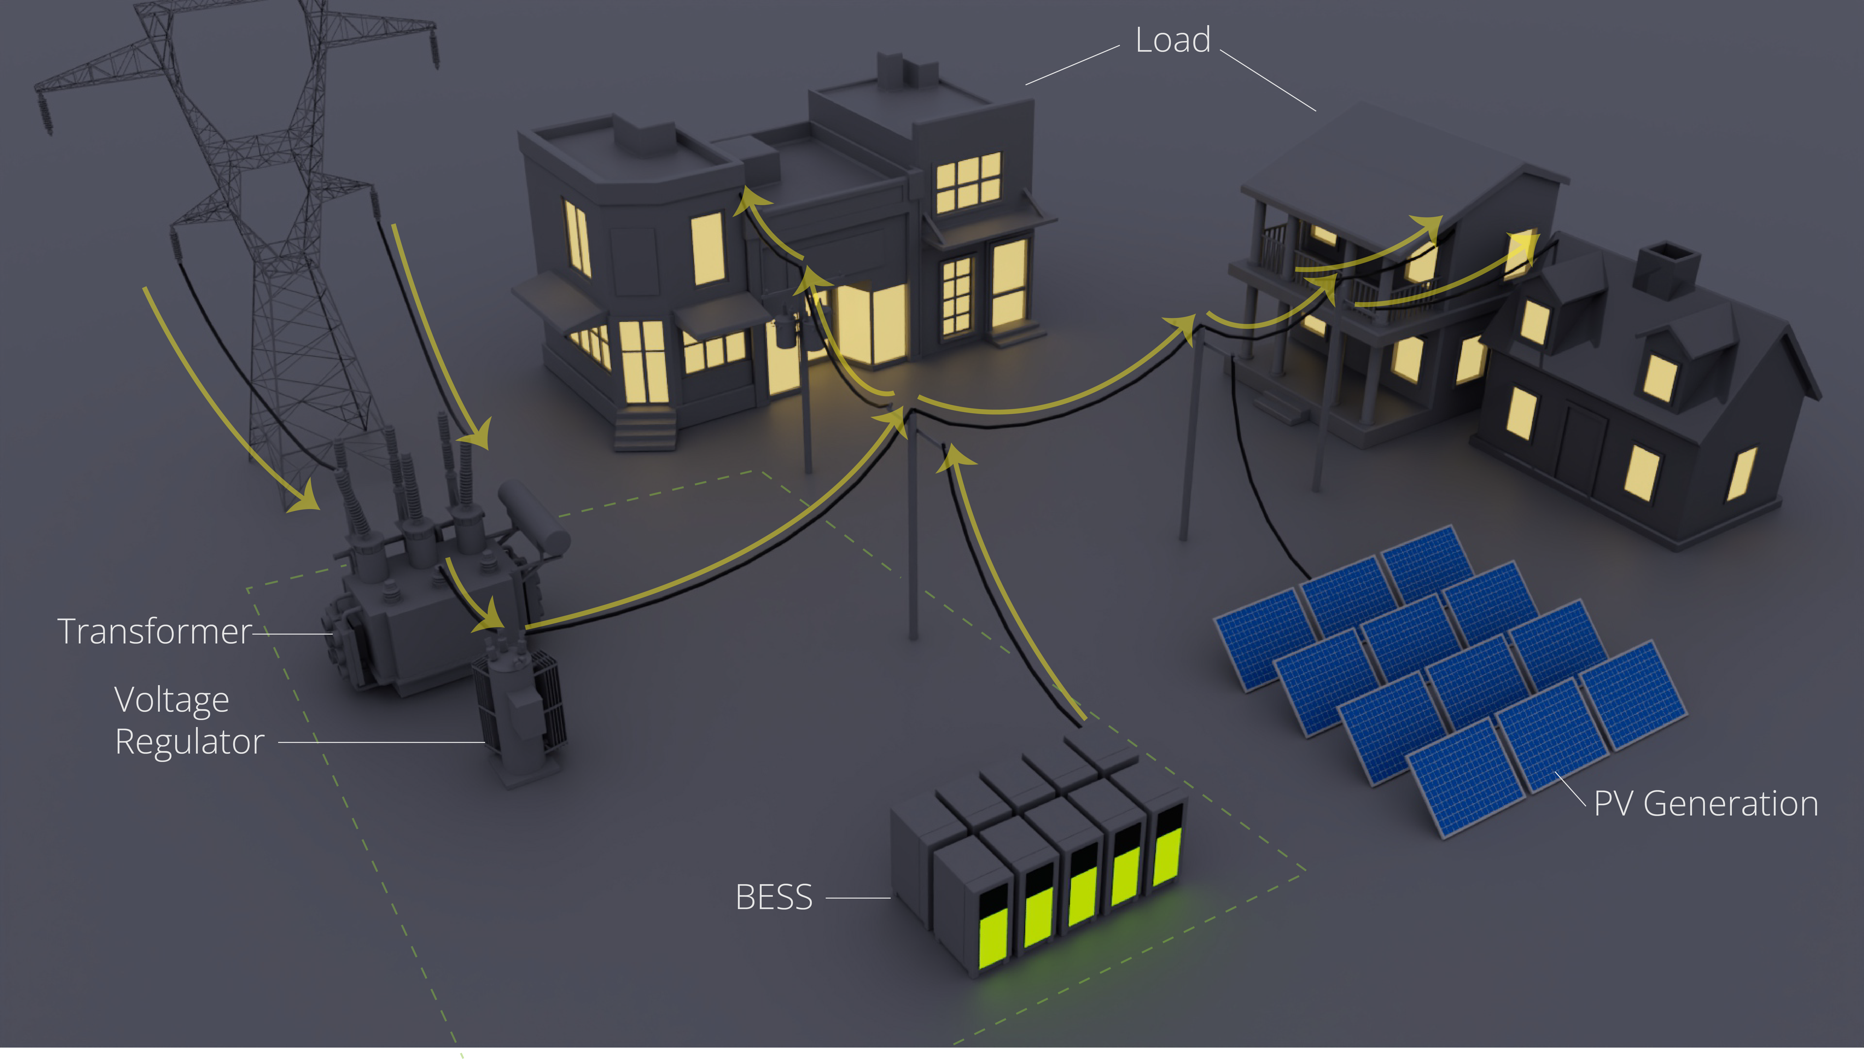
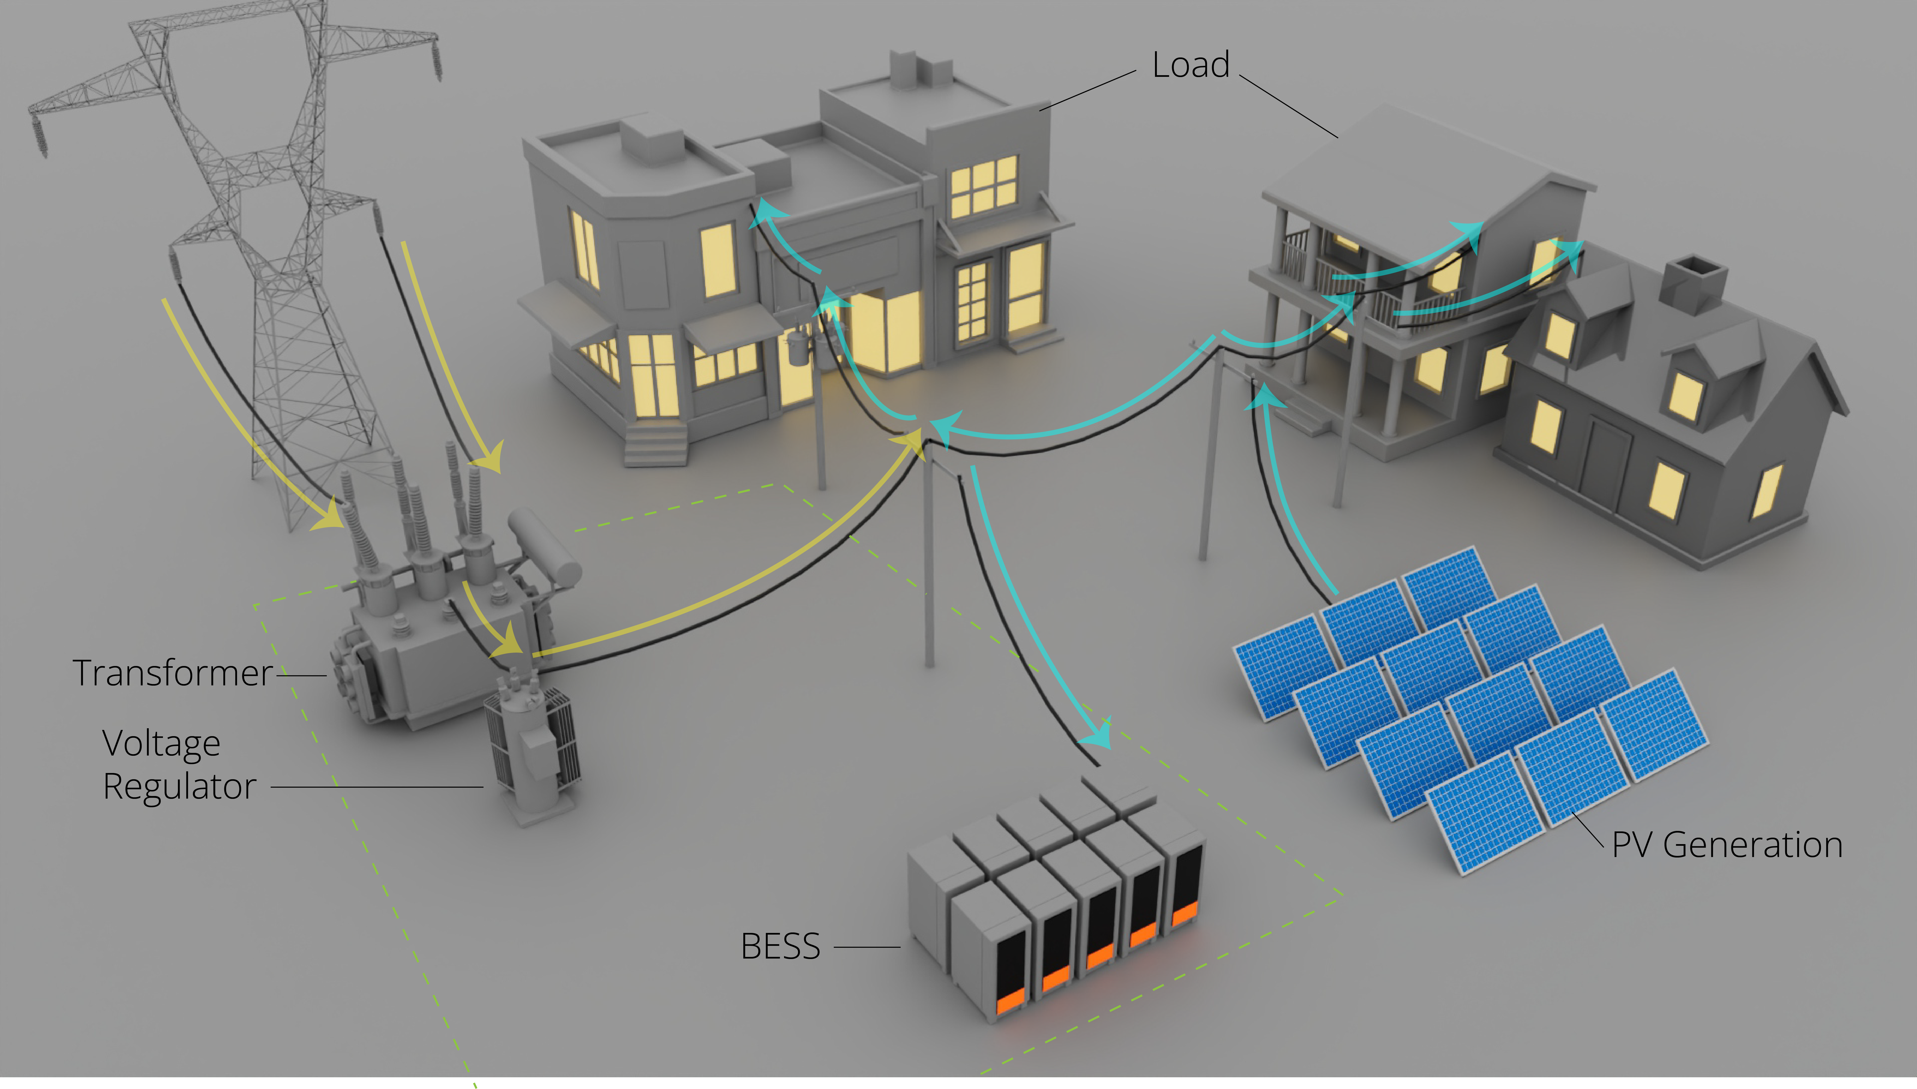
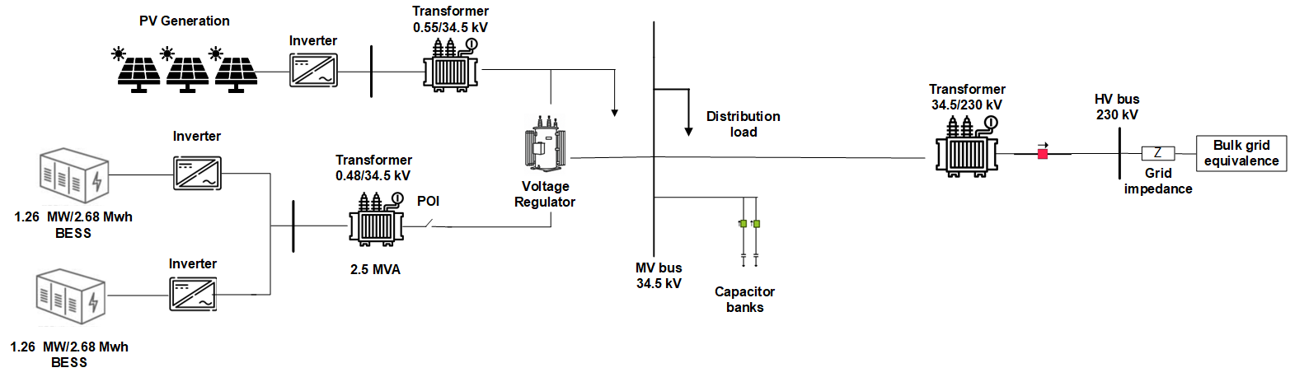
System Topology
Notes:
Here is our system topology, we have a 2.52 MW/5.36 MWh but only use the 2 Mw/ 4MWh.
The battery is slightly oversized to enable other functionals outside of Active power Control and to account for battery degrading for the pilot project
The battery pilot project is for 5 year project and the warranty is for BESS is 10 years
This battery is connected to a 20 MW PV generation site and on this circuit we have a voltage regulator for the 34.5 kV bus and two capacitor banks rated each for 4.8 MVAR. Then we have a step up transformer to 230 kV and our grid impedance and equivalent source.
Here is a 3D visual of the site during the day, the dashed lines represent the substation and here you can see the voltage regulator, transformer and BESS is located within the substation. Also, you can again see the excees PV generation charging the BESS.
Also, here is a 3D Visal during the night and here you can see the BESS discharging and the PV not generating any power.
For this specific pilot project, we wanted to explore the other BESS capabilities and so we evaluated the performance of the voltage regulator verses the enabling the Automatic Voltage Regulator (AVR) function from the battery for 6 months.
Battery is a 2.52 MW/5.36 mWh
The battery pilot project is for 5 years and the warranty is for 10 years

Slide 7
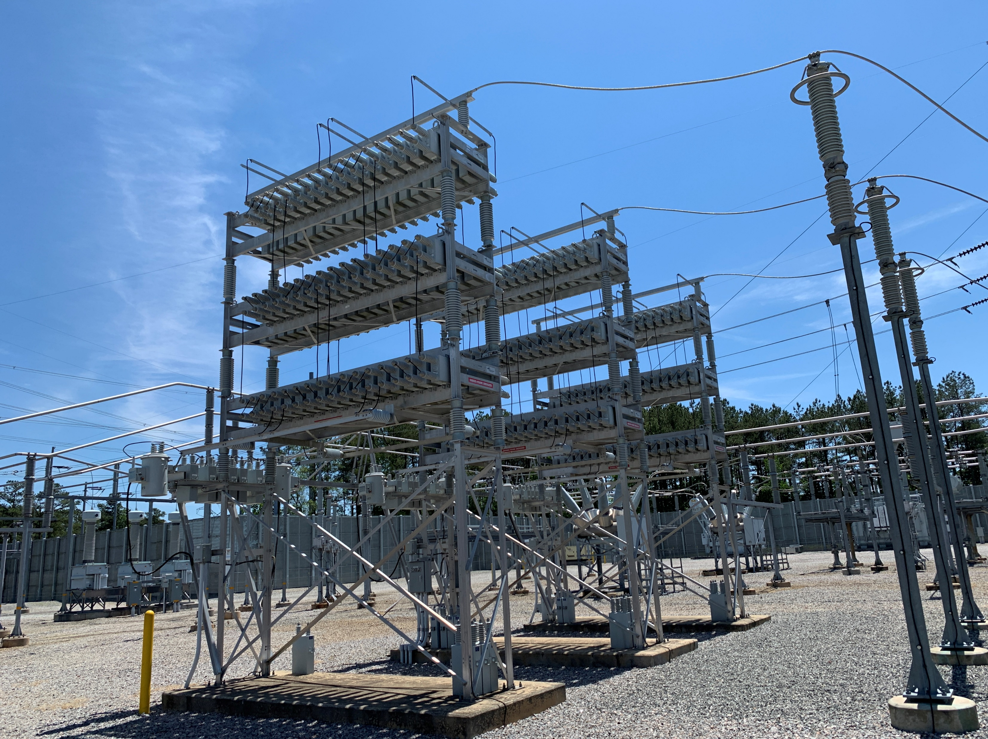
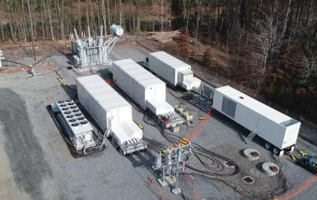
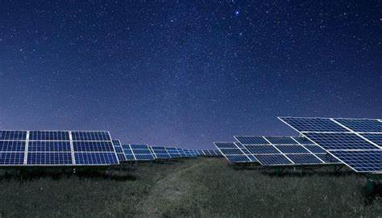
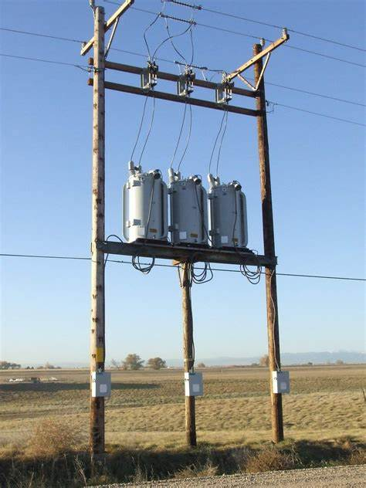
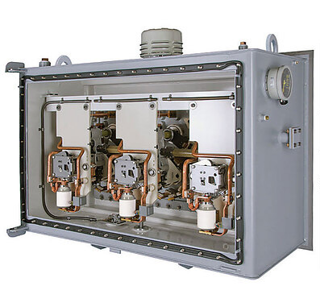
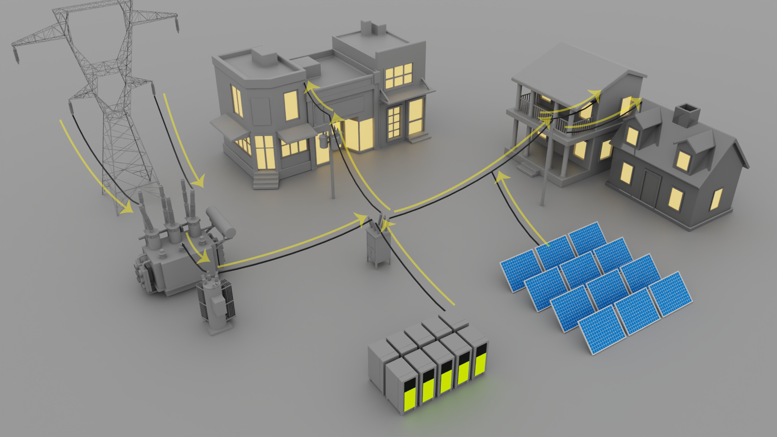
Voltage Regulation Methods
Load Tap Changer (LTC)
Voltage Regulator
Capacitor Banks/ Shunt Reactor
Static synchronous compensator (STATCOMS)
Night VARS using PV (transmission)
Notes:
Some Voltage regulations methods we use at Dominion consists of
Load Tap Changer (LTC)
Voltage Regulator
Capacitor Bank and Shunt Reactors
Static Synchronous Compensators (STATSOMS) , Dominion has 3 mobile statcoms on our system used typically when there is a long transmission outage
On our transmission system we also have a couple solar sites that uses Night VARS

Slide 8
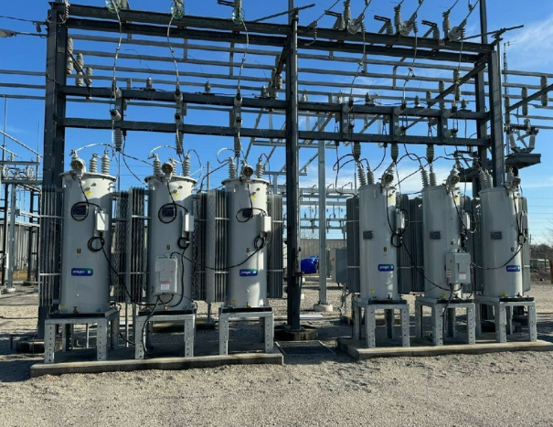
Voltage Regulation
Standard substation voltage regulation is performed by LTC or 3 single phase voltage regulators
Test circuit: Single phase regulators
  124 V setting with 3 V deadband
Mean absolute error: 2.6% for 6-month study period
Notes:
Our standard substation voltage regulation is performed either by LTC or 3 single phase voltage regulators
124V was the settings with a 3V deadband
Throughout the 6 month study the mean absolute error was 2.6%, the voltage variation was 3.2V.
NOTE:
Mean absolute error → Any deviation from the setting is an error. If the set point if 124V, all data points with over the 6 months that’s the 2.6%. The voltage varied about 3.2 V when it was 2.6 % error
0.6% give you a 0.7 V variation
Define: Mean absolute error is a better measurement because you are considering anything outside the setting as an error

Slide 9
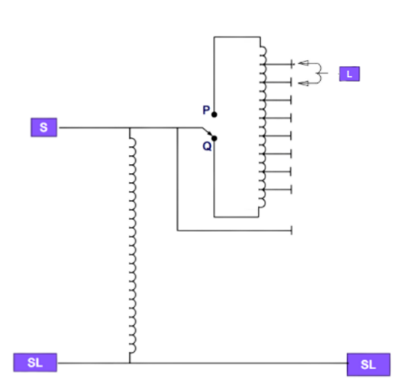

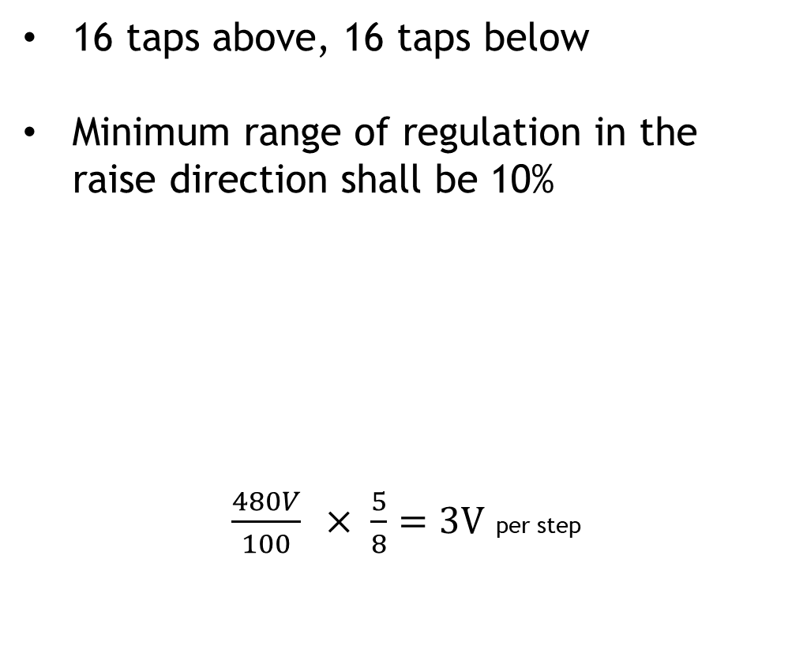
Voltage Regulation
16 taps above, 16 taps below
Minimum range of regulation in the raise direction shall be 10%
$\frac{480V}{100} × \frac{5}{8}=3V$ per step
Notes:
The voltage regular has 16 taps above and below with a miniuim range of regulation of 10%
So the tap percent is going to be (5/8)% of your nominal votlage
Our nominal is 480 V so times (5/8) and divide by 100 gives you 3V per step
→3 V per step ← 5/8 of a percent
NOTES:
IEEE Std C57.15 sec 6.4
NOTE:"SL" is the neutral, or the ground, “S” is the source ,
If the Switch is on "Q" you are adding windings on top of the Excitation winding. Starting at the bottom you can add in 1,2..., 7, or 8 taps.
8 taps, times 2 movable contacts so you have bridging/non-bridging, then times 2 again for the reversing switch to have raise/lower… then the last position is neutral so a total of 33 step regulator

Slide 10
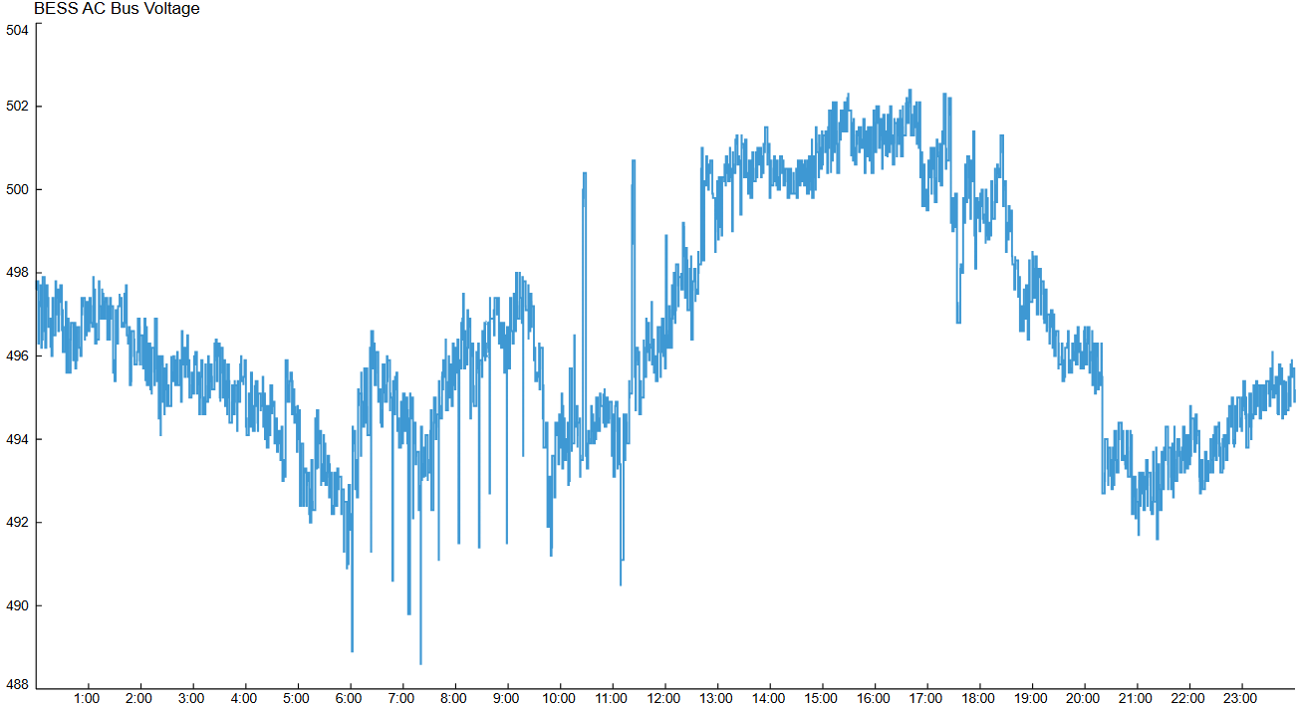
Field Results
Notes:
→Here we have field data that shows what a typical day looks like before enabling Automatic Voltage Regulator (AVR)
So here the voltage regulator is regulating the voltage and the bandwidth base on the 480 V is +- 6 V .
NOTES:
Floating system, system is trying to adapt verses the utility controlling the system
Only if people ask → PT accuracy of regulators

Slide 11
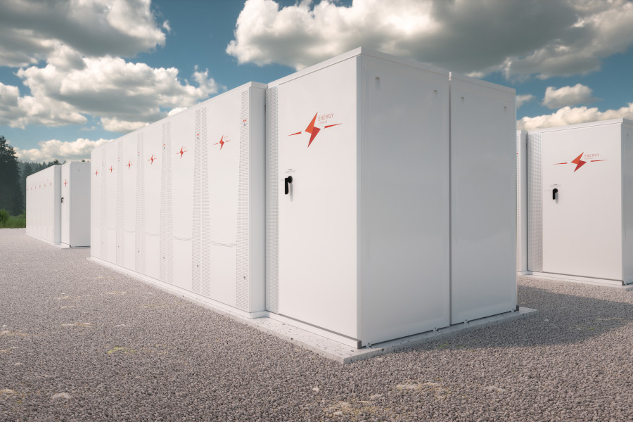
Battery Energy Storage
What if BESS helped regulate voltage?
Control active power while regulating voltage simultaneously
BESS regulation setting: 496 V on the AC bus side (480 V base), no deadband
  Equivalent to 124 V on 120 V scale
Mean absolute error: 0.5% for 6 month study period
With a +/- 2 MVAR capacity, the maximum exported reactive power during the study period was +320 kVAR and the maximum imported reactive power was -650 kVAR
Notes:
Now what if we have the BESS help regulate the voltage.
The battery has the ability to regulate voltage and simultaneously control active power
The Battery is oversized to 2.52 MW, so currently we only charge and discharge to 2MW. If it needs to charge to prevent backfeed into the grid it does have the capability.
The BESS settings is 496 V AC bus side and the base is on 480V
Similar to the 124 V on a 120 V scale
The mean absolute error during the 6 month period was 0.5%
The BESS has a +- MVAR capacity and during the study the maximum exported reactive power was +320 kVAR and the maxiuim imported reactive power was -650 Kvar. As you can see the battery was not close to the maximum capacity
NOTES:
Decommissioning plan → recycle the battery
Actual size is 2 MW
Battery is not close to its maximum capacity, no going through the cycling process
1 cycle per day for 10 years ←3,650 Cycles
The Voltage Control block can be configured to either provide a steady state droop characteristic with a specified time response or include integral action to adjust reactive power to reach the specified set point.
They plan on possibly changing the setting to 123V← still under planning review

Slide 12
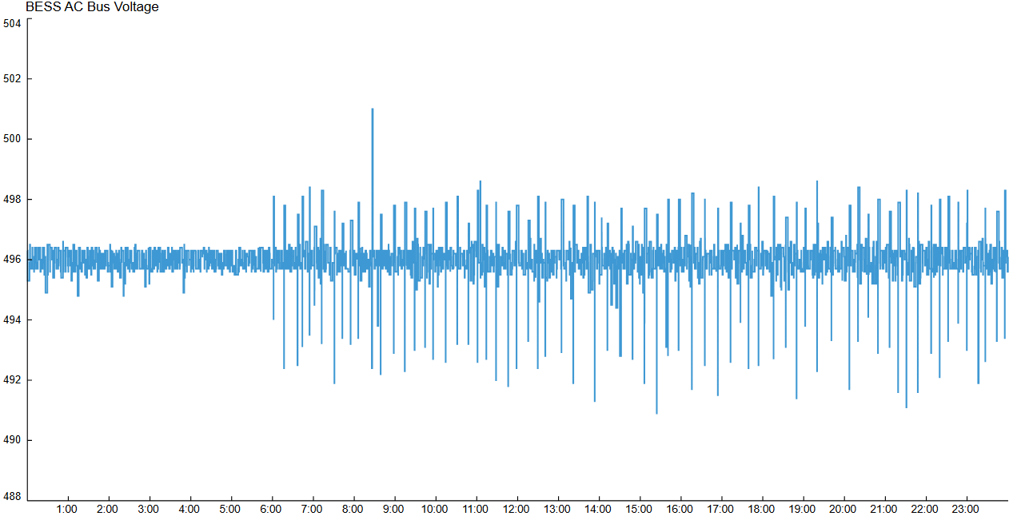
Field Results
Notes:
August 30, 2024 with BESS AVR enabled
Here is what a typical day looks like when AVR is enabled as you can see since it’s a 0 bandwidth it’s much closer to the reference voltage of 496V

Slide 13
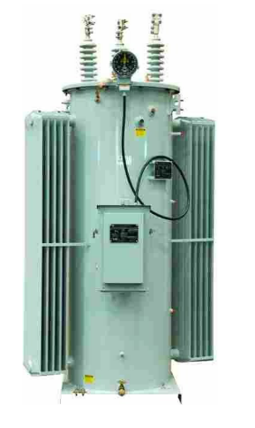
  Circuit Regulator Usage
Every 6 months, facilities manually verified the tap operations in the field
Before the BESS was installed the regulator averaged 171 operations per months
Once the BESS was installed and only the voltage regulator was in use each phase circuit regulator averaged 87 operations per month
  Once installed the BESS absorbed the power from the PV site using Active Power Control, which help stabilize the voltage
After BESS voltage control was activated, each phase circuit regulator dropped to an average of 52 operations per month, a 40% decrease
  Battery was temporary offline 37 days during the 6-month regulator measurement period due to maintenance on the circuit.
  Therefore, we expect the amount of regulator operation to drop further
Notes:
Every 6 months facility goes to the field and manually checks what the tap operation is for that time frame
Before the battery was installed the regulator operated on average 171 times per month
Once the battery was installed each circuit regulator averaged 87 operations per month because the BESS absorbed the power generation form the PV using active power control which help stablized the voltage
Once the BESS voltage control was activated each phase circuit regulator dropped to an average of 52 operations per month which was a 40% decrease
Standard switching procedures that occurred and unrelated maintenance at the Substation caused the BESS to be offline for 37 days during the 6 month study period
Therefore we can predict that the amount of circuit regulator operations will further drop
NOTE:
→We do not have a SCADA point for the tap position on the voltage regulator
→During the Fall, for 37 in total in the Fall, the BESS was offline due to maintenance,

Slide 14
Conclusion & Key Takeaways
Improved Voltage Stability: Enabling the battery inverter’s Automatic Voltage Regulator (AVR) function stabilized the BESS’s AC bus voltage at the substation.
Instant Response: Zero deadband allowed the inverter to respond instantly to voltage deviations, adjusting reactive power output before station circuit regulators operated.
Consistent Voltage Setpoint: Voltage control function maintained a mean absolute error of 0.5%, compared to 2.6% when disabled.
Reduced Regulator Operations: Regulator operations decreased by 40% during the six-month activation period, reducing wear and tear.
Notes:
→Some take aways from this project focuses on improving voltage stability by using the Automatic Voltage Regulator (AVR) function from the battery.
→With the battery we got an instant response verses the voltage regulator that has a delay because you are will operate if the voltage is within a certain bandwith for 30 seconds
→We got a mean absolute error of 0.5% with the battery verses the 2.6% with the voltage regulator
→Overall we reduced the wear and Tear on the voltage regulator and reduced the operations by 40%

Slide 15
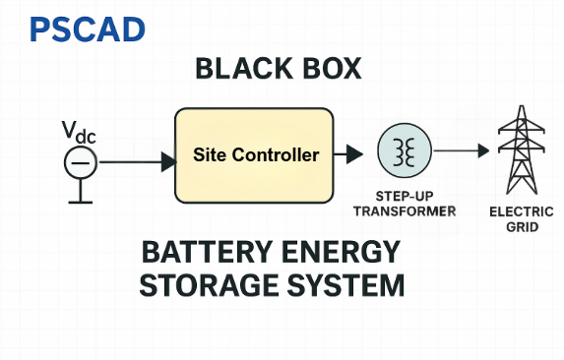
Future Work
Develop a detailed EMT:
  Model including the battery, inverter, and distribution circuit using real field data for the Thevenin equivalent.
Simulate other voltage control functions:
  Direct Reactive Power Command
  Power Factor Control
  Compare other voltage regulating device in PSCAD such as Load Tap Changer (LTC) and Capacitor banks.
Measure inverter wear-and-tear:
  Annually, system round-trip-efficiency is calculated and reported, so changes in round-trip-efficiency since AVR was activated will help guide analysis of inverter wear-and-tear
Exploring Grid Forming Inverters for microgrids
Notes:
NOTES:
Grid forming inverter may be something we explore with this pilot but currently depending on the results of the other pilot project
Currently we have 3 Microgrid projects → One of them is at a customer location and the other two are on the Dominion Facilitates
Test the efficiency of the battery
How much power is pulled in and how much is pushed out
Base on the % of efficiency
If it degrades faster when using AVR in comparison to not using it
The pilot provide is a guide for us for future battery projects to determine if we should enable AVR
Test and see how much this function will damage the inverter (wear and tear on the inverter)

Slide 16
References
Virginia Clean Energy Act (VCEA). 2020. Accessed: Jun. 27, 2024. [Online]. Available: https://lis.virginia.gov/cgi-bin/legp604.exe?201+ful+HB1526ER
Development of a Utility Solar PV Site EMT Model and Power Quality Investigation due to Distributed Solar Generation, S. Banik, G.M. Ilunga, G.B. Alvarez, A.T. Valdez, I.O. Korede, and K.A. Vance, CIGRE USNC Grid of the Future Symposium, Raleigh, NC, Nov. 2024
G. Eason, B. Noble, and I. N. Sneddon, “On certain integrals of Lipschitz-Hankel type involving products of Bessel functions,” Phil. Trans. Roy. Soc. London, vol. A247, pp. 529–551, April 1955. (references)
Dominion Energy, "SmartEnergy - Grid Transformation Plan," Dominion Energy, Apr. 2025. [Online]. Available: https://www.dominionenergy.com/-/media/pdfs/global/smartenergy-grid-transformation-plan.pdf?la=en&rev=848753c5f6e9482bbdae0588ecd10569&hash=8C2906000CD0F2E484702CF80A76F63B.
S. Singh and R. Jha, “IBR performance issues: potential threats to grid stability and security,” 2024. [Online]. Available: https://ieeexplore.ieee.org/
document/10719248

Slide 17


Thank you
Luis Rivera
  Luis.A.Rosa.Rivera@dominionenergy.com
Alexander Freeman
  Alexander.B.Freeman@dominionenergy.com
Genesis Alvarez
Dominion Energy
genesis.b.alvarez@dominionenergy.com

