Slide 1
Fault and disturbance records sharing platform – what it is and why we need it
Dr. Alexander Apostolov
OMICRON electronics

Slide 2
Questions
What are we doing ?
Why are we doing it ?
How are we doing it ?

Slide 3
What are we doing ?
Considering a fault and disturbance records sharing platform

Slide 4
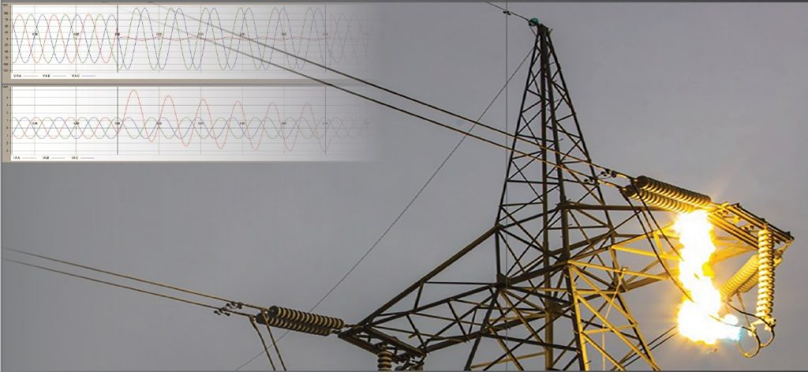
Why are we doing it?
Modern power systems are changing
IEDs and recording systems capture valuable data during system faults
Currently, fault and disturbance records remain confined within organizations
Missed opportunity for broader industry learning and improvement

Slide 5
What is FDR Sharing Platform?
Centralized digital infrastructure for power system fault data
Repository for multiple data types:
Oscillography data from protection relays and IEDs
Sequence of events records
Power quality monitoring data
PMU data and DFR files
System operator contextual notes

Slide 6
Key Components
Secure, scalable database system
Standardization tools (converting to COMTRADE format)
Comprehensive metadata framework
Search and retrieval interface
Integrated analysis tools
Privacy controls for sensitive information
Collaboration features (forums, annotations)

Slide 7
Governance Structure - stakeholders
Utility representatives
Equipment manufacturers
Academic institutions
Industry associations (IEEE PES, CIGRE)
Standards organizations (IEEE, IEC)
Regulatory authorities (advisory capacity)

Slide 8
Current Limitations
Fault data remains isolated within individual organizations
Limited sample sizes for specific fault types
Lack of specialized expertise in many utilities
Incompatible proprietary formats
Privacy and security concerns

Slide 9
Benefits for Utilities and Grid Operators
Benchmarking protection system performance
Knowledge transfer from experienced to newer utilities
Shared analytical capabilities (resource efficiency)
Better understanding of fault characteristics
Improved system design and protection coordination

Slide 10
Benefits for Equipment Manufacturers
Testing protection algorithms against diverse real-world scenarios
Validating new protection functions against historical data
Supporting continuous product improvement
Accelerating innovation in protection systems

Slide 11
Benefits for Academic and Research Institutions
Access to otherwise unavailable real-world data
Validation of theoretical power system models
Educational resource for students
Bridge between classroom theory and field experience

Slide 12
Industry-Wide Benefits
Collaborative analysis of emerging issues
Development of more effective standards
Systematic analysis of fault patterns
Enhanced grid reliability and resilience

Slide 13
Industry-Wide Benefits – AI/ML
Neural networks for fault identification
Predictive maintenance algorithms
Adaptive protection schemes
Deep learning for waveform analysis
Transfer learning across different power systems

Slide 14
Technical Implementation
Cloud-based infrastructure
Balanced architecture (centralized/distributed)
API-driven design for integration
Data standardization (COMTRADE)
Comprehensive taxonomy
Quality guidelines for submissions

Slide 15
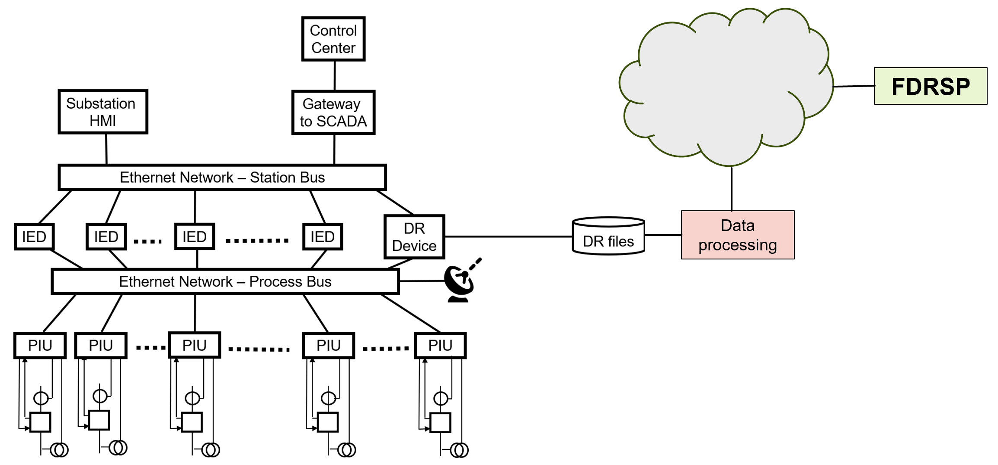
Technical Implementation

Slide 16
Security and Privacy Measures
Data anonymization techniques
Granular access controls
End-to-end encryption
Comprehensive audit trails
Protection of sensitive information

Slide 17
Organizational Implementation
Representative governance model
Transparent decision-making procedures
Dispute resolution mechanisms
Sustainable funding options:
Industry consortium
Tiered membership
Public-private partnerships
Research grants

Slide 18
Participation Incentives
Reciprocity requirements
Recognition programs for contributors
Analytical insights from collective dataset
Regulatory recognition as industry best practice

Slide 19
Implementation Roadmap
Foundation Phase:
Establishing governance and stakeholders
Developing requirements and specifications
Creating data sharing policies
Building basic infrastructure
Initial Deployment Phase
Full Operation Phase
Evolution Phase

Slide 20

Implementation Roadmap

Slide 21
Addressing Potential Challenges
Legal and regulatory concerns
Industry resistance and competitive concerns
Cultural barriers in information sharing
Security risk perceptions
Technical challenges:
Managing enormous datasets
Converting proprietary formats
Ensuring data quality

Slide 22
Potential Applications
Regional utility consortium identifying coordination issues
Equipment manufacturers improving relay performance
Academic researchers discovering new fault signatures
Industry-wide safety improvements

Slide 23
Conclusions
Significant opportunity for the power system protection community
Benefits outweigh implementation challenges
Enhanced protection system design
Improved operational practices
Accelerated research and development
More reliable and resilient power grid

Slide 24
Call to Action
Industry leaders
Professional organizations
Academic institutions
Regulatory bodies
Working together for safe, reliable electrical power

Slide 25


