Slide 1
Improved Multi-Ended Impedance-Based Fault Locating for Untransposed Transmission Lines
Sathish Kumar Mutha, Arun Shrestha, and Sajal Harmukh
Schweitzer Engineering Laboratories, Inc.
© 2025 SEL

Slide 2
Outline
Traditional approach
Background
Untransposed-error analysis
Proposed approach
Sequence coupling line-parameters (Z₂₁ and Z₂₀) estimation
Fault-location estimation
Simulation and field-events results
Limitations

Slide 3
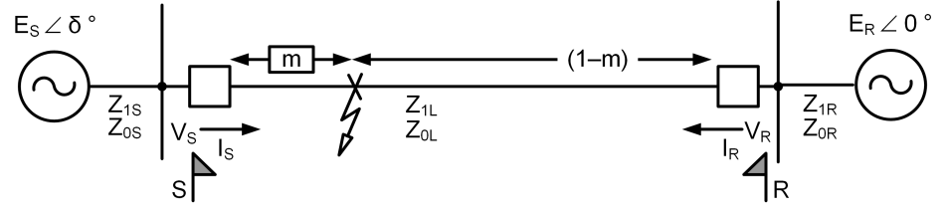
Traditional approach

Slide 4
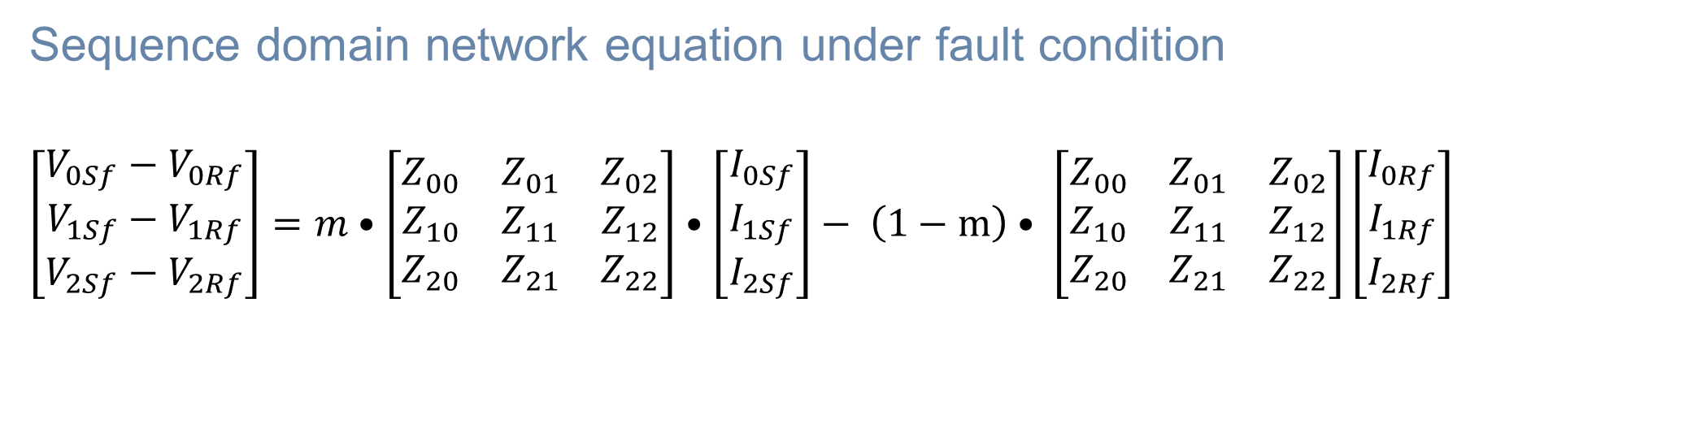
Traditional approach
Sequence domain network equation under fault condition
$$\left[\begin{matrix}V_{0Sf}−V_{0Rf} \\ V_{1Sf}−V_{1Rf} \\ V_{2Sf}−V_{2Rf}\end{matrix}\right]=m•\left[\begin{matrix}Z_{00} & Z_{01} & Z_{02} \\ Z_{10} & Z_{11} & Z_{12} \\ Z_{20} & Z_{21} & Z_{22}\end{matrix}\right]•\left[\begin{matrix}I_{0Sf} \\ I_{1Sf} \\ I_{2Sf}\end{matrix}\right]− \left(1−m\right)• \left[\begin{matrix}Z_{00} & Z_{01} & Z_{02} \\ Z_{10} & Z_{11} & Z_{12} \\ Z_{20} & Z_{21} & Z_{22}\end{matrix}\right]\left[\begin{matrix}I_{0Rf} \\ I_{1Rf} \\ I_{2Rf}\end{matrix}\right]$$

Slide 5
Traditional approach
Sequence domain network equation under fault condition
$$\left[\begin{matrix}V_{0Sf}−V_{0Rf} \\ V_{1Sf}−V_{1Rf} \\ V_{2Sf}−V_{2Rf}\end{matrix}\right]=m•\left[\begin{matrix}Z_{00} & Z_{01} & Z_{02} \\ Z_{10} & Z_{11} & Z_{12} \\ Z_{20} & Z_{21} & Z_{22}\end{matrix}\right]•\left[\begin{matrix}I_{0Sf} \\ I_{1Sf} \\ I_{2Sf}\end{matrix}\right]− \left(1−m\right)• \left[\begin{matrix}Z_{00} & Z_{01} & Z_{02} \\ Z_{10} & Z_{11} & Z_{12} \\ Z_{20} & Z_{21} & Z_{22}\end{matrix}\right]\left[\begin{matrix}I_{0Rf} \\ I_{1Rf} \\ I_{2Rf}\end{matrix}\right]$$
Assume a fully transposed line

Slide 6
Traditional approach
Sequence domain network equation under fault condition
$$\left[\begin{matrix}V_{0Sf}−V_{0Rf} \\ V_{1Sf}−V_{1Rf} \\ V_{2Sf}−V_{2Rf}\end{matrix}\right]=m•\left[\begin{matrix}Z_{00} & Z_{01} & Z_{02} \\ Z_{10} & Z_{11} & Z_{12} \\ Z_{20} & Z_{21} & Z_{22}\end{matrix}\right]•\left[\begin{matrix}I_{0Sf} \\ I_{1Sf} \\ I_{2Sf}\end{matrix}\right]− \left(1−m\right)• \left[\begin{matrix}Z_{00} & Z_{01} & Z_{02} \\ Z_{10} & Z_{11} & Z_{12} \\ Z_{20} & Z_{21} & Z_{22}\end{matrix}\right]\left[\begin{matrix}I_{0Rf} \\ I_{1Rf} \\ I_{2Rf}\end{matrix}\right]$$
0
0
Assume a fully transposed line

Slide 7

Traditional approach
Sequence domain network equation under fault condition
$$\left[\begin{matrix}V_{0Sf}−V_{0Rf} \\ V_{1Sf}−V_{1Rf} \\ V_{2Sf}−V_{2Rf}\end{matrix}\right]=m•\left[\begin{matrix}Z_{00} & 0 & 0 \\ 0 & Z_{11} & 0 \\ 0 & 0 & Z_{22}\end{matrix}\right]•\left[\begin{matrix}I_{0Sf} \\ I_{1Sf} \\ I_{2Sf}\end{matrix}\right]− \left(1−m\right)• \left[\begin{matrix}Z_{00} & 0 & 0 \\ 0 & Z_{11} & 0 \\ 0 & 0 & Z_{22}\end{matrix}\right]\left[\begin{matrix}I_{0Rf} \\ I_{1Rf} \\ I_{2Rf}\end{matrix}\right]$$

Slide 8
Traditional approach
Sequence domain network equation under fault condition
$$\left[\begin{matrix}V_{0Sf}−V_{0Rf} \\ V_{1Sf}−V_{1Rf} \\ V_{2Sf}−V_{2Rf}\end{matrix}\right]=m•\left[\begin{matrix}Z_{00} & 0 & 0 \\ 0 & Z_{11} & 0 \\ 0 & 0 & Z_{22}\end{matrix}\right]•\left[\begin{matrix}I_{0Sf} \\ I_{1Sf} \\ I_{2Sf}\end{matrix}\right]− \left(1−m\right)• \left[\begin{matrix}Z_{00} & 0 & 0 \\ 0 & Z_{11} & 0 \\ 0 & 0 & Z_{22}\end{matrix}\right]\left[\begin{matrix}I_{0Rf} \\ I_{1Rf} \\ I_{2Rf}\end{matrix}\right]$$

Slide 9

Traditional approach – unbalanced faults
Negative-sequence network equation
$$\begin{aligned}V_{2Sf}−V_{2Rf}=m{(Z}_{20}I_{0Sf}+Z_{21}I_{1Sf}+Z_{22}I_{2Sf})−\left(1−m\right)\left(Z_{20}I_{0Rf}+Z_{21}I_{1Rf}+Z_{22}I_{2Rf}\right) \\ \end{aligned}$$

Slide 10
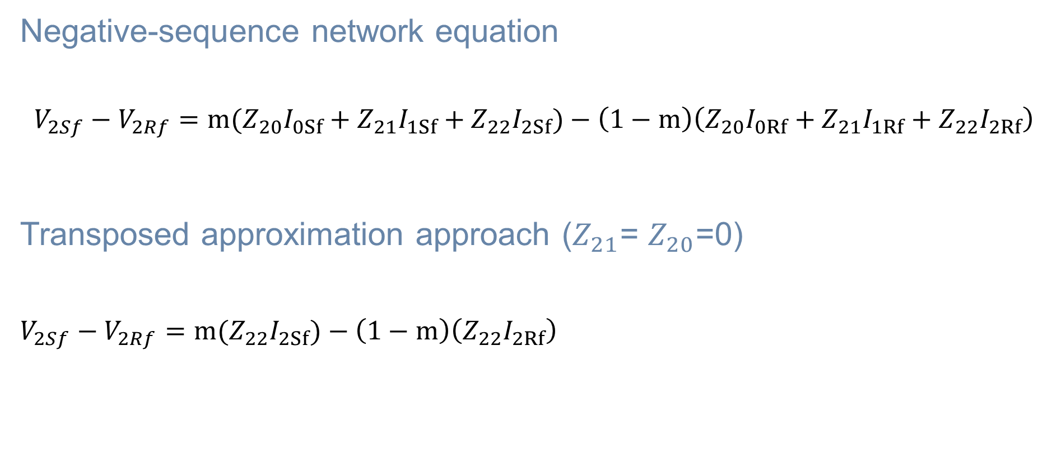
Traditional approach – unbalanced faults
Negative-sequence network equation
$$\begin{aligned}V_{2Sf}−V_{2Rf}=m{(Z}_{20}I_{0Sf}+Z_{21}I_{1Sf}+Z_{22}I_{2Sf})−\left(1−m\right)\left(Z_{20}I_{0Rf}+Z_{21}I_{1Rf}+Z_{22}I_{2Rf}\right) \\ \end{aligned}$$
Transposed approximation approach ($Z_{21}$= $Z_{20}$=0)
$V_{2Sf}−V_{2Rf}=m(Z_{22}I_{2Sf})−\left(1−m\right)\left(Z_{22}I_{2Rf}\right)$

Slide 11
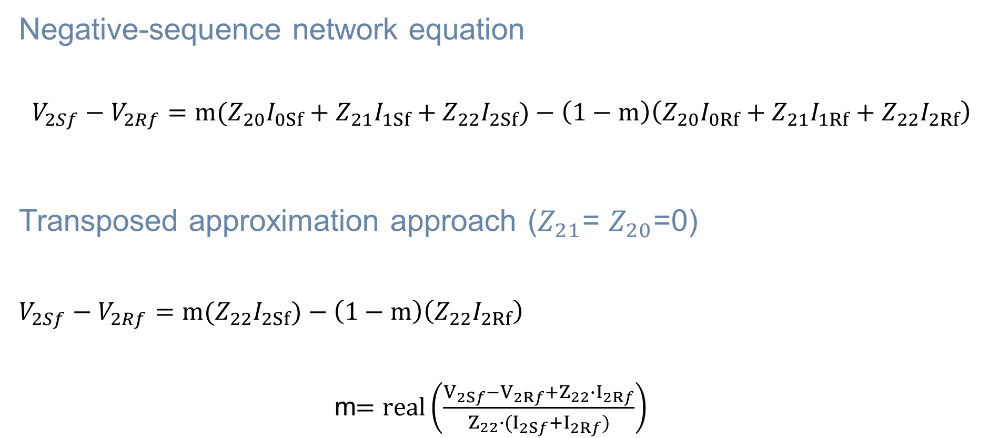
Traditional approach – unbalanced faults
Negative-sequence network equation
$$\begin{aligned}V_{2Sf}−V_{2Rf}=m{(Z}_{20}I_{0Sf}+Z_{21}I_{1Sf}+Z_{22}I_{2Sf})−\left(1−m\right)\left(Z_{20}I_{0Rf}+Z_{21}I_{1Rf}+Z_{22}I_{2Rf}\right) \\ \end{aligned}$$
Transposed approximation approach ($Z_{21}$= $Z_{20}$=0)
$V_{2Sf}−V_{2Rf}=m(Z_{22}I_{2Sf})−\left(1−m\right)\left(Z_{22}I_{2Rf}\right)$
m$=real\left(\frac{V_{2Sf}−V_{2Rf}+Z_{22}∙I_{2Rf}}{Z_{22}∙(I_{2Sf}+I_{2Rf})}\right)$

Slide 12
Traditional approach – unbalanced faults
Negative-sequence network equation
$$\begin{aligned}V_{2Sf}−V_{2Rf}=m{(Z}_{20}I_{0Sf}+Z_{21}I_{1Sf}+Z_{22}I_{2Sf})−\left(1−m\right)\left(Z_{20}I_{0Rf}+Z_{21}I_{1Rf}+Z_{22}I_{2Rf}\right) \\ \end{aligned}$$
Transposed approximation approach ($Z_{21}$= $Z_{20}$=0)
$V_{2Sf}−V_{2Rf}=m(Z_{22}I_{2Sf})−\left(1−m\right)\left(Z_{22}I_{2Rf}\right)$
m$=real\left(\frac{V_{2Sf}−V_{2Rf}+Z_{22}∙I_{2Rf}}{Z_{22}∙(I_{2Sf}+I_{2Rf})}\right)$
Errors in Traditional Approach

Slide 13

Untransposed-error analysis
Error terms in traditional approach
$\begin{aligned}m{(Z}_{20}I_{0Sf}+Z_{21}I_{1Sf})− \\ \left(1−m\right)\left(Z_{20}I_{0Rf}+Z_{21}I_{1Rf}\right)\#\end{aligned}$

Slide 14
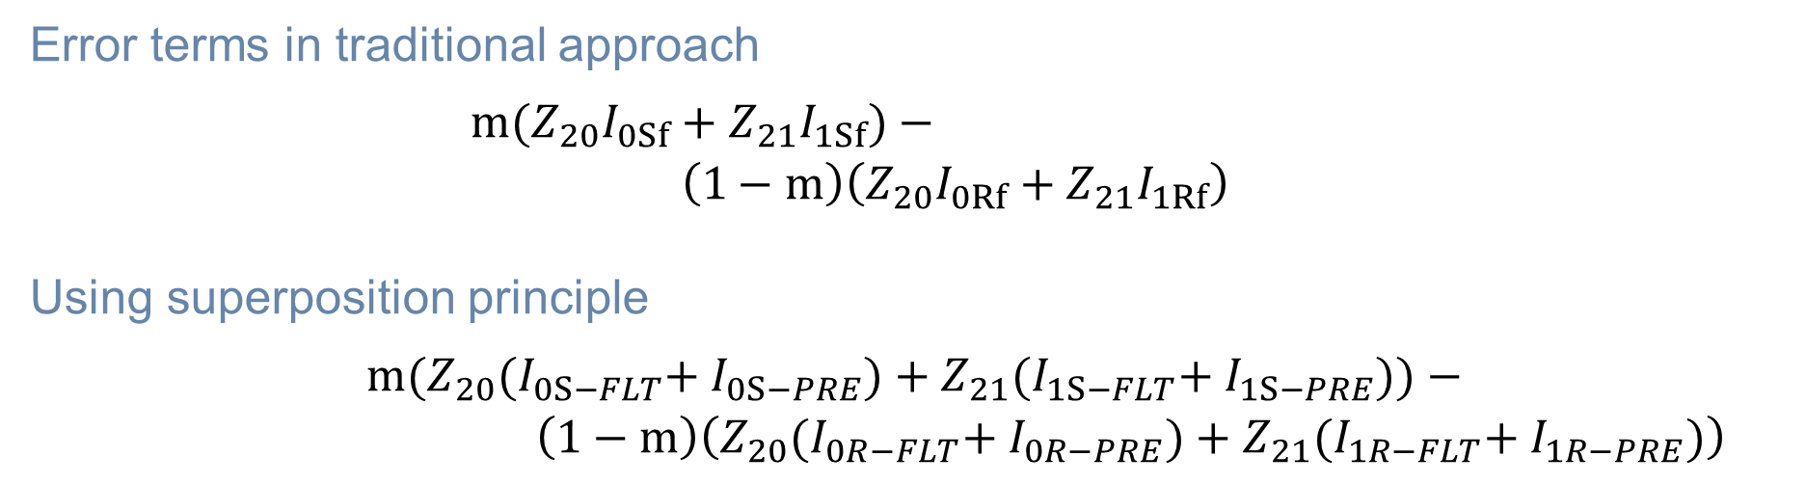
Untransposed-error analysis
Error terms in traditional approach
$\begin{aligned}m{(Z}_{20}I_{0Sf}+Z_{21}I_{1Sf})− \\ \left(1−m\right)\left(Z_{20}I_{0Rf}+Z_{21}I_{1Rf}\right)\#\end{aligned}$
Using superposition principle
$$\begin{aligned}m{(Z}_{20}{(I}_{0S−FLT}{+ I}_{0S−PRE})+Z_{21}{(I}_{1S−FLT}{+ I}_{1S−PRE}))− \\ \left(1−m\right)\left(Z_{20}{(I}_{0R−FLT}{+ I}_{0R−PRE})+Z_{21}{(I}_{1R−FLT}{+ I}_{1R−PRE})\right)\#\end{aligned}$$

Slide 15
Untransposed-error analysis
Error terms in traditional approach
$\begin{aligned}m{(Z}_{20}I_{0Sf}+Z_{21}I_{1Sf})− \\ \left(1−m\right)\left(Z_{20}I_{0Rf}+Z_{21}I_{1Rf}\right)\#\end{aligned}$
Using superposition principle
$$\begin{aligned}m{(Z}_{20}{(I}_{0S−FLT}{+ I}_{0S−PRE})+Z_{21}{(I}_{1S−FLT}{+ I}_{1S−PRE}))− \\ \left(1−m\right)\left(Z_{20}{(I}_{0R−FLT}{+ I}_{0R−PRE})+Z_{21}{(I}_{1R−FLT}{+ I}_{1R−PRE})\right)\#\end{aligned}$$

Slide 16
Untransposed-error analysis
Error terms in traditional approach
$\begin{aligned}m{(Z}_{20}I_{0Sf}+Z_{21}I_{1Sf})− \\ \left(1−m\right)\left(Z_{20}I_{0Rf}+Z_{21}I_{1Rf}\right)\#\end{aligned}$
Using superposition principle
$$\begin{aligned}m{(Z}_{20}{(I}_{0S−FLT}{+ I}_{0S−PRE})+Z_{21}{(I}_{1S−FLT}{+ I}_{1S−PRE}))− \\ \left(1−m\right)\left(Z_{20}{(I}_{0R−FLT}{+ I}_{0R−PRE})+Z_{21}{(I}_{1R−FLT}{+ I}_{1R−PRE})\right)\#\end{aligned}$$

Slide 17
Untransposed-error analysis
Error terms in traditional approach
$\begin{aligned}m{(Z}_{20}I_{0Sf}+Z_{21}I_{1Sf})− \\ \left(1−m\right)\left(Z_{20}I_{0Rf}+Z_{21}I_{1Rf}\right)\#\end{aligned}$
Using superposition principle
$$\begin{aligned}m{(Z}_{20}{(I}_{0S−FLT}{+ I}_{0S−PRE})+Z_{21}{(I}_{1S−FLT}{+ I}_{1S−PRE}))− \\ \left(1−m\right)\left(Z_{20}{(I}_{0R−FLT}{+ I}_{0R−PRE})+Z_{21}{(I}_{1R−FLT}{+ I}_{1R−PRE})\right)\#\end{aligned}$$

Slide 18
Untransposed-error analysis
Error terms in traditional approach
$\begin{aligned}m{(Z}_{20}I_{0Sf}+Z_{21}I_{1Sf})− \\ \left(1−m\right)\left(Z_{20}I_{0Rf}+Z_{21}I_{1Rf}\right)\#\end{aligned}$
Using superposition principle
$$\begin{aligned}m{(Z}_{20}{(I}_{0S−FLT}{+ I}_{0S−PRE})+Z_{21}{(I}_{1S−FLT}{+ I}_{1S−PRE}))− \\ \left(1−m\right)\left(Z_{20}{(I}_{0R−FLT}{+ I}_{0R−PRE})+Z_{21}{(I}_{1R−FLT}{+ I}_{1R−PRE})\right)\#\end{aligned}$$

Slide 19
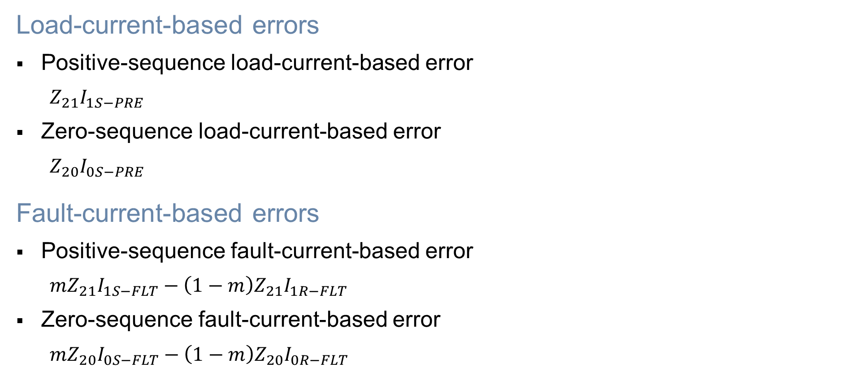
Untransposed-error analysis
Load-current-based errors
Positive-sequence load-current-based error
$$Z_{21}I_{1S−PRE}$$
Zero-sequence load-current-based error
$$Z_{20}I_{0S−PRE}$$
Fault-current-based errors
Positive-sequence fault-current-based error
$${mZ}_{21}I_{1S−FLT}−\left(1−m\right)Z_{21}I_{1R−FLT}$$
Zero-sequence fault-current-based error
$${mZ}_{20}I_{0S−FLT}−\left(1−m\right)Z_{20}I_{0R−FLT}$$

Slide 20
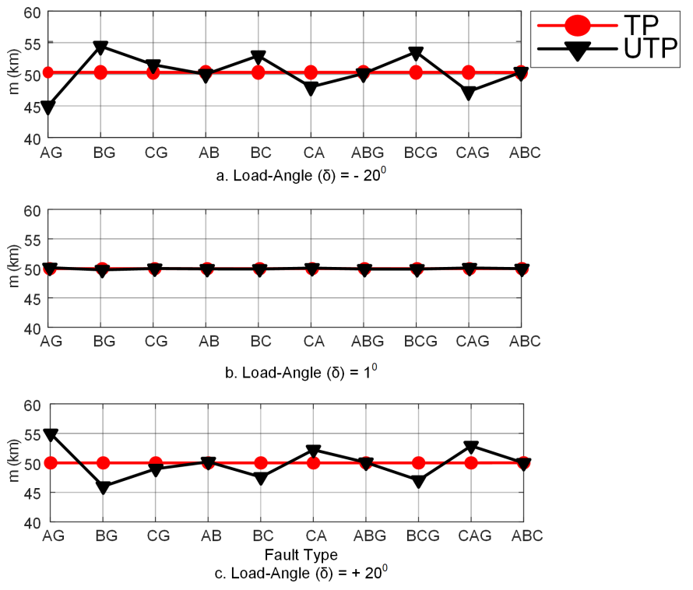
Traditional approach – simulation results
FL estimates – 400 kV system horizontal tower configuration
Source-impedance ratios,
SIR_{S} = 1
SIR_{R} = 1
Fault location = 50 km
Line length = 100 km
TP = Transposed line UTP = Untransposed line

Slide 21
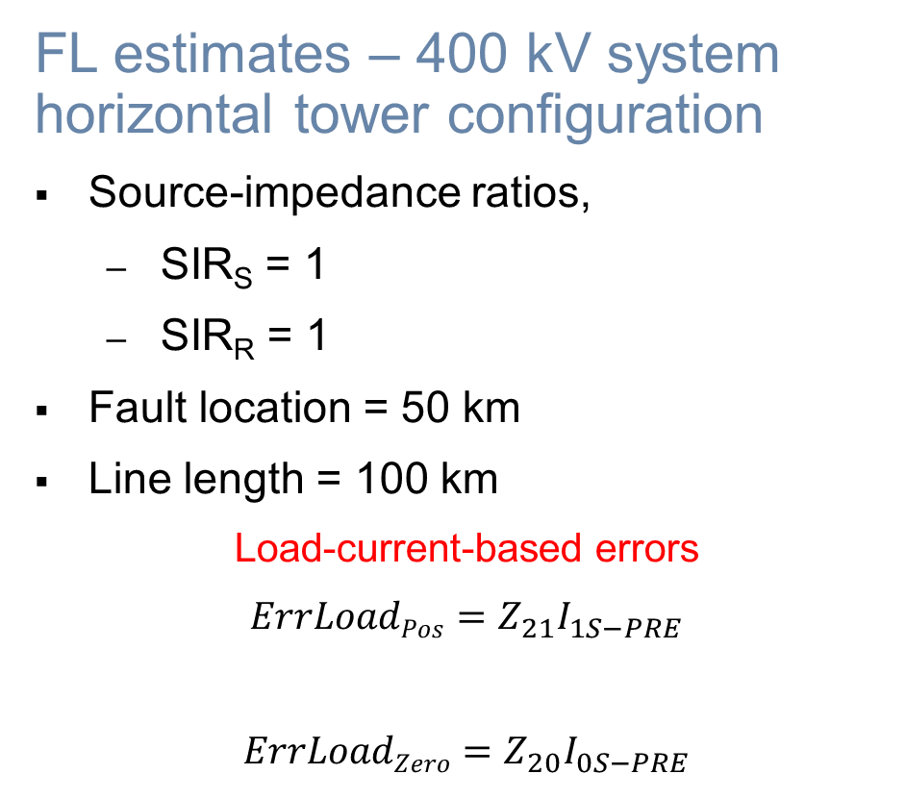
Traditional approach – simulation results
FL estimates – 400 kV system horizontal tower configuration
Source-impedance ratios,
SIR_{S} = 1
SIR_{R} = 1
Fault location = 50 km
Line length = 100 km
Load-current-based errors
$${ErrLoadPos=Z}_{21}I_{1S−PRE}$$
$${ErrLoadZero=Z}_{20}I_{0S−PRE}$$
TP = Transposed line UTP = Untransposed line

Slide 22
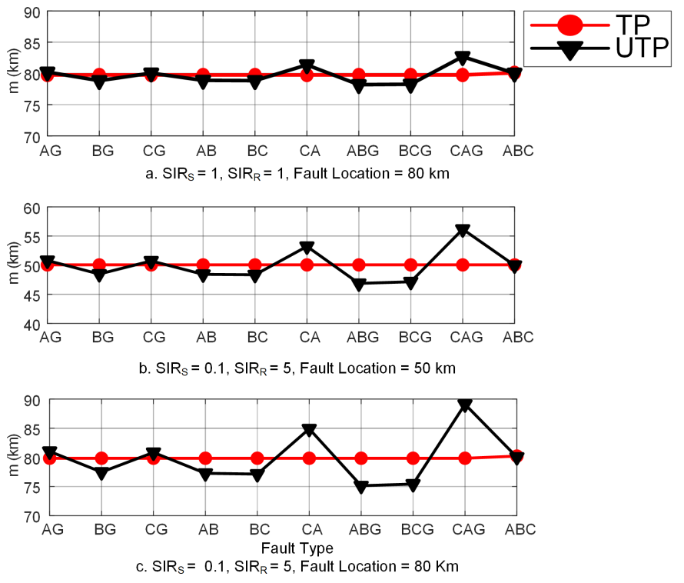
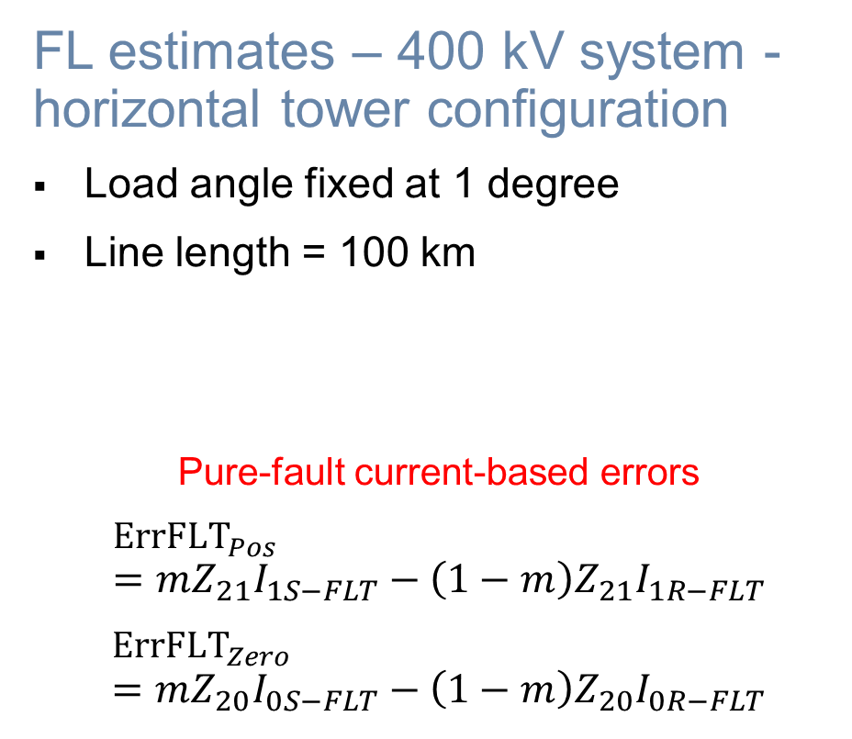
Traditional approach – simulation results
FL estimates – 400 kV system - horizontal tower configuration
Load angle fixed at 1 degree
Line length = 100 km
Pure-fault current-based errors
$${ErrFLT}_{Pos}={mZ}_{21}I_{1S−FLT}−\left(1−m\right)Z_{21}I_{1R−FLT}$$
$${ErrFLT}_{Zero} \\ ={mZ}_{20}I_{0S−FLT}−\left(1−m\right)Z_{20}I_{0R−FLT}$$

Slide 23
Traditional approach – simulation results
FL estimates – 400 kV system - horizontal tower configuration
Load angle fixed at 1 degree
Line length = 100 km
Pure-fault current-based errors
$${ErrFLT}_{Pos}={mZ}_{21}I_{1S−FLT}−\left(1−m\right)Z_{21}I_{1R−FLT}$$
$${ErrFLT}_{Zero} \\ ={mZ}_{20}I_{0S−FLT}−\left(1−m\right)Z_{20}I_{0R−FLT}$$

Slide 24
Traditional approach – simulation results
FL estimates – 400 kV system - horizontal tower configuration
Load angle fixed at 1 degree
Line length = 100 km
Pure-fault current-based errors
$${ErrFLT}_{Pos}={mZ}_{21}I_{1S−FLT}−\left(1−m\right)Z_{21}I_{1R−FLT}$$
$${ErrFLT}_{Zero} \\ ={mZ}_{20}I_{0S−FLT}−\left(1−m\right)Z_{20}I_{0R−FLT}$$

Slide 25
Traditional approach – simulation results
FL estimates – 400 kV system - horizontal tower configuration
Load angle fixed at 1 degree
Line length = 100 km
Pure-fault current-based errors
$${ErrFLT}_{Pos}={mZ}_{21}I_{1S−FLT}−\left(1−m\right)Z_{21}I_{1R−FLT}$$
$${ErrFLT}_{Zero} \\ ={mZ}_{20}I_{0S−FLT}−\left(1−m\right)Z_{20}I_{0R−FLT}$$

Slide 26
Traditional approach – simulation results
FL estimates – 400 kV system - horizontal tower configuration
Load angle fixed at 1 degree
Line length = 100 km
Pure-fault current-based errors
$${ErrFLT}_{Pos}={mZ}_{21}I_{1S−FLT}−\left(1−m\right)Z_{21}I_{1R−FLT}$$
$${ErrFLT}_{Zero} \\ ={mZ}_{20}I_{0S−FLT}−\left(1−m\right)Z_{20}I_{0R−FLT}$$

Slide 27

Parameters neglected in traditional approach
Summary – errors
$Z_{21}I_{1S−PRE}$
$Z_{20}I_{0S−PRE}$
${mZ}_{21}I_{1S−FLT}−\left(1−m\right)Z_{21}I_{1R−FLT}$
${mZ}_{20}I_{0S−FLT}−\left(1−m\right)Z_{20}I_{0R−FLT}$

Slide 28
Parameters neglected in traditional approach
Summary – errors
$Z_{21}I_{1S−PRE}$
$Z_{20}I_{0S−PRE}$
${mZ}_{21}I_{1S−FLT}−\left(1−m\right)Z_{21}I_{1R−FLT}$
${mZ}_{20}I_{0S−FLT}−\left(1−m\right)Z_{20}I_{0R−FLT}$
Z₂₁ – sequence impedance coupling from positive-sequence network to negative-sequence network

Slide 29
Parameters neglected in traditional approach
Summary – errors
$Z_{21}I_{1S−PRE}$
$Z_{20}I_{0S−PRE}$
${mZ}_{21}I_{1S−FLT}−\left(1−m\right)Z_{21}I_{1R−FLT}$
${mZ}_{20}I_{0S−FLT}−\left(1−m\right)Z_{20}I_{0R−FLT}$
Z₂₁ – sequence impedance coupling from positive-sequence network to negative-sequence network
Z₂₀ – sequence impedance coupling from zero-sequence network to negative-sequence network

Slide 30
Proposed approach – unbalanced faults

Slide 31
Proposed approach – unbalanced faults
Estimates Z₂₁ and Z₂₀ using pre-fault data

Slide 32
Proposed approach – unbalanced faults
Estimates Z₂₁ and Z₂₀ using pre-fault data
Includes Z₂₁ and Z₂₀ in faulted negative-sequence network

Slide 33
Proposed approach – unbalanced faults
Estimates Z₂₁ and Z₂₀ using pre-fault data
Includes Z₂₁ and Z₂₀ in faulted negative-sequence network
Solves network for fault location

Slide 34
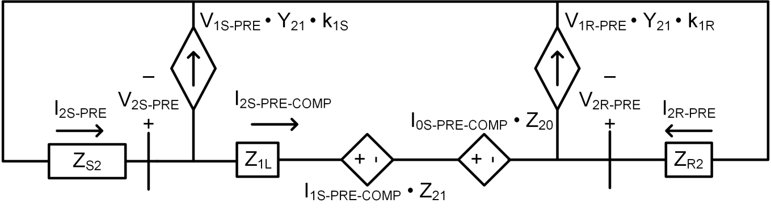
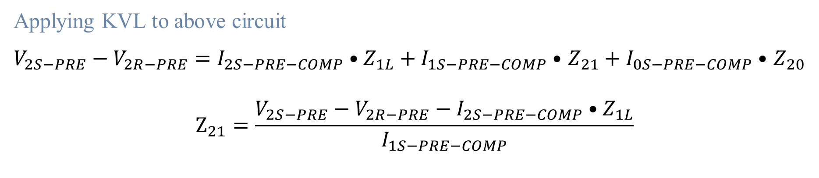
Z₂₁ estimation
Pre-fault negative-sequence network
Applying KVL to above circuit
$V_{2S−PRE}−V_{2R−PRE}=I_{2S−PRE−COMP}•Z_{1L}+I_{1S−PRE−COMP}•$ $Z_{21}+I_{0S−PRE−COMP}•$ $Z_{20}$
$$Z_{21}=\frac{V_{2S−PRE}−V_{2R−PRE}−I_{2S−PRE−COMP}•Z_{1L}}{I_{1S−PRE−COMP}}$$

Slide 35


Z₂₀ estimation
Interesting symmetry in sequence domain
$Z_{20}=Z_{01}$
$$\left[\begin{matrix}Z_{00} & Z_{01} & Z_{02} \\ Z_{10}=Z_{02} & Z_{11} & Z_{12} \\ Z_{20}=Z_{01} & Z_{21} & Z_{22}=Z_{11}\end{matrix}\right]$$
(Single-circuit Tx line sequence impedance matrix)

Slide 36
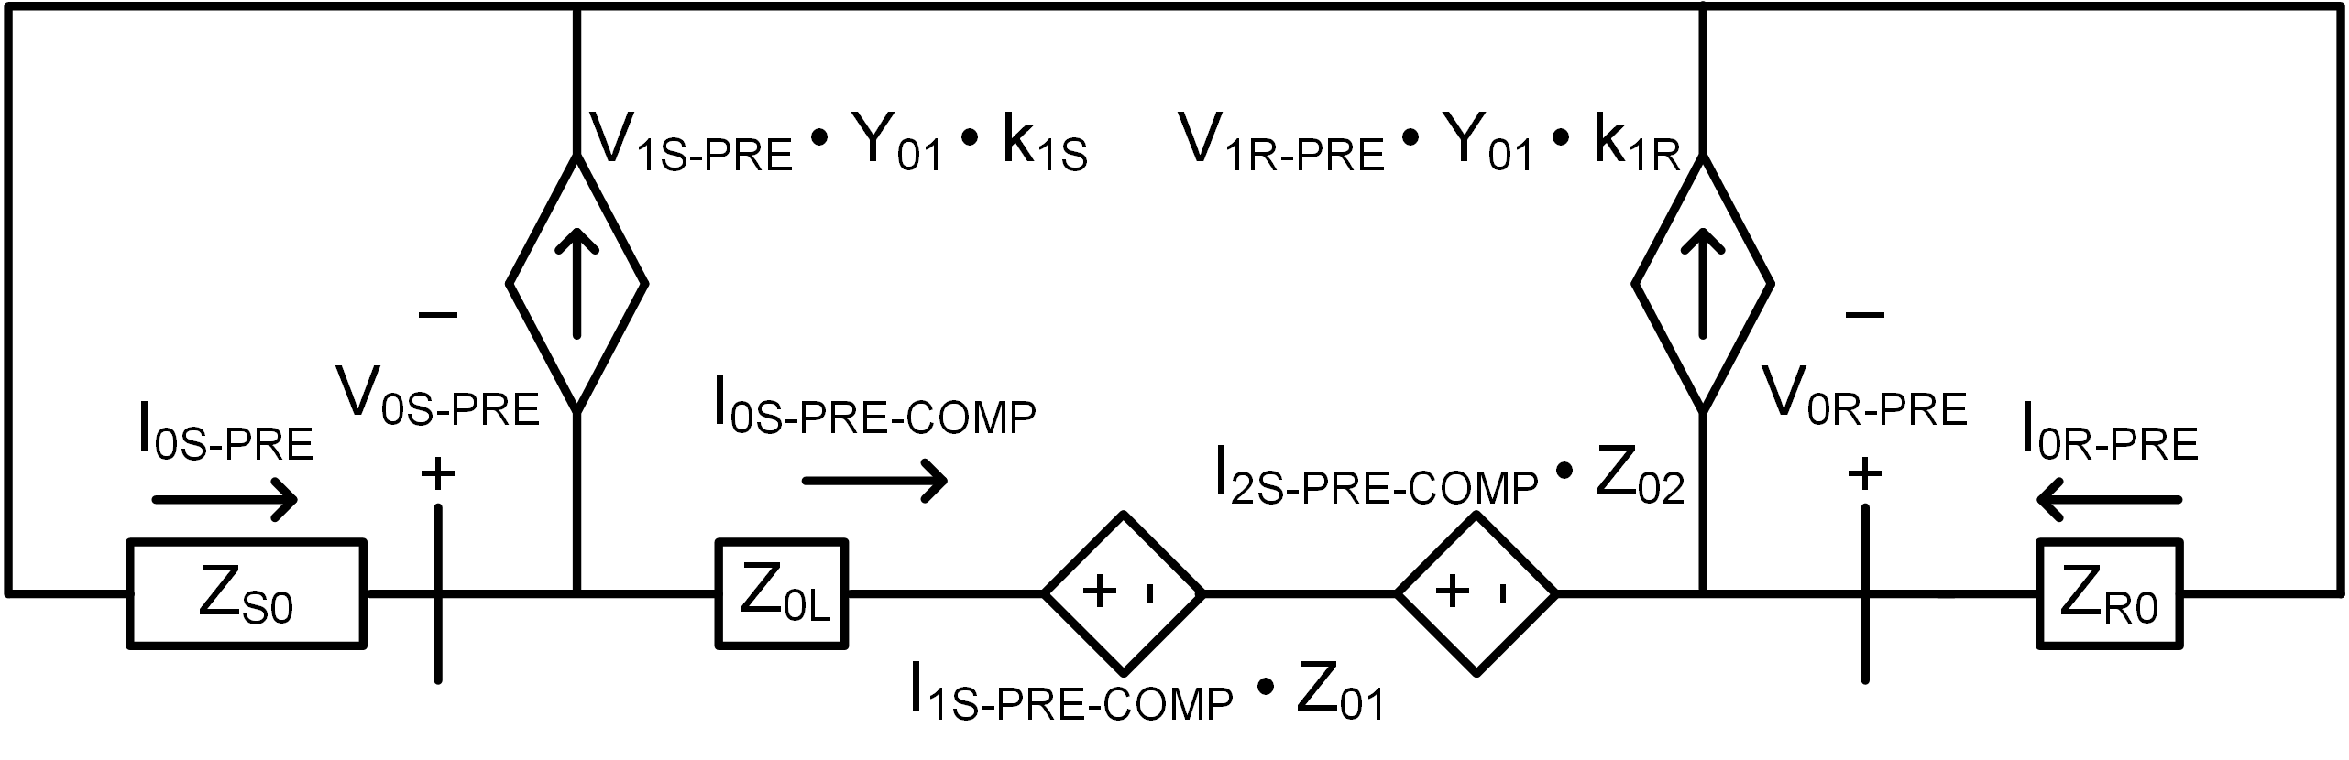
Z₀₁ estimation
Pre-fault zero-sequence network

Slide 37
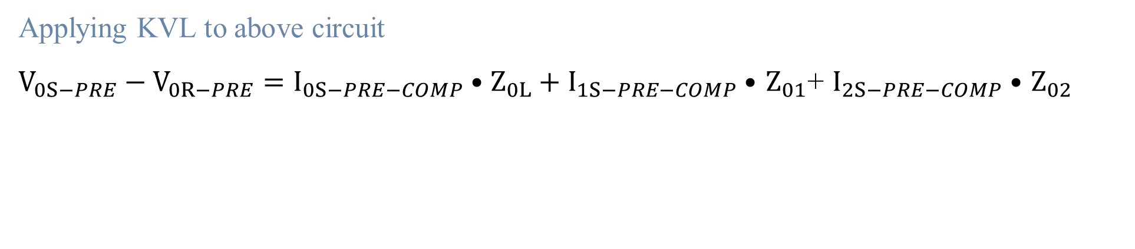
Z₀₁ estimation
Pre-fault zero-sequence network
Applying KVL to above circuit
$V_{0S−PRE}−V_{0R−PRE}=I_{0S−PRE−COMP}•Z_{0L}+I_{1S−PRE−COMP}•$ $Z_{01}$+ $I_{2S−PRE−COMP}•$ $Z_{02}$

Slide 38
Z₀₁ estimation
Pre-fault zero-sequence network
Applying KVL to above circuit
$V_{0S−PRE}−V_{0R−PRE}=I_{0S−PRE−COMP}•Z_{0L}+I_{1S−PRE−COMP}•$ $Z_{01}$+ $I_{2S−PRE−COMP}•$ $Z_{02}$

Slide 39
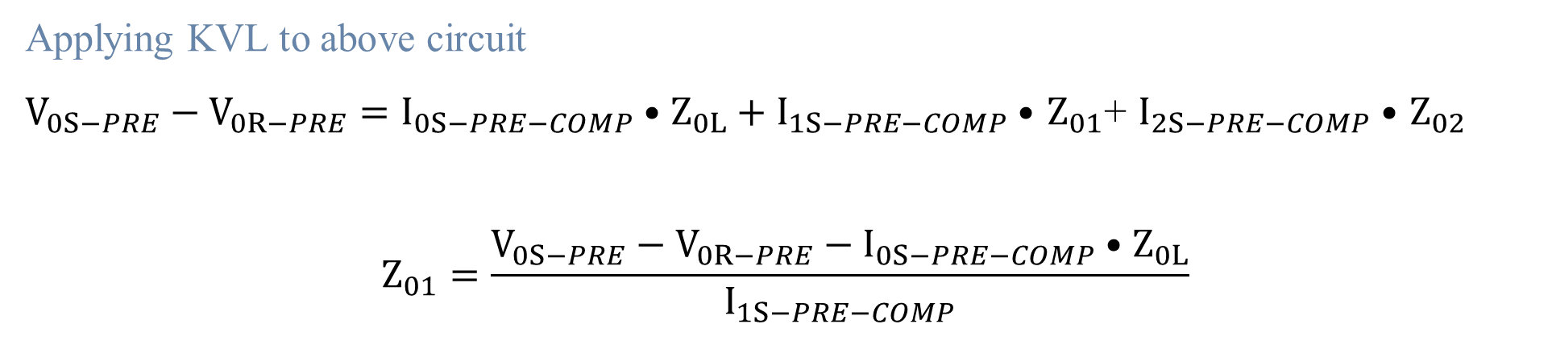
Z₀₁ estimation
Pre-fault zero-sequence network
Applying KVL to above circuit
$V_{0S−PRE}−V_{0R−PRE}=I_{0S−PRE−COMP}•Z_{0L}+I_{1S−PRE−COMP}•$ $Z_{01}$+ $I_{2S−PRE−COMP}•$ $Z_{02}$
$$Z_{01}=\frac{V_{0S−PRE}−V_{0R−PRE}−I_{0S−PRE−COMP}•Z_{0L}}{I_{1S−PRE−COMP}}$$

Slide 40
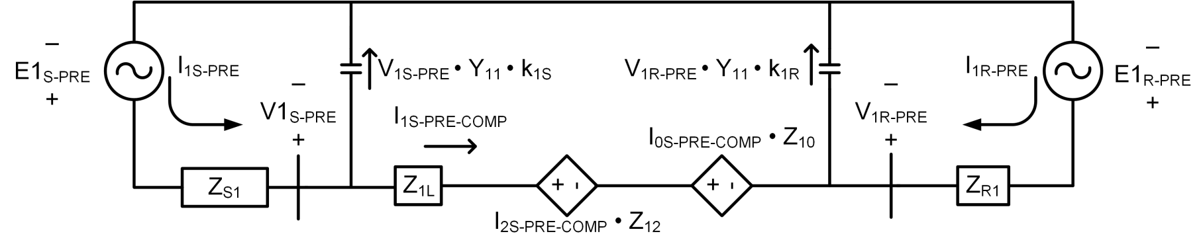
Y₁₁ estimation
Pre-fault positive-sequence network

Slide 41

Y₁₁ estimation
Pre-fault positive-sequence network
$k_{1x}=\left|\frac{V_{1x−PRE}}{V_{1S−PRE}+V_{1R−PRE}}\right|$ (x = S, R)

Slide 42

Y₁₁ estimation
Pre-fault positive-sequence network
$k_{1x}=\left|\frac{V_{1x−PRE}}{V_{1S−PRE}+V_{1R−PRE}}\right|$ (x = S, R)
Apply KCL to above circuit
$$Y_{11}=\frac{I_{1S−PRE}+I_{1R−PRE}}{k_{1S}•V_{1S−PRE}+k_{1R}•V_{1R−PRE}}$$

Slide 43

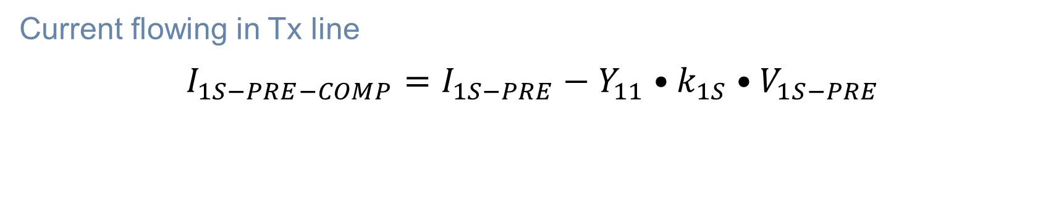
I₁ compensation
Pre-fault positive-sequence network
Current flowing in Tx line
$$I_{1S−PRE−COMP}=I_{1S−PRE}−Y_{11}•k_{1S}•V_{1S−PRE}$$

Slide 44
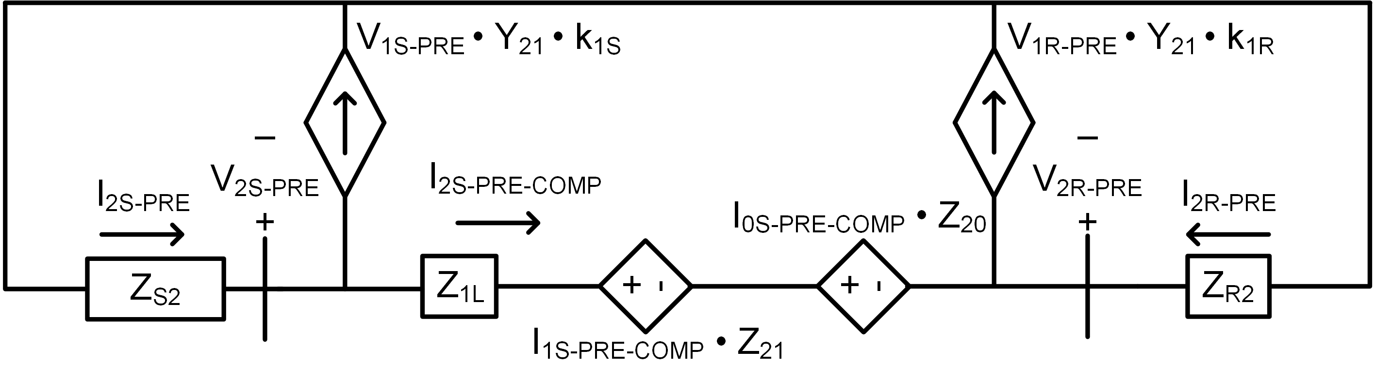
Y₂₁ estimation and I₂ compensation
Pre-fault negative-sequence network

Slide 45

Y₂₁ estimation and I₂ compensation
Pre-fault negative-sequence network
Apply KCL to above circuit
$$Y_{21}=\frac{I_{2S−PRE}+I_{2R−PRE}}{k_{1S}•V_{1S−PRE}+k_{1R}•V_{1R−PRE}}$$

Slide 46

Y₂₁ estimation and I₂ compensation
Pre-fault negative-sequence network
Apply KCL to above circuit
$$Y_{21}=\frac{I_{2S−PRE}+I_{2R−PRE}}{k_{1S}•V_{1S−PRE}+k_{1R}•V_{1R−PRE}}$$
Current flowing in Tx line
$$I_{2S−PRE−COMP}=I_{2S−PRE}−Y_{21}•k_{1S}•V_{1S−PRE}$$

Slide 47
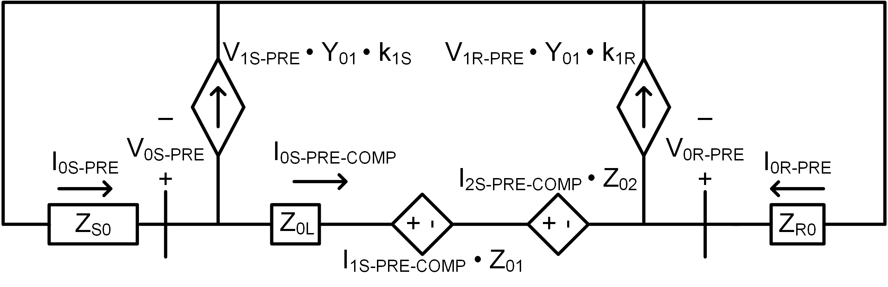

Y₀₁ estimation and I₀ compensation
Pre-fault zero-sequence network
Apply KCL to above circuit
$$Y_{01}=\frac{I_{0S−PRE}+I_{0R−PRE}}{k_{1S}•V_{1S−PRE}+k_{1R}•V_{1R−PRE}}$$
Current flowing in Tx line
$$I_{0S−PRE−COMP}=I_{0S−PRE}−Y_{01}•k_{1S}•V_{1S−PRE}$$

Slide 48
Summary – steps for Z₂₁ and Z₂₀ estimation
Estimate admittance distribution factors (k_{1S} and k_{1R})
Estimate admittance line parameters (Y₁₁, Y₂₁, and Y₀₁)
Compensate sequence currents (I₁, I₂, and I₀)
Estimate Z₂₁ using negative-sequence network Estimate Z₂₀ using zero-sequence network

Slide 49
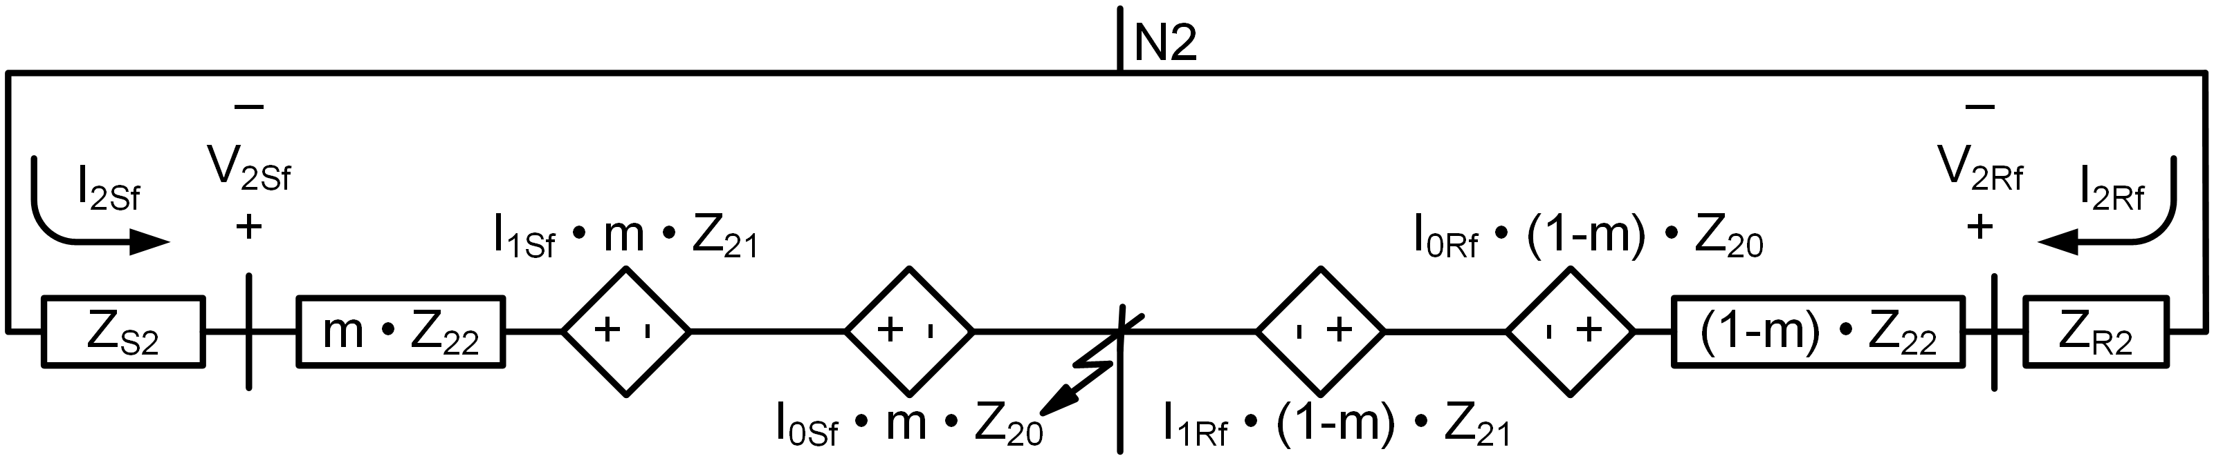
Proposed approach – unbalanced faults
Faulted negative-sequence network

Slide 50
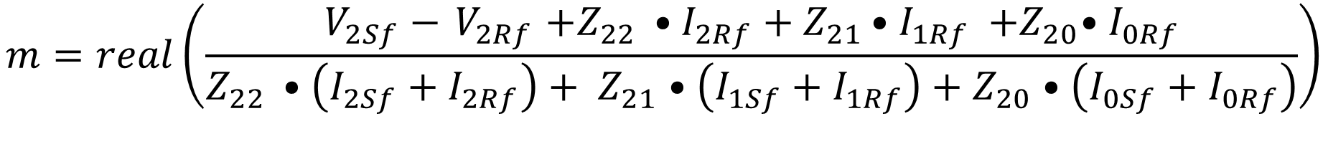
Proposed approach – unbalanced faults
Faulted negative-sequence network
$$m=real\left(\frac{V_{2Sf}−{ V}_{2Rf }+Z_{22 }•I_{2Rf}+{ Z}_{21 }•I_{1Rf} {+Z}_{20}•{ I}_{0Rf}}{Z_{22 }•\left(I_{2Sf}+I_{2Rf}\right)+ Z_{21}•\left(I_{1Sf}+I_{1Rf}\right)+Z_{20}•\left(I_{0Sf}+I_{0Rf}\right)}\right)$$

Slide 51
Phasor simulation results
Systems tested
400 kV system – single-circuit transmission line with horizontal tower configuration
400 kV system – single-circuit transmission line with vertical tower configuration
230 kV system – single-circuit transmission line with right-triangle tower configuration
230 kV system – double-circuit transmission line
400 kV system – double-circuit transmission line
System conditions
SIR_{S} = 0.1 – SIR_{R} varied from 1 to 5 in steps of 0.5
SIR_{S} = 1 – SIR_{R} varied from 1 to 5 in steps of 0.5

Slide 52
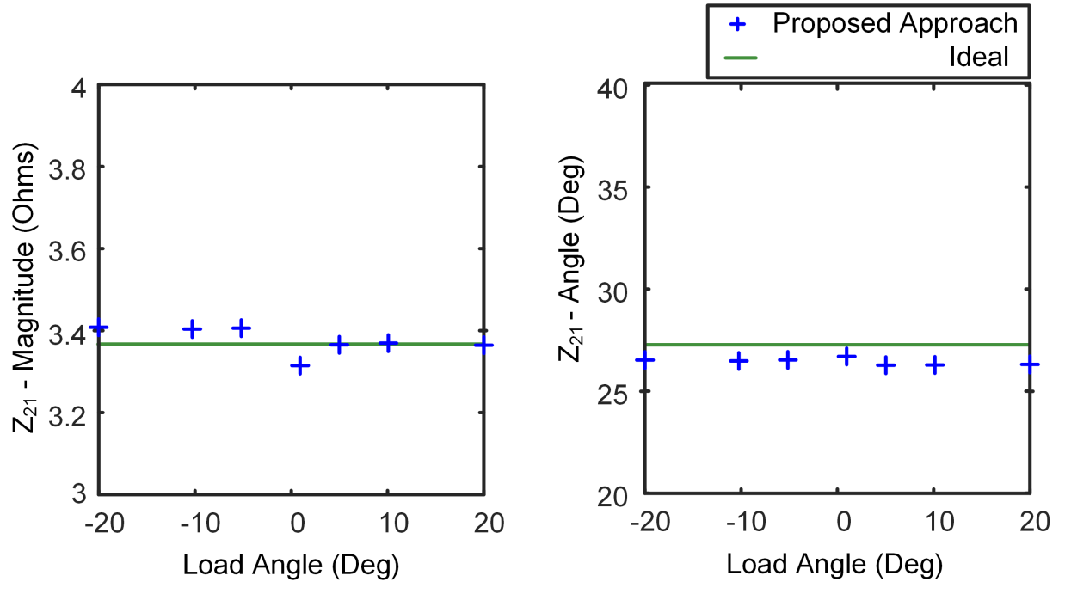
Phasor simulation results
Z₂₁ estimates – 400 kV system, horizontal tower configuration
SIR_{S} = 0.1
SIR_{R} = 1
Z₂₁ Mag error < 1.2%
Z₂₁ Ang error < 1 deg

Slide 53
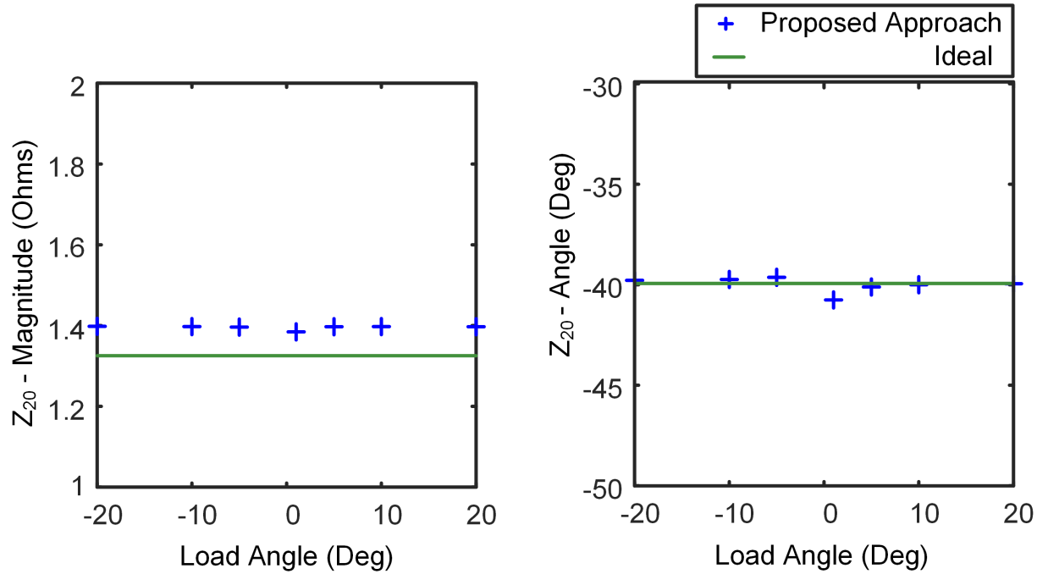
Phasor simulation results
Z₂₀ estimates – 400 kV system, horizontal tower configuration
SIR_{S} = 0.1
SIR_{R} = 1
Z₂₀ Mag error < 5.5 %
Z₂₀ Ang error < 0.5 deg

Slide 54
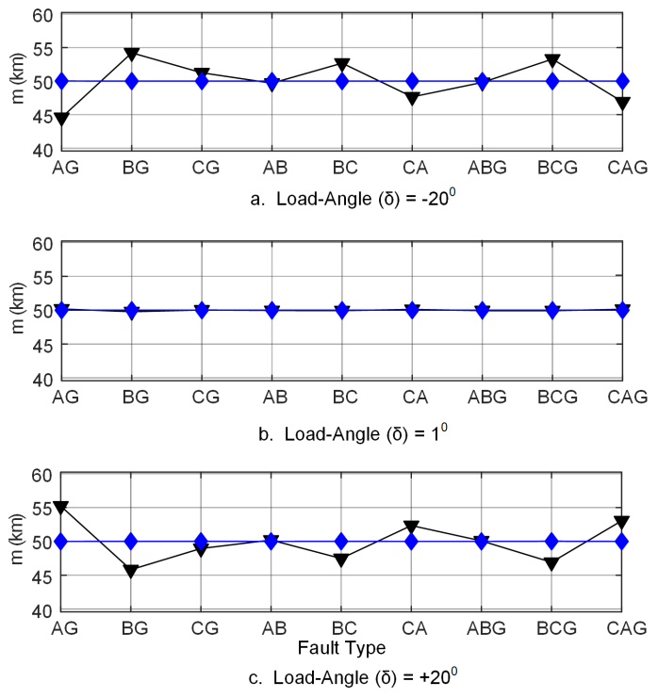
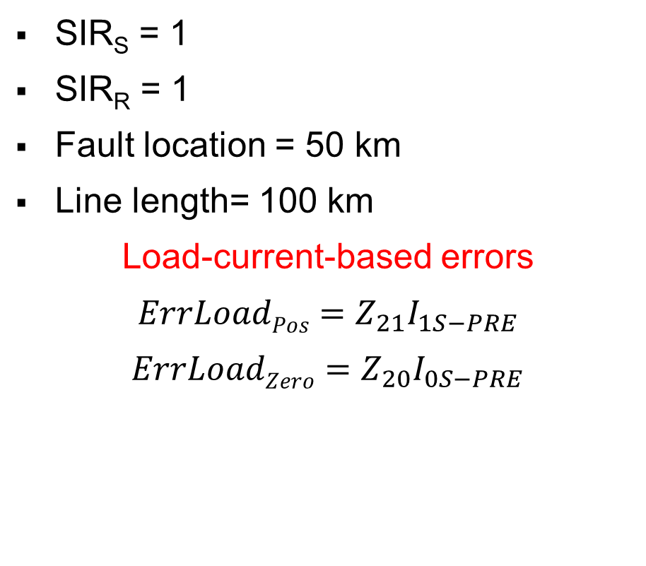
Phasor simulation results
FL estimates – 400 kV system, horizontal tower configuration
SIR_{S} = 1
SIR_{R} = 1
Fault location = 50 km
Line length= 100 km
Load-current-based errors
$${ErrLoadPos=Z}_{21}I_{1S−PRE}$$
$${ErrLoadZero=Z}_{20}I_{0S−PRE}$$

Slide 55
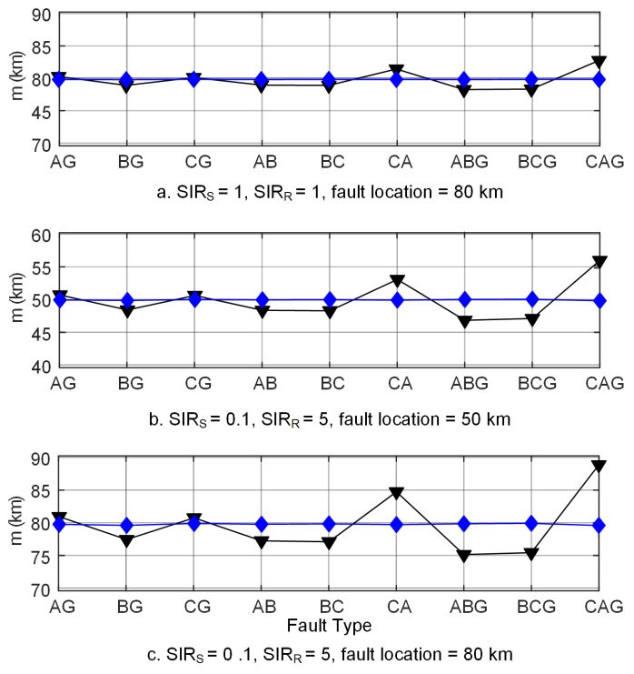
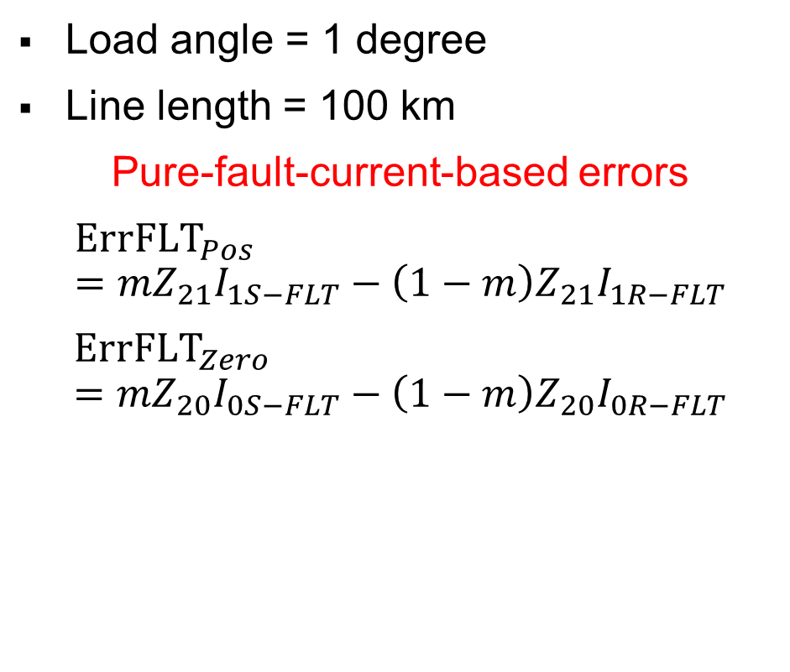
Phasor simulation results
FL estimates – 400 kV system, horizontal tower configuration
Load angle = 1 degree
Line length = 100 km
Pure-fault-current-based errors
$${ErrFLT}_{Pos}={mZ}_{21}I_{1S−FLT}−\left(1−m\right)Z_{21}I_{1R−FLT}$$
$${ErrFLT}_{Zero}={mZ}_{20}I_{0S−FLT}−\left(1−m\right)Z_{20}I_{0R−FLT}$$

Slide 56
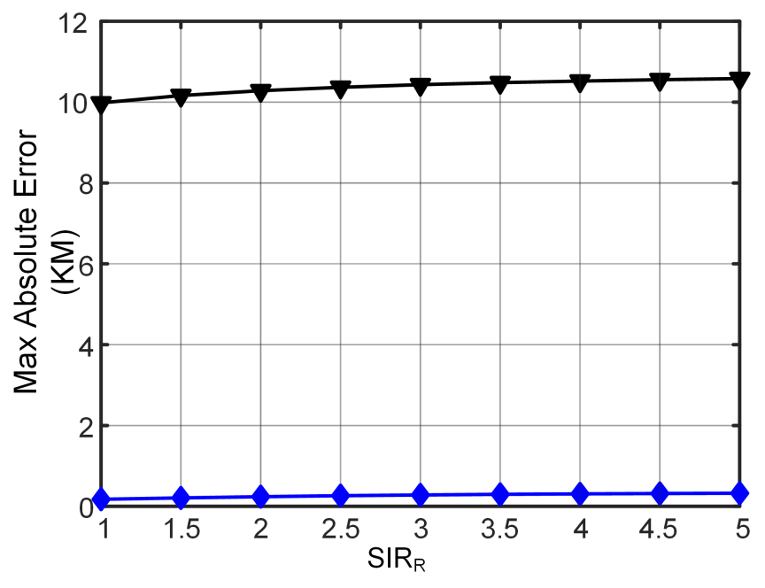
Phasor simulation results
Worst-case FL error – 400 kV system, horizontal tower configuration
Simulation test variables
SIR_{S} = 0.1
Fault locations (km) -> 30, 50, 80
Load angle (deg) -> –20, –10, –5, 5, 10, 20
Fault type -> AG, BG, CG, AB, BC, CA, ABG, BCG, CAG
Fault resistance -> 0.001, 10, 40

Slide 57
Phasor simulation results
Worst-case FL error for various tower configurations

Slide 58
Field event results
Absolute FL error for five field events

Slide 59
Proposed approach
Limitations
Line-parameter (Z_{1L}, Z_{0L}) errors
CT, PT errors
Double-circuit lines
Intermittently-transposed transmission lines

Slide 60
Conclusion
Proposed approach
Estimates sequence-mutual-coupling parameters in negative-sequence network accurately
Requires no extra inputs from user
Accurately estimates fault location while eliminating untransposed errors
Results from simulations and real-world events demonstrate the effectiveness and robustness of our method

Slide 61
Questions?

