Slide 1
Mutual Coupling in Subtransmission Systems—A Real-World Experience
Cleofas Rojas Los Angeles Department of Water and Power
Aadityaa Padmanabhan Electric Power Research Institute
Mohit Sharma and Amanvir Sudan Schweitzer Engineering Laboratories, Inc.
© 2025 Los Angeles Department of Water and Power, Electric Power Research Institute, and SEL

Slide 2

Outline
Mutual coupling phenomenon
System description
System modeling and simulation results
Utility’s subtransmission protection philosophy
Misoperation event analysis
Lessons learned

Slide 3
Electromagnetic coupling
Electromagnetic coupling is not just a transmission phenomenon
At ac peak, magnetic field intensity is the highest
Shorter distance between conductors yields higher magnetic coupling

Slide 4
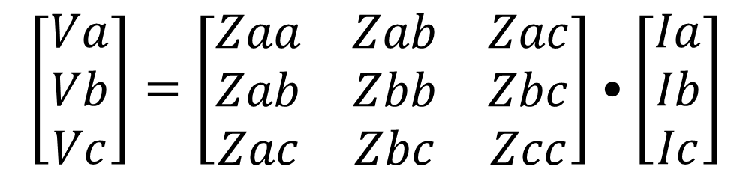
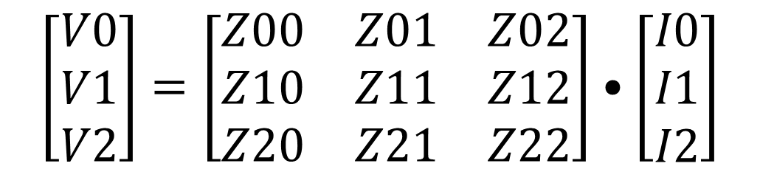
Self- and mutual impedance matrix
$$\left[\begin{matrix}Va \\ Vb \\ Vc\end{matrix}\right]=\left[\begin{matrix}Zaa & Zab & Zac \\ Zab & Zbb & Zbc \\ Zac & Zbc & Zcc\end{matrix}\right]•\left[\begin{matrix}Ia \\ Ib \\ Ic\end{matrix}\right]$$
$$\left[\begin{matrix}V0 \\ V1 \\ V2\end{matrix}\right]=\left[\begin{matrix}Z00 & Z01 & Z02 \\ Z10 & Z11 & Z12 \\ Z20 & Z21 & Z22\end{matrix}\right]•\left[\begin{matrix}I0 \\ I1 \\ I2\end{matrix}\right]$$

Slide 5
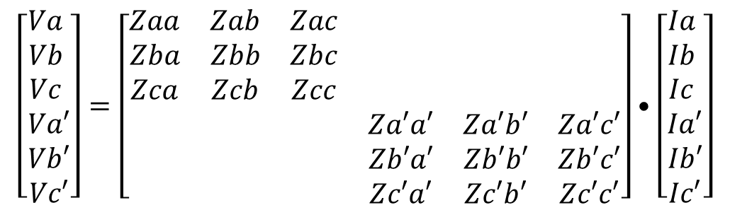
Two parallel circuits
Circuit X
Circuit Y
$$\left[\begin{matrix}Va \\ Vb \\ Vc \\ Va′ \\ Vb′ \\ Vc′\end{matrix}\right]=\left[\begin{matrix}Zaa & Zab & Zac & & & \\ Zba & Zbb & Zbc & & & \\ Zca & Zcb & Zcc & & & \\ & & & Za′a′ & Za′b′ & Za′c′ \\ & & & Zb′a′ & Zb′b′ & Zb′c′ \\ & & & Zc′a′ & Zc′b′ & Zc′c′\end{matrix}\right]•\left[\begin{matrix}Ia \\ Ib \\ Ic \\ Ia′ \\ Ib′ \\ Ic′\end{matrix}\right]$$
Circuit X
Circuit Y

Slide 6
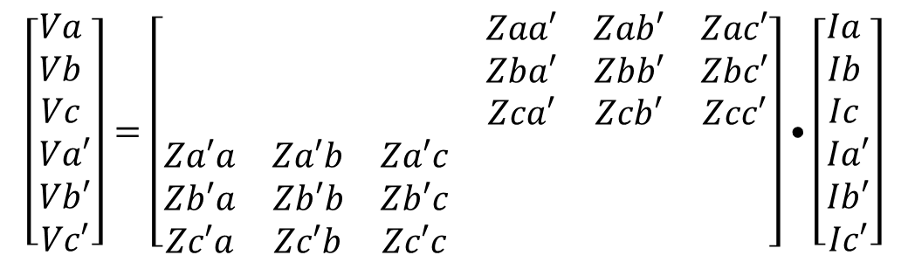
Two parallel circuits
Circuit X
Circuit Y
Voltage drop on Circuit X due to current flow on Circuit Y
$$\left[\begin{matrix}Va \\ Vb \\ Vc \\ Va′ \\ Vb′ \\ Vc′\end{matrix}\right]=\left[\begin{matrix} & & & Zaa′ & Zab′ & Zac′ \\ & & & Zba′ & Zbb′ & Zbc′ \\ & & & Zca′ & Zcb′ & Zcc′ \\ Za′a & Za′b & Za′c & & & \\ Zb′a & Zb′b & Zb′c & & & \\ Zc′a & Zc′b & Zc′c & & & \end{matrix}\right]•\left[\begin{matrix}Ia \\ Ib \\ Ic \\ Ia′ \\ Ib′ \\ Ic′\end{matrix}\right]$$
Circuit X
Circuit Y
Voltage drop on Circuit Y due to current flow on Circuit X

Slide 7
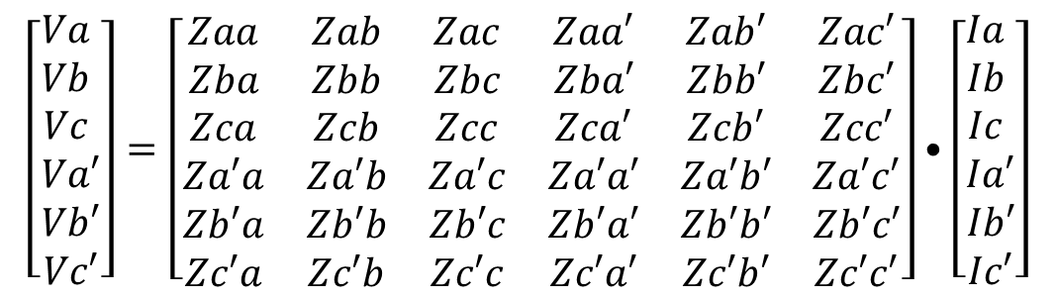
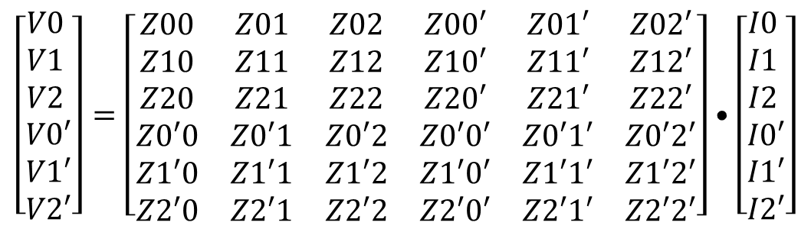
Two parallel circuits
Circuit X
Circuit Y
$$\left[\begin{matrix}Va \\ Vb \\ Vc \\ Va′ \\ Vb′ \\ Vc′\end{matrix}\right]=\left[\begin{matrix}Zaa & Zab & Zac & Zaa′ & Zab′ & Zac′ \\ Zba & Zbb & Zbc & Zba′ & Zbb′ & Zbc′ \\ Zca & Zcb & Zcc & Zca′ & Zcb′ & Zcc′ \\ Za′a & Za′b & Za′c & Za′a′ & Za′b′ & Za′c′ \\ Zb′a & Zb′b & Zb′c & Zb′a′ & Zb′b′ & Zb′c′ \\ Zc′a & Zc′b & Zc′c & Zc′a′ & Zc′b′ & Zc′c′\end{matrix}\right]•\left[\begin{matrix}Ia \\ Ib \\ Ic \\ Ia′ \\ Ib′ \\ Ic′\end{matrix}\right]$$
Sequence translation
$$\left[\begin{matrix}V0 \\ V1 \\ V2 \\ V0′ \\ V1′ \\ V2′\end{matrix}\right]=\left[\begin{matrix}Z00 & Z01 & Z02 & Z00′ & Z01′ & Z02′ \\ Z10 & Z11 & Z12 & Z10′ & Z11′ & Z12′ \\ Z20 & Z21 & Z22 & Z20′ & Z21′ & Z22′ \\ Z0′0 & Z0′1 & Z0′2 & Z0′0′ & Z0′1′ & Z0′2′ \\ Z1′0 & Z1′1 & Z1′2 & Z1′0′ & Z1′1′ & Z1′2′ \\ Z2′0 & Z2′1 & Z2′2 & Z2′0′ & Z2′1′ & Z2′2′\end{matrix}\right]•\left[\begin{matrix}I0 \\ I1 \\ I2 \\ I0′ \\ I1′ \\ I2′\end{matrix}\right]$$

Slide 8
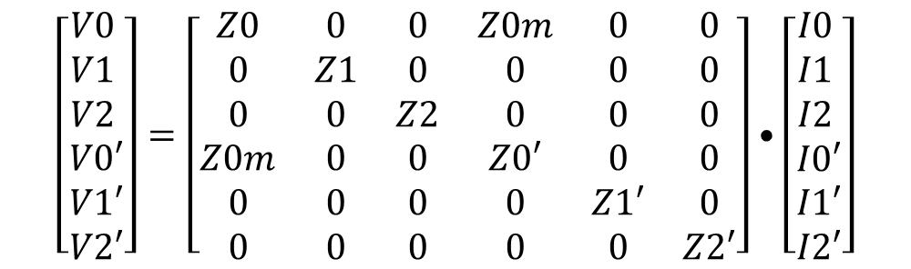
Net magnetic flux
$$\left[\begin{matrix}V0 \\ V1 \\ V2 \\ V0′ \\ V1′ \\ V2′\end{matrix}\right]=\left[\begin{matrix}Z0 & 0 & 0 & Z0m & 0 & 0 \\ 0 & Z1 & 0 & 0 & 0 & 0 \\ 0 & 0 & Z2 & 0 & 0 & 0 \\ Z0m & 0 & 0 & Z0′ & 0 & 0 \\ 0 & 0 & 0 & 0 & Z1′ & 0 \\ 0 & 0 & 0 & 0 & 0 & Z2′\end{matrix}\right]•\left[\begin{matrix}I0 \\ I1 \\ I2 \\ I0′ \\ I1′ \\ I2′\end{matrix}\right]$$

Slide 9
System description
FDR 4 and FDR 5 are 5 miles long
No ground wires
477 26/7 ACSR conductors
9 ft average spacing between FDR 4 and FDR 5

Slide 10
Modeling and simulation results
Fault simulated on FDR 5 and I₀ induced on mutually coupled FDR 4
Length of mutual coupling segment varied from 0–5 miles in steps of 0.5 miles
Observations
Higher induced I₀ for longer mutually coupled length
Higher induced I₀ when remote-end breaker of FDR 5 is open
Maximum induced I₀ ~50% of ground fault level on that feeder

Slide 11
Modeling and simulation results
Fault simulated on FDR 5 and I₀ induced on mutually coupled FDR 4
Length of mutual coupling segment varied from 0–5 miles in steps of 0.5 miles
Observations
Higher induced I₀ for longer mutually coupled length
Higher induced I₀ when remote-end breaker of FDR 5 is open
Maximum induced I₀ ~50% of ground fault level on that feeder

Slide 12
System description
25-mile lines
5-mile feeders
No ground wires
1,351.5 54/19 ACSR conductors
25 ft spacing between Line 3 and FDR 1

Slide 13
Modeling and simulation results

Slide 14
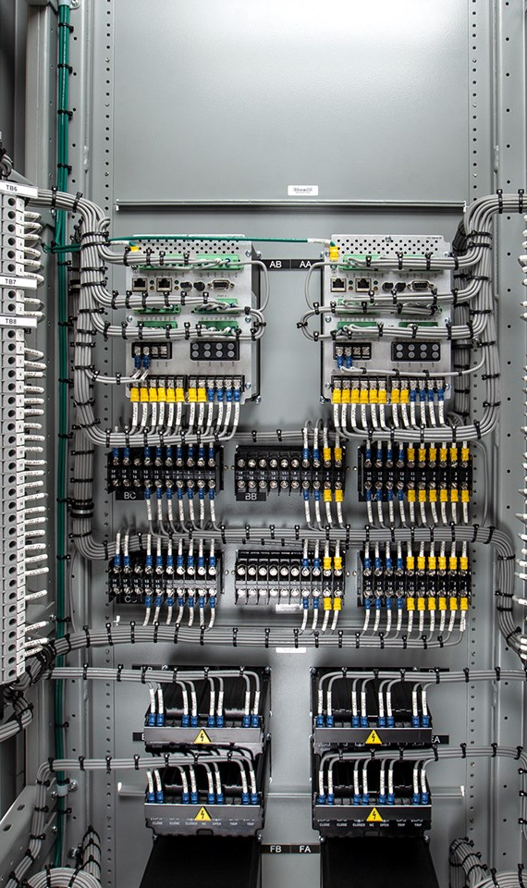
Subtransmission protection philosophy at utility
Lines originate from 34.5 kV RS bus and terminate at DS
RS end: Nondirectional 51
51 pickup: 2x emergency line rating
Coordination interval: 15–18 cycles
DS end: Directional 51
51 pickup: 1.25x emergency line rating
Coordination interval: 15–18 cycles

Slide 15
Event analysis
AG fault occurred on FDR 5
R3, R4, R2, and R1 picked up on 51N
51N in R2 was supervised by 32QF
R4 tripped open first on 51AT

Slide 16
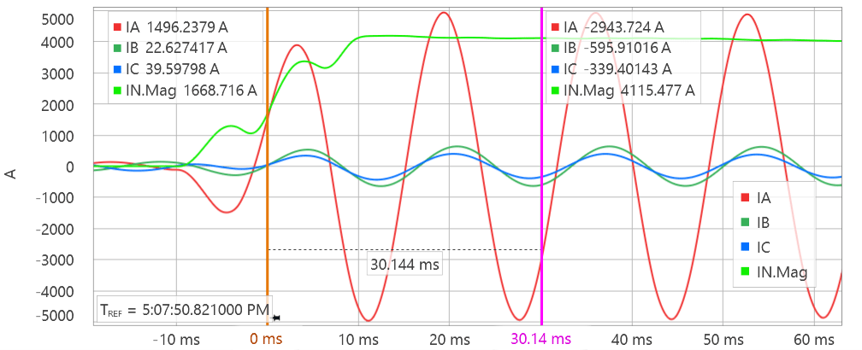
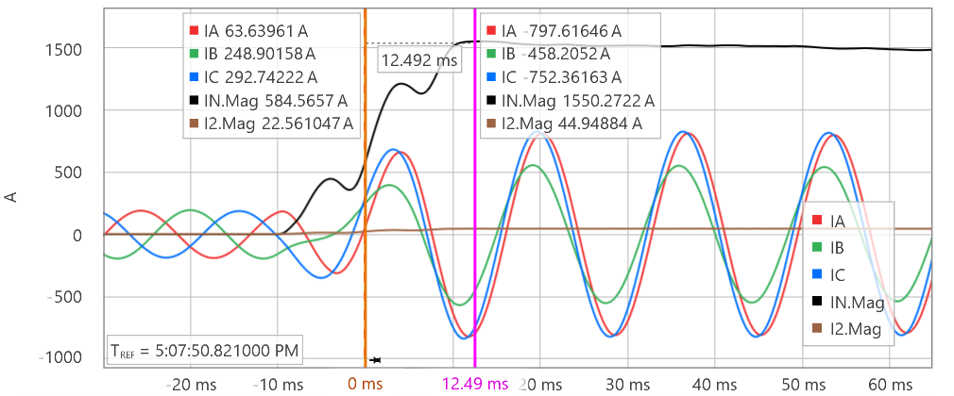
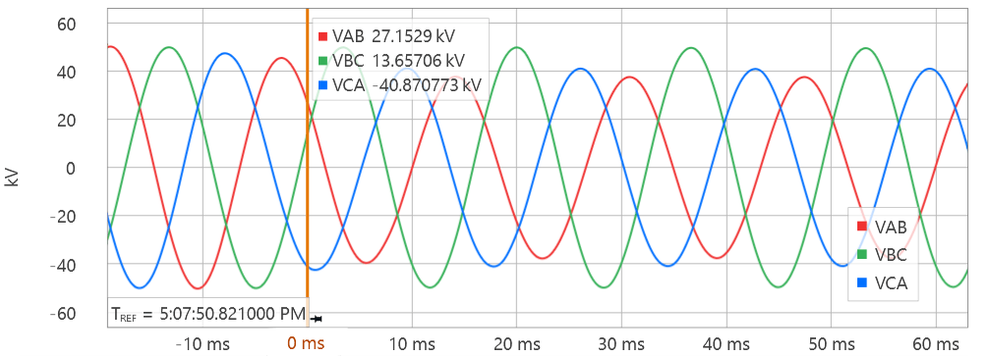
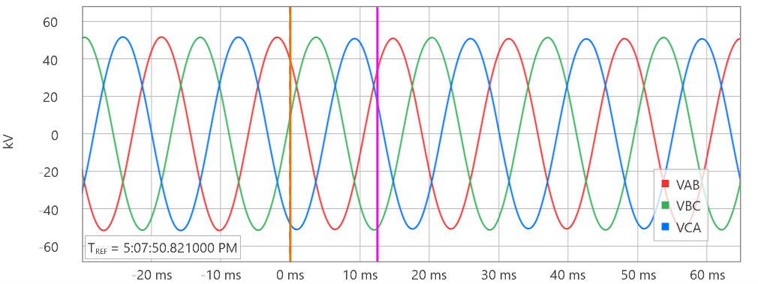
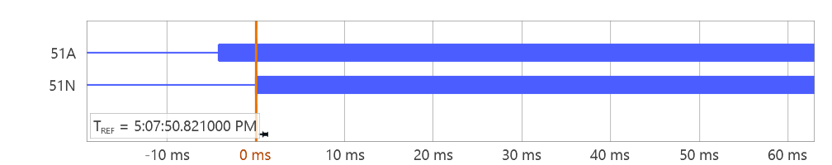
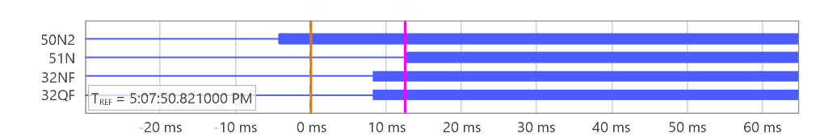
Event analysis
R3
R2

Slide 17
Event analysis
AG fault on FDR 5

Slide 18
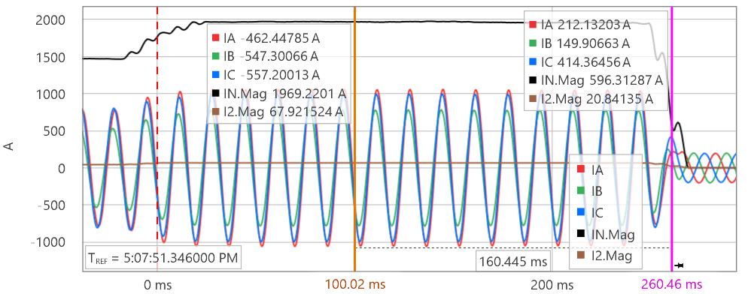
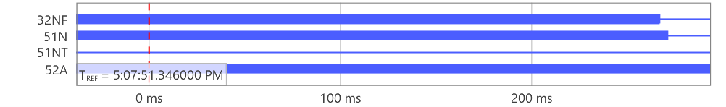
Event analysis
R2

Slide 19
Event analysis
R3 tripped 5–6 cycles after R4 opened its breaker
R3 initiated autoreclose
Autoreclose in all 4 relays was set to 1 shot to lock out with 10-second open interval timer

Slide 20
Event analysis
R3 sent close command and Breaker 3 was successfully closed
R2 tripped on 51NT, which never reset during entire reclosing cycle of R3
R1 did not trip

Slide 21
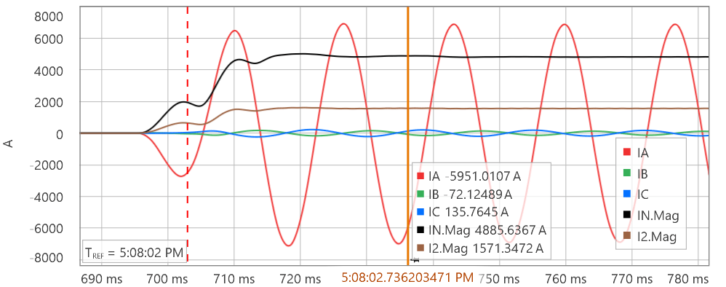
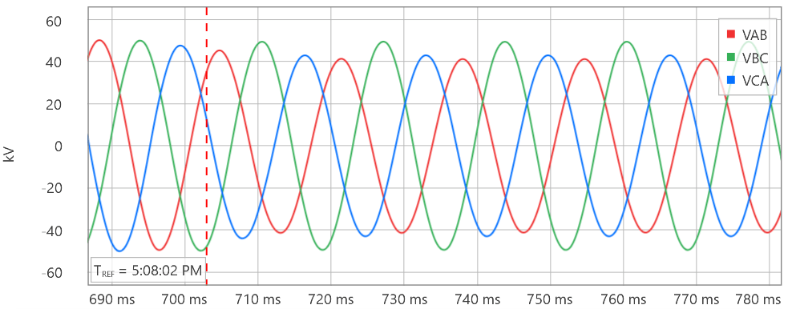
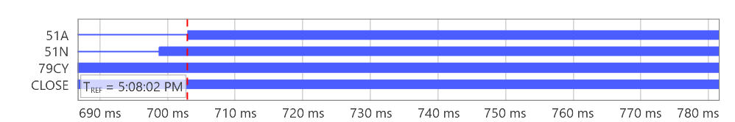
Event analysis
R3
R2

Slide 22
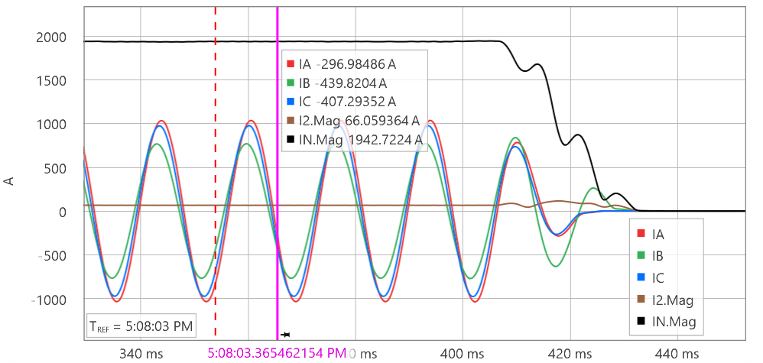
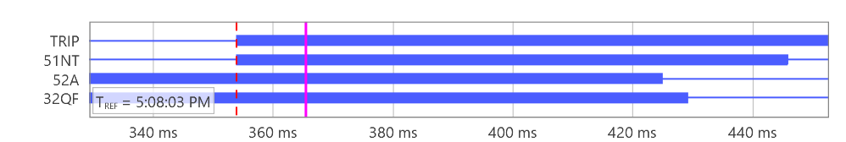
Event analysis
R2 finally tripped

Slide 23
Mitigation strategies
Can we change ground directional priority and preference?
ORDER = Q
ORDER = QV

Slide 24
Mitigation strategies
Can we change positive-sequence current restraint factor A2?
A2 engages directional enable
A2 must be chosen to provide dependability for its own feeder fault
A2 = 0.5 is the highest value to have dependability for all fault types

Slide 25
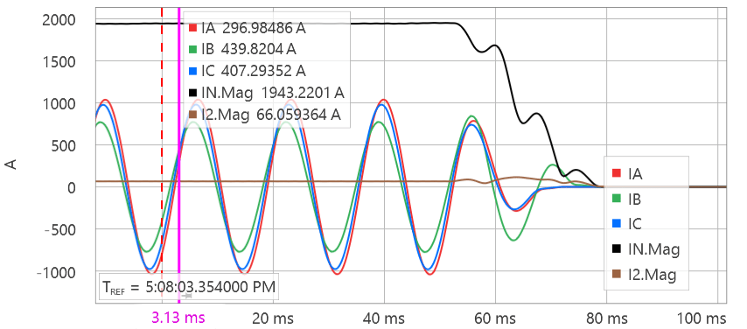
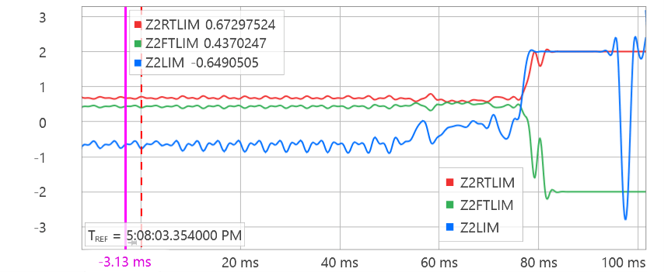
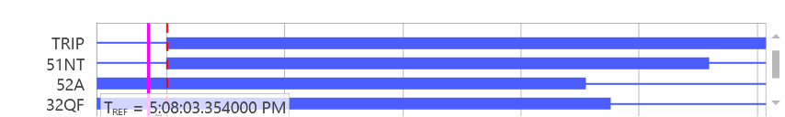
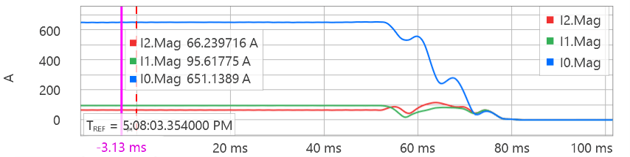
Directional element characteristic for R2

Slide 26
Mitigation strategies
Can we increase ground overcurrent pickups?
51N pickup should be selected based on worst-case mutual coupling but should maintain sensitivity for coordination
Mutual coupling effects due to operational switching should be considered
Worst-case mutual coupling also depends on system configuration – common bus on both ends, common bus only on one end, isolated buses on both ends

Slide 27
Mitigation strategies
Can we change fault detector pickups – 50QFP and 50QRP?
50QFP and 50QRP are also inputs to directional enable logic
Raising 50QFP might work but must confirm dependability for all unbalanced faults on its own feeder/line
I2.Mag in our case study = 66 A primary = 1.2375 A secondary

Slide 28
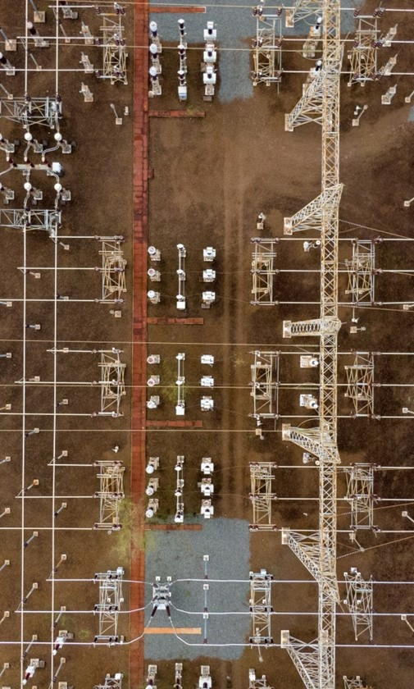
Conclusion
Effects of mutual coupling should be modeled even for subtransmission networks
Modeling should be considered when ≥10% line is coupled
32Q is a superior directional element on mutually coupled lines due to voltage drop caused by Z_{0M} but it is also prone to misoperations
With some tweaks in directional enable logic of 32Q, security can be established

Slide 29
Questions?

