Slide 1
NERC Update
Protection Standards and Data Center Fault
JP Skeath, Manager, Engineering and Security Integration
Annual Georgia Tech Fault and Disturbance Conference
May 5, 2025

Slide 2
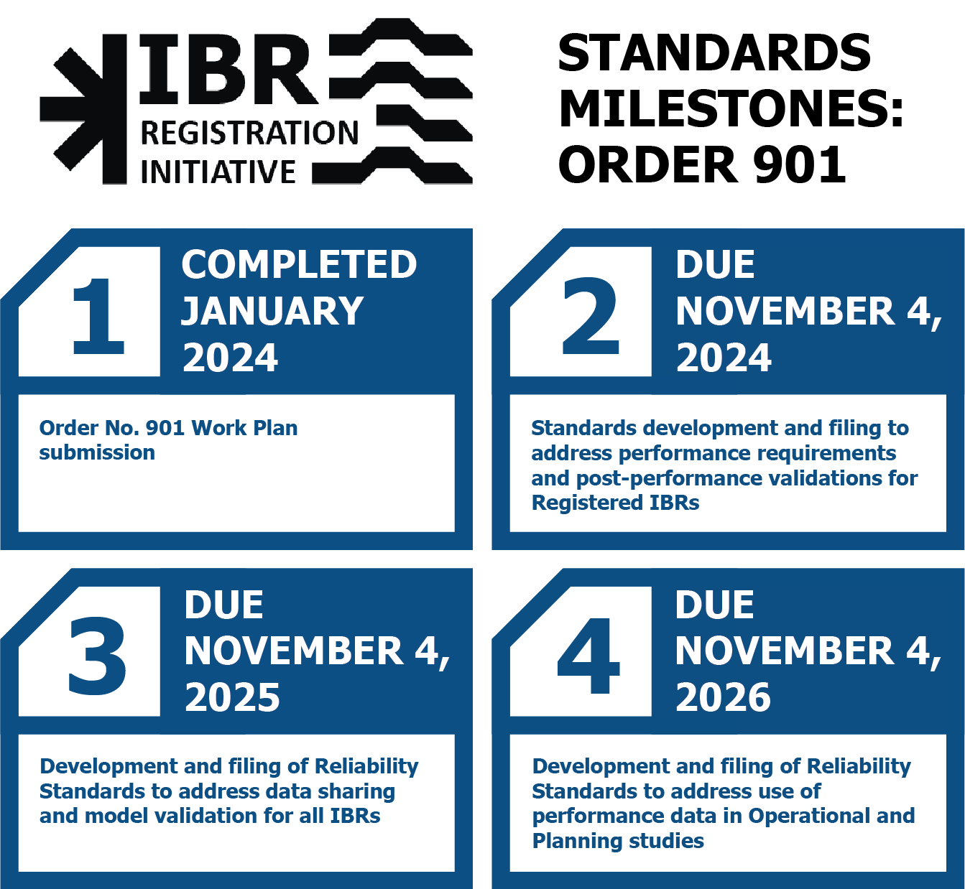
Order 901 Summary

Slide 3
Milestone 2 Summary
Installation of disturbance monitoring equipment
Share data on request
New PRC-029
Performance based ride-through criteria
Capability based ride-through criteria
New PRC-030
Analysis of performance during a disturbance
Initiates what is evaluated for ride-through performance
New PRC-028

Slide 4
Milestone 2 Summary
Out for NOPR
Installation of disturbance monitoring equipment
Share data on request
New PRC-029
Performance based ride-through criteria
Capability based ride-through criteria
New PRC-030
Analysis of performance during a disturbance
Triggers what is evaluated for ride-through performance
New PRC-028
83.85%
77.8%
70.88%

Slide 5
Milestone 2 Summary – Other Affected Standards
Project 2021-04 – Modifications to PRC-002-5
  Final Ballot of 84.2%
  Excluded IBRs, minor clarifications on CSV headers
Project 2020-02 – Modifications to PRC-024-4
  Final Ballot of 86.41%
  Focused on synchronous generation. Added applicability for synchronous condensers

Slide 6
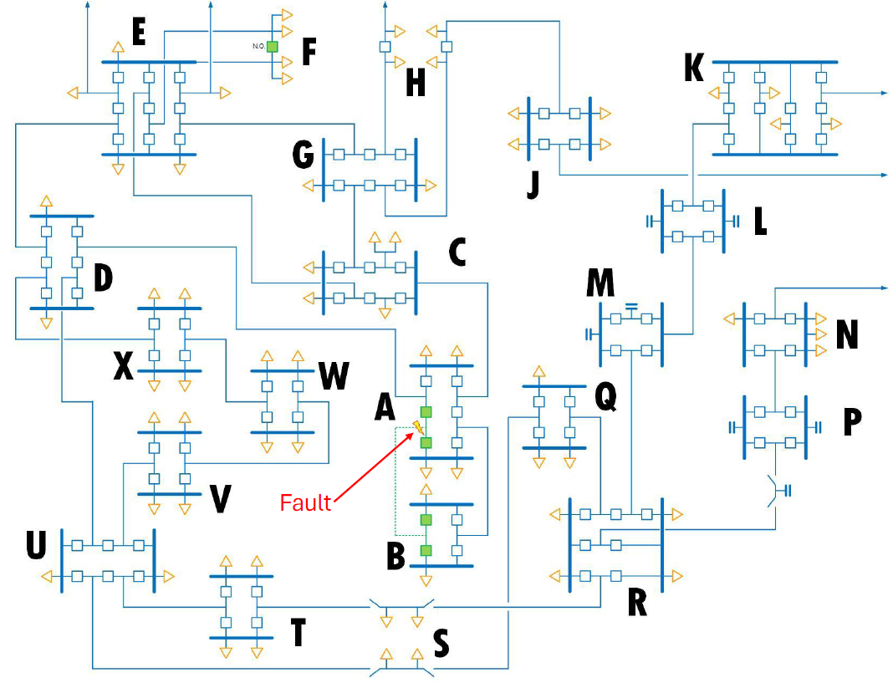
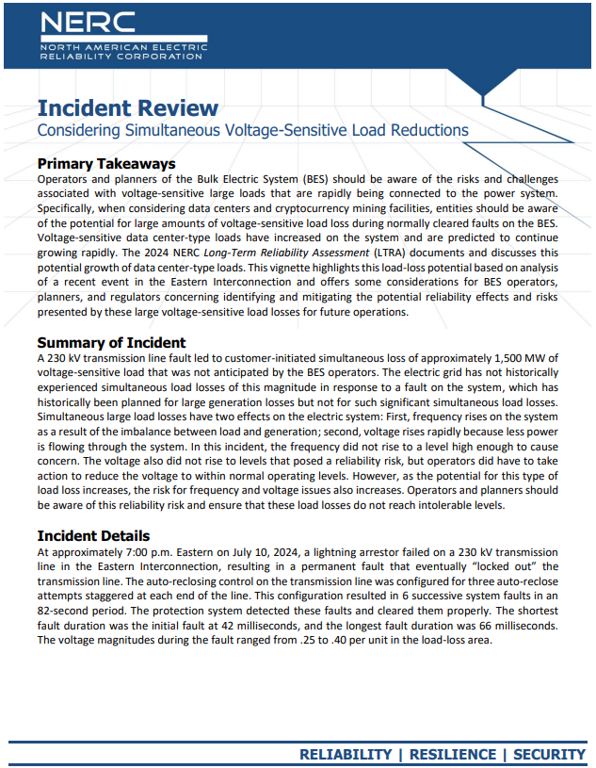
Load Loss Incident

Slide 7
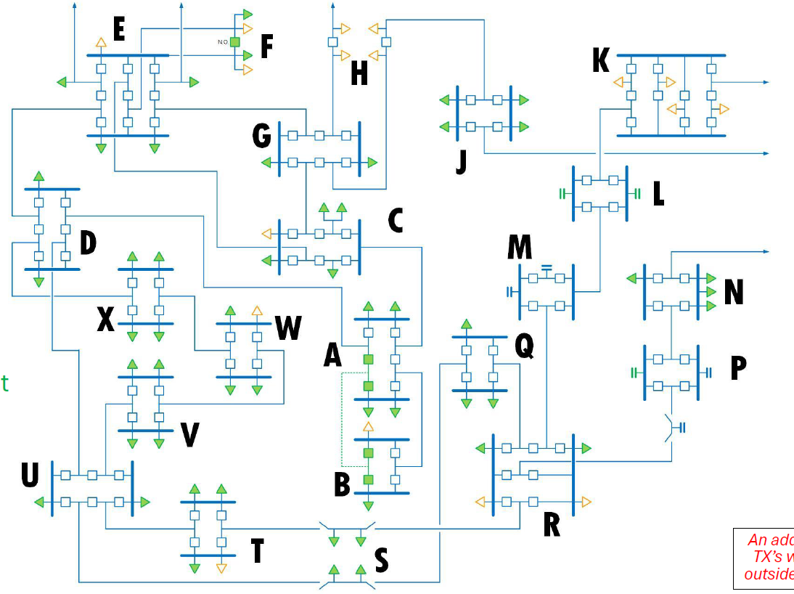
Load Loss Incident – Affected Load
Load Lost During Event
(GREEN)

Slide 8
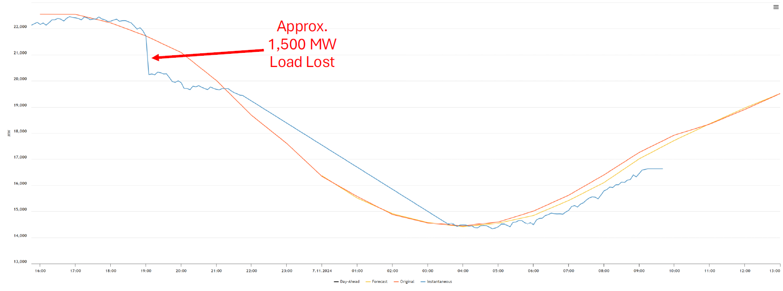
Load Loss Incident – Affected Load

Slide 9
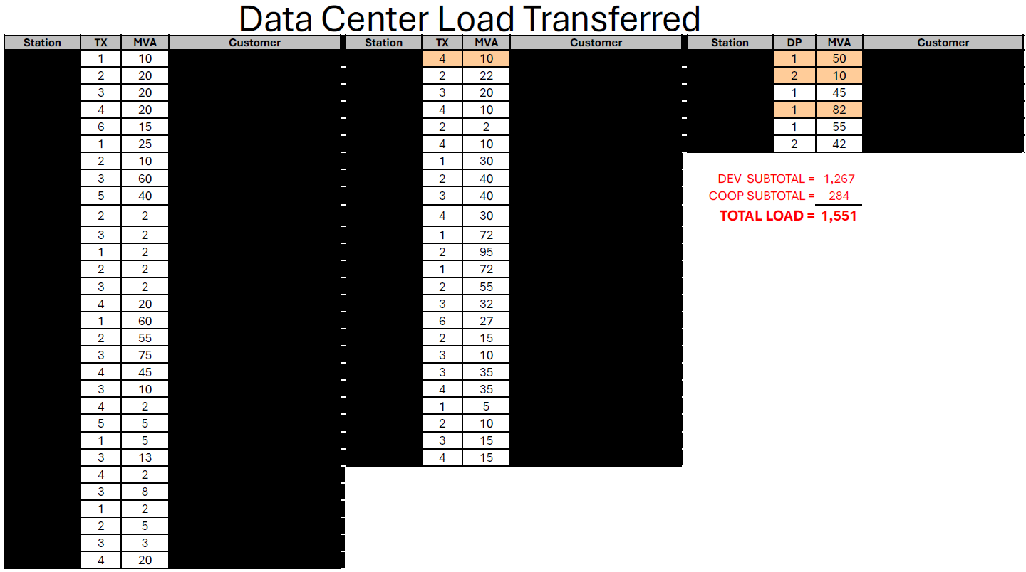
Load Loss Incident – Affected Load
Exclusively Data Center load
25-30 substations
~ 60 individual data center load points
Individual load loss ranged from 2 MW to 85 MW

Slide 10
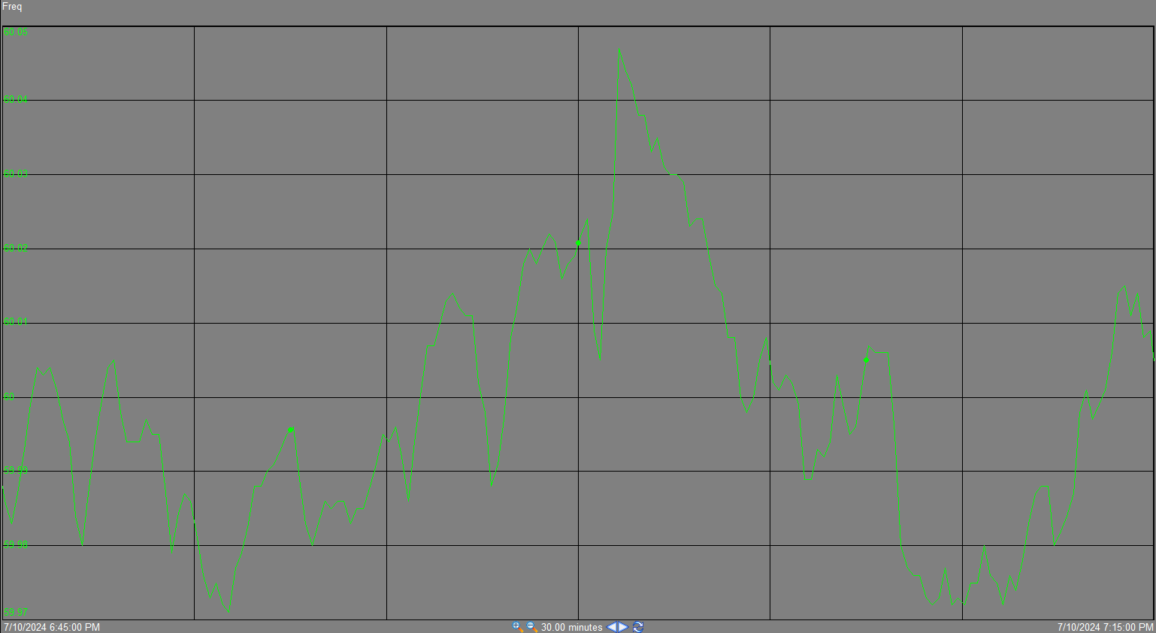
Load Loss Effects - Frequency
Frequency rises to 60.047

Slide 11
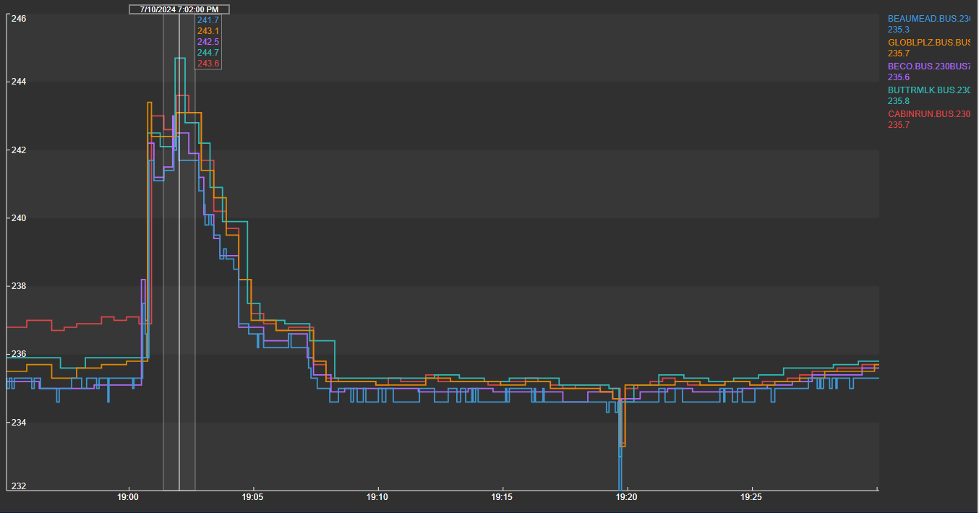
Load Loss Effects - Voltage
High Voltage
Less than 1.1 per unit
Operators removed local area 230 kV capacitor banks to reduce voltage

Slide 12
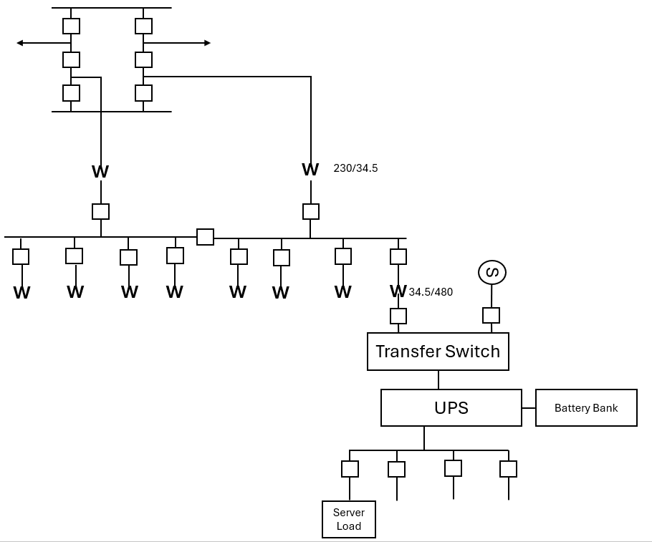
Event Analysis

Slide 13
Event Analysis
The load did not come back immediately

Slide 14
Event Analysis
Something Else Happened
????

Slide 15
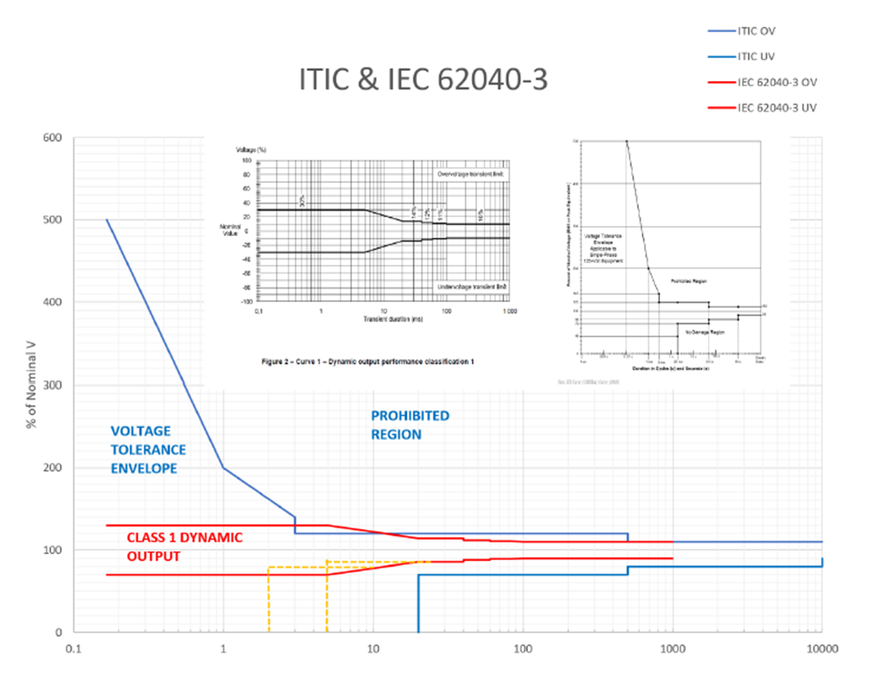
Data Center Coalition Input
Data Center Load
Cooling load is critical after voltage disturbance
Design follows ITIC curve
Will “lockout” after a number of events in a specific period of time
More than one power distribution architecture

Slide 16
Data Center Coalition Input
Data Center Load
Cooling load is critical after voltage disturbance
Design follows ITIC curve
Will “lockout” after a number of events in a specific period of time
More than one power distribution architecture

Slide 17
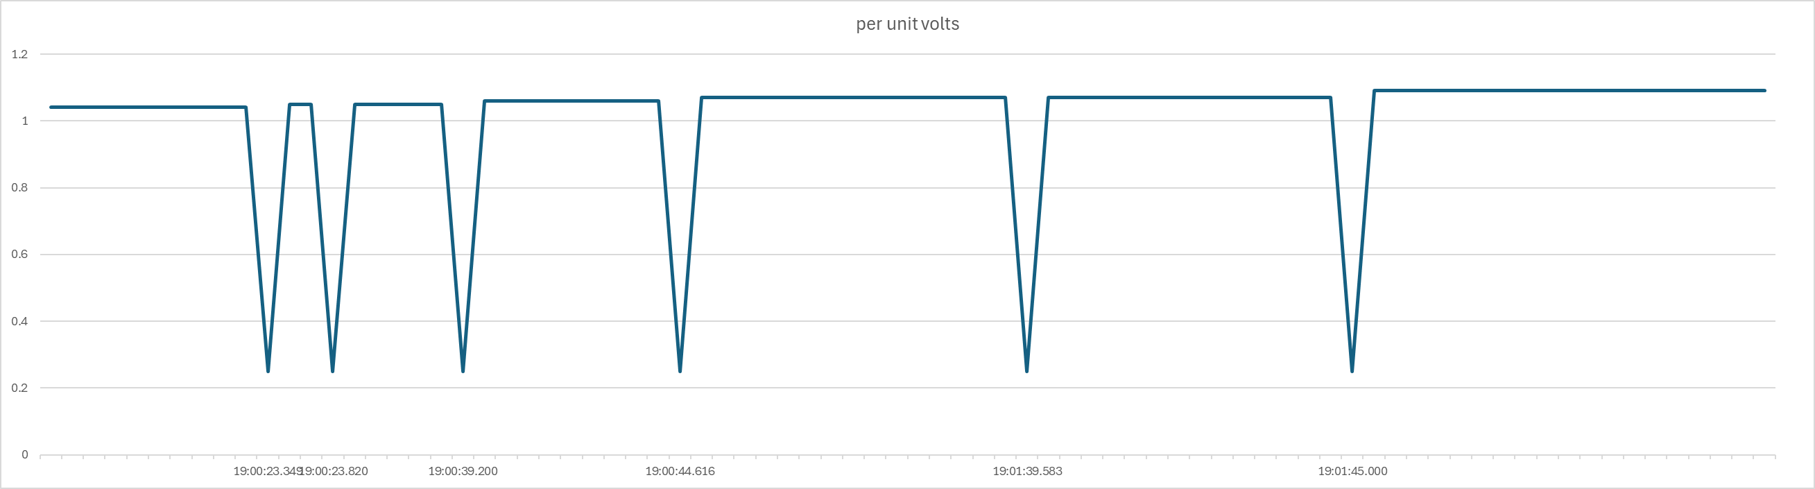
The rest of the story…

Slide 18

Event Analysis Results
3 Strikes…
You’re Out!

Slide 19
Incident Review Considerations
Require dynamic response models of large loads in facility interconnection requirements
Perform studies to determine the potential magnitude of load loss for system disturbances (particularly faults)
Take into consideration the potential for voltage-sensitive load loss when configuring automatic reclosing schemes

Slide 20
Next steps/Needs
We need to understand this ride through response looks like for all facilities

Slide 21
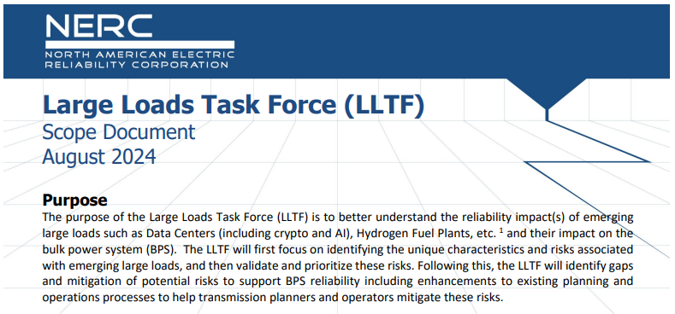
NERC Large Loads Task Force
Identify and characterize unique aspects and risks of Large Loads
Large Load definition
Identify gaps and potential risk mitigation
Develop guidance and best practice

Slide 22
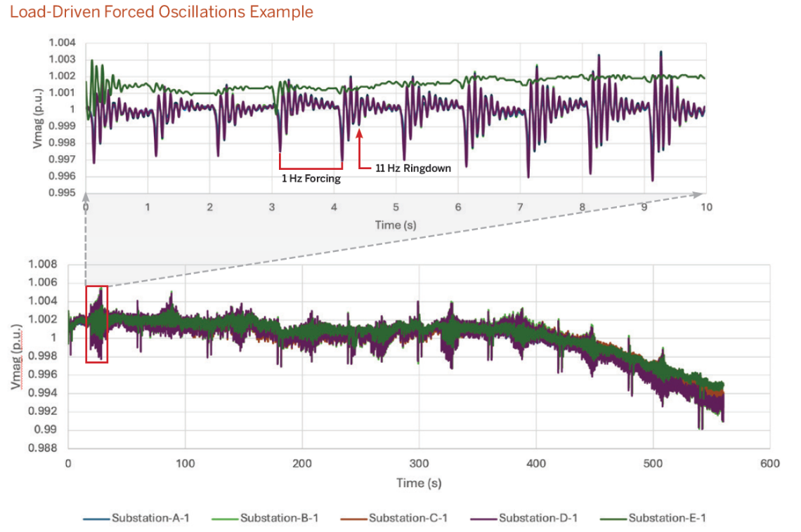
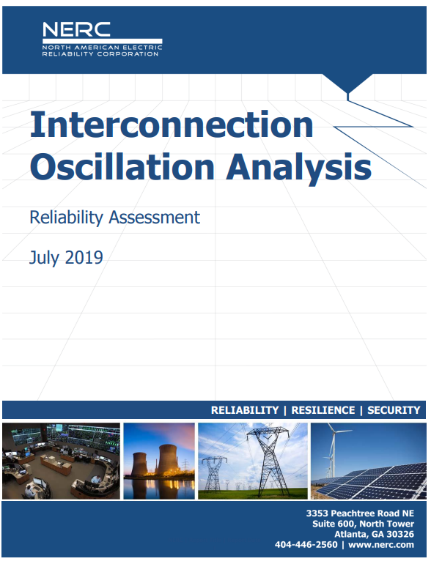
Forced Oscillations

Slide 23
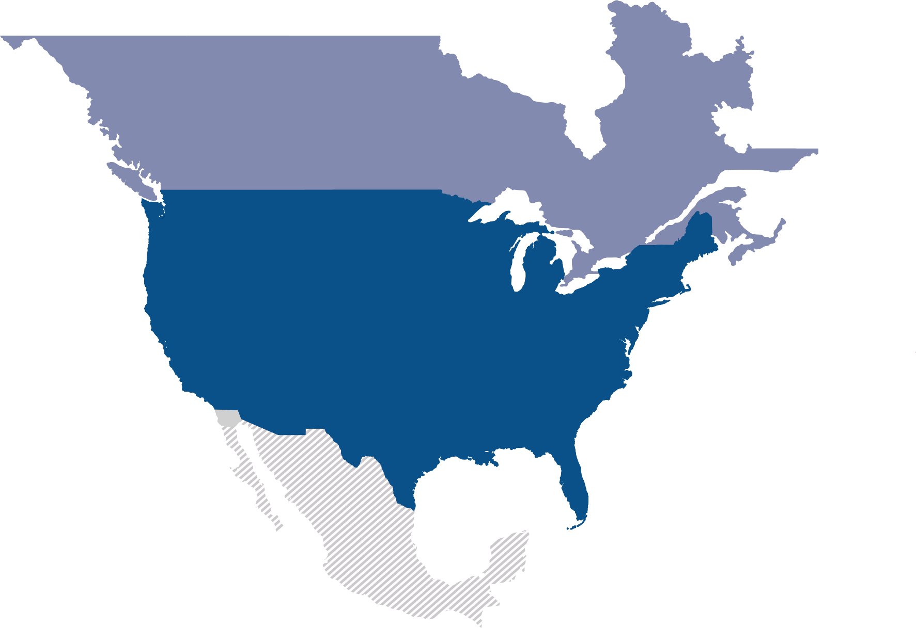
Questions and Answers
John Paul “JP” Skeath
Manager, Engineering and Security Integration
North American Electric Reliability Corporation
3353 Peachtree Road NE, Suite 600 – North Tower
Atlanta, GA 30326
404-446-9630 office | 404-823-1365 cell
Email: John.Skeath@nerc.net

