Slide 1
Observed Effects of Geomagnetic Disturbances from Wide Area Monitoring System
Theo Laughner - Lifescale Analytics
Jim Anderson, Stan Heckman, Bob Marshall – Whisker Labs

Slide 2
Overview
Background
Measurements
Observations / Analysis
Findings / Conclusions

Slide 3
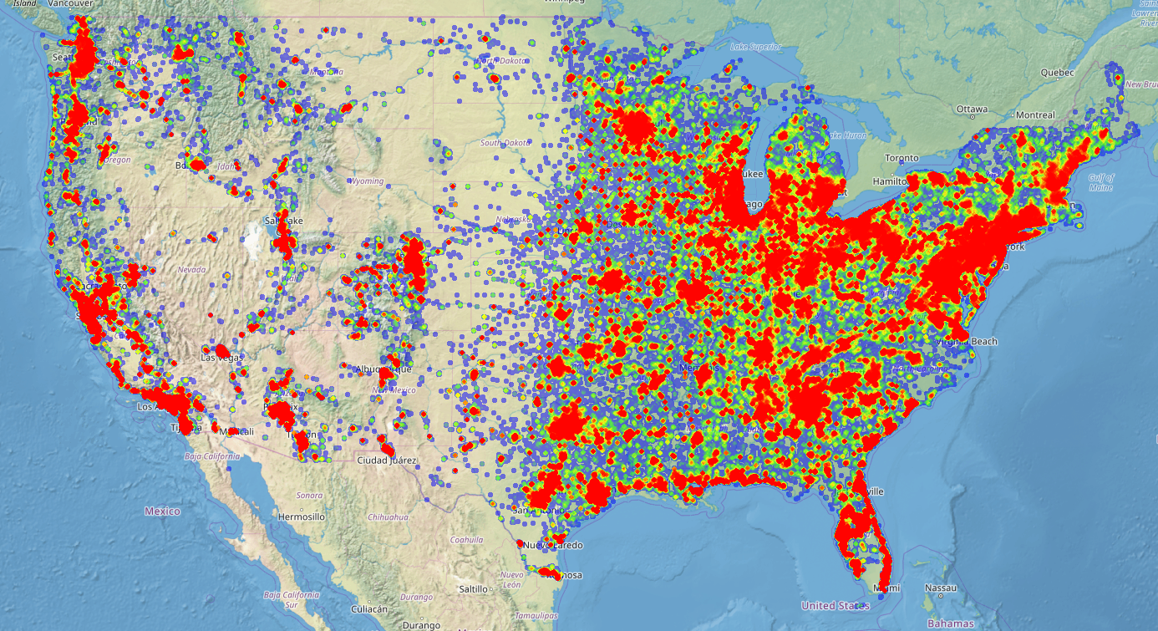
Background
>1M sensors
50k sensors / month growth
Sampling rate 30MHz/30KHz

Slide 4
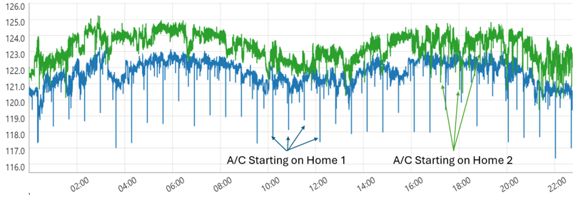
Monitors From Different Homes

Slide 5
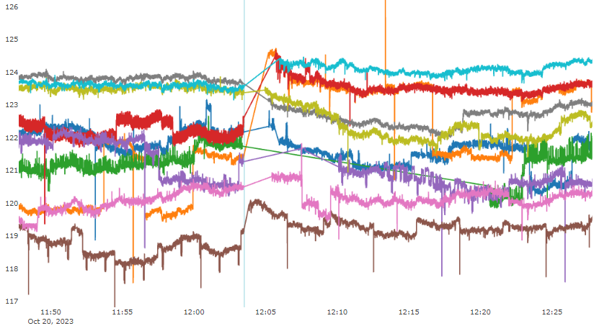
Grid Events
Interruption

Slide 6
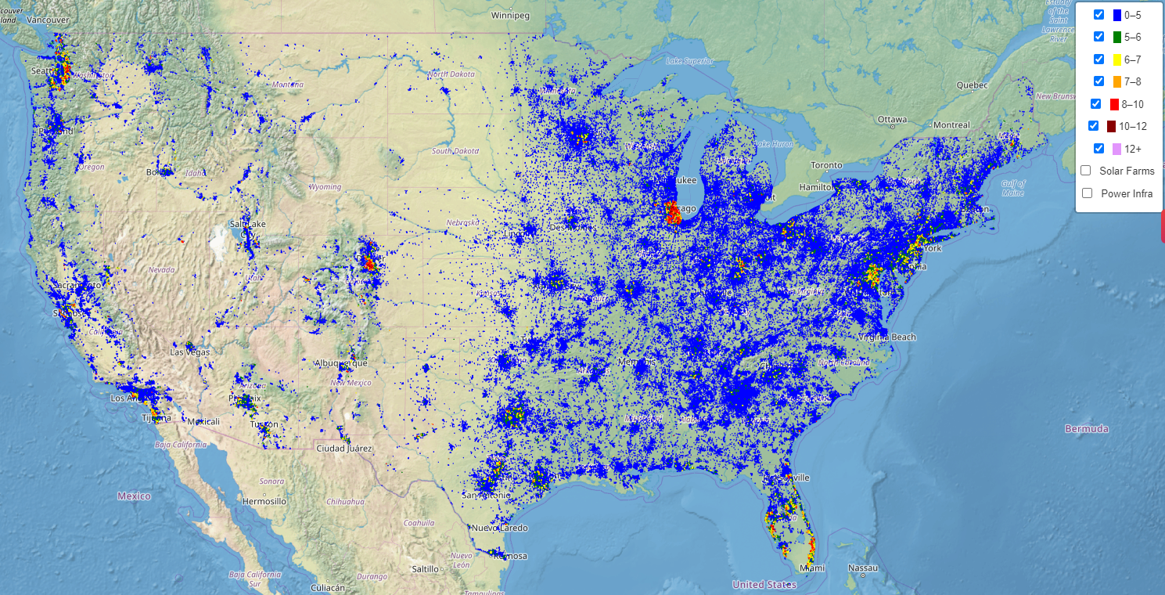
Total Harmonic Distortion (THD)

Slide 7
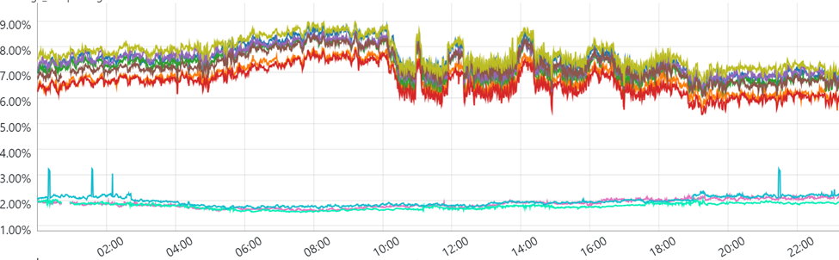
THD Trend
Same Feeder
Different Feeders

Slide 8
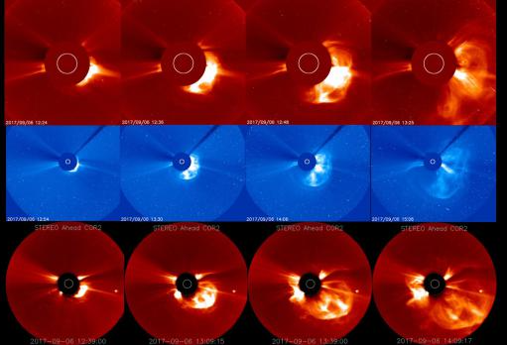
Coronal Mass Ejection (CME)
Sun’s magnetic field flips ~11 years (aka Solar Cycle).
Sunspot / CME activities increase during this time.
CME is a large plasma and magnetic field ejection from the Sun’s corona.
May results in Geomagnetic Disturbances (GMD) which in turn create Geomagnetically Induced Currents (GIC).

Slide 9
GMD Timeline
1903
1921
1946
Communication Outages
Transportation Issues
Communication Outages
1989
Hydro Quebec Power System
Prompted the development of NERC TPL-007-1
“Reliability Standard TPL-007-1 establishes requirements for certain registered entities to assess the vulnerability of their transmission systems to geomagnetic disturbance events (GMDs), which occur when the sun ejects charged particles that interact with and cause changes in the earth’s magnetic fields.“

Slide 10
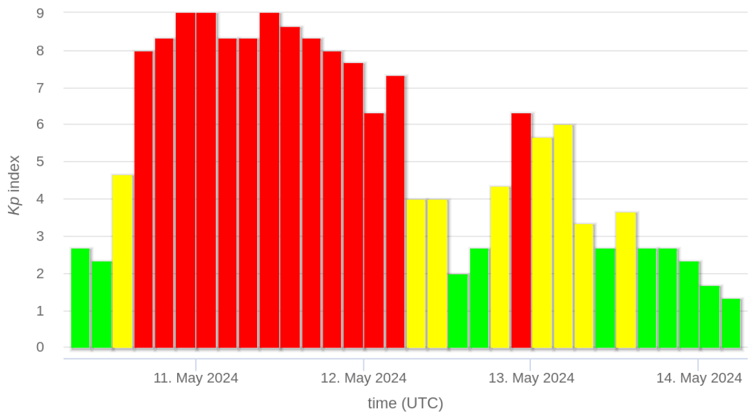
CME on May 8, 2024
CMEs take a few days to reach Earth.
Kp is a measure of strength of the GMD event (over 7 is considered strong by NERC).

Slide 11
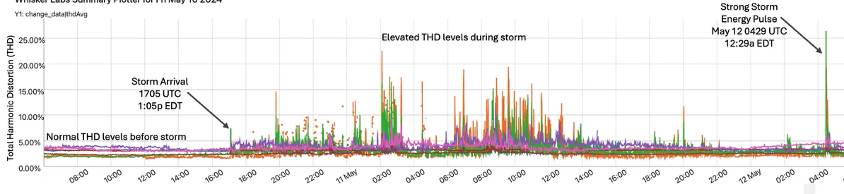
THD Measurements During CME
IEEE 519 Limit

Slide 12
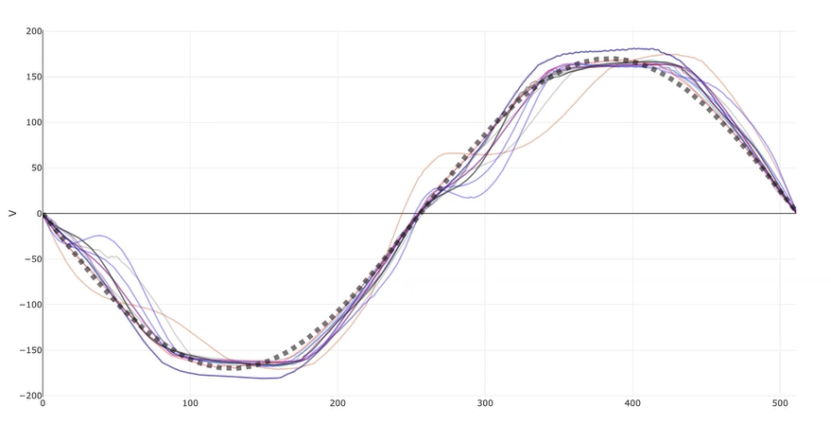
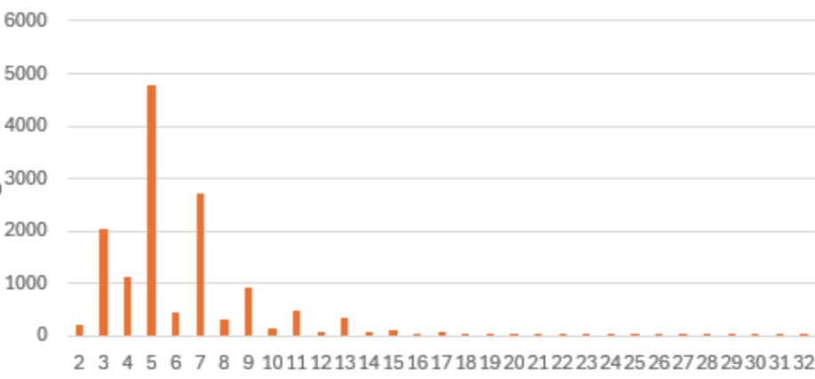
Waveform Recordings
Harmonic Spectra

Slide 13
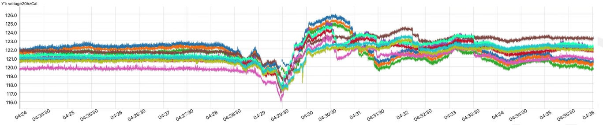
Voltage Influence

Slide 14
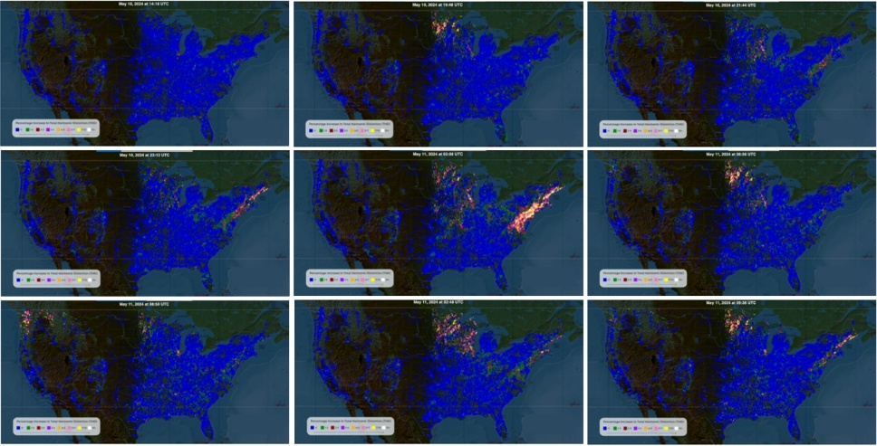
THD Map Across The US

Slide 15
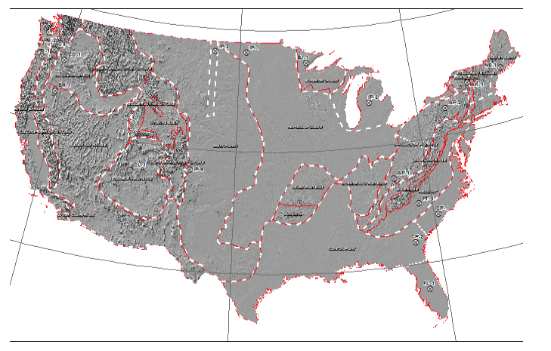
Observations
GIC is likely to be higher where the Earth’s resistivity is higher.
The map on the left shows the resistivity in different areas.
As expected, there was a high correlation between high earth resistivity and higher harmonic values which suggests transformers were saturated.

Slide 16
Conclusions
Historically viewed as a transmission system issue. This shows the effects can be very localized.
Existing models appear to underestimate THD.
Existing models do not predict the propagation of harmonics through the distribution network.

Slide 17
Thank You!
Acknowledgements
Jim Anderson
Stan Heckman
Bob Marshall

