Slide 1
Use of IEEE 2664 for Transmitting Point on Wave Records
R. C. Carroll¹, C. Lackner¹, T.J. Purcell², J. A. Johnston²
¹ Grid Protection Alliance
² Dominion Energy

Slide 2


IEEE 2664-2024 (STTP)
Streaming Telemetry Transport Protocol
US DOE Funded Project
Intrinsically reduces losses and latency compared to frame-based protocols
Allows the safe co-mingling of phasor data with other operational data network traffic
Detailed metadata exchanged as part of protocol
Includes lossless compression to reduce bandwidth utilization
Security-first design with strong authentication and option for encryption
Designed for Synchrophasor data

Slide 3
TSSC Testing with Point of Wave
Use of STTP TSSC for Point on Wave (POW) data
we collected some POW sample data and ran tests
Compression is very good for streaming phasor data
Low latency, low CPU impact, and fast
Tests with streaming audio data also compressed well
Streaming signals at 44100 Hz data compressed well
TSSC was expected to perform well with point on wave data…
Test data was recorded at 960Hz
It did not…

Slide 4
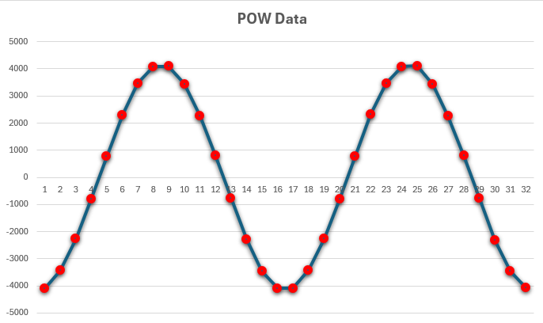
Why? Rate of Change
TSSC performs well for data sets where there is a slow gradient of change:
This works well for phasor data (30/60Hz)
This works well for audio data (44100Hz)
What makes 960Hz special?
Within 16 measurements, you move through 360 degrees →
WARNING: Curves Ahead!

Slide 5
How to compress POW
After playing around with many compression techniques, you find that standard compression algorithms work fairly well.
Of all the common players, LZMA (a.k.a. 7-zip) seemed to do the best job.
For a 5.6GB POW file representing a full day of data, 7-zip would reduce size by 65.6% (34.44% compression ratio)
In terms of compression, we felt like this ratio could be improved, especially by understanding the sinusoidal nature of the data – something LZMA would not “assume”

Slide 6
Trying to match the curve…
Started with a goal of trying to emulate the source curve as close as possible
Tried lots of frequency estimators with simple sine wave:
Zero crossing / FFT / and just assuming fixed 60hz
For several sample files, narrowed in on the following solution
NOTE: This was based on empirical work and intuition, not some mathematical hypothesis, which may produce better results
Emulating the POW curves with harmonic estimation, narrowing in on the 8th harmonic – simply because it produced the best match to original curve
For available data sources, anything higher or lower did not do as well

Slide 7

Trying to match the curve…
$$A∗sin⁡(ωt+φ)$$

Slide 8
Repeated Experimentation shows n=8 ideal

Slide 9
Everything is peaches and cream…
excludes results that used around 100% supplemental compression
Smaller compression ratios values are better:
Example 1:
Encoded Size: 39.82 megabytes / 158 megabytes (25.17%)
Supplemental Compression: 1,028 / 1,265 (81.26%)
Example 2:
Encoded Size: 39.47 megabytes / 158 megabytes (24.95%)
Supplemental Compression: 319 / 1,265 (25.22%)
Example 3:
Encoded Size: 36.25 megabytes / 158 megabytes (22.91%)
Supplemental Compression: 436 / 1,265 (34.47%)
Example 4:
Encoded Size: 40.01 megabytes / 158 megabytes (25.29%)
Supplemental Compression: 0 / 1,265 (0.00%)
Example 5:
Encoded Size: 40.21 megabytes / 158 megabytes (25.42%)
Supplemental Compression: 0 / 1,265 (0.00%)
Example 6:
Encoded Size: 40 megabytes / 158 megabytes (25.29%)
Supplemental Compression: 598 / 1,265 (47.27%)
Example 7:
Encoded Size: 39.76 megabytes / 158 megabytes (25.13%)
Supplemental Compression: 518 / 1,265 (40.95%)
Example 8:
Encoded Size: 39.58 megabytes / 158 megabytes (25.02%)
Supplemental Compression: 0 / 1,265 (0.00%)
Example 9:
Encoded Size: 40.36 megabytes / 158 megabytes (25.51%)
Supplemental Compression: 0 / 1,265 (0.00%)
Example 10:
Encoded Size: 40.13 megabytes / 158 megabytes (25.37%)
Supplemental Compression: 0 / 1,265 (0.00%)

Slide 10
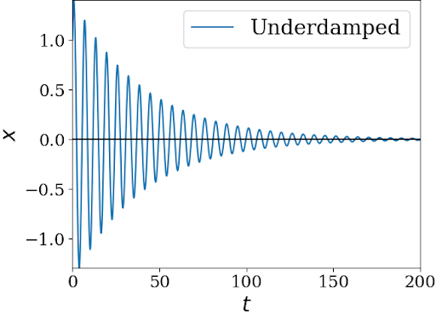
Everything is peaches and cream…
Until it’s not…
Pretty, predictable curves aren’t always so pretty
Sometimes they get angry and noisy
So, you need a “plan B” for compression in these cases
As previously tested, LZMA is a good “general choice” for compression
When things don’t compress well, e.g., less than a target of 26%, use a common compression algorithm, e.g., LZMA

Slide 11
Conclussion
For a sinusoidal inputs, results were better than LZMA alone
For wave forms that don’t “fit”, LZMA produced better results
The current implementation operates by using both, again, when ratio is less than (configurable) 26%, use LZMA
Pros:
Good compression, ~25%
Suitable for streaming compression, e.g., STTP
Reduces bandwidth for streaming and file transfers in reduced bandwidth environments, e.g., sub-station
Cons:
CPU costs are high – lots of calculation required – so better suited for single value streams
More compression would be better, more work to be done on improving algorithm results

