Slide 1
TVA Power Quality Evaluation of Inverter-Based Resource Impact on High Voltage Transmission Operations
James B. Rossman
Nashville, Tennessee
jbrossman@tva.gov
Tim N. Fritch
Chattanooga, Tennessee
tnfritch@tva.gov
Grace E. Piercy
Nashville, Tennessee
gepiercy@tva.gov

Slide 2

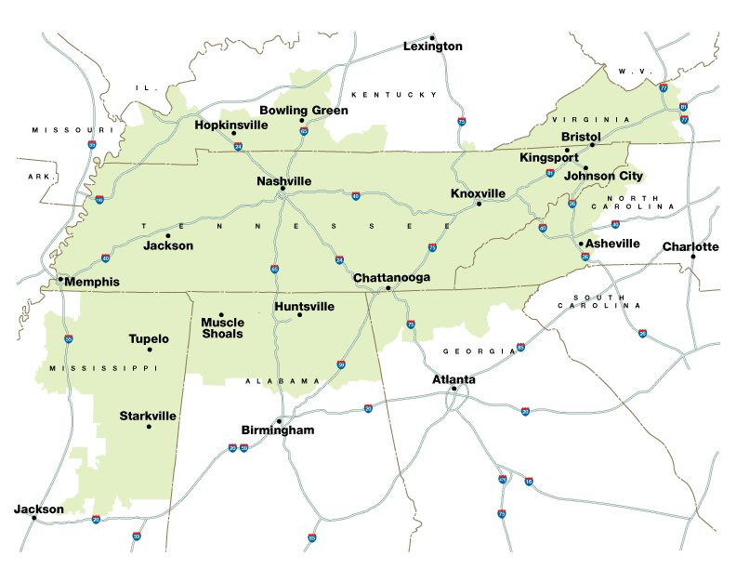
Tennessee Valley Authority
TVA is a generator and transmission owner/operator providing electricity for 153 local power companies serving 10 million people in the watershed of the Tennessee River valley.
TVA also directly serves 60 customers including large industrial facilities and federal installations.
TVA operates a network of 16,000 miles of high voltage transmission lines and 2,300 substations across our service area.

Slide 3

Outline
Introduction
TVA Network Requirements for IBR
Power Quality Evaluation Overview
Rapid Voltage Change Evaluation
Harmonic Evaluation
Case Study
Conclusion

Slide 4
System Impact Study for Inverter-Based Resource Interconnection Requests
Steady State and Breaker Duty
Telecom & System Protection
Power Quality
Dynamics
Interconnection Cost Estimating
From 2021 to 2025, TVA Power Quality staff completed SIS power quality evaluations for over 200 proposed IBR sites.
Rapid Voltage Change
Harmonic Distortion
55% RVC mitigation
35% harmonic mitigation

Slide 5
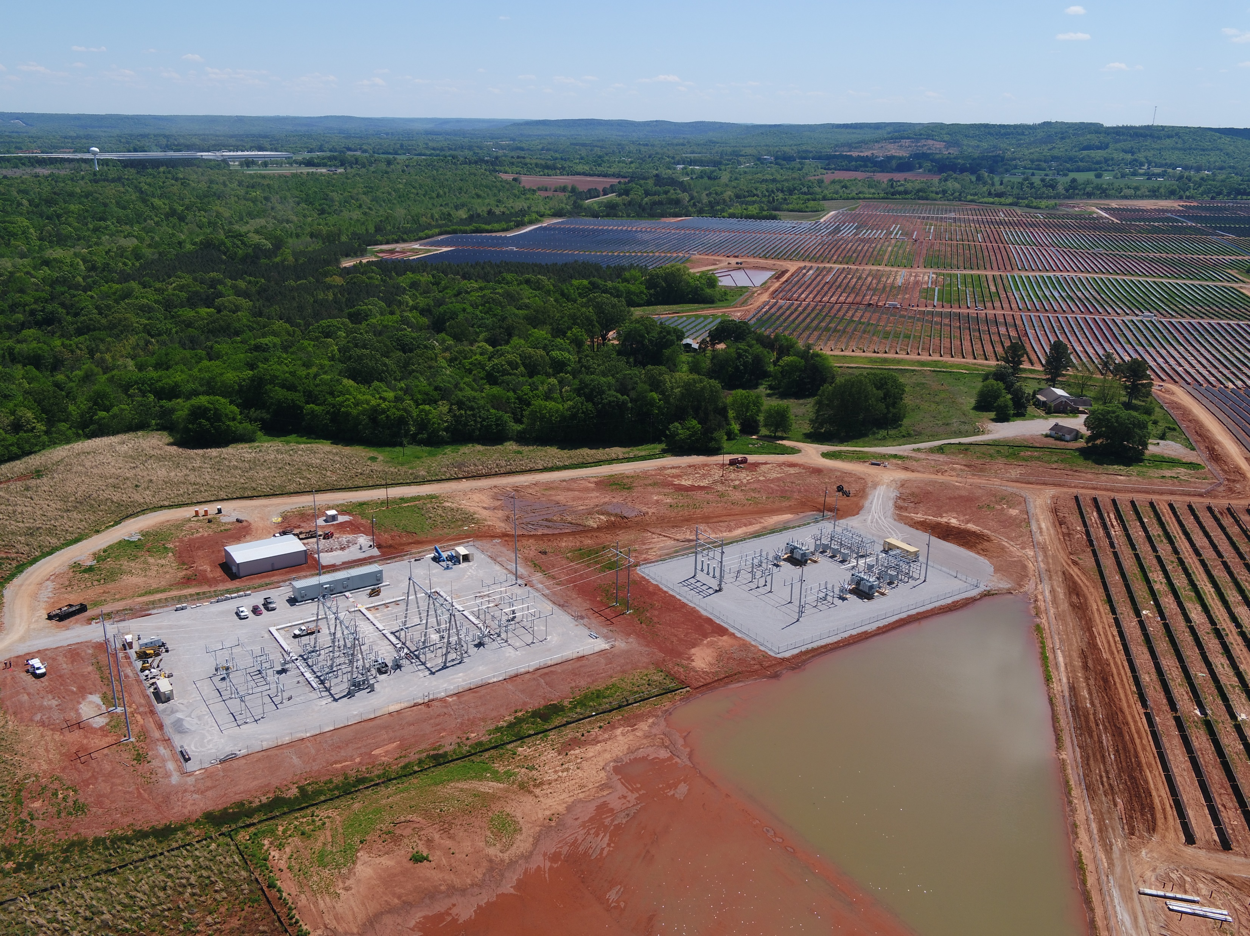
IBR Transmission Network Requirements
TVA utility scale IBR typically have 161-kV POI
IBR 75-MW or smaller may be connected through a tap on an existing transmission line.
IBR larger than 75-MW require interconnection through a three-position ring bus.
When the ratio of available Short Circuit MVA to IBR MVA is less than 3, TVA requires transmission upgrades to increase SCR at the POI.

Slide 6
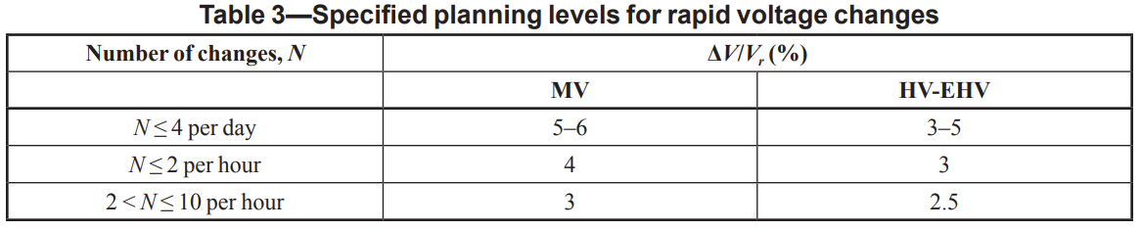
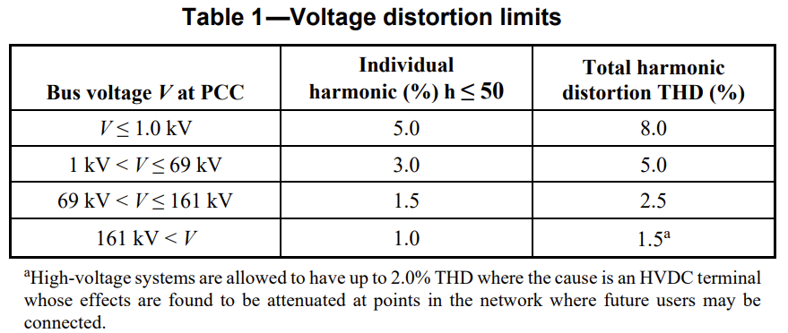
Power Quality Evaluation Overview
Rapid Voltage Change
  Energizing large GSU transformers.
  Energizing MV inverter collector circuits.
  TVA RVC Planning limits:
    161-kV POI: 5%
    500-kV POI: 3%
IEEE Std. 1453, Table 3
Voltage Harmonic Distortion
  PV inverters inject harmonics characteristic of 6 pulse rectification systems (5th, 7th, 11th, 13th…)
  IBR systems may interact with the TVA system at the POI to create objectionable harmonic voltage distortion.
  TVA 161-kv voltage harmonic distortion limits:
    Individual harmonic: 1.5%
    V_{THD}: 2.5%
IEEE Std. 519, Table 1

Slide 7
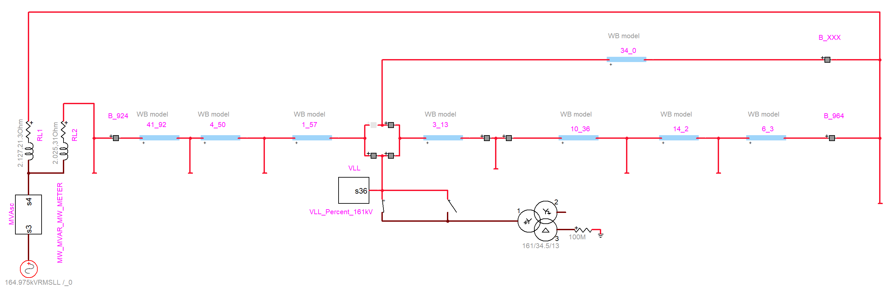
Rapid Voltage Change Evaluation EMT Model Example
Thevenin Equivalent Impedance of Substations
Verify accurate model SC MVA at substation A, B and solar POI
Delivery Point
Delivery Point
Delivery Point
Delivery Point
SW 1
SW 2
Solar Site 140 MW Net to POI
Simulate worst-case remanent flux:
SW 1 closed at t=0
SW 1 opened at t=33.333 ms
SW2 closed at t=41.667 ms (1/2 cycle later)
GSU
161/34.5/13.8-kV
120/160/200 MVA
Z1=10% @ 120 MVA
Standard magnetization data

Slide 8
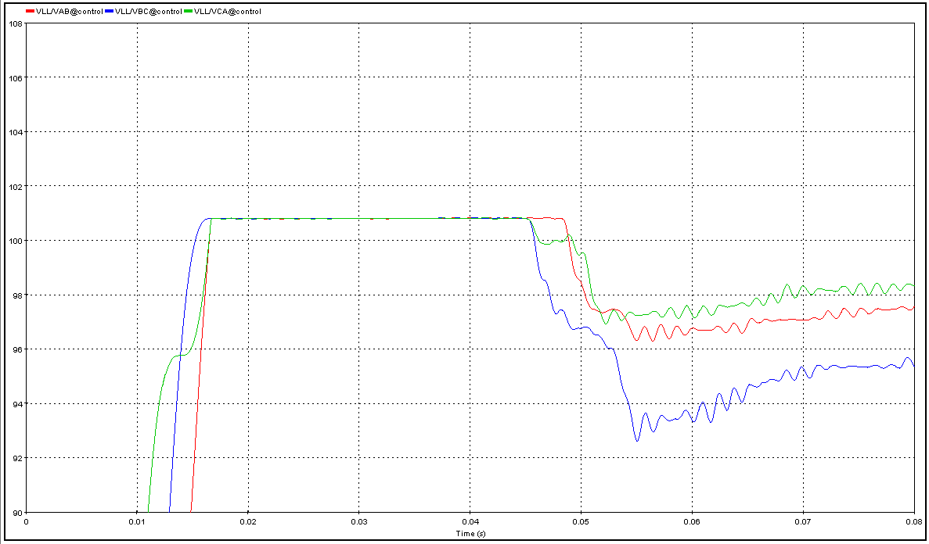
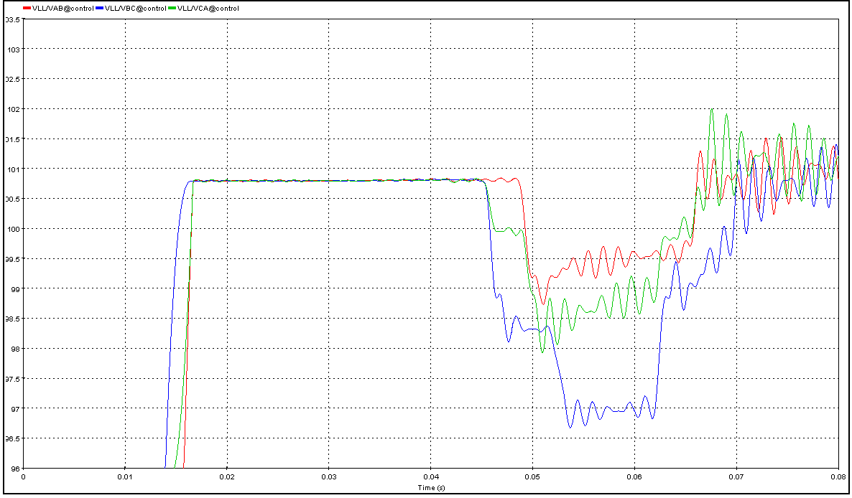
Rapid Voltage Change Evaluation
Worst Case N-1 GSU Energization RVC:
8.22% (> 5% Limit)
Proposed solution: Add minimum 70-ohm pre-insertion resistance
Worst Case N-1 GSU Energization RVC with 70-ohm PIR:
4.14% (< 5% Limit)

Slide 9
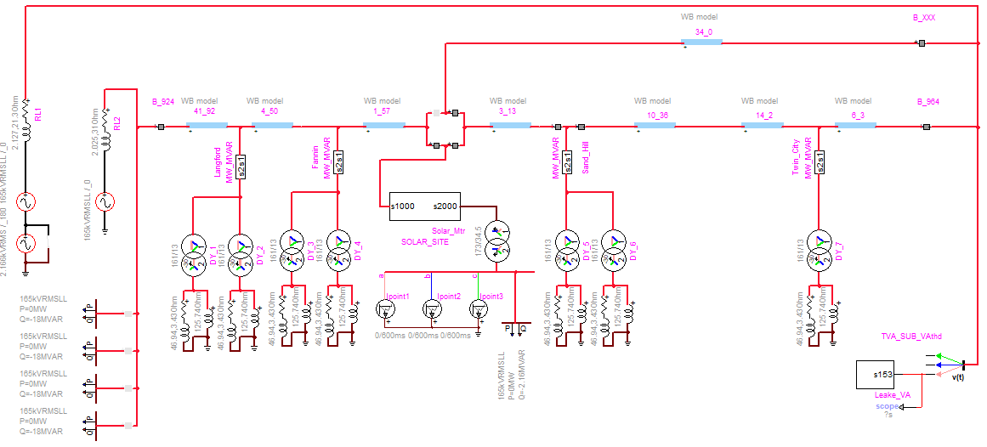
Harmonic Evaluation EMT Model Example
Measured background voltage harmonic distortion considered
34.5-kV collector cable MVAr
Solar 34.5-kV AC current injection at 100% rated site MW.
161-kV capacitor banks

Slide 10
Harmonic Evaluation
Measured 161-kV Current Distortion at Active IBR Sites
 | Solar Site A | Solar Site B | Solar Site C
Rated MW | 75 | 129 | 227
TDD | 0.74% | 0.91% | 0.98%
5th harmonic | 0.42% | 0.80% | 0.68%
7th harmonic | 0.49% | 0.32% | 0.34%
11th harmonic | 0.14% | 0.11% | 0.08%
13th harmonic | 0.07% | 0.09% | 0.01%
17th harmonic | 0.08% | 0.09% | 0.62%
19th harmonic | 0.11% | 0.11% | 0.05%
23rd harmonic | 0.01% | 0.07% | 0.00%
25th harmonic | 0.02% | 0.04% | 0.01%
6th Multiple TDD | 0.68% | 0.89% | 0.98%
At the SIS stage, EMT models of the proposed IBR facility are not available, but estimation of the potential harmonic impact is required.
TVA models harmonic current injection of proposed IBR sites by scaling current harmonic data measured at existing sites and injecting the scaled current values at the 34.5-kV side of the GSU in the EMT model.
TVA’s experience has shown that this is a reasonable approach at the SIS stage when detailed models of the proposed solar site are not available.
TVA has not adopted harmonic current distortion limits in IEEE Std. 2800-2022 which allows up to 2.5% total rated distortion (TRD).

Slide 11
Harmonic Evaluation
Medium Voltage Collector Cable Capacitance
IBR Site Rated MW | Measured 35-kV Collector Cable kVAR | Measured kVAr/Site Rated MW Ratio
70 | 920 | 13.11
100 | 1,700 | 17.00
173 | 3,500 | 20.23
200 | 2,300 | 11.50
227 | 2,300 | 10.13
 | Average kVAR/MW Ratio: | 14.40
IBR sites connect multiple inverter units to a 34.5-kV collector system through medium voltage step-up transformers.
34.5-kV underground cable contributes sufficient capacitance to alter system tuning.
In SIS EMT analysis, TVA approximates collector cable capacitance based on measured quantities at existing solar sites.
Actual capacitance will vary based on site generation capacity, physical site layout, and cable installation method.

Slide 12
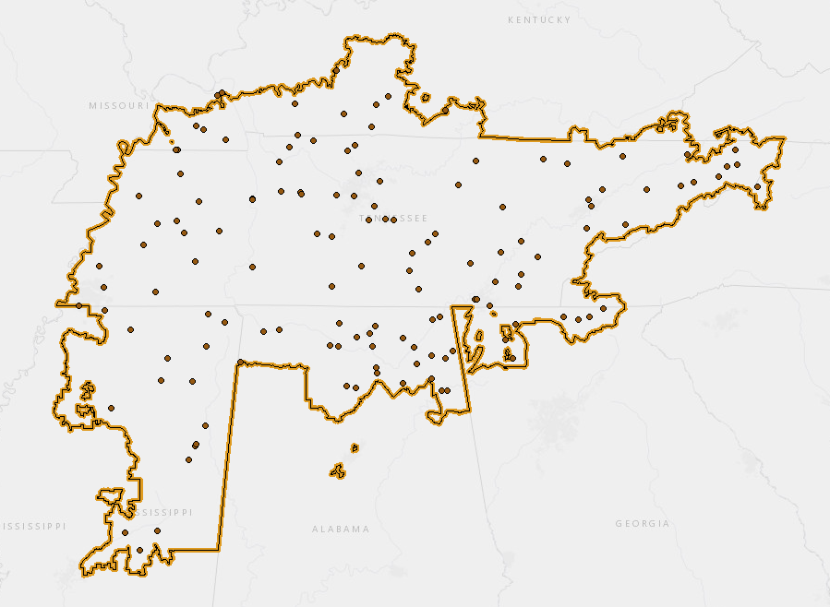
Harmonic Evaluation
TVA High Voltage Capacitor Banks
Transmission capacitor banks impact system tuning near IBR sites.
TVA has over 100 161-kV multi-stage capacitor banks on the transmission system.
For some SIS, multiple combinations of TVA transmission capacitor banks and IBR capacitors must be evaluated to identify harmonic resonance conditions.

Slide 13
Case Study: Utility Scale Solar Commissioning
Switching Station A
Switching Station B
BKR
BKR
BKR
10.6 miles
9.74 miles
12.5 miles
BKR
BKR
BKR
Wholesale Delivery Point
< 1 mile
Large Industrial Customer
2 x 36 MVAR
161-kV Capacitor Banks
BKR
Transformer
161/34.5/13.8-kV
110/146/183 MVA
Z=9% at 110 MVA
173 MW Net to POI
Solar Generation

Slide 14

Case Study – SIS RVC Evaluation
RVC Mitigation Required
Mode | Max % Voltage Change (VLL) | Under 5% Limit
All-Ties-Closed | 4.8% | YES
Radial from SS-A | 7.1% | NO
Radial from SS-B | 9.6% | NO
The PQ SIS identified that rapid voltage change mitigation is necessary for this solar site due to the Reduced SC MVA when supplied radially from SS-A or SS-B.
The IPP chose to implement independent phase closing with phase sensing control at the GSU primary breaker.

Slide 15
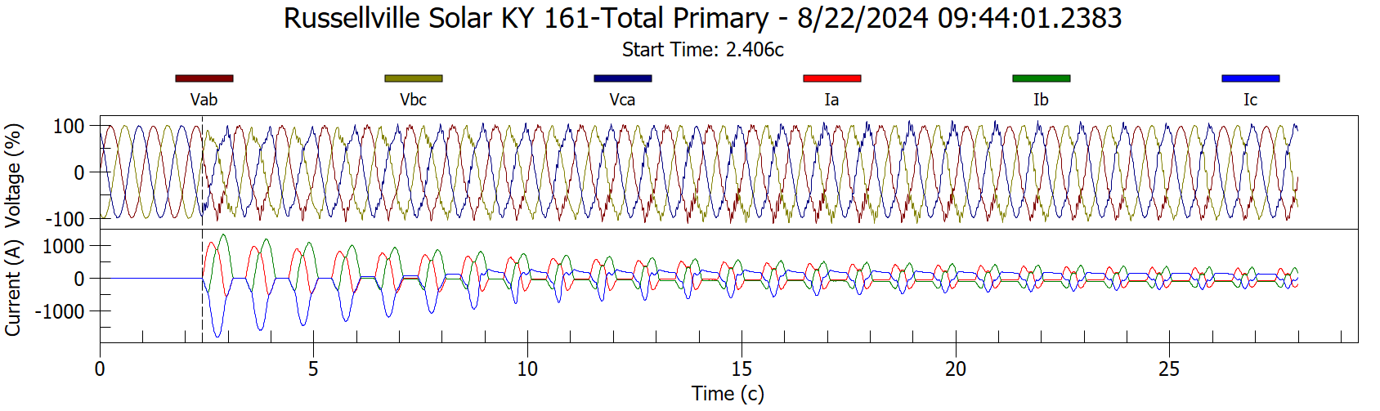
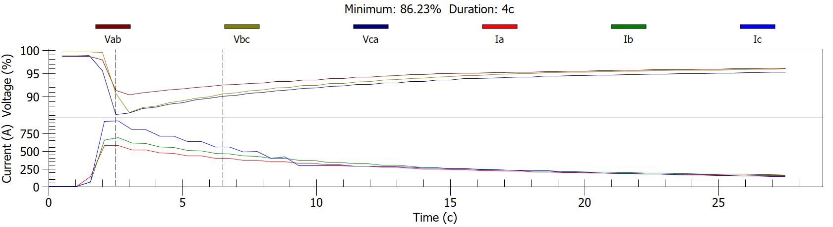
Case Study: Solar Commissioning RVC Testing
GSU energization when radial from switching station B resulted in 13.8% RVC recorded at 161-kV POI.
GSU primary breaker independent phase closing with phase sensing control was not configured during initial transformer energization.
Breaker closing controls were subsequently configured and no objectionable RVC has reoccurred.

Slide 16

Case Study – SIS Harmonic Evaluation
Background Harmonics not Considered - Harmonic mitigation not required
Mode | Switching Station B 36 MVAR Units | V_{THD} at POI Site A Generic Current Harmonic Data | V_{THD} at POI IPP-Provided Current Harmonic Data
All-Ties-Closed | 0 | 1.5% | 0.68%
 | 1 | 1.6% | 0.44%
 | 2 | 1.0% | 0.62%
Radial from SS-B | 0 | 3.9% | 2.53%
 | 1 | 2.2% | 1.10%
 | 2 | 2.8% | 1.20%
Radial from SS-A | 0 | 5.7% | 1.70%

Slide 17


During Commissioning Period: V_{THD} at 161-kV POI exceeds
IEEE 519 Limits with All Ties Closed

Slide 18
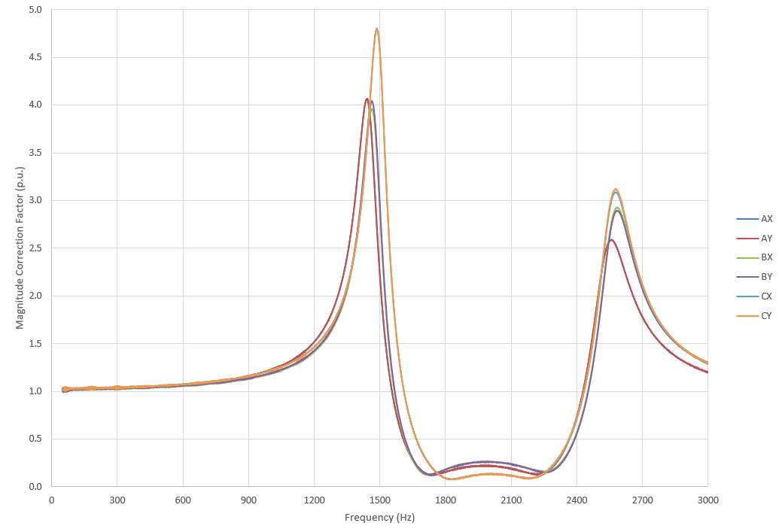
Parallel Resonance identified at PT/CT Combo Unit
Frequency Response of CT/PT Combo Unit
EPRI performed in-situ frequency response testing of the PT/CT combo unit providing the high harmonic distortion measurements.
Parallel resonance detected near the 23rd and 25th harmonics, resulting in signal amplification.
TVA employs this PT/CT combo unit at multiple other utility-scale solar sites. None have recorded high V_{THD}.
The nearby industrial site injecting 23rd and 25th harmonics and the frequency response of the CT/PT combo unit caused the elevated harmonic distortion measurements.
Courtesy of EPRI

Slide 19
Case Study – Lessons Learned
Background harmonics, including those injected by nearby industries, must be considered in power quality EMT analysis of solar sites.
An estimate of the capacitance of medium voltage collector cables at solar sites should be included in power quality analysis. This capacitance may alter system tuning and contribute to harmonic resonance.
Awareness of the frequency response of specified voltage transformers is important.

Slide 20

Conclusion
Power Quality evaluations performed early in the IBR interconnection process identify RVC and harmonic issues requiring consideration during detailed site design.
TVA evaluates IBR sites for RVC compliance with IEEE Std. 1453 and harmonic voltage distortion compliance IEEE Std. 519.
Since 2021, TVA has performed PQ evaluations for over 200 proposed IBR sites. 50% have required RVC mitigation and 35% have required harmonic mitigation.
Commissioning of IBR sites has provided lessons learned, including:
  Consideration of background harmonics and nearby harmonic producing loads,
  Consideration of IBR MV capacitance, and
  Frequency response of instrument transformers

