Slide 1
TVA Response to GMD event
05/10/2024 through 05/13/2024
By Gary Kobet and Ulyana Elliott

Slide 2
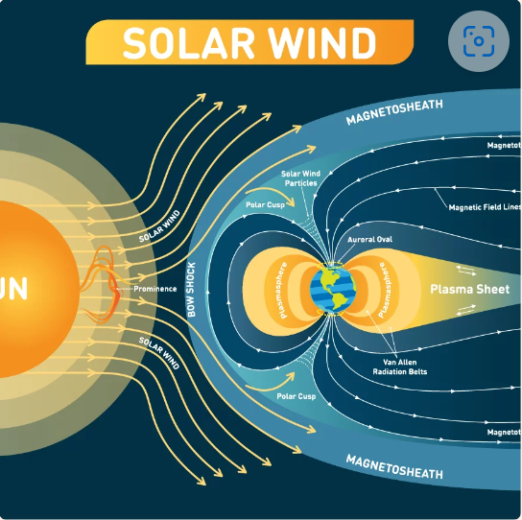
Contents
TVA Monitoring Network
Summary
TVA GIC Measurements
Weakley GIC Blocker
TVA Magnetometer Data
Harmonics
Source: https://www.reseau-teria.com/en/high-solar-activity-what-impact-will-it-have-on-your-gnss-device/

Slide 3
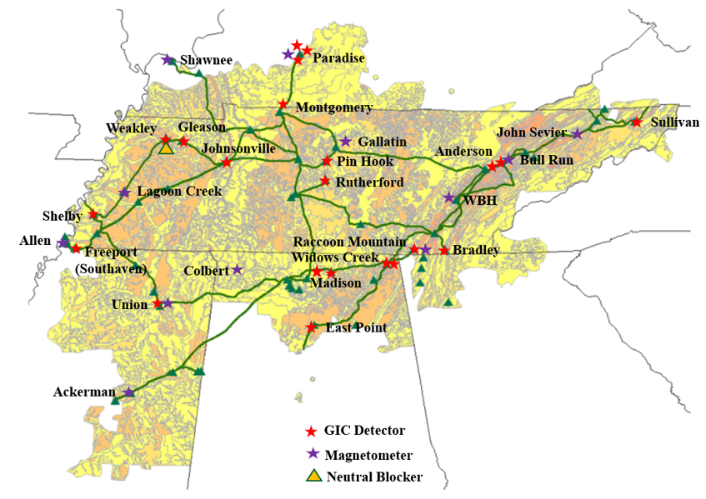
TVA Monitoring Network
GIC Detector | Magnetometer
Anderson | Ackerman
Bradley | Allen
Bull Run | Bull Run
East Point | Colbert
Gleason | Gallatin
Johnsonville | John Sevier
Madison 1 | Lagoon Creek
Madison 2 | Paradise
Montgomery 2 | Raccoon Mountain
Paradise 5 | Shawnee
Paradise 6 | Union
Paradise 7 | Watts Bar
Pin Hook
Raccoon Mountain
Rutherford
Shelby
Southaven
Sullivan 3
Union 1
Weakley
Widows Creek 10
Widows Creek 17

Slide 4
Summary
TVA began noticing effects 5/10/2024 at about 10:00AM system time (15:00UTC)
Highest GICs at Montgomery (44Adc) and Union (41Adc)
  These sites continue to seem to nearly mirror each other
  Data available from Anderson, Bull Run, Bradley, East Point, Gleason, Montgomery 2, Johnsonville, Paradise 7, Pin Hook 2, Raccoon Mountain, Shelby, Southaven, Sullivan 3, Union 1, Weakley, Widows Creek 17
  No data available from Madison 1 or 2, Limestone, Paradise 5 or 6, Widows Creek 10
Weakley GIC blocker inserted 12 times from 5/10/2024@12:05 system time to 5/12/2024@23:39 system time
  Longest insertion time was a little over 2 hours (5/10/2024 from 13:58:21 to 16:00:39 system time)
Slight increase in system harmonics
  No cap bank trips due to harmonics

Slide 5
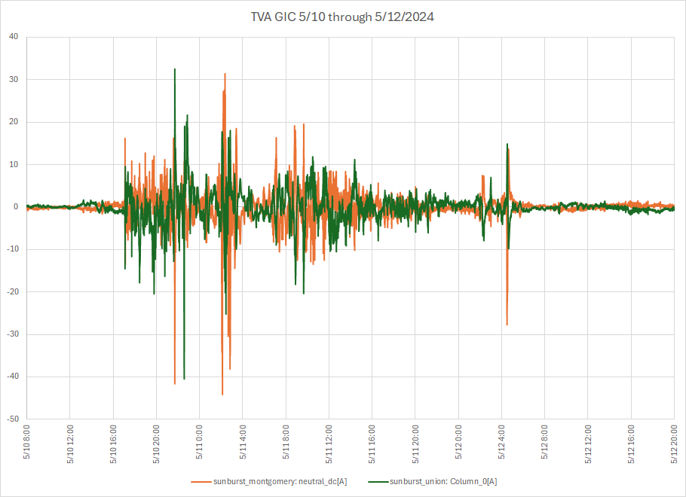
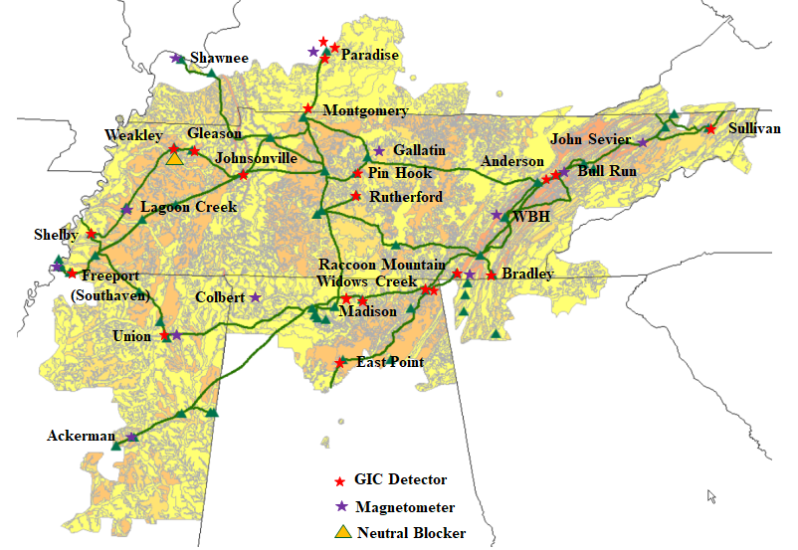
TVA GIC Measurements
Two highest sites: Montgomery & Union
Montgomery
178 mi (286km)
Union
Times are UTC (EST is UTC-5hrs)

Slide 6
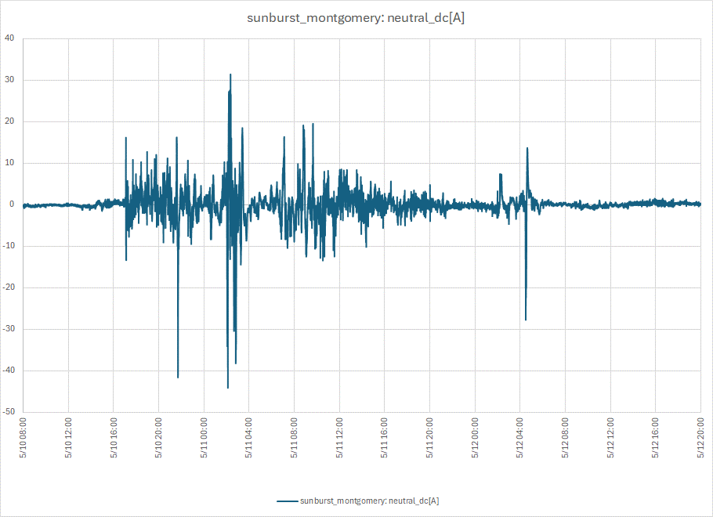
TVA GIC Measurements
Montgomery: Peak GIC -44Adc
Montgomery
178 mi (286km)
Peak GIC -44Adc on 5/11/2024@0207UTC
(5/10/2024@2107 system time-EST)
Union
Times are UTC (EST is UTC-5hrs)

Slide 7
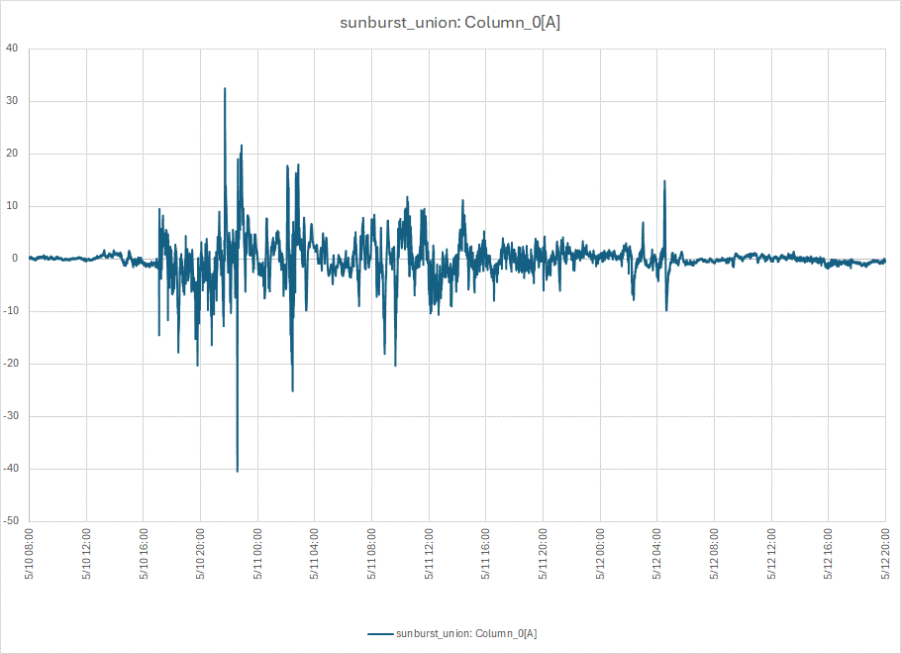
TVA GIC Measurements
Union: Peak GIC -40Adc
Montgomery
178 mi (286km)
Peak GIC -40Adc on 5/10/2024@2235UTC
(5/10/2024@1735 system time-EST)
Union
Times are UTC (EST is UTC-5hrs)

Slide 8
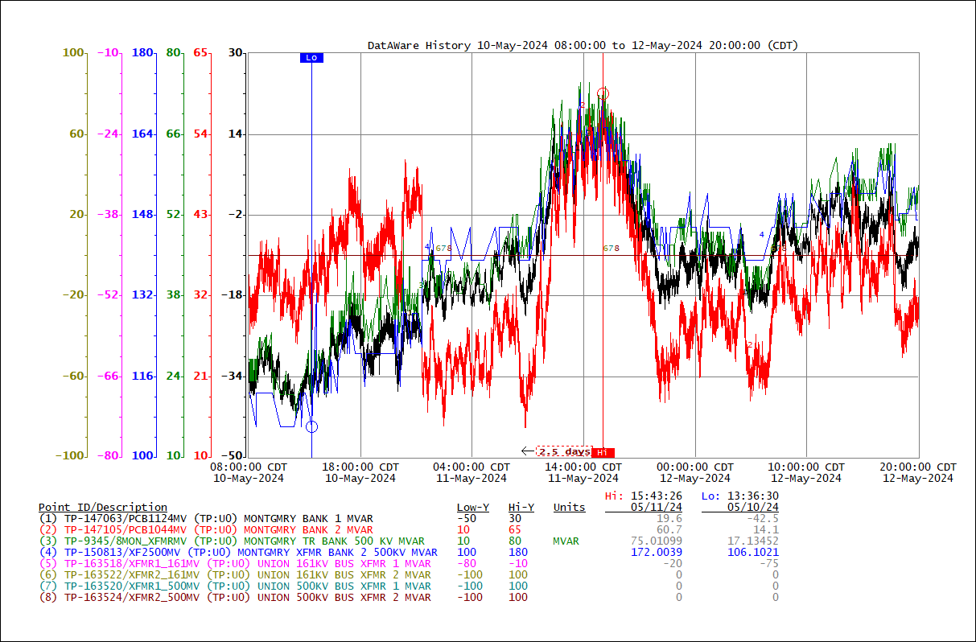
TVA GIC Measurements
Montgomery & Union Banks MVAR
Peak MVAR on 5/11/2024@about 1430 system time (1930UTC) (no correlation to peak GIC)

Slide 9
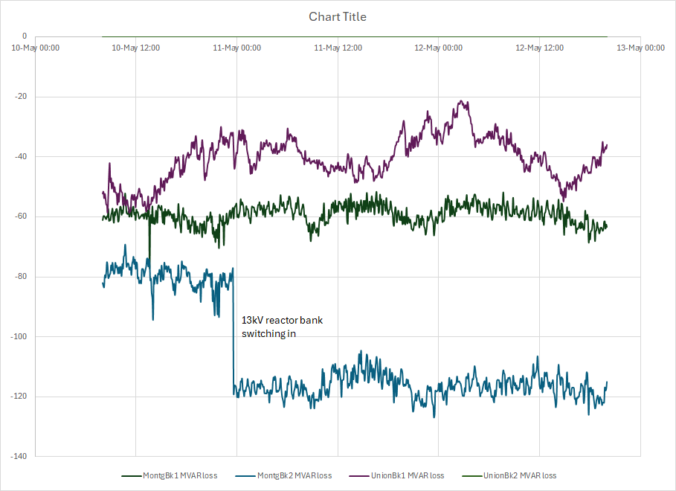
TVA GIC Measurements
Montgomery & Union Banks MVAR losses
Bank MVAR losses (no correlation to peak GIC)

Slide 10
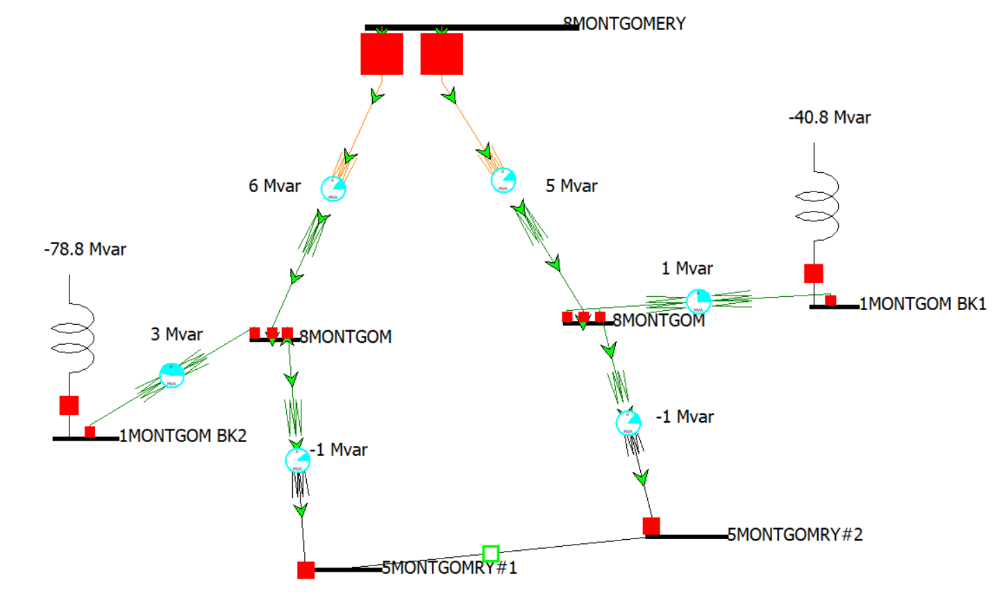
TVA GIC Measurements
Montgomery Banks MVAR losses

Slide 11
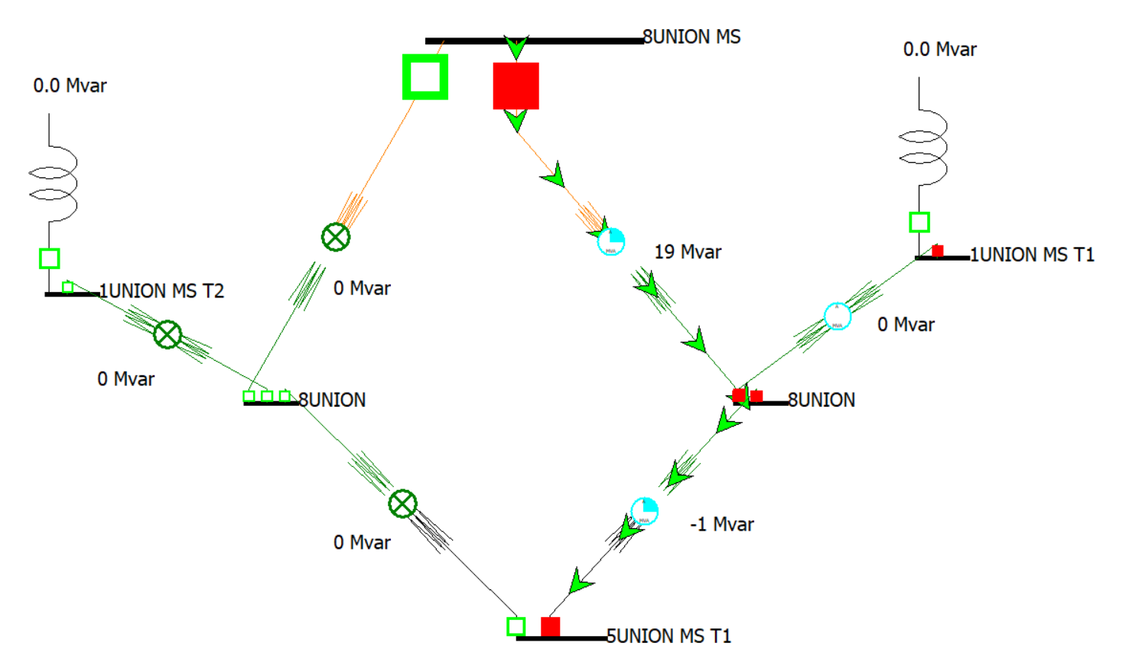
TVA GIC Measurements
Union Banks MVAR losses

Slide 12

Weakley GIC blocker
NBD = Neutral Blocking Device

Slide 13
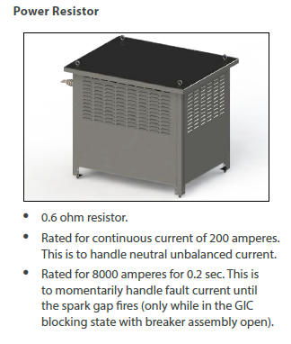
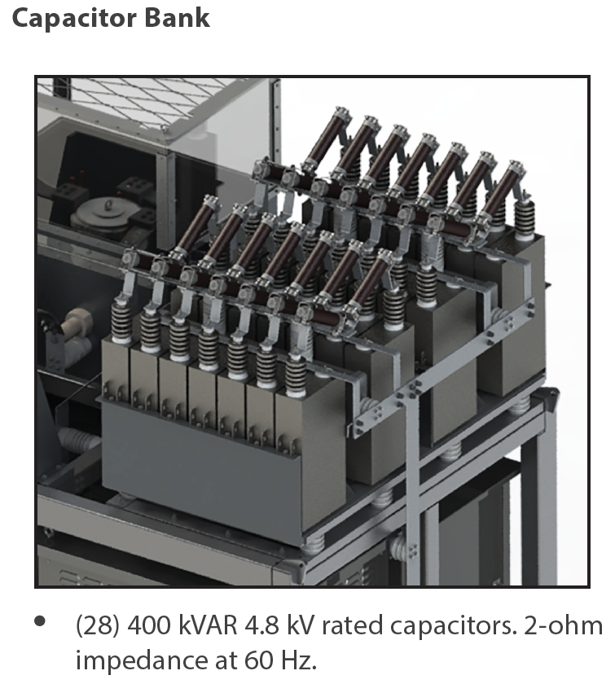
Weakley GIC blocker
Resistor-Capacitor Ratings

Slide 14
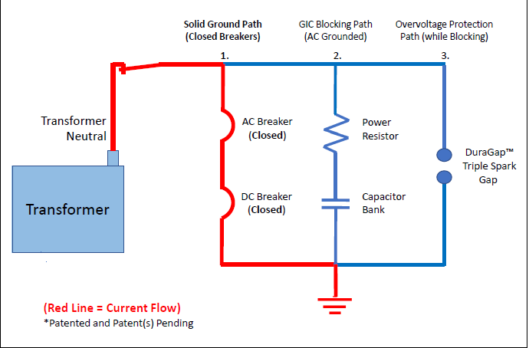
Weakley GIC blocker
GIC Blocker – normal state
Transformer neutral solidly grounded
CT1
CT2
VP1
CT3

Slide 15
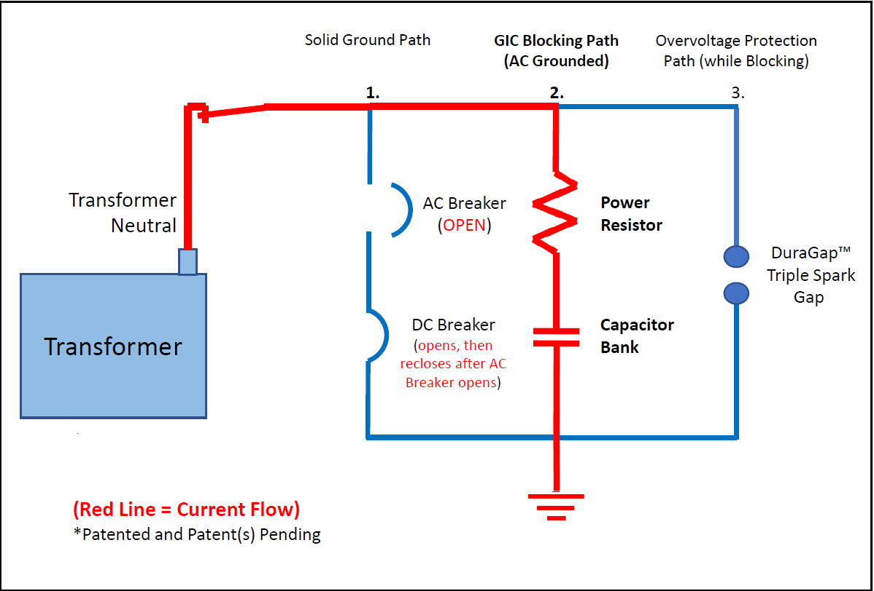
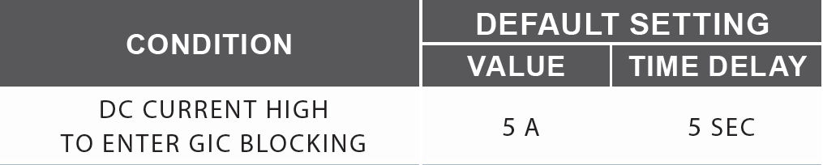
Weakley GIC blocker
GIC Blocker – inserted
When GIC in excess of 5Adc:
DC Breaker opens
DC Breaker aux contact opens AC Breaker
DC Breaker re-closes
AC Breaker remains open
CT1
CT2
VP1
CT3

Slide 16

Weakley GIC blocker
GIC Blocker – return to normal
Once the power system event has cleared:
If no GIC present (VP1<5V for 1hr), remains solidly grounded (closed breaker assembly)
CT1
VP1
CT2
CT3

Slide 17
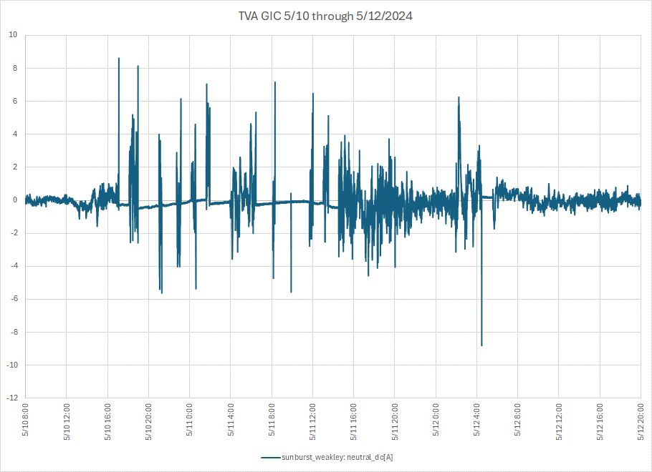
Weakley GIC blocker
Weakley GIC Measurements
2
4
6
8
10
12
Weakley GIC blocker had 12 insertions during the GMD storm
1
3
5
7
9
11

Slide 18
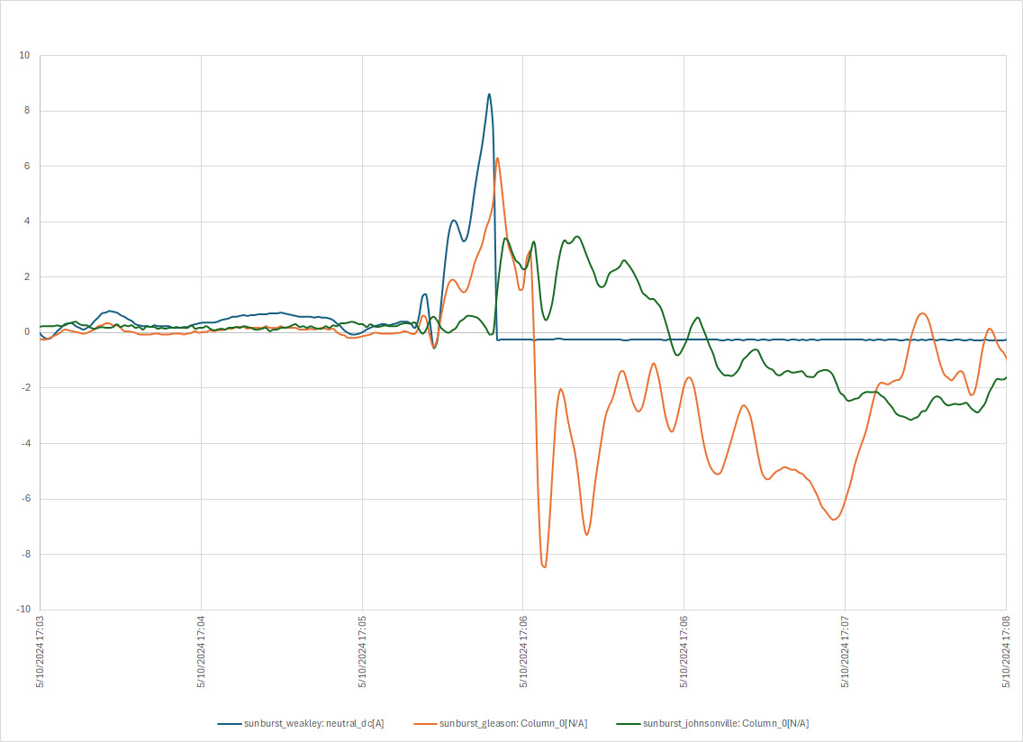
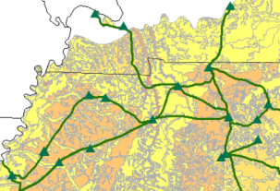
Weakley GIC blocker
Johnsonville & Gleason GIC
Change in Johnsonville/Gleason GIC when Weakley GIC blocker inserts 12:05:54EST
Weakley
Gleason
Johnsonville
GIC Detector
Neutral Blocker
Times are UTC (EST is UTC-5hrs)

Slide 19
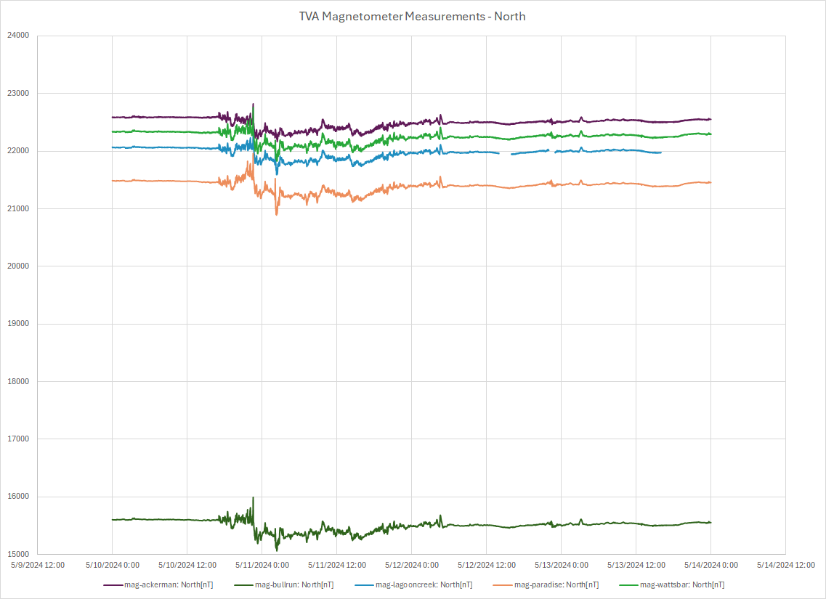
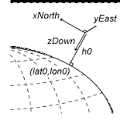
TVA Magnetometer Data-North
*
*https://www.mathworks.com/help/map/choose-a-3-d-coordinate-system.html

Slide 20
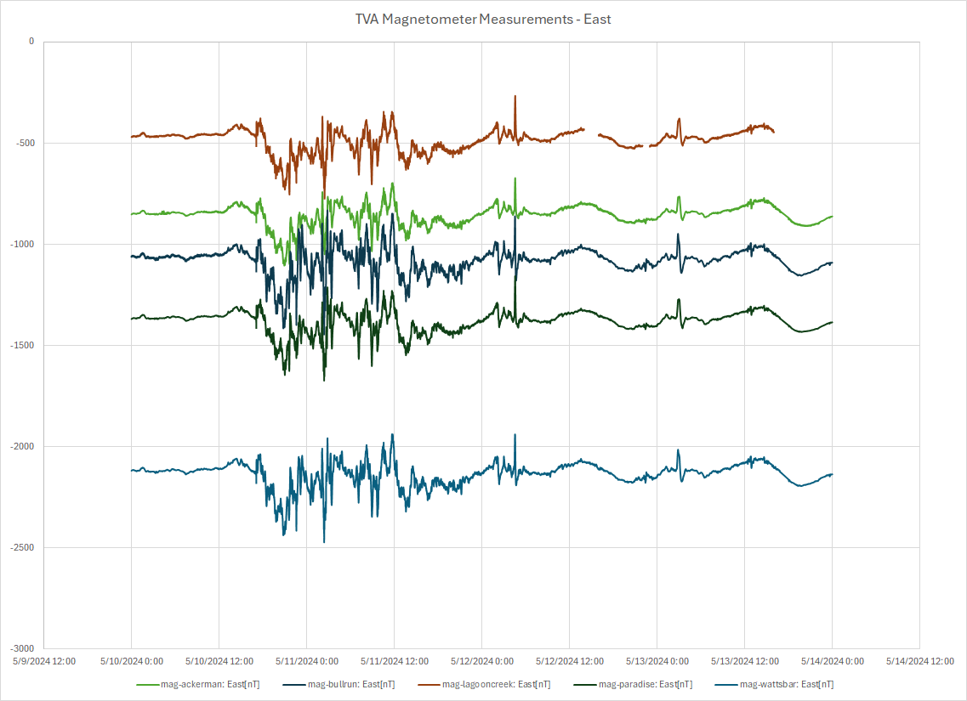
TVA Magnetometer Data-East
*
*https://www.mathworks.com/help/map/choose-a-3-d-coordinate-system.html

Slide 21
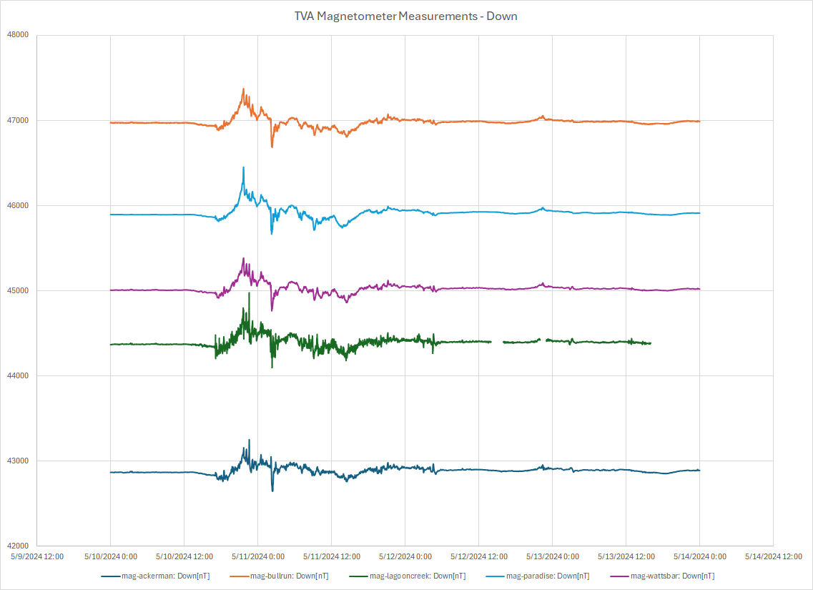
TVA Magnetometer Data-Down
*
*https://www.mathworks.com/help/map/choose-a-3-d-coordinate-system.html

Slide 22
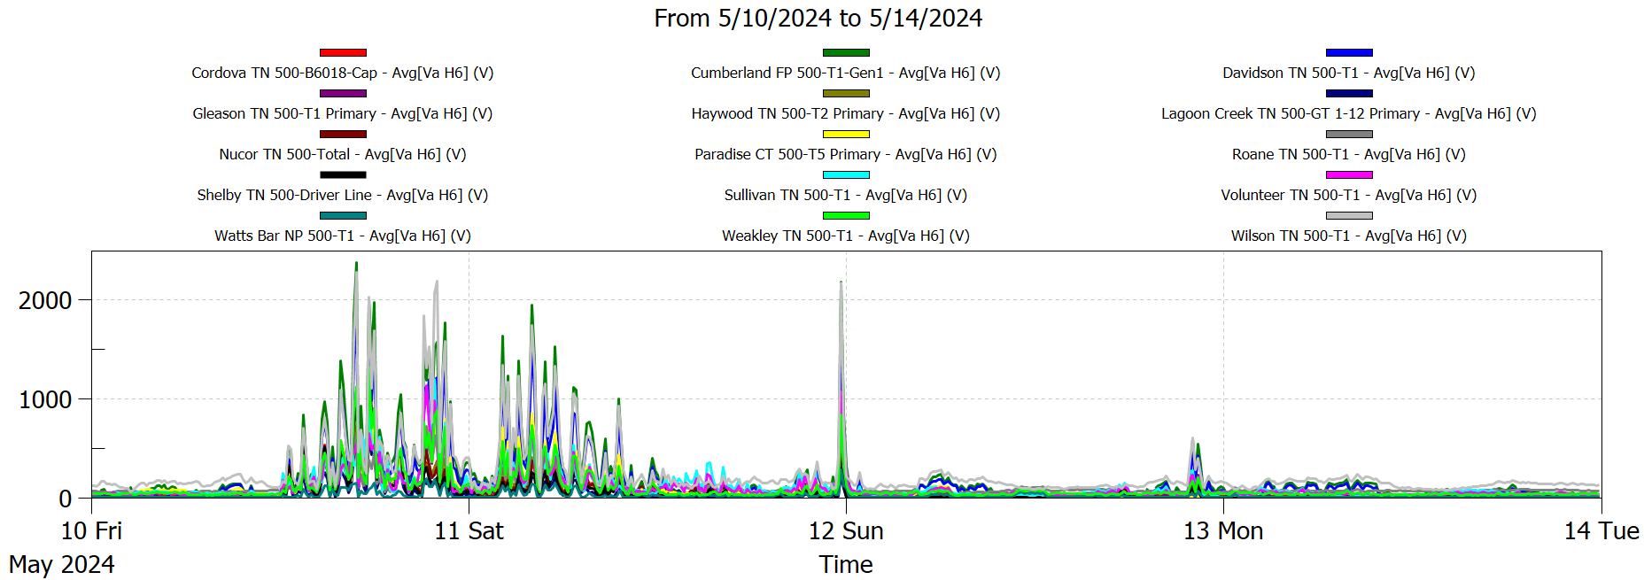
TVA Harmonic Measurements
slight increase, considered insignificant

Slide 23
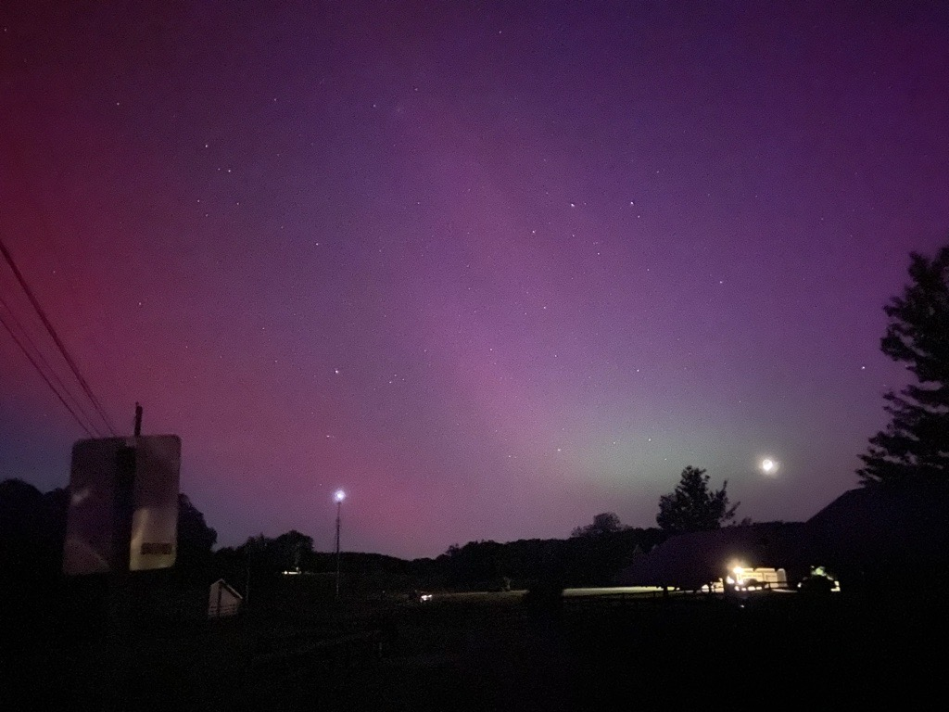
Questions?
Aurora borealis visible from Signal Mountain, TN around 11:30PM EDT on Friday, May 10th, 2024.

