Slide 1
Understanding and interpreting lightning data
Dr. Ryan Said, Dr. Martin Murphy, Brooke Pearson, Hans Loewenheath
Vaisala Xweather
Agenda:
Lightning Locating System (LLS) applications
How an LLS works
Interpreting and using LLS data

Slide 2
Applications of LLS data

Slide 3
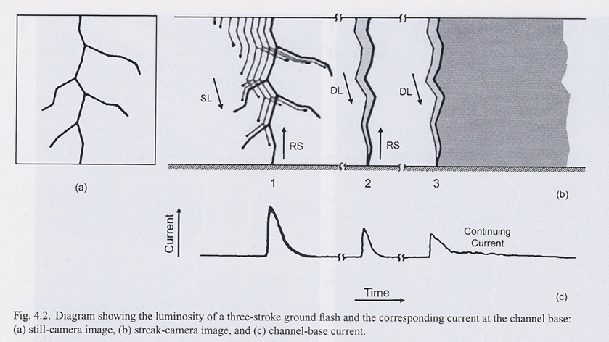
A cloud-to-ground flash consists of one or more return strokes
Return strokes last for tens of microseconds
Peak current
Max rate-of-rise
Rakov and Uman, 2003, Ch4
Notes:
Any kind of lightning that hits a turbine transfers electrical current, which can cause damage
The distribution of these current parameters vary by type of lightning
Let’s take a look at a negative CG flash
This diagram from a textbook shows three views
Panel a shows what a long-exposure photo might look like, with a branched structure of the downward negative leader
Panel b shows time on the x-axis, imagine rotating the camera during the flashes. Panel c shows the current at the channel base on the same time axis
What you see is a current surge when the stepped leader makes contact with the upward connecting leader. This leads to a return stroke that lasts for a few tens of microseconds.
There’s then a calm period, and we might see one or more subsequent return strokes with their own current surges
The peak current in these events can range from a few kA to several hundred kA
There may also be something called a continuing current, which is much lower in amplitude, around a few hundred amps, but it can last for 1000 times as long – 10s or 100s of milliseconds
Positive CG strokes typically have just one return stroke are more likely to have a continuing current

Slide 4
Precision lightning data provides real-time correlation of lightning-caused faults
Lightning strikes to infrastructure can cause flashovers and faults
  Flashover: voltage spike from a lightning strike to a phase or shielding wire, causing a line-to-ground fault
  Backflashover: line-to-ground fault initiated by insufficiently grounded tower
  Induced voltage spikes from lightning a strike nearby
Fault current causes breakers to trip and a momentary outage
Lightning Data Verification:
  Time & Location Correlation – Match stroke timestamp and error-ellipse location with transient recorder data to confirm a lightning‐caused trip
  Peak Current Estimate – Stroke amplitude (kA) indicates strike severity and the likelihood of flashover

Slide 5
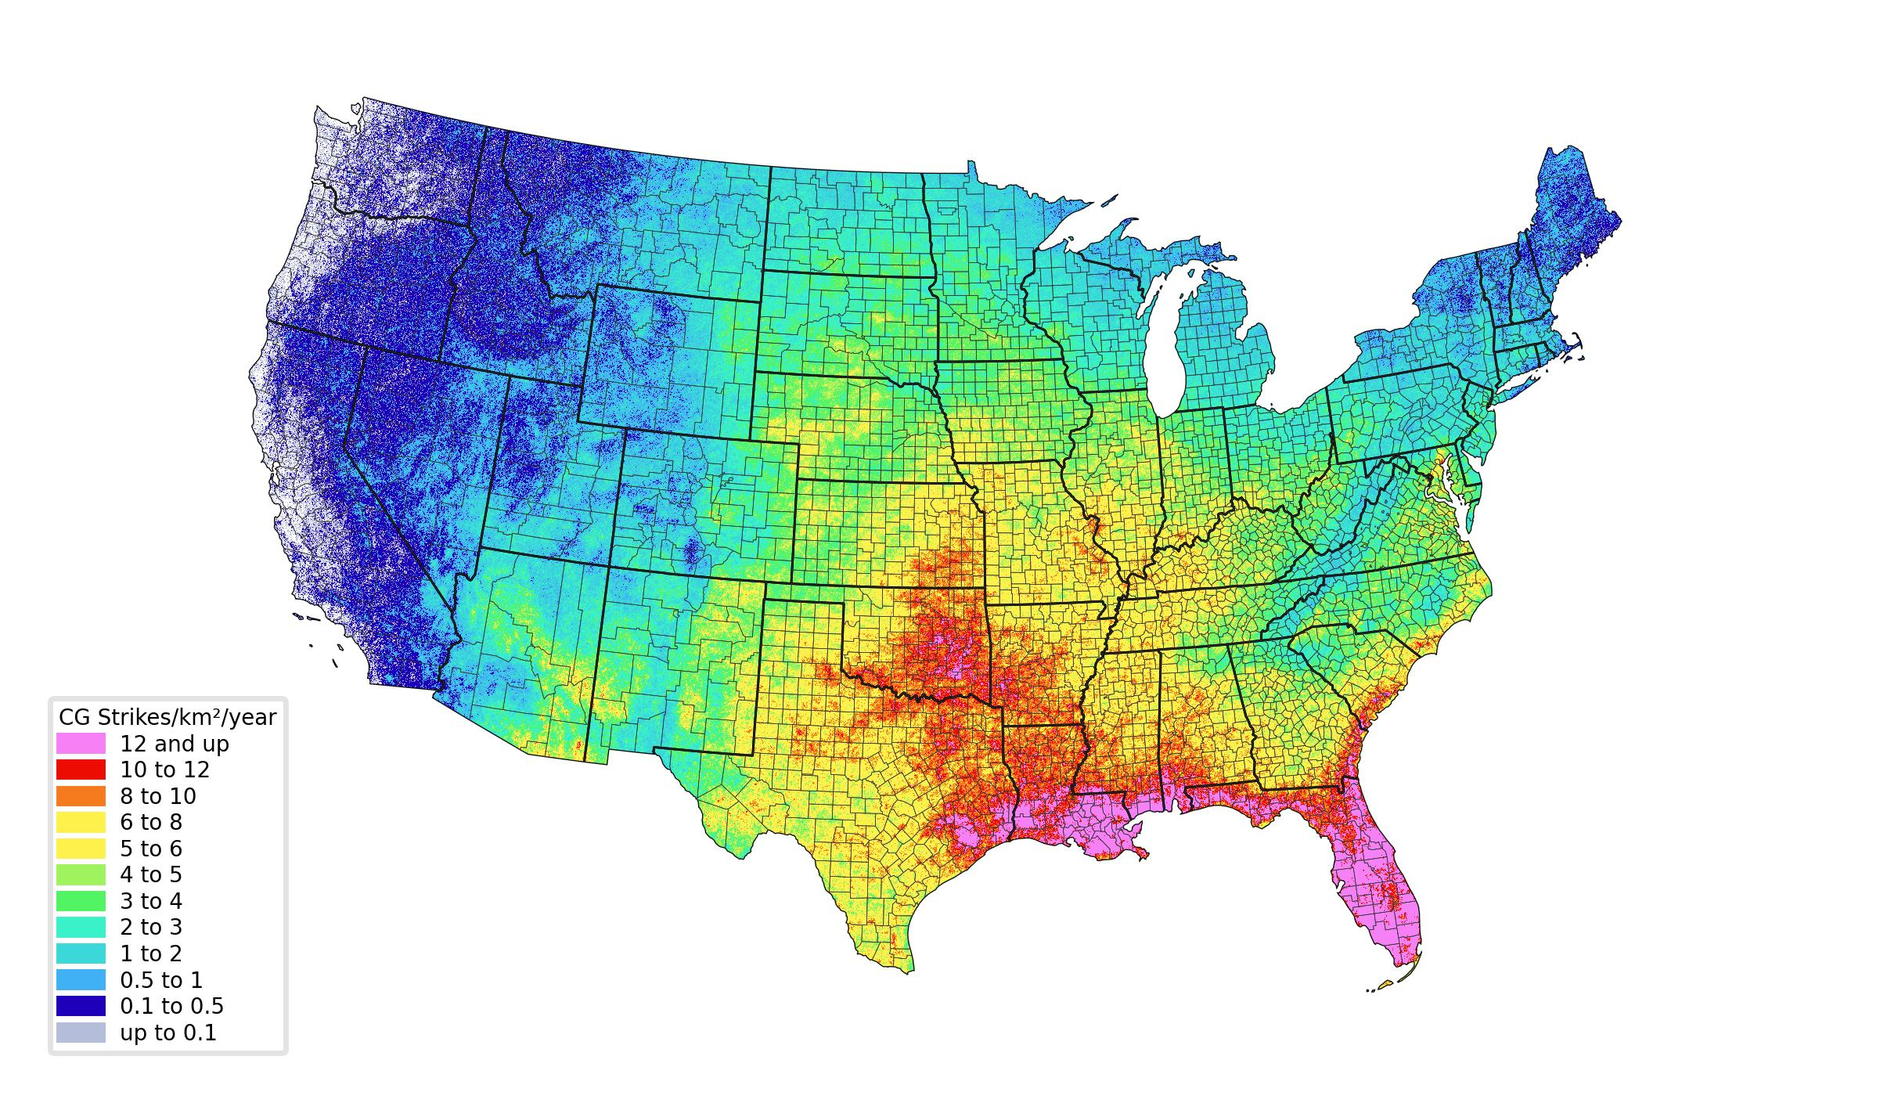
Historical lightning records reveal the exposure along a line
10-year NLDN Cloud-to-ground (CG) strike-point density
2015-2024 (inclusive)

Slide 6
How a Lightning Location System (LLS) Works

Slide 7
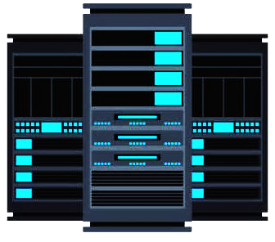
Lightning Locating Systems (LLS) use remote sensors and a central analyzer to determine latitude, longitude, time, and more
Remote sensors:
  Detect radio-frequency signals generated by lightning
  Stream to central analyzer: Time of Arrival (TOA), Magnetic Direction Finding (MDF), amplitude, and other parameters
Central analyzer:
  Finds sensor reports produced by the same lightning source
  Calculates latitude, longitude, time + other characteristics of each lightning event using observations from multiple sensors

Slide 8
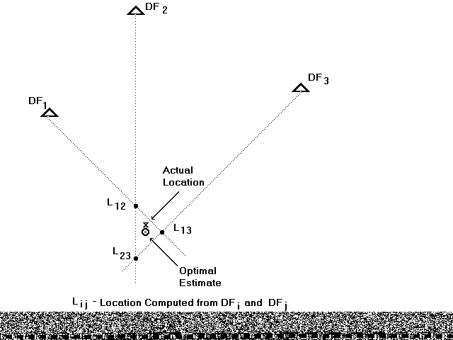
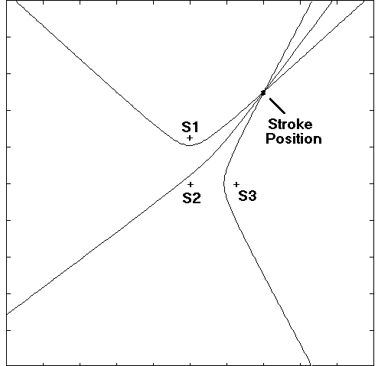
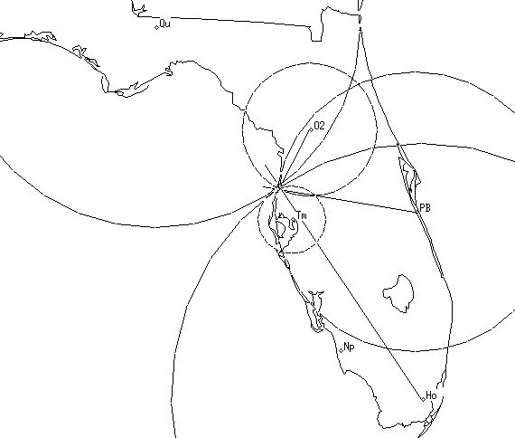
Vaisala combines angle of arrival (MDF) and TOA location methods
MDF TOA Combined DF+TOA
Location with 5 sensors using a combination of MDF and TOA
Optimize solution by minimizing squared errors between all observed and calculated times/angles
Provides a network with more uniform coverage and more resilience to sensor outages

Slide 9
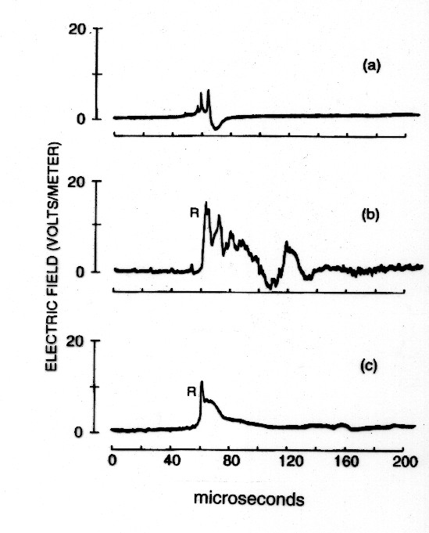
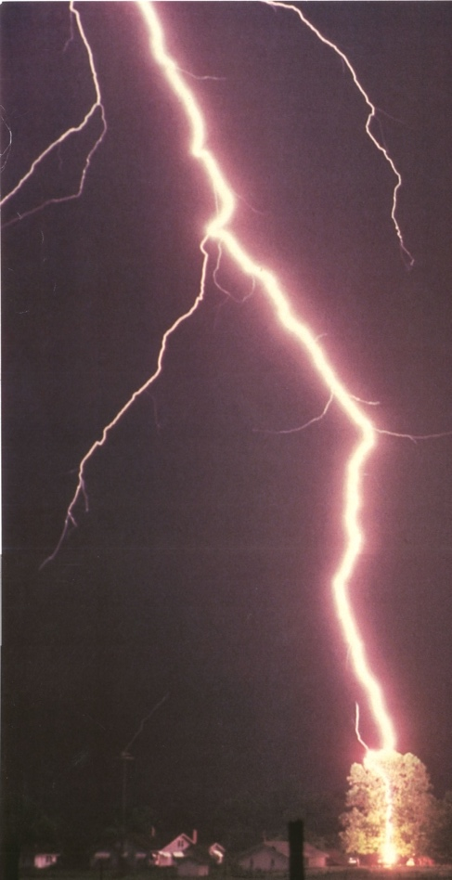
Lightning signal shapes are used to determine if lightning hit the ground
IC pulse
CG first stroke
Photo © 1994 by Ron Holle
CG subsequent stroke
Photo © 1984 by Johnny Autery
Notes:
Features of the shapes (“waveforms”) are used in classification: telling the difference between what hits ground and what stays in the cloud

Slide 10
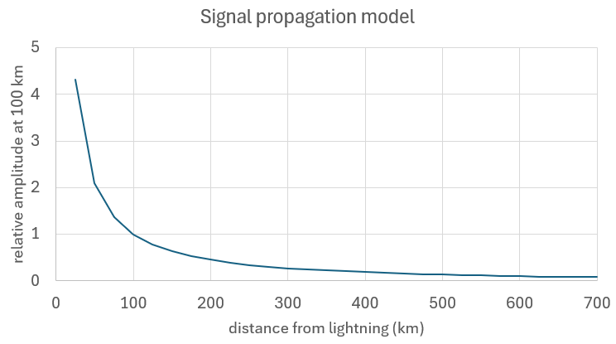
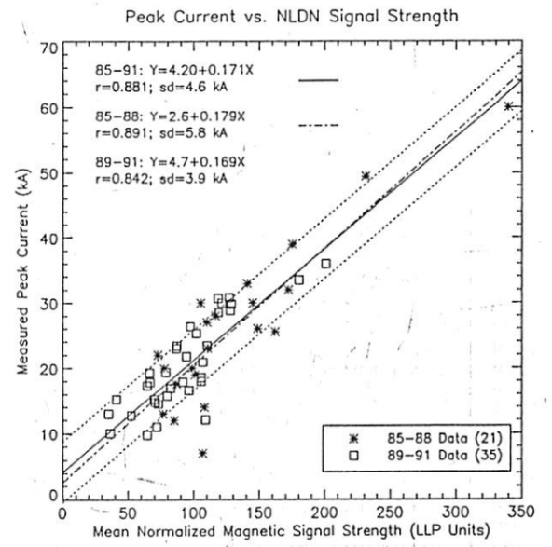

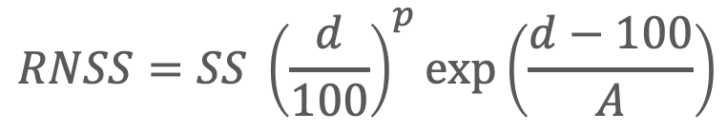
Peak current and sensor amplitude are linearly correlated at a fixed distance
Step 1: Range-normalize sensor amplitudes to 100 km:
$$RNSS=SS {\left(\frac{d}{100}\right)}^{p}exp\left(\frac{d−100}{A}\right)$$
$$d$$
Step 2: Convert RNSS to channel-base peak current. Assuming lowest portion of lightning channel acts as a transmission line, normalized amplitude is linearly related to peak current
Idone, V.P. et al. 1993: J. Geophys. Res., 98, 18323-18332

Slide 11
LLS Performance

Slide 12
Performance is determined by how much and how well lightning is detected
Location Accuracy (LA): how close to the real location did we get?
Detection Efficiency (DE): what fraction (or percentage) of the lightning is detected?
Classification Accuracy: how well did we differentiate between CG strokes and IC pulses?
Notes:
LA relevant to individual return strokes in CG flashes
expressed by median, due to skewed & one-sided distribution

Slide 13
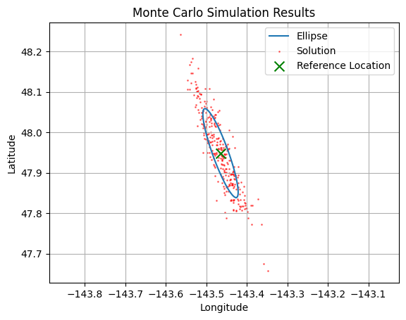
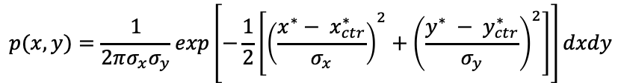
The LLS estimates the location accuracy for each event by calculating an error ellipse at the 50th percentile confidence level
Semi-major axis
Confidence region (50th percentile)
Probability density follows 2D joint Gaussian distribution
$$p(x,y)=\frac{1}{2πσ_{x}σ_{y}}exp\left[−\frac{1}{2}\left[{\left(\frac{x^{∗}− x_{ctr}^{∗}}{σ_{x}}\right)}^{2}+{\left(\frac{y^{∗} − y_{ctr}^{∗}}{σ_{y}}\right)}^{2}\right]\right]dxdy$$
Semi-minor axis
Ellipse determined by:
  Time and angle uncertainty at each sensor
  Sensor locations
  Solution location
Notes:
Lightning position is at center of ellipse
Probability level determines the probability that the actual lightning event is somewhere inside the ellipse
Semi-major axis provides a single number that represents the worst-case location error

Slide 14
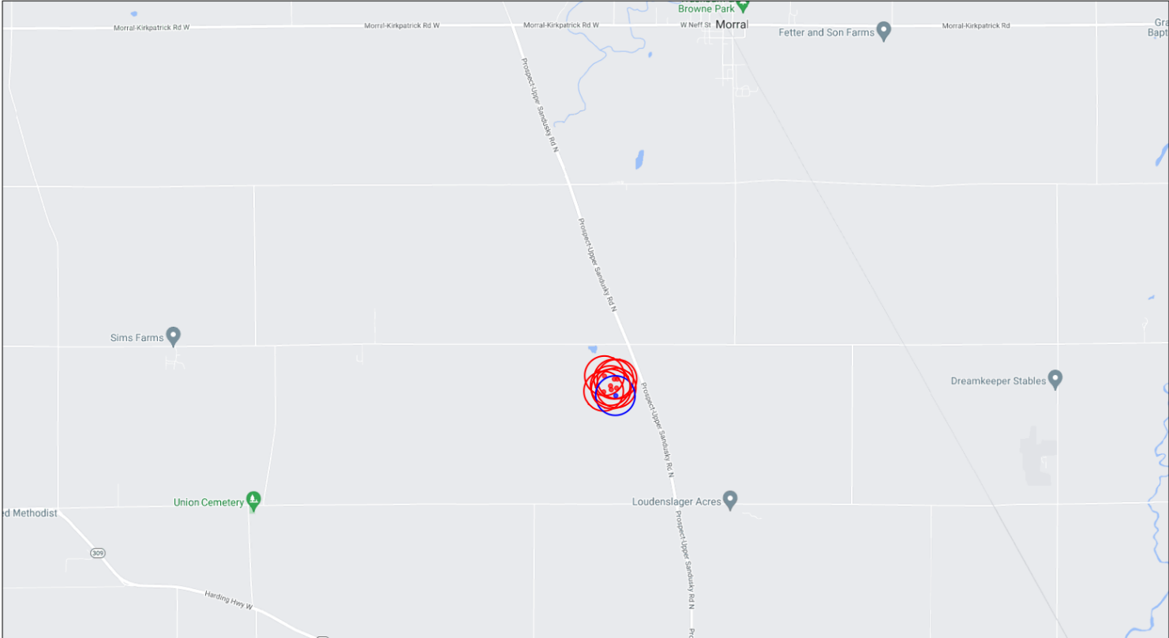
A typical CG flash in the NLDN has 50% error ellipses with better than 200-meter axes
CG strokes (7)
IC pulse (1)
1 km
Notes:
Small ellipse axes will be allowed later in 2025 to provide the accuracy closer to reality, instead of over-inflated when well located.

Slide 15
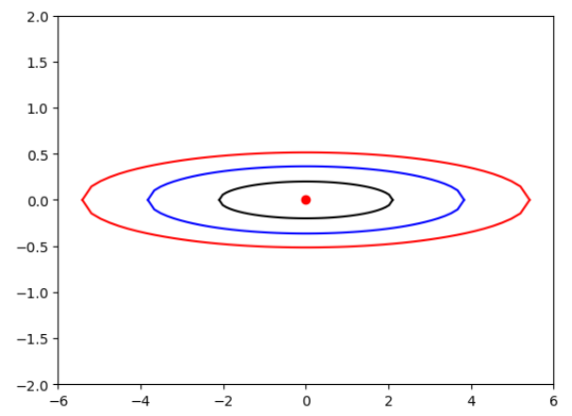
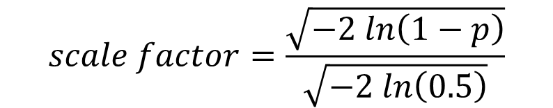
Ellipses are scalable with the probability level depending on desired confidence
The 50th percentile ellipse is reported with each stroke
If desired probability level is given as a fraction p (0-1) then:
50%
90%
99%
Probability levels
kilometers N-S
$$scale factor=\frac{\sqrt{−2 ln\left(1−p\right)}}{\sqrt{−2 ln\left(0.5\right)}}$$
kilometers E-W

Slide 16
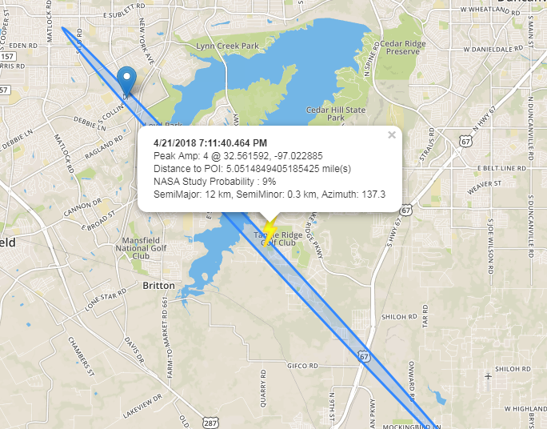
Lightning correlating to a fault is very rarely calculated to be far away, e.g. 5 mi
Real customer case:
4 kA: very low current
Detected by only 2 sensors
Fairly uncommon on both points...
Reported error ellipse allows for poorly-located events to be correlated
Notes:
Time correlation gives one clue
Ellise collision with a line gives another clue

Slide 17
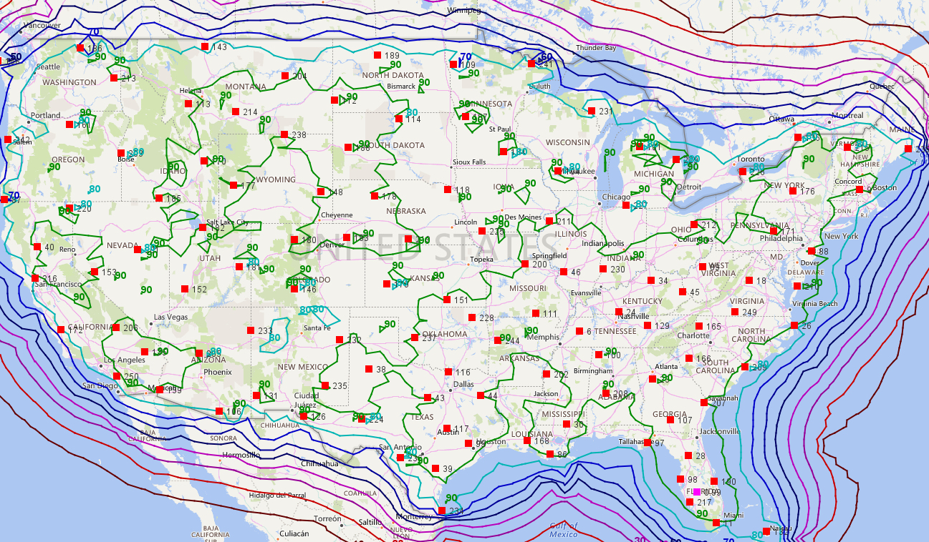
Detection Efficiency model incorporates sensor response, propagation effects, and source amplitudes
Sensor response: sensor detection threshold and saturation
Propagation effects: geometric spreading and exponential decay
Source amplitudes: Integrate across distribution of expected effective peak currents (eg CG or IC)
For each location:
Identify detection probability at each sensor based on the arrival amplitude
Consider all combinations of sensors that may contribute
Calculate distribution of error ellipses and accumulated detection probability
Typical CG flash DE > 95%

Slide 18
Effects of bidirectional classification errors are impacted by the distribution
Positive polarity events
Negative polarity events
IC pulses
IC pulses
A few misclassified +IC events results
in a flood of misclassified +CG
Some misclassification of negative events
also occurs, but the net effect is less severe
Overall rate of misclassification for all events of both polarities is around 5-10%

Slide 19
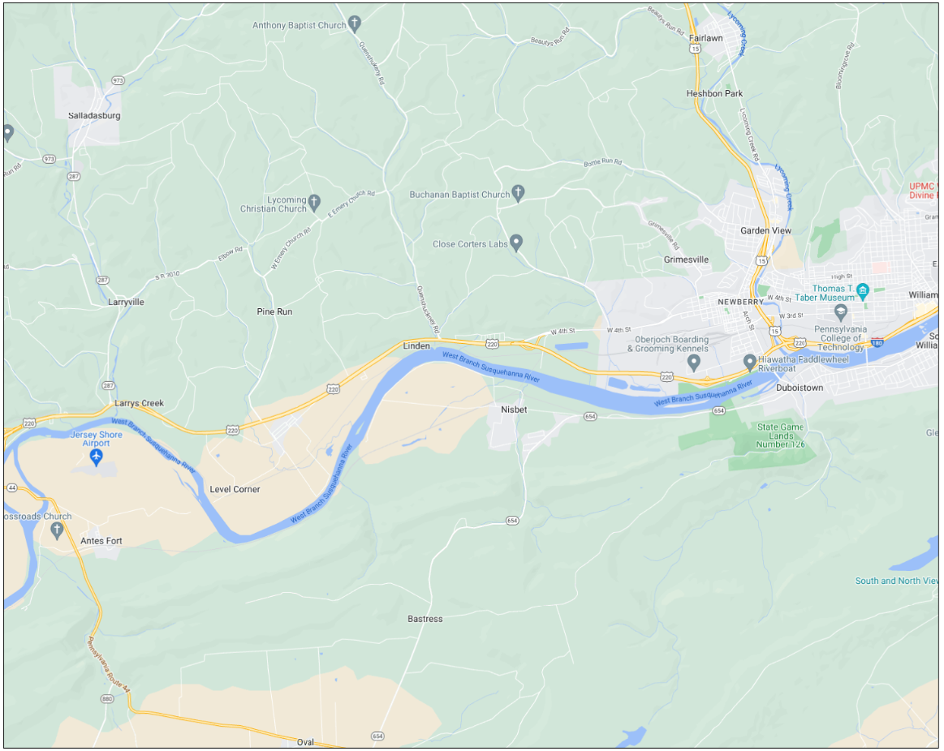
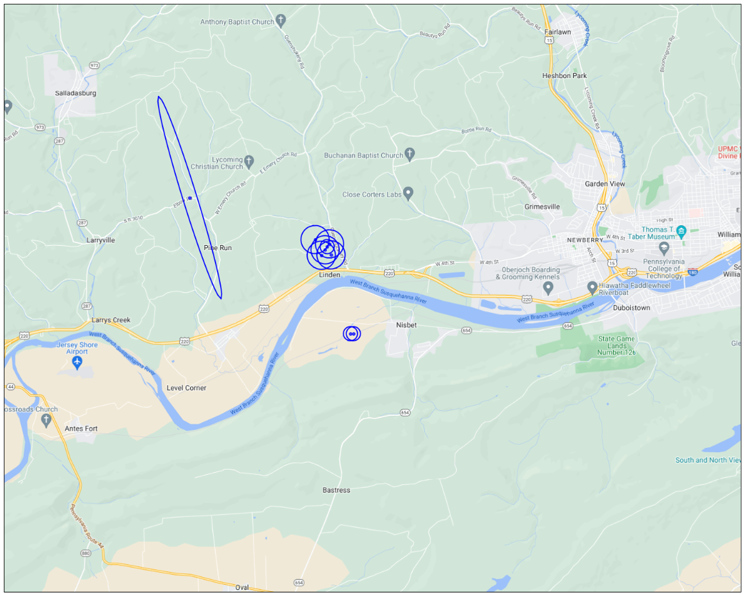
If fault correlation query shows zero CGs, try including IC events in the query
Case from August 2021
Query of CG only
With IC events included
Power line fault in this general area
Lightning was observed but all classified as “IC,” when actually one may have been a CG
Notes:
Make sure to point out that most are actually IC, but likely just one was actually a CG

Slide 20
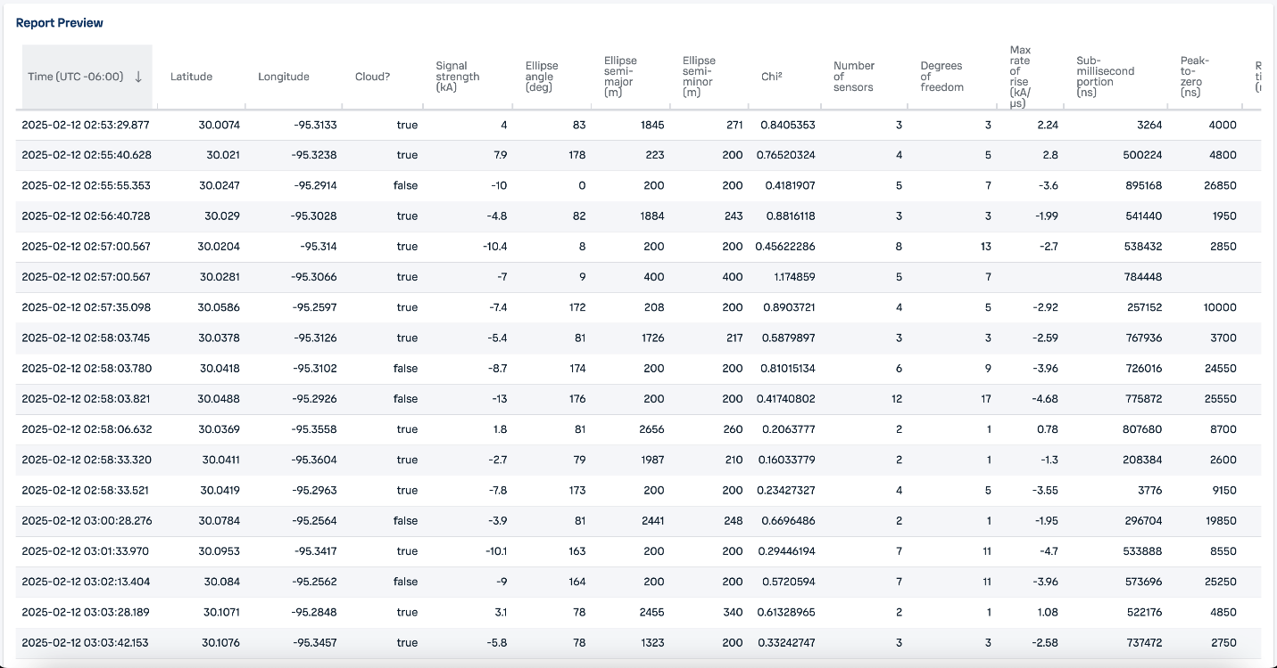
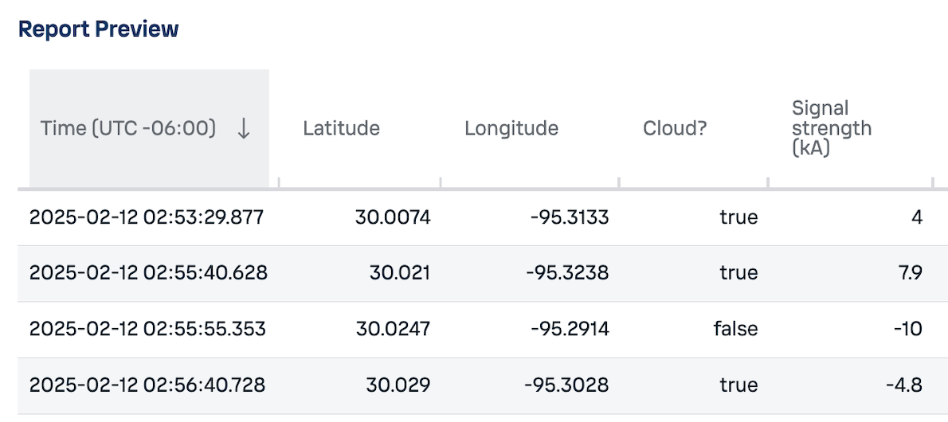
Major data fields include time, latitude, longitude, type, and signal strength (kA)

Slide 21
Summary
Real-Time Fault Monitoring: Cloud-to-ground stroke reports correlate with fault records to confirm lightning-induced faults
Confidence & Classification: Understanding the network’s error-ellipse metrics, peak current accuracy, detection efficiency, and classification accuracy ensure you can reliably attribute outages to lightning (and rule out other causes)
Long-Term Diagnostics: Aggregated lightning archives reveal recurring hot spots and failure modes

