Slide 1
Unsupervised Clustering for Fault Analysis in Power Systems
Julian Oelhaf¹, Georg Kordowich², Andreas Maier¹, Johann Jäger², and Siming Bayer¹ ¹Pattern Recognition Lab ²Institute of Electrical Energy Systems Friedrich-Alexander-University Erlangen-Nuremberg, Germany

Slide 2
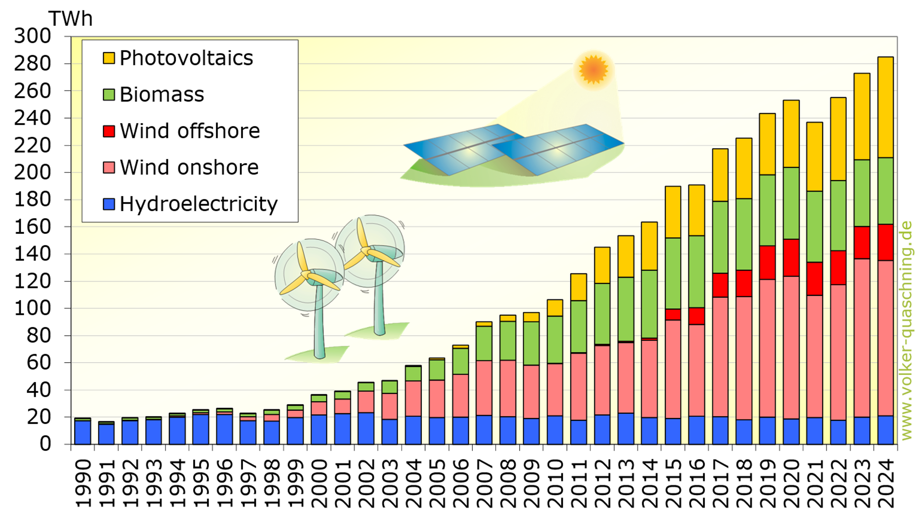
Germany’s Energiewende - Chance and Challenges
Notes:
Renewable Energy Growth caused Increased Complexity in Power Systems - More renewable sources like wind and solar add variability, making grid management more complex.
Massive Data from Decentralized Grids Distributed generation and smart technologies generate vast amounts of data, overwhelming traditional analysis methods.
Fault and Disturbance Analysis Challenge: Difficulty in Identifying and Responding to Issues With more components and data, detecting and responding to faults in real-time becomes increasingly challenging.

Slide 3
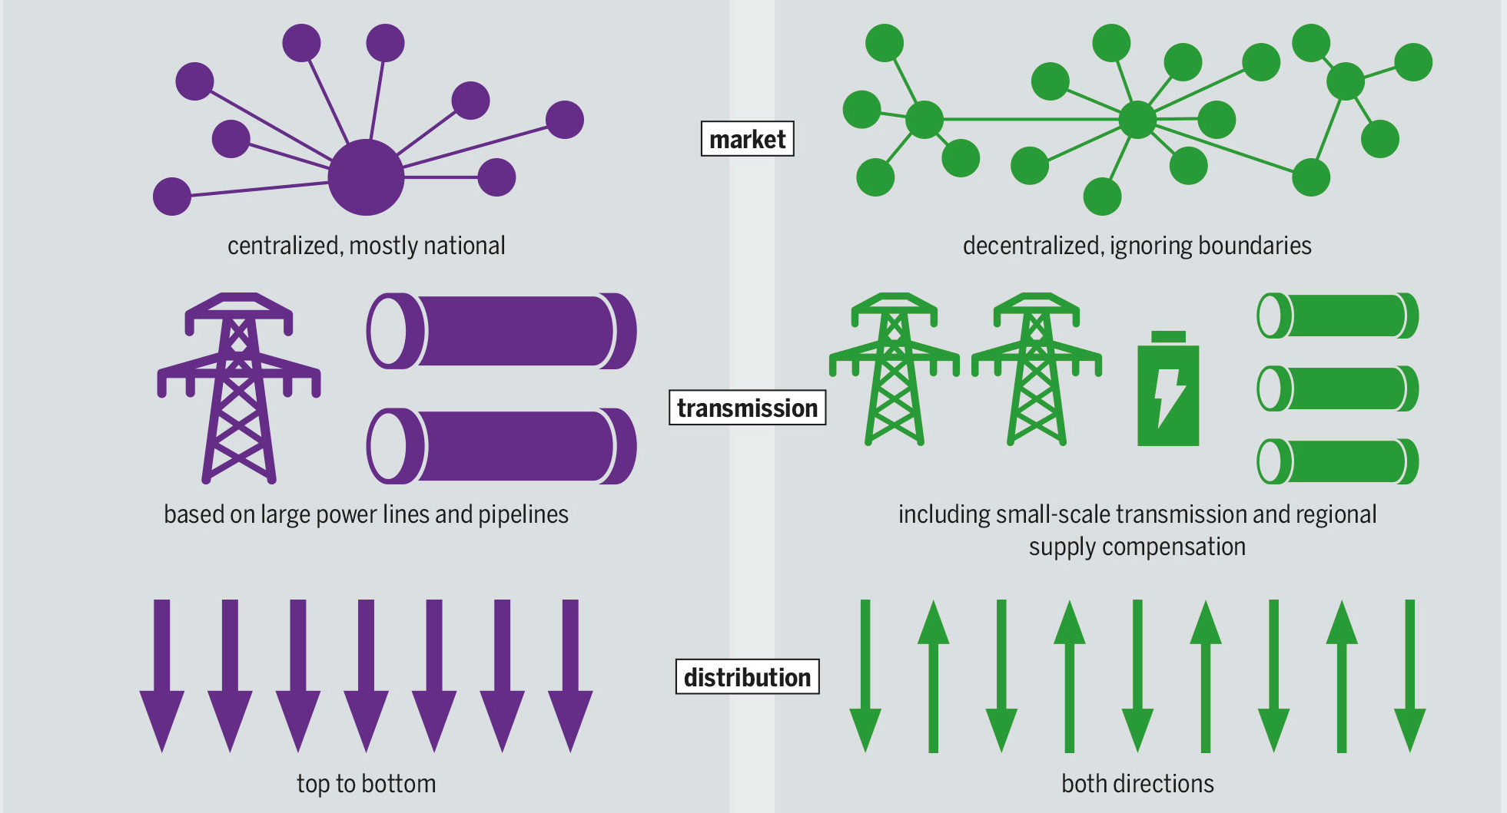
Challenges In Modern Power System Protection
Bartz/Stockmar, CC BY-SA 4.0, https://creativecommons.org/licenses/by-sa/4.0, via Wikimedia Commons.
Notes:
Bi-directional Power Flow: Increased complexity due to reverse power flow and distributed generation sources (e.g., renewables).
More Components in the Grid: Growing number of components such as distributed energy resources (DERs), storage, and smart devices.
More Sensors/Measurements: Expanding sensor networks for real-time monitoring, leading to high-volume, high-dimensional data.
More Data: Massive influx of data from sensors, SCADA systems, and digital twins, creating challenges in storage, processing, and analysis.
ML as a Potential Solution: Machine learning (ML) methods offer scalable, adaptive solutions for protection, fault detection, and predictive maintenance.
Lack of Labels/Ground Truths: Inadequate labeled data for supervised learning, making it difficult to train models and validate predictions.

Slide 4
Motivation
Power system disturbances and faults produce complex data that’s hard to analyze manually.
Fast, reliable event understanding is critical for protection, control, and system reliability.
Unsupervised clustering enables automatic grouping of events for better analysis and decision support.
Notes:
Power system faults and disturbances produce complex, high-frequency waveform data
Engineers need to extract insights from large volumes of unlabeled disturbance records
Manual analysis is time-consuming and not scalable
Fast, reliable event understanding is critical for protection, control, and system reliability
Unsupervised clustering enables automatic grouping of similar events for better analysis and decision support

Slide 5
Problem statement
How can we automatically discover and interpret meaningful patterns in large-scale, unlabeled power system disturbance data using unsupervised clustering methods?

Slide 6

Dataset Overview: RTE Electrical Signals Database
Operator: RTE – France’s national transmission system operator
Grid Scale: 60,000+ miles of high-voltage lines, 2,800+ substations, 50Hz
Release: Publicly available since May 2024
Content: Real-world measurements from France’s high-voltage transmission network
Focus: Captures electrical signals during events such as faults and switching operations
Notes:
https://upload.wikimedia.org/wikipedia/commons/thumb/1/1f/RTE_logo.svg/2048px-RTE_logo.svg.png

Slide 7
What we know (about the Dataset)
12,053 disturbance events recorded on 90 kV lines
Each recording has 6 signals (v1, v2, v3, i1, i2, i3) with 21,000 data points
~3.28s

Slide 8
What we don't know (about the Dataset)
The fault types or classifications—no labels are provided.
The fault locations or conditions under which faults occurred.

Slide 9
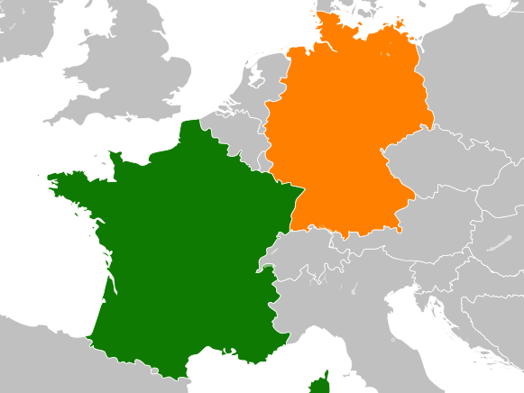


Alternative title: What to do, if your neighbor doesn’t talk to you.
Notes:
https://upload.wikimedia.org/wikipedia/commons/thumb/c/c3/Flag_of_France.svg/2560px-Flag_of_France.svg.png
https://upload.wikimedia.org/wikipedia/commons/2/21/Flag_of_Germany_%283-2%29.svg
https://upload.wikimedia.org/wikipedia/commons/thumb/d/db/France_Germany_Locator_%28Europe%29.svg/1200px-France_Germany_Locator_%28Europe%29.svg.png

Slide 10
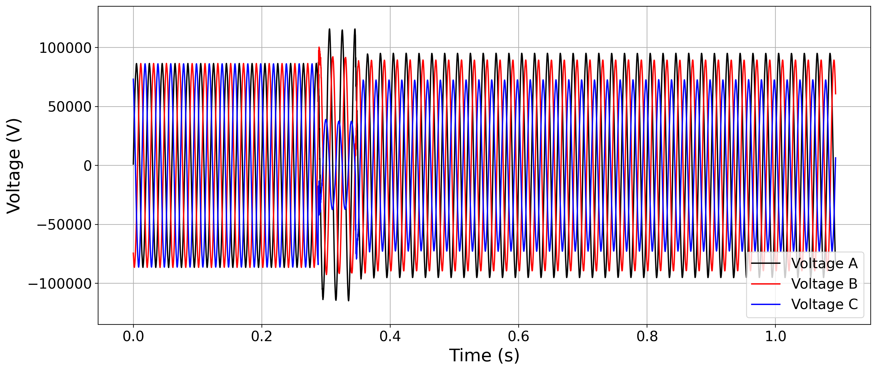
Which disturbance can be observed here?

Slide 11
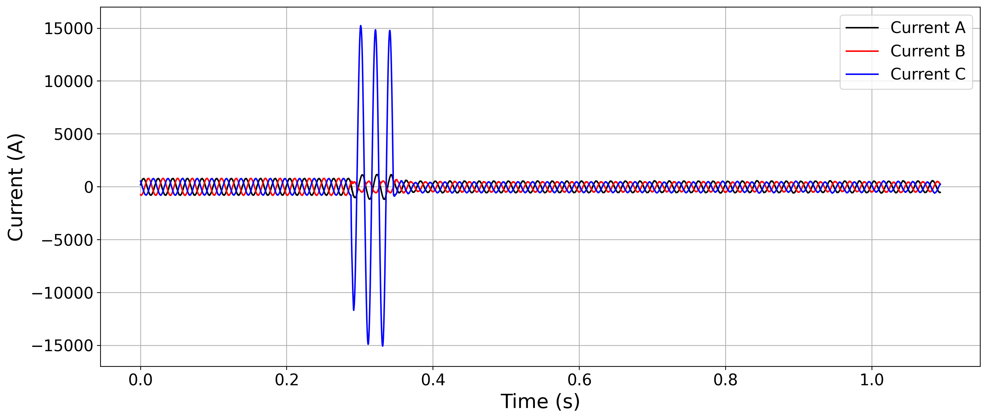
What type of fault can be observed here?

Slide 12

Dataset
Each sample contains 6 channels: three voltage, three current
Nr. of datapoints per sample: $6 ∗21 000=126 000$

Slide 13
Task
We need a framework for the systematic analysis of an unlabeled dataset to gain insight into the disturbances.

Slide 14
Dataset
Each sample contains 6 channels: three voltage, three current
Nr. of datapoints per sample: $6 ∗21 000=126 000$
Need to reduce the datapoints per sample

Slide 15
Feature Extraction
Feature Extraction
Feature Reduction
Feature Clustering
Cluster Analysis

Slide 16
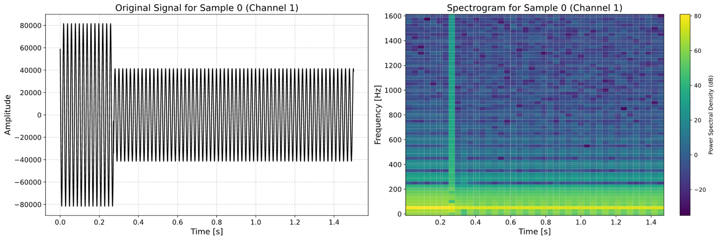

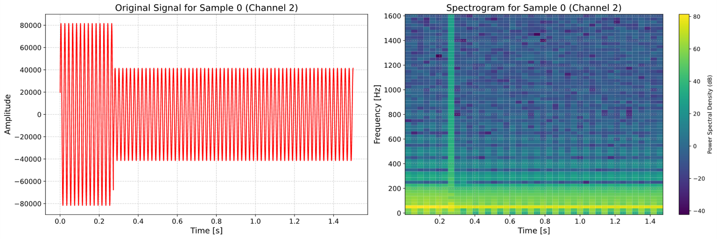

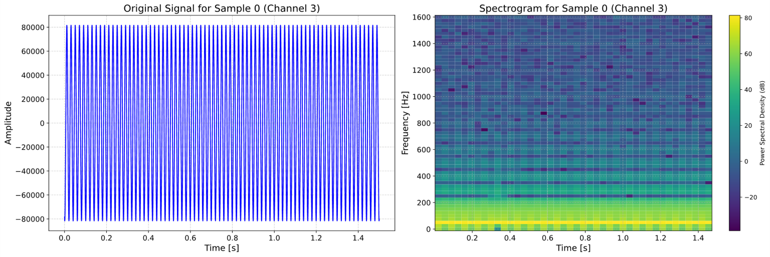

Feature Extraction
Feature Extraction
Feature Reduction
Feature Clustering
Cluster Analysis

Slide 17
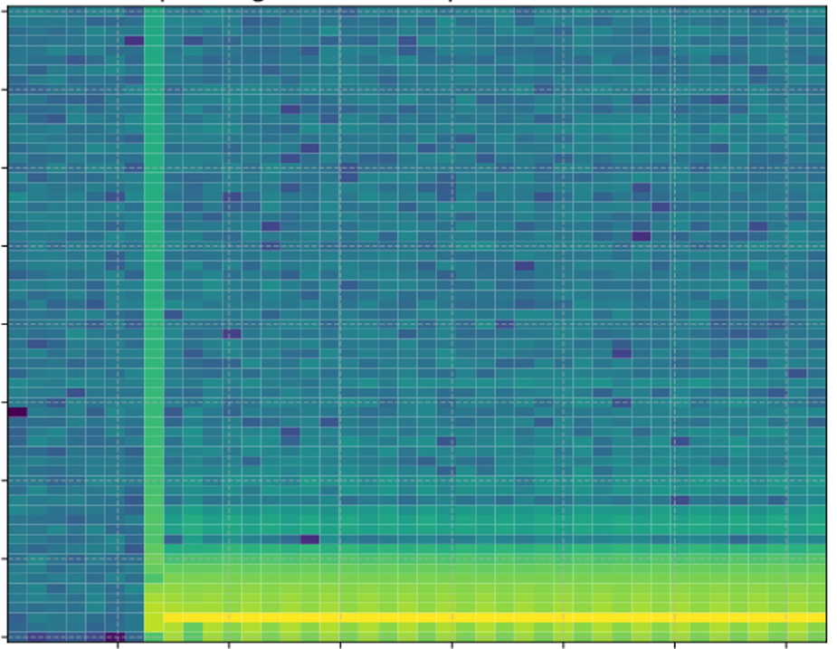
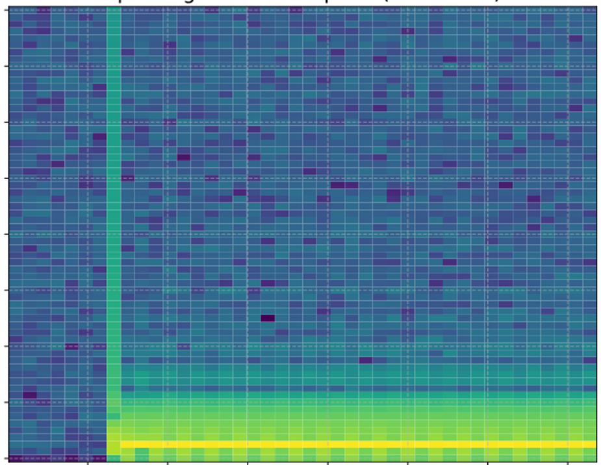
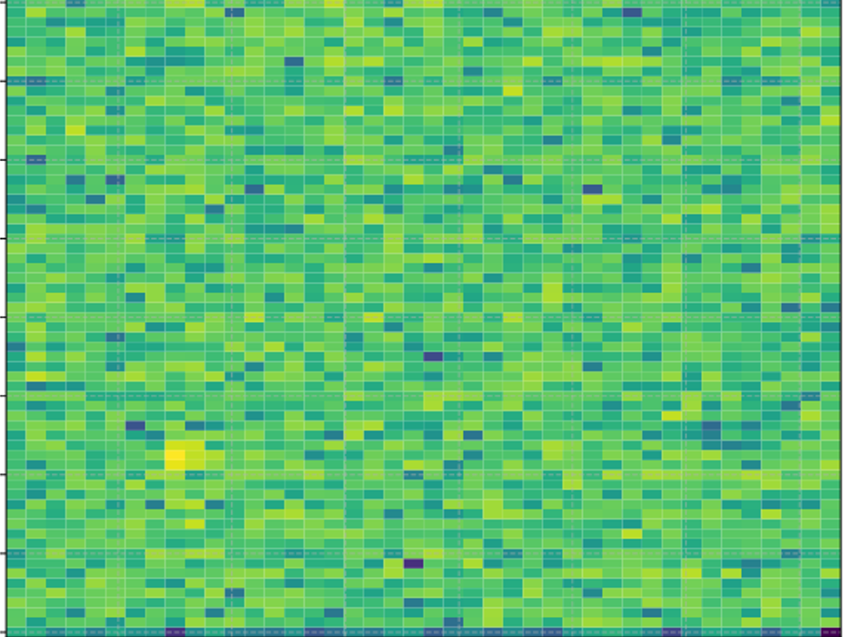
Feature Extraction
Feature Extraction
Feature Reduction
Feature Clustering
Cluster Analysis
Feature
Space
(Number of datapoints per sample)
VOLTAGE
CURRENT
Notes:
Shape of FFT: (10500, 6)

Slide 18
Feature Reduction
Feature Extraction
Feature Reduction
Feature Clustering
Cluster Analysis

Slide 19
Feature Reduction
Feature Extraction
Feature Reduction
Feature Clustering
Cluster Analysis
Simplify Data: Reduce feature complexity for efficiency.
Prevent Overfitting: Focus on relevant features.
Enhance Interpretability: Make fault patterns easier to analyze.

Slide 20
Feature Reduction
Feature Extraction
Feature Reduction
Feature Clustering
Cluster Analysis
Simplify Data: Reduce feature complexity for efficiency.
Prevent Overfitting: Focus on relevant features.
Enhance Interpretability: Make fault patterns easier to analyze.
Principal Component Analysis (PCA)

Slide 21
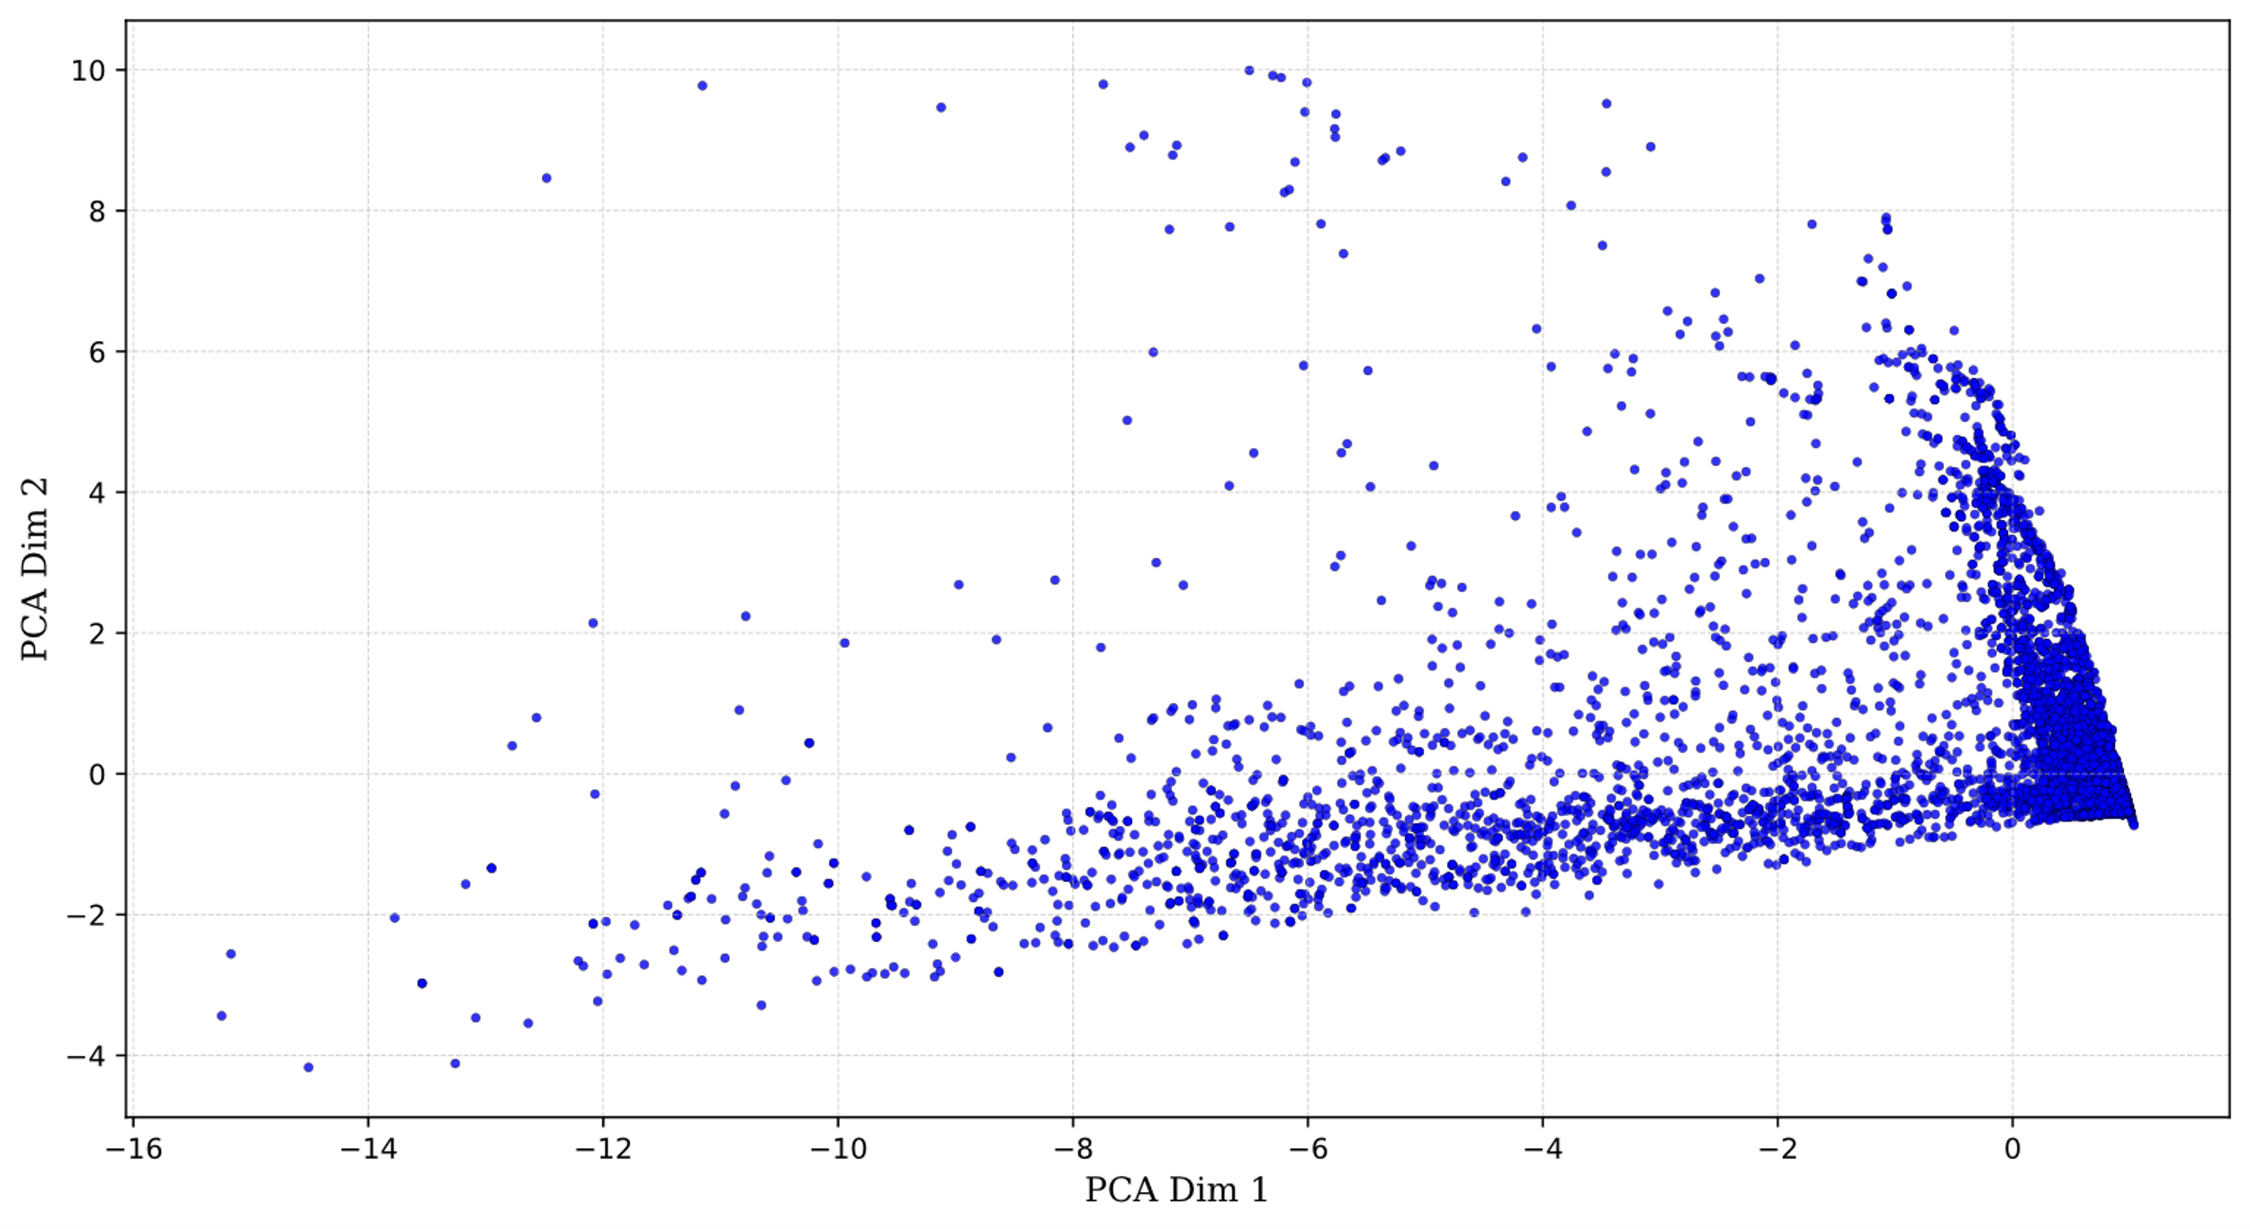
Problem: Linear Transformation
Feature Extraction
Feature Reduction
Feature Clustering
Cluster Analysis
Notes:
Explain the graph here. Each dot is a sample. X and Y is the entire signal reduced to two features/dimensions.

Slide 22
Problem: Linear Transformation
Feature Extraction
Feature Reduction
Feature Clustering
Cluster Analysis
Solution: Non-Linear Transformation

Slide 23
Dimensionality Reduction: PCA or t-SNE?
Feature Extraction
Feature Reduction
Feature Clustering
Cluster Analysis
PCA: Linear, fast, reduces dimensions while preserving variance.
t-SNE: Non-linear, captures complex patterns but computationally expensive.

Slide 24
Dimensionality Reduction: PCA or t-SNE?
Feature Extraction
Feature Reduction
Feature Clustering
Cluster Analysis
PCA: Linear, fast, reduces dimensions while preserving variance.
t-SNE: Non-linear, captures complex patterns but computationally expensive.
How to be fast and non-linear?

Slide 25
Dimensionality Reduction: PCA + t-SNE
Feature Extraction
Feature Reduction
Feature Clustering
Cluster Analysis
PCA: Linear, fast, reduces dimensions while preserving variance.
t-SNE: Non-linear, captures complex patterns but computationally expensive.
Solution: PCA → t-SNE: Reduce dimensions with PCA, then use t-SNE for detailed visualization.

Slide 26
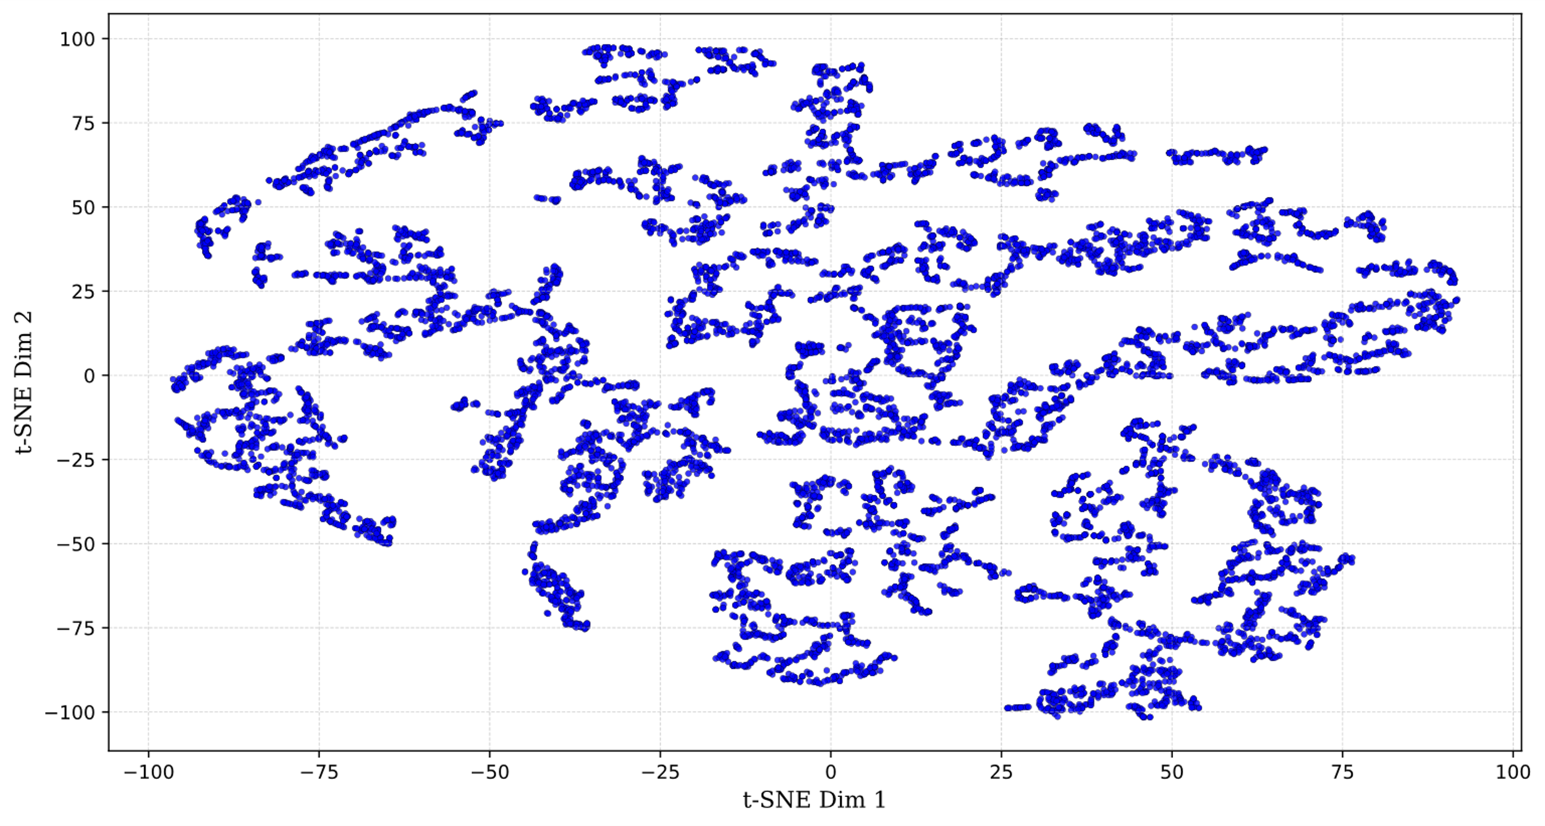
Dimensionality Reduction: PCA + t-SNE

Slide 27
Feature Clustering
Feature Extraction
Feature Reduction
Feature Clustering
Cluster Analysis

Slide 28

$K$-Means Clustering
Feature Extraction
Feature Reduction
Feature Clustering
Cluster Analysis
Input: Raw data, divided into K groups based on similarity.
Output: Data points grouped into clusters, refined through iterations.
Pros & Cons: Efficient and scalable but requires a set number of groups and struggles with outliers and irregular data patterns.
Lloyd, Stuart. "Least squares quantization in PCM." IEEE transactions on information theory 28.2 (1982): 129-137.
MacQueen, James. "Some methods for classification and analysis of multivariate observations." Proceedings of the Fifth Berkeley Symposium on Mathematical Statistics and Probability, Volume 1: Statistics. Vol. 5. University of California press, 1967.

Slide 29
Initial Data Analysis
Dataset includes a wide range of disturbances:
different short-circuits, transients, switching events, downstream load connections, high-impedance faults, busbar switching, and other anomalies
In total, 10+ distinct disturbance types observed
Optimal balance found at K = 15, capturing meaningful structure without overfitting
Notes:
Exploring Different Values for K (Number of Clusters)
High K:
Results in overly granular clusters, leading to fragmentation and complexity.
Can cause overfitting and difficulty in interpretation.
Low K:
Produces broad, mixed clusters with reduced interpretability.
May underfit the model, missing finer patterns.
K as a Heuristic:
Selecting K is a balancing act, guided by methods like the elbow method.
The choice depends on the specific context and desired model complexity.

Slide 30
Cluster Analysis
Feature Extraction
Feature Reduction
Feature Clustering
Cluster Analysis

Slide 31
Key Assumptions
The dataset contains multiple types of faults and disturbance events
15 clusters provide a reasonable trade-off between detail and interpretability, based on exploratory analysis
Events with similar electrical characteristics (features) are expected to group into the same cluster

Slide 32
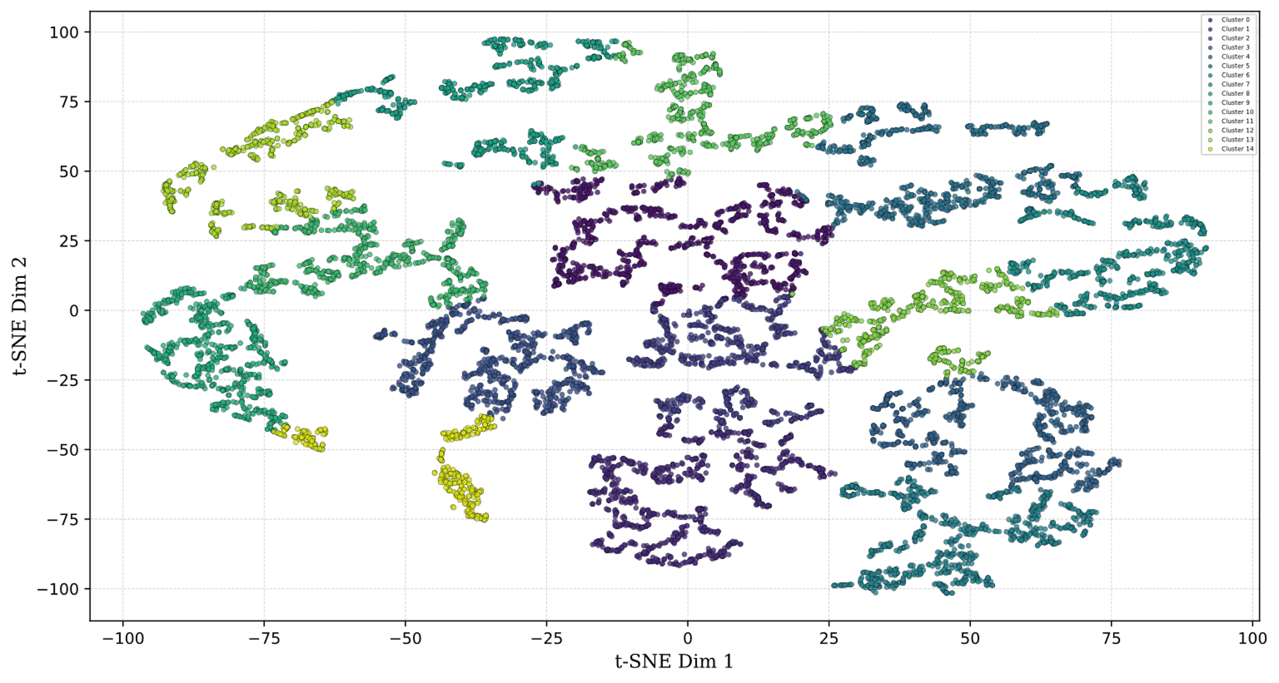
K-Means clustering based on t-SNE features

Slide 33
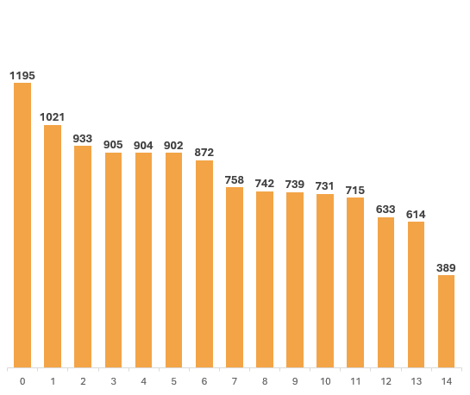
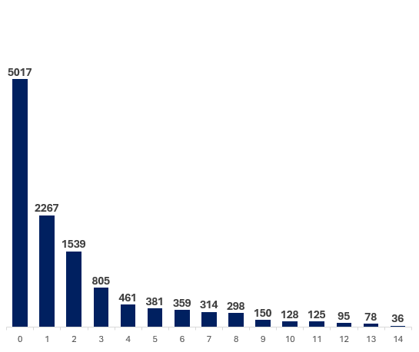
Comparison of Cluster Distribution
PCA
t-SNE

Slide 34
🧪 Hypothesis
If unsupervised clustering effectively captures the structure of the data, then manually labeled samples within each cluster should exhibit high consistency — enabling meaningful interpretation of entire clusters.

Slide 35
Analysis of Manually Labeled Clustering Results
Feature Extraction
Feature Reduction
Feature Clustering
Cluster Analysis

Slide 36
Cluster Interpretation via Manual Labeling
Labeled a representative subset of 205 samples to evaluate clustering results
Assessed label consistency within clusters to validate cluster coherence
Event Type Label
Normal
Short-circuit
Switching
Transients
Other
Unknown
Notes:
We conducted a detailed manual labeling of each sample, including attributes such as Sample ID, Event Type, Fault Class, Fault Type, and Affected Phase(s). However, for the sake of brevity and clarity in this presentation, we will focus solely on the Event Type when discussing cluster interpretation.

Slide 37
Event Distribution per Cluster
Clusters

Slide 38
Cluster With Primarily Normal Events
Notes:
Cluster 7: 12 Normal

Slide 39
K-Means Clustering Based on t-SNE Features

Slide 40
Clusters With Primarily Switching Events
Notes:
Cluster 0: 19 events Switching
Cluster 2: 11 events Switching

Slide 41
K-Means Clustering Based on t-SNE Features

Slide 42
Clusters With Primarily Short-Circuits Events
Notes:
Cluster 8: 12 events Short-Circuits
Cluster 10: 14 events Short-Circuits
Cluster 11: 15 events Short-Circuits
Cluster 12: 7 events Short-Circuits
Cluster 14: 11 events Short-Circuits

Slide 43
K-Means Clustering Based on t-SNE Features

Slide 44
Discussion
Unsupervised clustering reveals structure in large, unlabeled fault datasets but lacks prior knowledge for validation.
Feature transformation impacts clustering quality—t-SNE improves fault separation compared to PCA alone.
Cluster interpretability remains challenging, with external factors (e.g., sensor variations) potentially influencing results.

Slide 45
Conclusion
K-Means clustering helps structure large datasets, aiding initial fault analysis and reducing expert workload.
Limitations include low silhouette scores and manual validation constraints, highlighting the need for alternative methods.
Future work should explore hybrid models, alternative clustering techniques, and simulated data for validation.

Slide 46


Thank you! Questions?
Funding
This project was funded by the Deutsche Forschungsgemeinschaft (DFG, German Research Foundation) - 535389056.
Contact
Julian Oelhaf Pattern Recognition Lab Department of Computer Science Friedrich-Alexander University Erlangen-Nürnberg Erlangen, GERMANY
julian.oelhaf@fau.de
Notes:
https://www.dfg.de/resource/blob/196772/815c8be8174a278bbac1de13d2b43210/logo-international-267-data.png

Slide 47
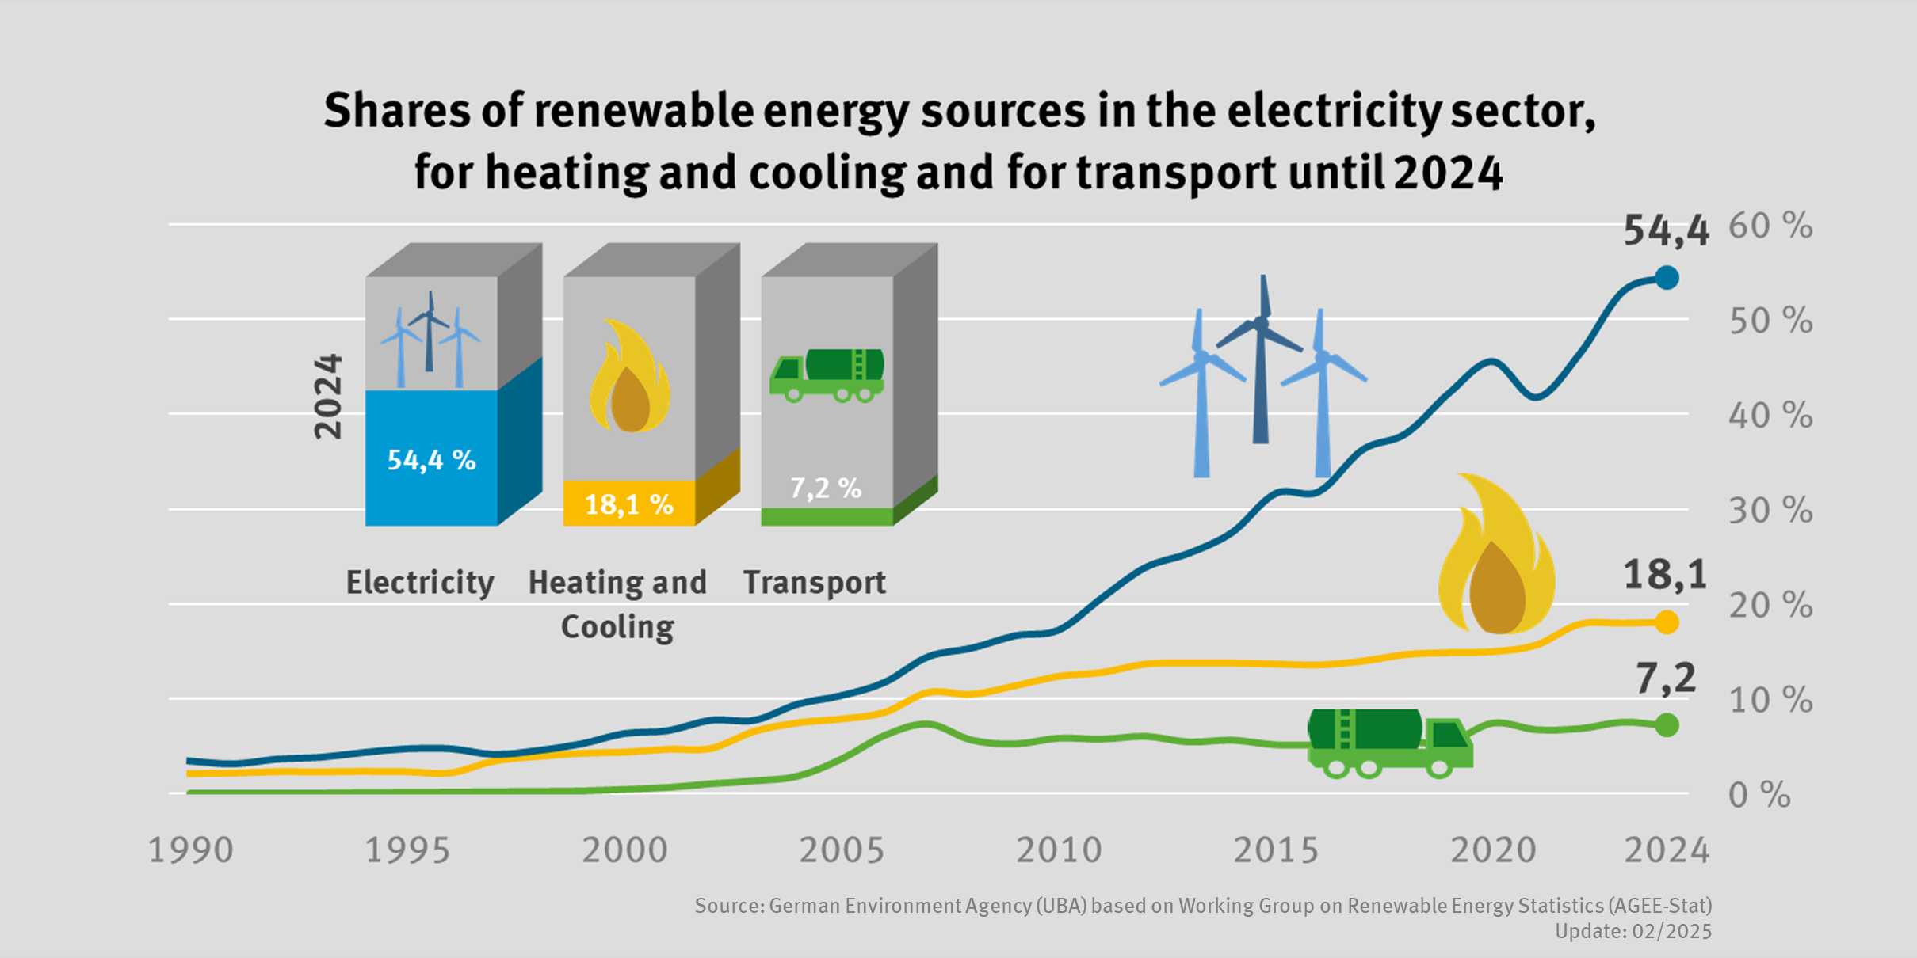
Germany's Energiewende
Notes:
The Problem

Slide 48
Overview
Artificial Intelligence
Pattern Recognition
Machine Learning
Notes:
Machine Learning as a potential solution

Slide 49
Feature Extraction
Feature Extraction
Feature Reduction
Feature Clustering
Cluster Analysis
Fast Fourier Transform (FFT) transforms time-series data into frequency-domain features
Normalization standardizes spectral magnitudes
Enhancing model generalization and comparison.
Assumption: Frequency patterns are indicative of fault types, such as short circuits, open-circuits, and unbalanced faults.

Slide 50
Feature Extraction

Slide 51
Feature Extraction

Slide 52
Feature Extraction

Slide 53
One Problem: Curse of Dimensionality
Feature Extraction
Feature Reduction
Feature Clustering
Cluster Analysis
Original Data: 21,000 samples × 6 channels = 126,000 features
After FFT: 10,500 frequency components × 6 channels = 63,000 features
Challenge: Too many features for effective comparison and analysis
Solution: Feature Reduction Techniques to simplify and improve model performance

Slide 54
PCA
Feature Extraction
Feature Reduction
Feature Clustering
Cluster Analysis
Dimensionality Reduction: Projects data into a lower-dimensional space while preserving variance.
Linear Transformation: Finds principal components that maximize variance in the data.
Fast and Scalable: Efficiently handles large datasets with a clear mathematical foundation.
Are there any drawbacks?
Wold, Svante, Kim Esbensen, and Paul Geladi. "Principal component analysis." Chemometrics and intelligent laboratory systems 2.1-3 (1987): 37-52.

Slide 55
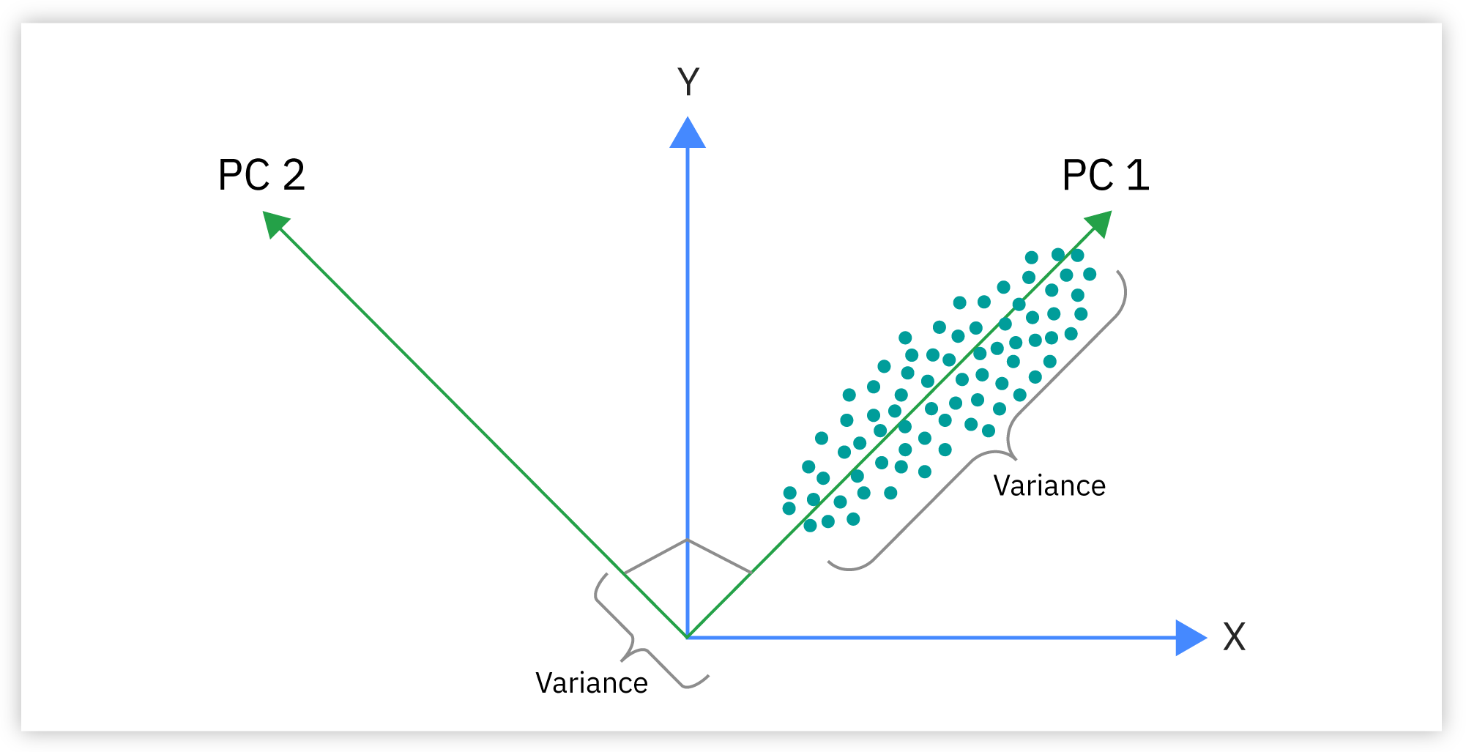
Principal Component Analysis (PCA)
Image Source: https://www.ibm.com/content/dam/connectedassets-adobe-cms/worldwide-content/creative-assets/s-migr/ul/g/89/56/2-1_orthogonal-relshp_pc1-pc2-1.png

Slide 56
t-Distributed Stochastic Neighbor Embedding
Feature Extraction
Feature Reduction
Feature Clustering
Cluster Analysis
Non-linear Dimensionality Reduction: Maps high-dimensional data to a lower dimension while preserving local structures.
Visualizes Clusters: Reveals complex relationships and clusters in the data.
Computationally Intensive: Effective for smaller datasets due to high computational cost.
Van der Maaten, Laurens, and Geoffrey Hinton. "Visualizing data using t-SNE." Journal of machine learning research 9.11 (2008).

Slide 57
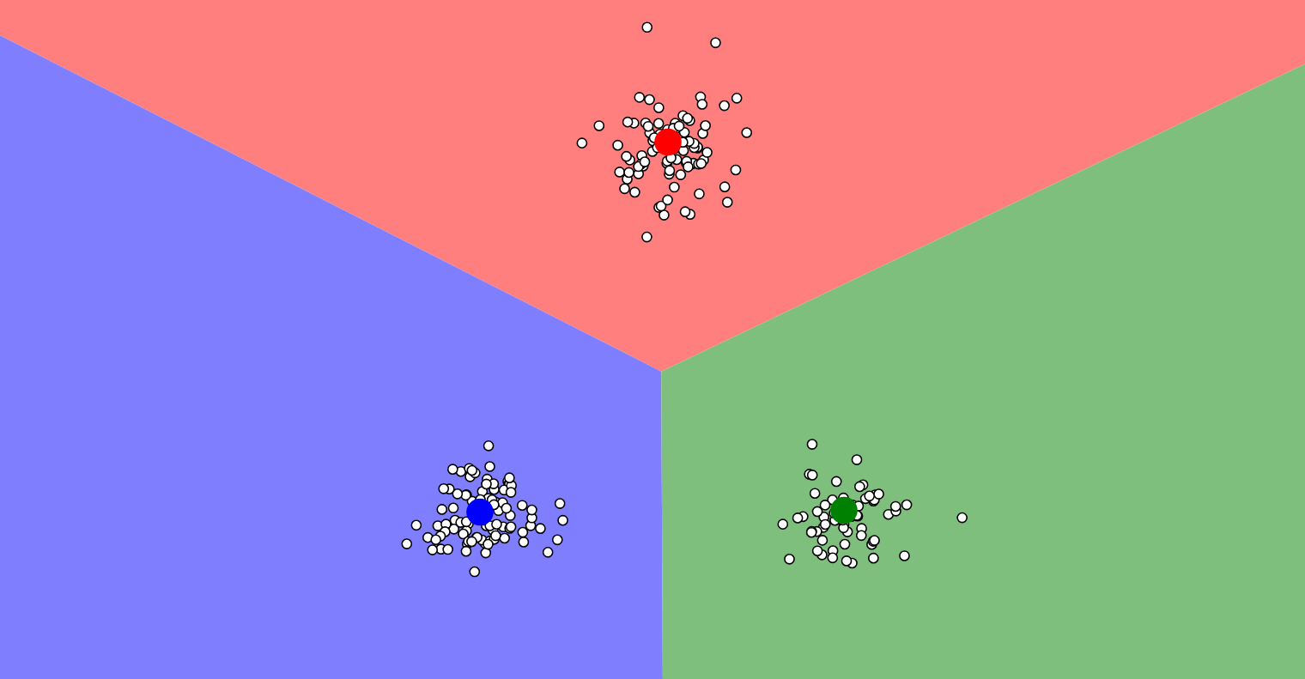
Created with: https://www.naftaliharris.com/blog/visualizing-k-means-clustering/

Slide 58
Dimensionality Reduction: PCA
Feature Extraction
Feature Reduction
Feature Clustering
Cluster Analysis

Slide 59
Dimensionality Reduction: t-SNE
Feature Extraction
Feature Reduction
Feature Clustering
Cluster Analysis

Slide 60
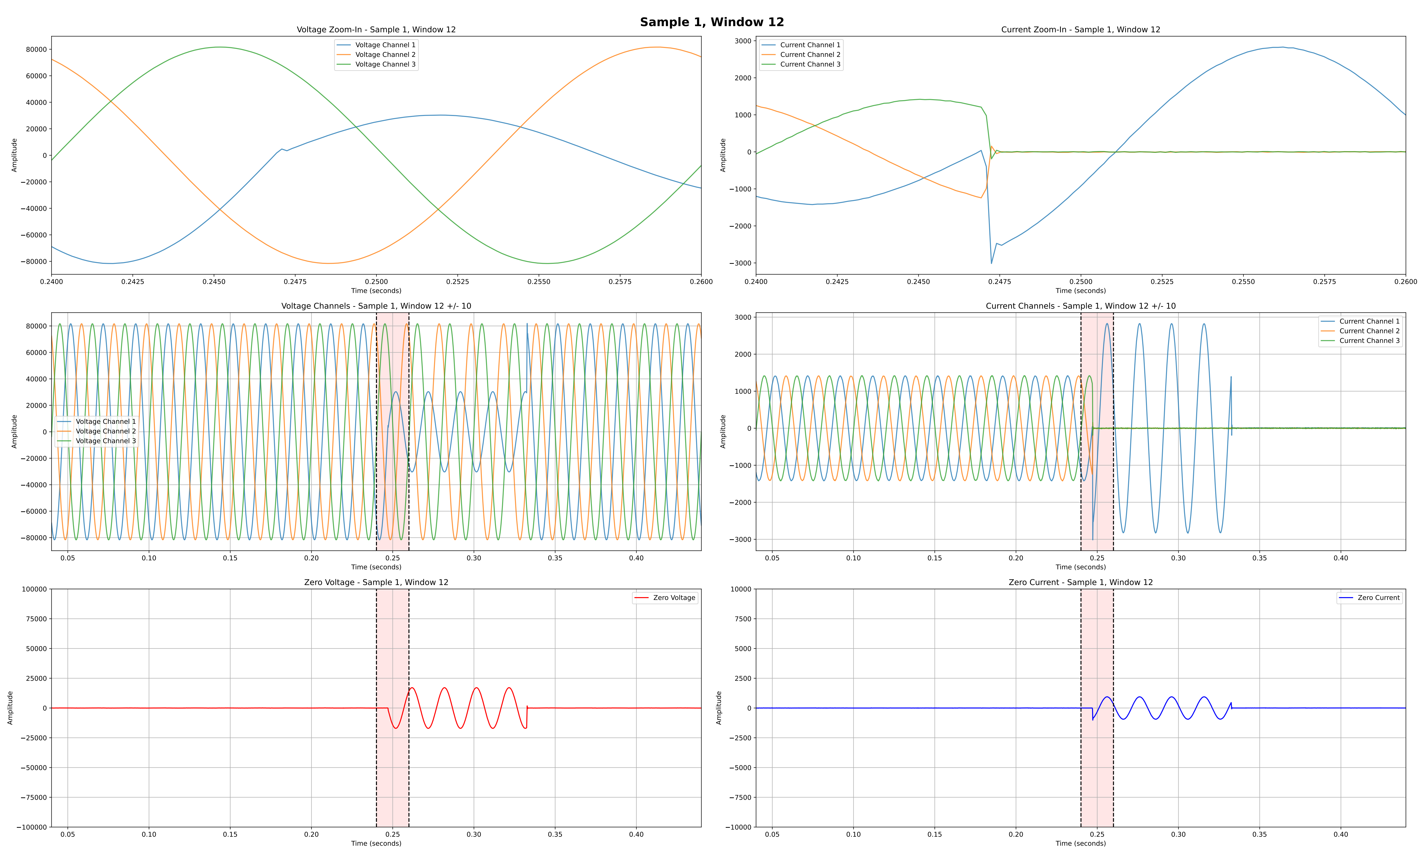
Plots for manual labeling

Slide 61
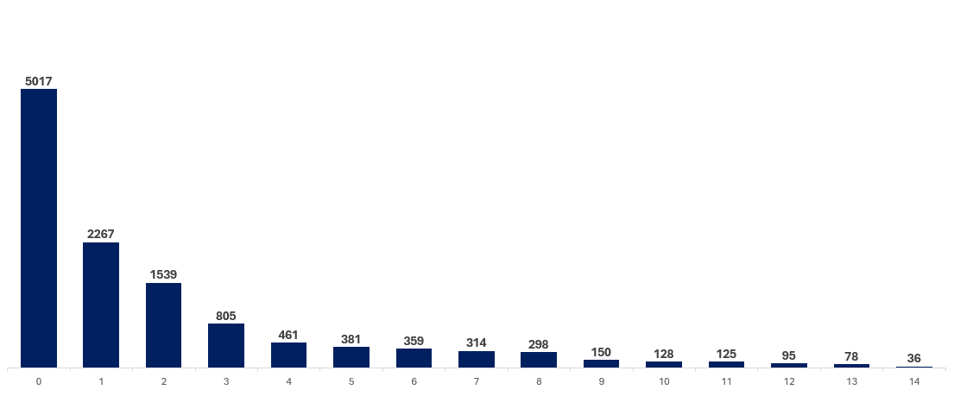
Cluster Distribution for PCA Features

Slide 62
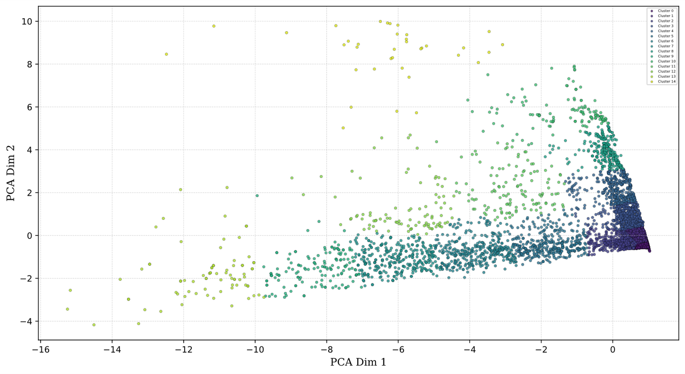
Visual Cluster Analysis
PCA
t-SNE

Slide 63
K-Means clustering based on PCA features

Slide 64
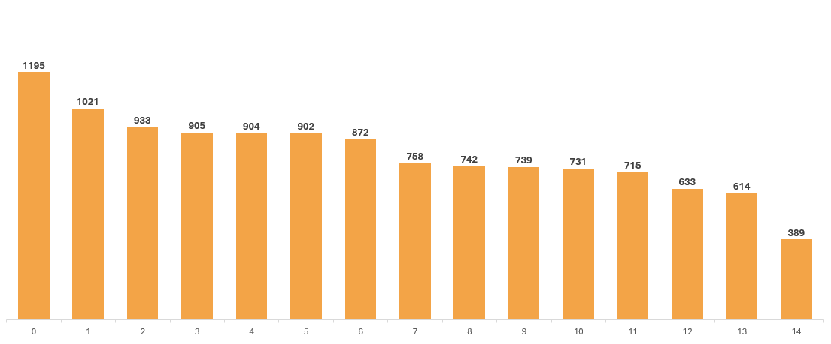
Cluster Distribution for t-SNE Features

Slide 65
Cluster Metrics
Method/Metric | Purity ↑ | Entropy ↓ | NMI ↑ | ARI ↑ | Silhouette ↑
K-Means PCA | 0.608 | 0.767 | 0.305 | 0.113 | -0.744
K-Means t-SNE | 0.720 | 1.095 | 0.328 | 0.115 | -0.399

Slide 66
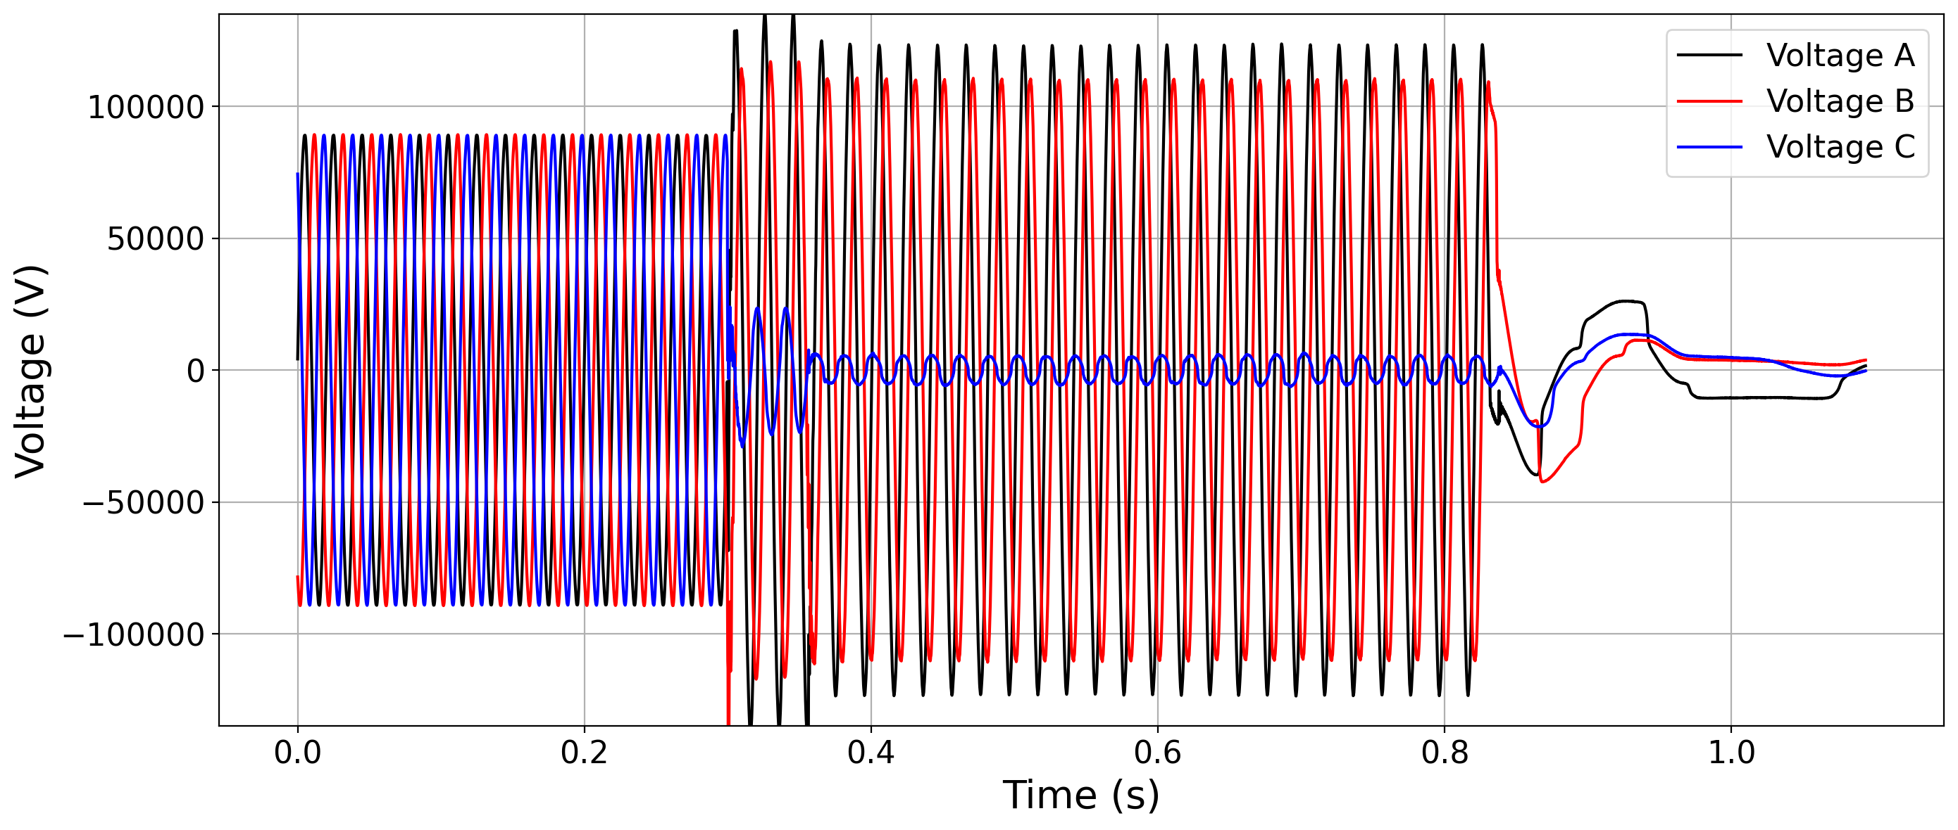
Example of Voltage Signal

Slide 67
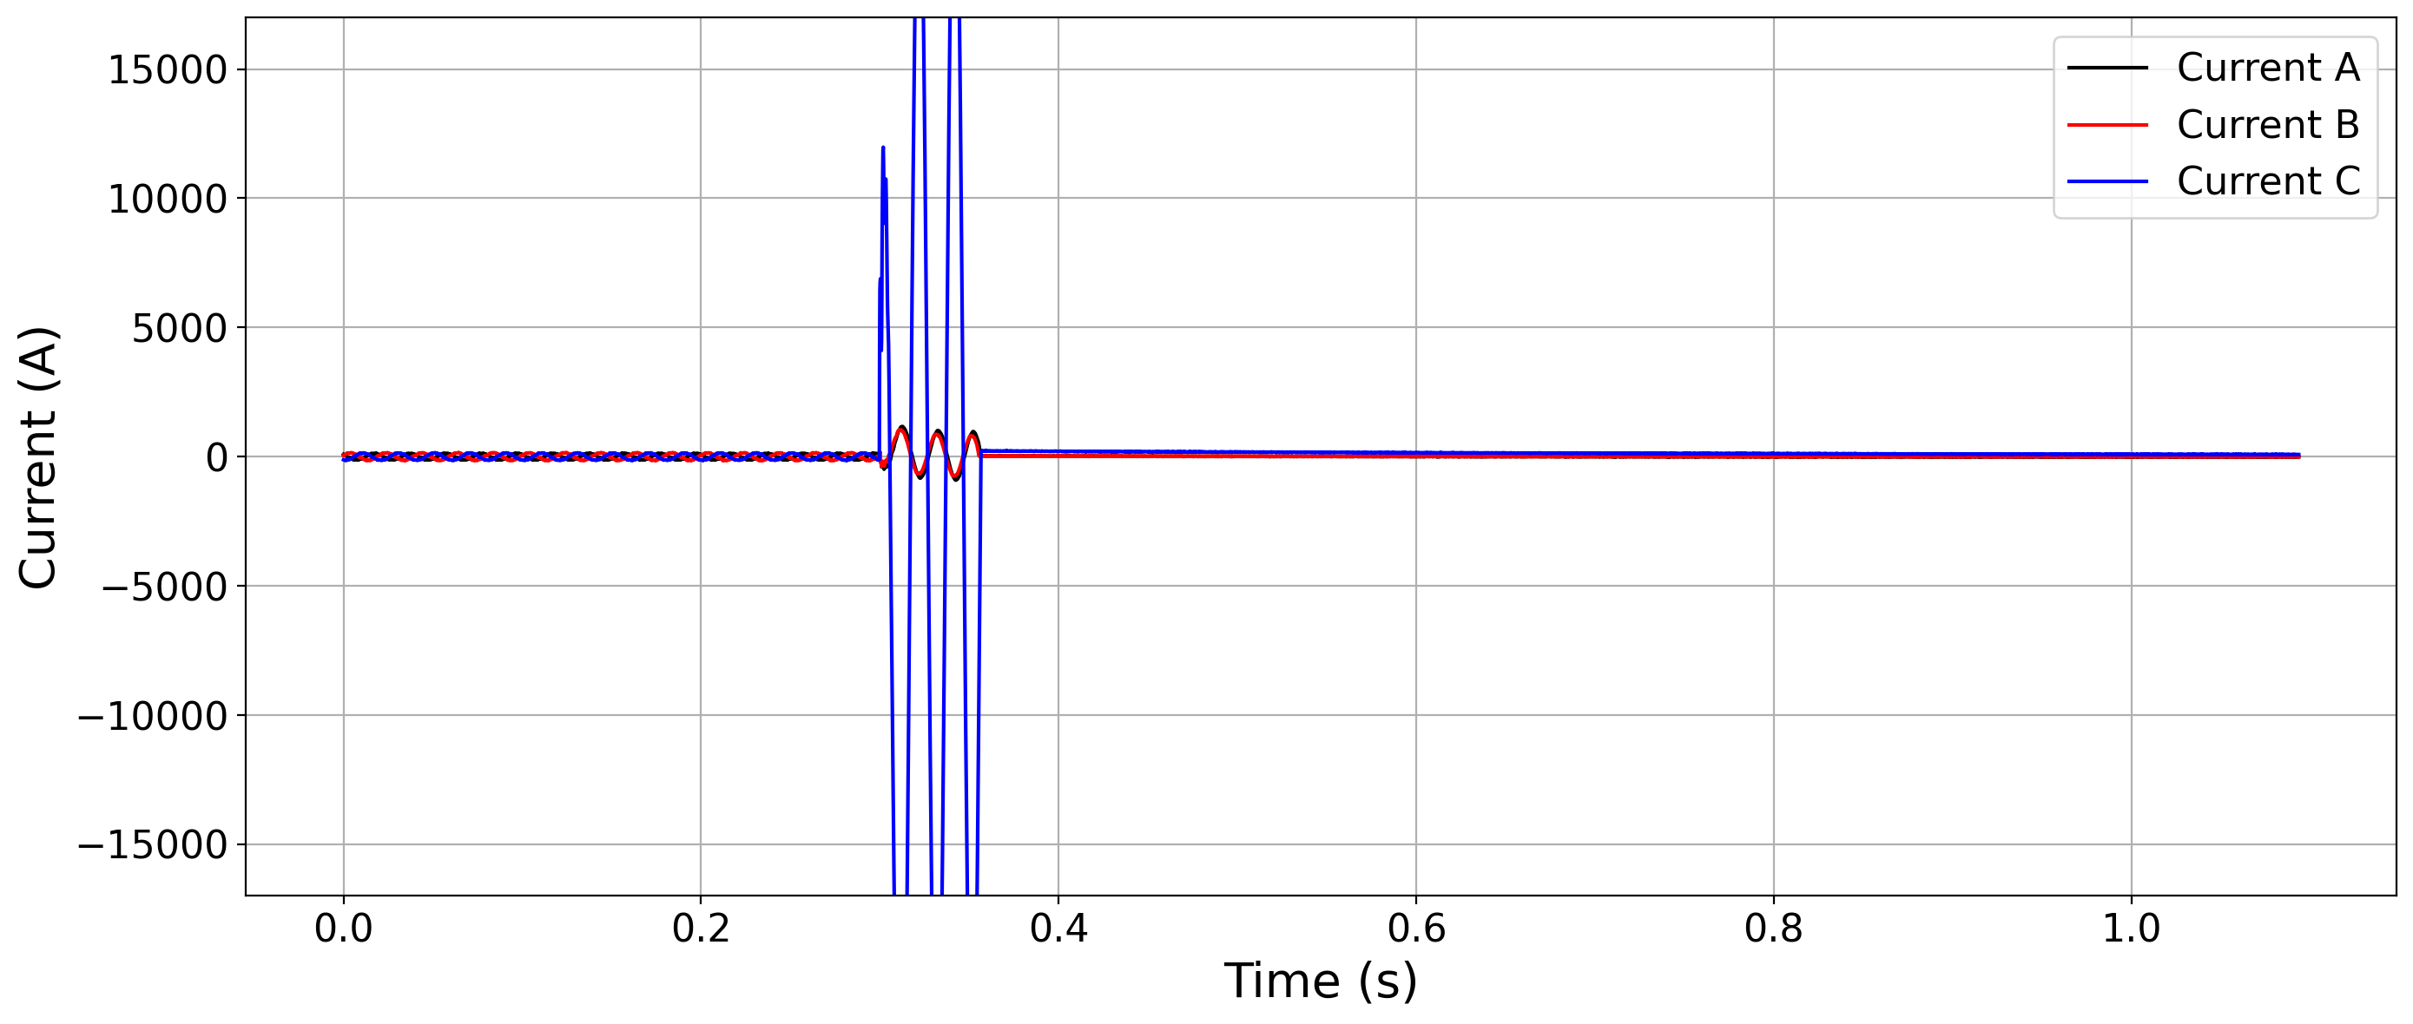
Example of Current Signal

Slide 68
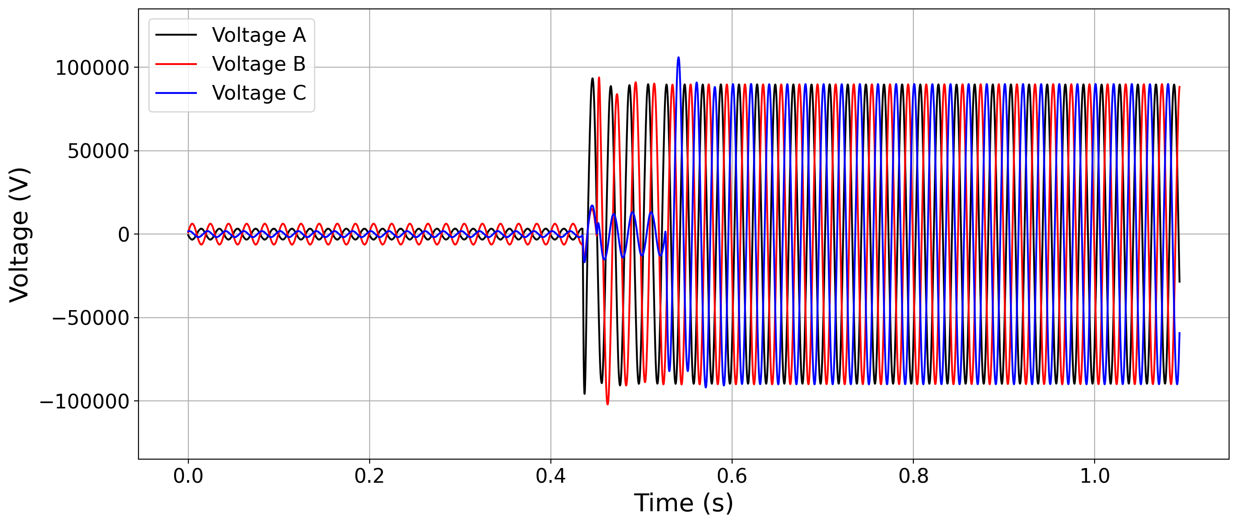
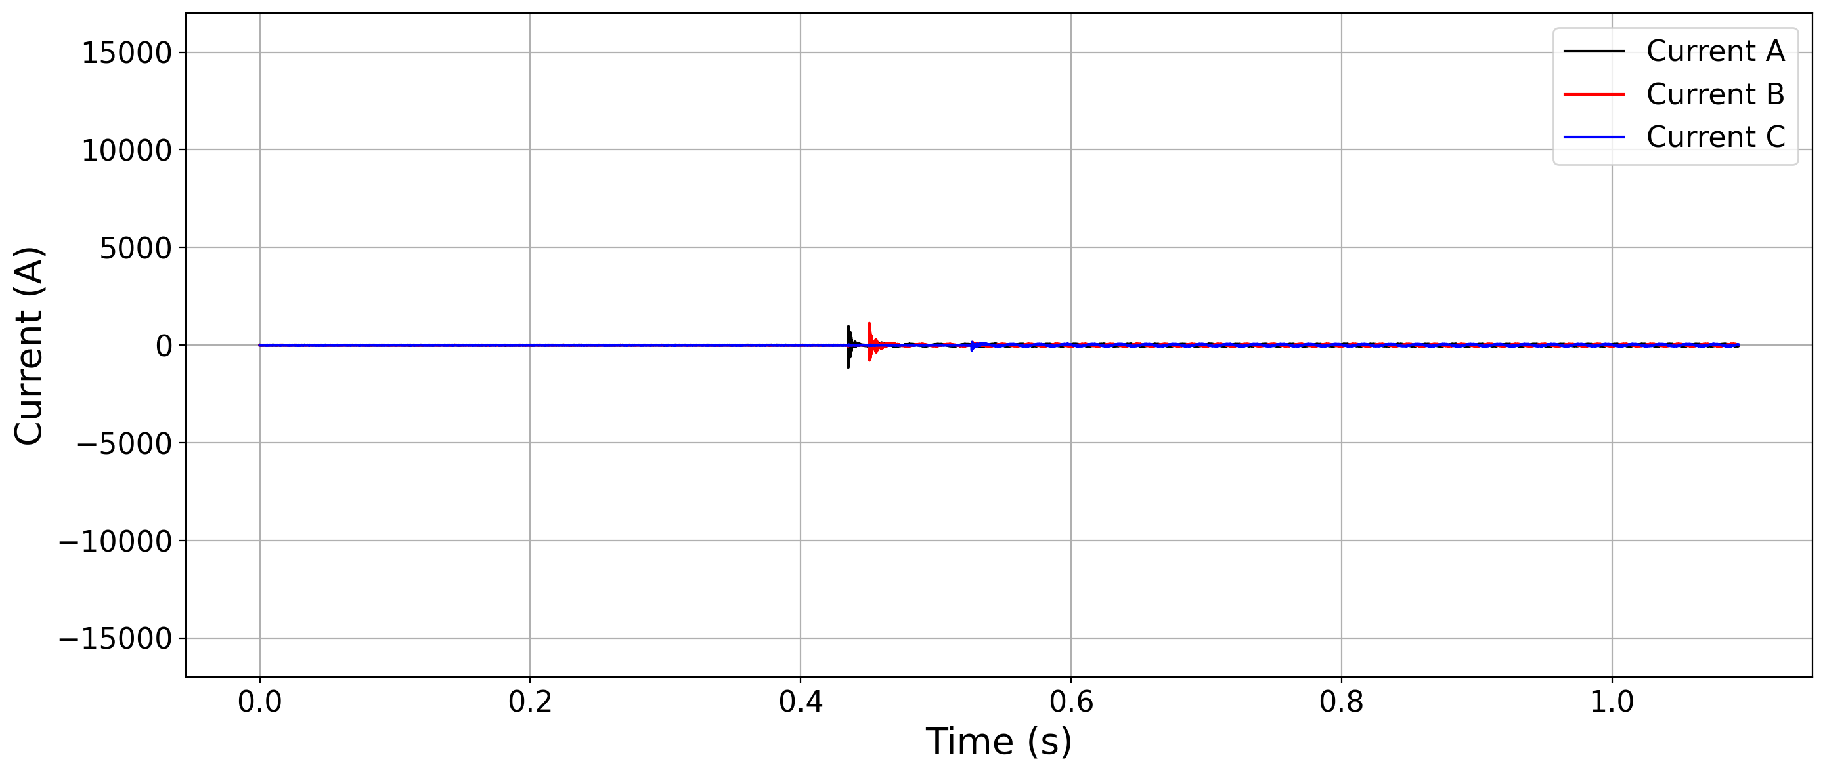
Example of combined signals

