Slide 1
EHV TRANSFORMER TAP ADJUSTMENT TO CORRECT WIDE AREA VOLTAGE UNBALANCE

Slide 2
TVA Voltage Unbalance Pilot Project
5/6/2025

Slide 3
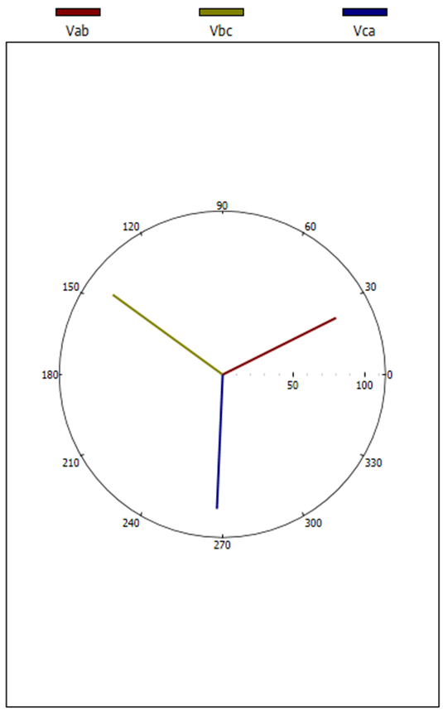

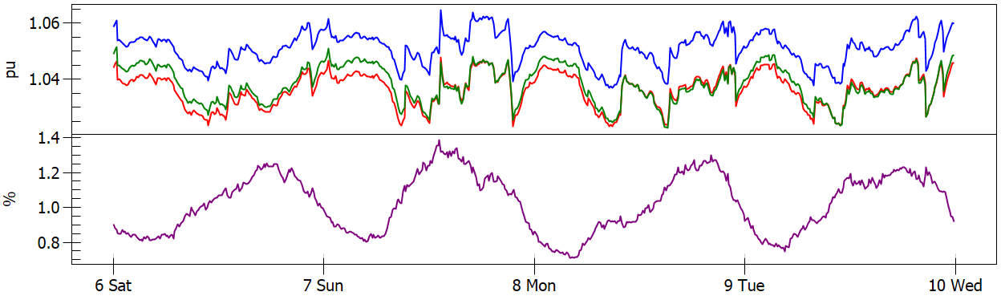
What is Voltage Unbalance
IEC/TR 61000-3-13 expresses voltage unbalance as a percentage, defined by the ratio of the modulus of the negative-sequence to the positive-sequence components of the voltage fundamental frequency (V₂/V₁%).
The following method is used to compare actual voltage unbalance against planning levels:
1008 10-minute interval average measurements are recorded over a one-week period of normal operation.
In the one-week period, the 95th percentile voltage unbalance value should not exceed the HV planning level of 1.4%.

Slide 4
The Problem
5/6/2025

Slide 5
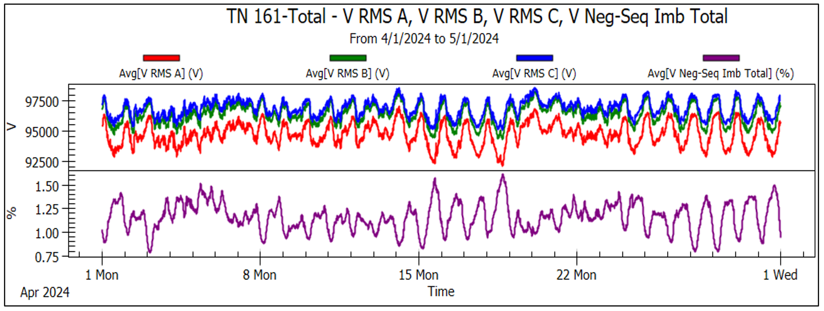
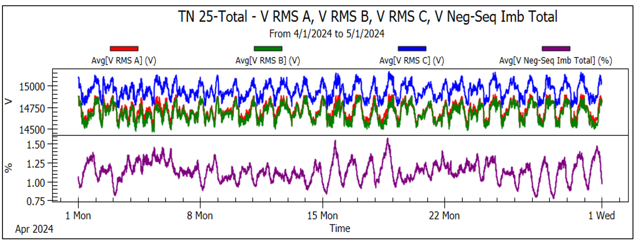

Issue Summary
Issue:
Transmission voltage unbalance causes 161-kV V_{A} to be lower than V_{B} and V_{C}
Delta-Wye transformation results in LPC distribution-level V_{CN} to be higher than V_{AN} and V_{BN}
Customer Impact:
LPCs reported higher C-phase voltage is noticed by end-use customers and is noticeably leading to higher rates of equipment failure by customers directly served off C-phase.
Limits LPCs ability to utilize voltage regulators at delivery points which leads to higher MW use and limits their benefit from fully participating in the DVR program.
High voltage unbalance has led to tripping of end use customer equipment(Mostly Motor Loads).

Slide 6
Middle Tennessee 161-kV Voltage Unbalance Trend
Weekly Pst95 V₂/V₁% 2015 - 2024
Winter storm Elliott
Winter storm Heather

Slide 7

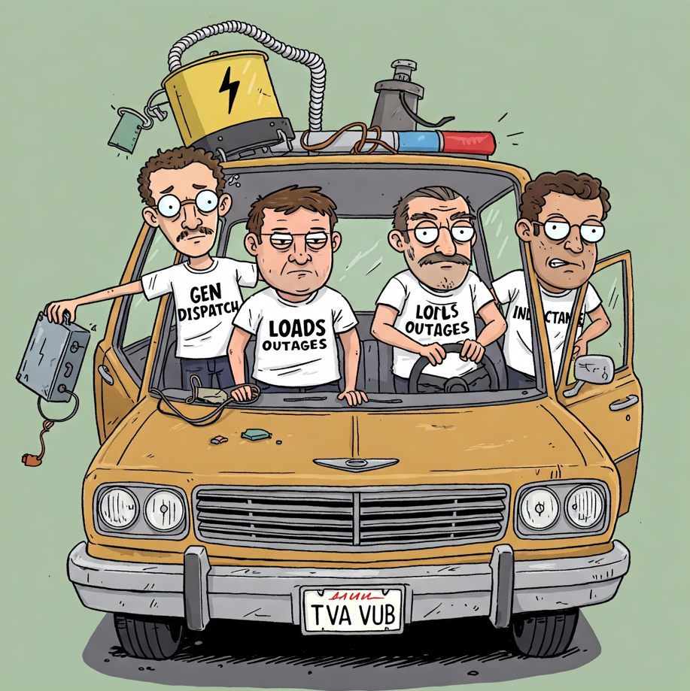
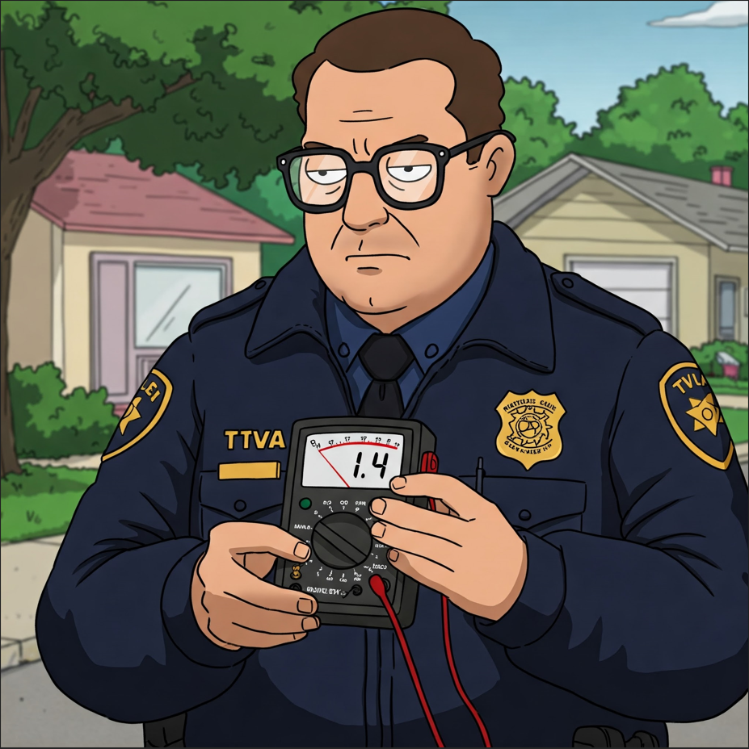
Regional Voltage Unbalance Drivers
Untransposed 500-kV lines(Mutual Inductance)
Generation dispatch profile
System load profile
Transmission configuration (outages)
T. Murphy

Slide 8
Possible Solution
5/6/2025

Slide 9
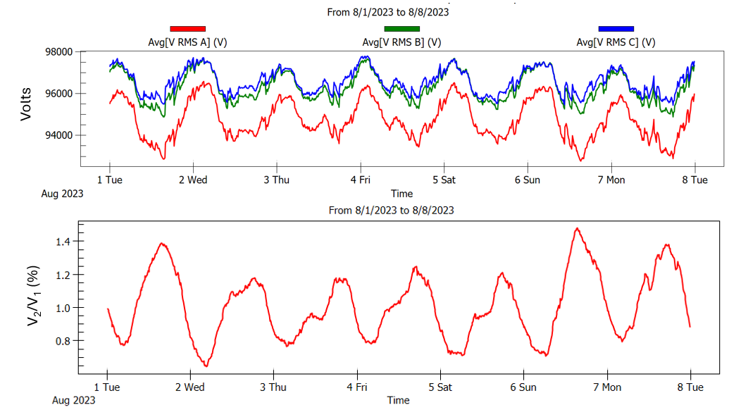
Potential Solution
Looking at the line-to-line voltage over the past year at the station that historically has the highest unbalance in the Nashville area Va is always higher than Vab and Vca. Also, as the loading increases the separation between the line-to-line voltages means the voltage unbalance increases. In theory, just the A phase should be able to be adjusted at or around the 500/161kV stations in the area and improve the area unbalance. So, the question is, how do we go about doing that?

Slide 10
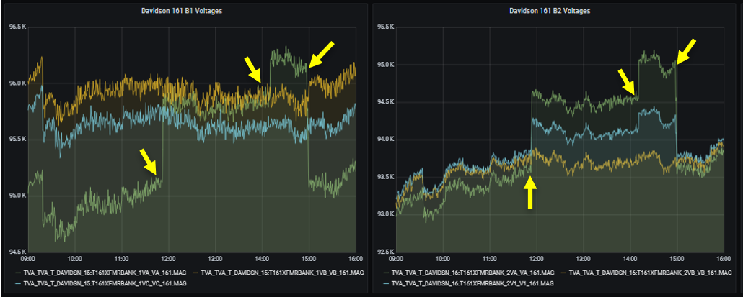
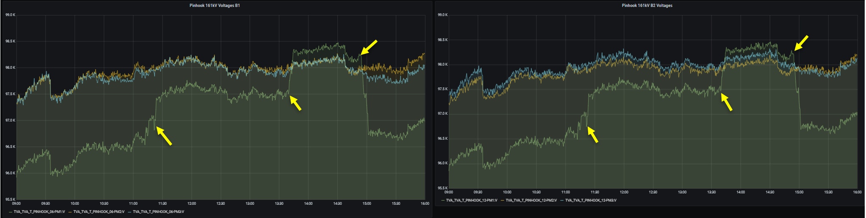
Voltage Unbalance Mitigation Options
STATCOM phase control
IBR phase control
500-kV line transpositions
Unbalanced Capacitor Banks
500/161-kV Intertie Bank LTC Adjustment Pilot
Notes:
Adjusting the A phase by just 2 steps at Davidson, Pin Hook, and Wilson and 4 steps at Rutherford reduced voltage unbalance by 15% or greater at 107 delivery points around middle TN.

Slide 11
Concerns with Approach
5/6/2025

Slide 12

Concerns With Operating Taps Out of Step
Increased Neutral Current
Increased Circulating Current in Tertiary
Increase VUB on 500kV Network, What is too high?
Does the VUB shift somewhere else on the network?
Minimal evidence of other utilities operating their transformers like this full time.
Been tested before at TVA with negative results
500kV VUB?
I just transferred from Environmental, how will this change impact the Salmon?
We have a lot of concerns with this! Just look at all of them behind me!
?
?
Bk1
?
?
?
161kV VUB?
TVA
LPC VUB?
Notes:
Adjusting the A phase by just 2 steps at Davidson, Pin Hook, and Wilson and 4 steps at Rutherford reduced voltage unbalance by 15% or greater at 107 delivery points around middle TN.

Slide 13

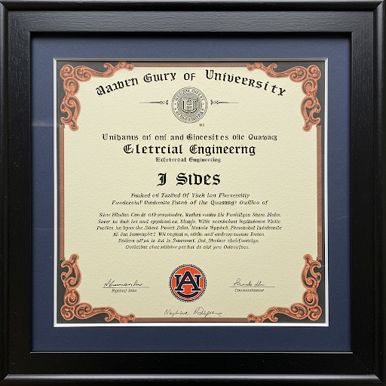
Addressing Initial Concerns with Historic Data
Neutral current does increase, but not close to what the models show
No clue on the increase in circulating current in tertiary
Figured VUB on 500kV isn’t a concern for us since no load is connected at 500kV.
No clue if VUB gets shifted elsewhere
Found an IEEE paper from AEP where they operated a EHV transformer out of step to correct unbalance at the transformer.
Can’t explain the initial test results. No data or witnesses from the test
Notes:
Adjusting the A phase by just 2 steps at Davidson, Pin Hook, and Wilson and 4 steps at Rutherford reduced voltage unbalance by 15% or greater at 107 delivery points around middle TN.

Slide 14
The Actual Test
5/6/2025

Slide 15
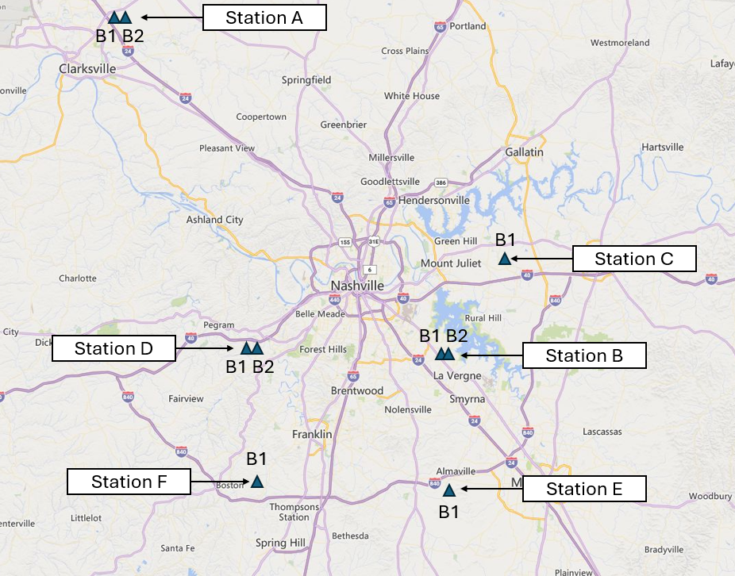
Testing Area
Notes:
Adjusting the A phase by just 2 steps at Davidson, Pin Hook, and Wilson and 4 steps at Rutherford reduced voltage unbalance by 15% or greater at 107 delivery points around middle TN.

Slide 16
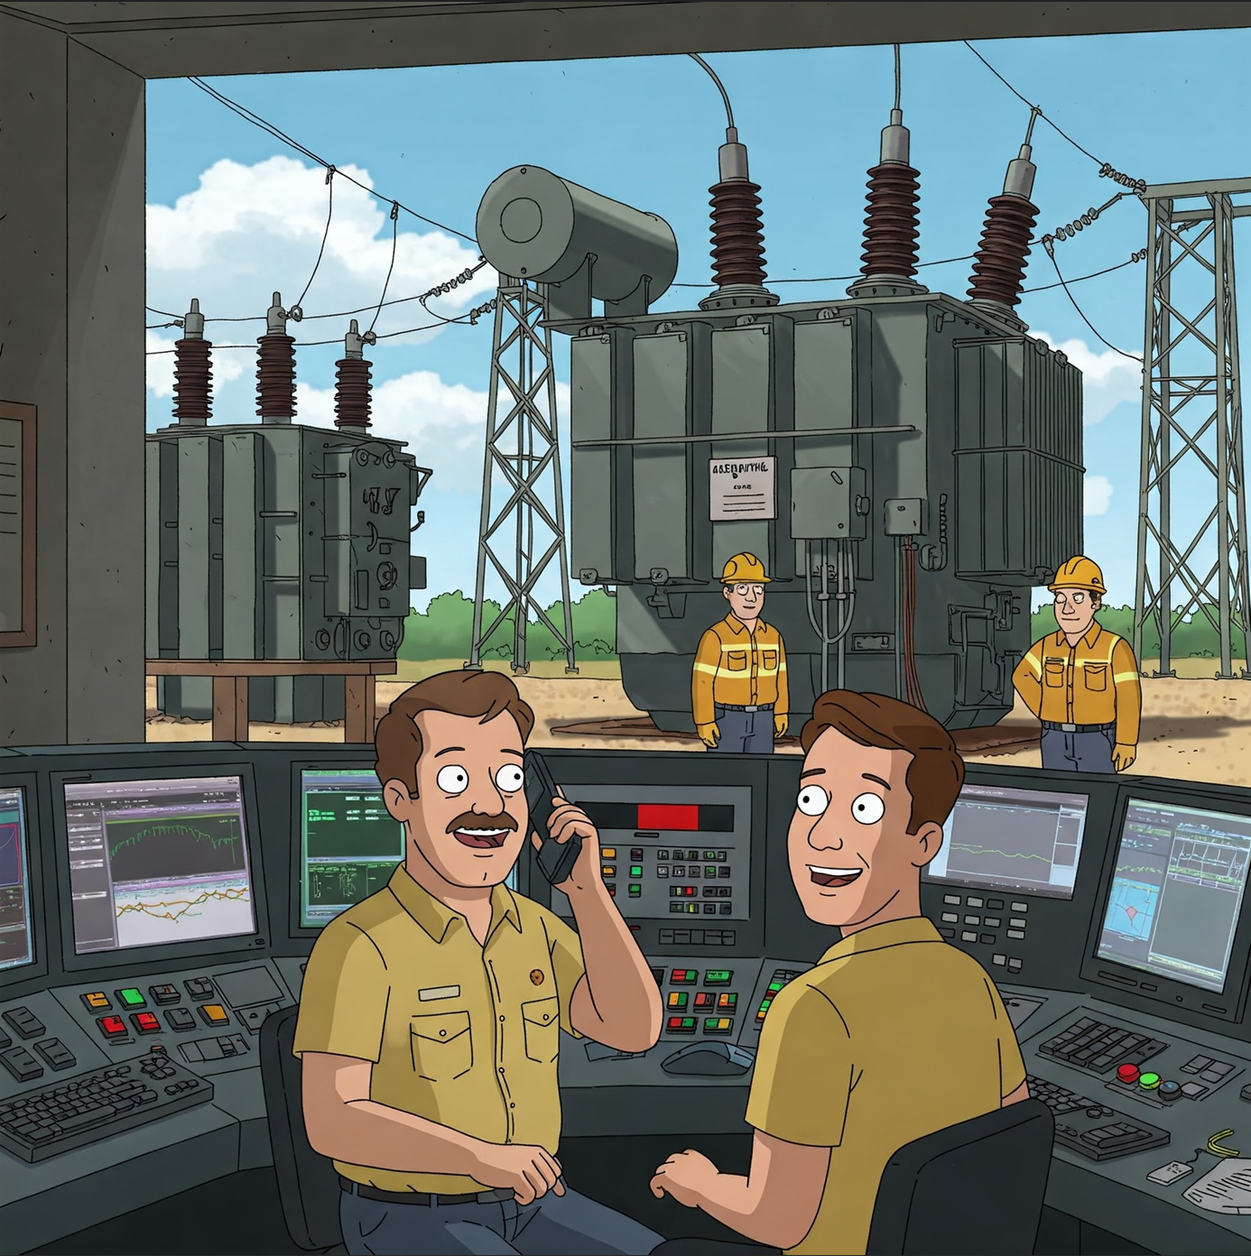

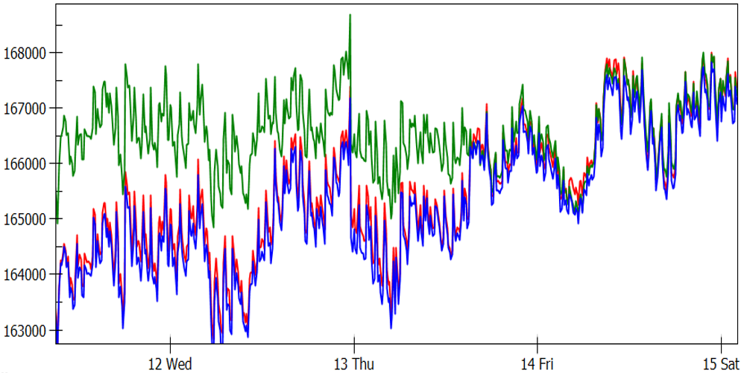

The Actual Test
Step Difference 0
Are we safe on this side of the Glass?
Alright Go Ahead!
Alright,
go ahead
We’re safe. The danger stops at the glass-along with your concern for other people.
TVA
TVA
Notes:
Adjusting the A phase by just 2 steps at Davidson, Pin Hook, and Wilson and 4 steps at Rutherford reduced voltage unbalance by 15% or greater at 107 delivery points around middle TN.

Slide 17
The Actual Test
Step Difference 2
Are we safe on this side of the Glass?
How does it Look?
Alright,
go ahead
We’re safe. The danger stops at the glass-along with your concern for other people.
TVA
TVA
Notes:
Adjusting the A phase by just 2 steps at Davidson, Pin Hook, and Wilson and 4 steps at Rutherford reduced voltage unbalance by 15% or greater at 107 delivery points around middle TN.

Slide 18
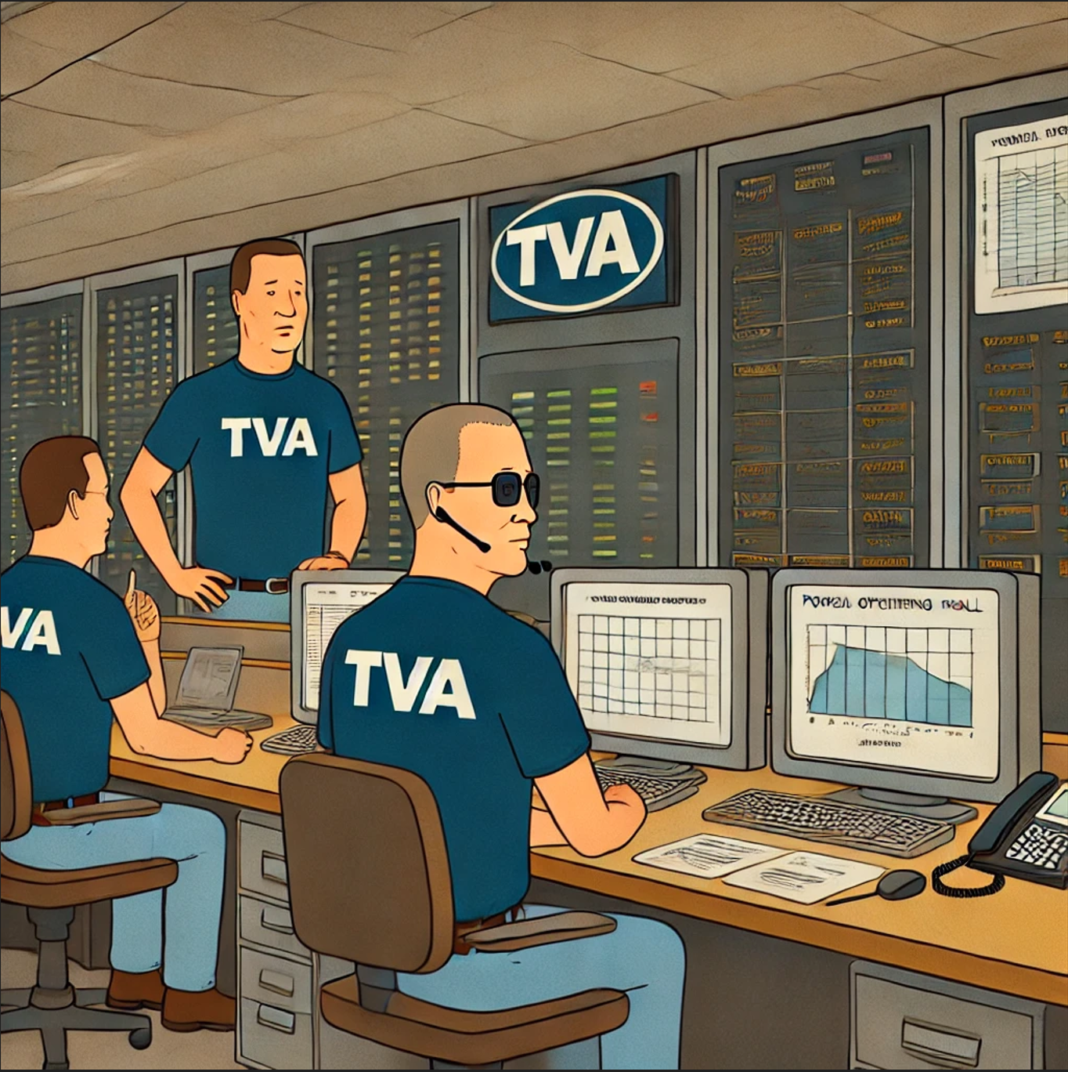

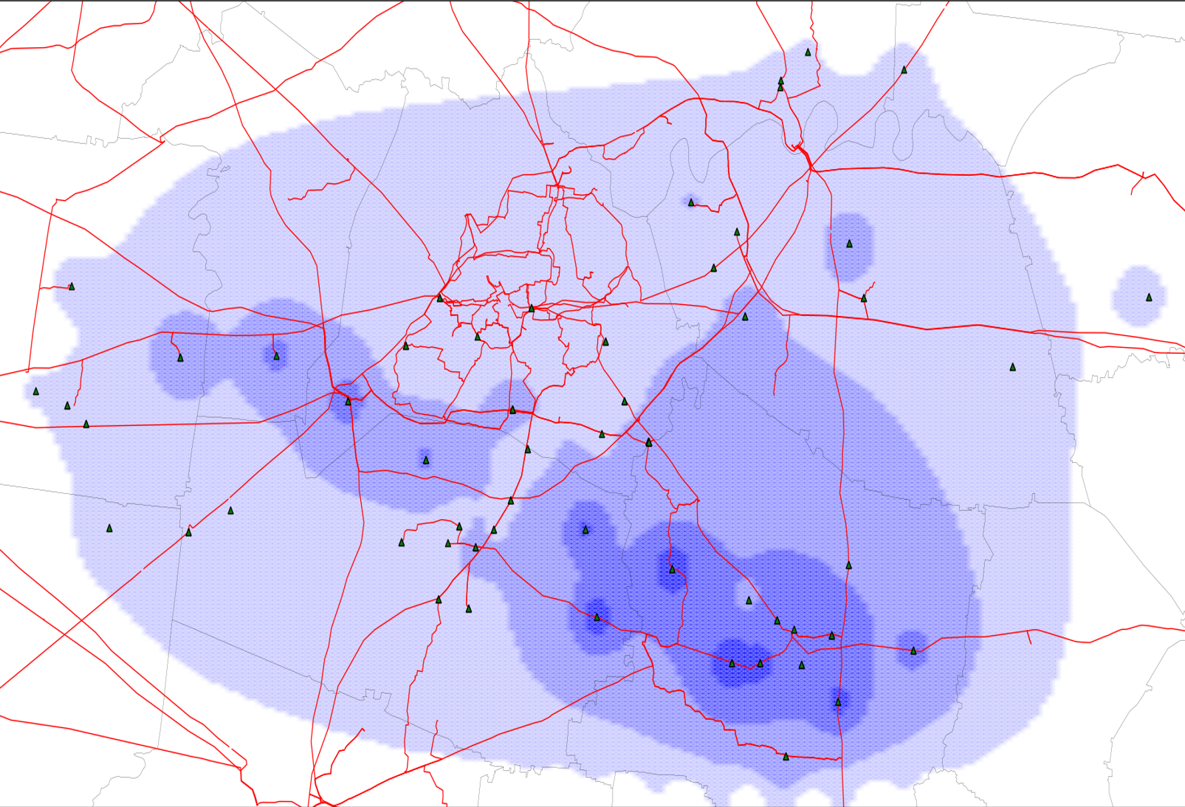

Operations is seeing Wide Area Improvement
It looks like you didn’t screw this up.
Notes:
Adjusting the A phase by just 2 steps at Davidson, Pin Hook, and Wilson and 4 steps at Rutherford reduced voltage unbalance by 15% or greater at 107 delivery points around middle TN.

Slide 19

Testing is Proving Successful
Step Difference 2
Its working!! Wait…
Why do you have two phones?
One for ignoring people and one for pretending I’m busy.
Are we safe on this side of the Glass?
Alright,
go ahead
!!!!
We’re safe. The danger stops at the glass-along with your concern for other people.
Notes:
Adjusting the A phase by just 2 steps at Davidson, Pin Hook, and Wilson and 4 steps at Rutherford reduced voltage unbalance by 15% or greater at 107 delivery points around middle TN.

Slide 20
Expect the Unexpected
5/6/2025

Slide 21

Expected/Unexpected Problem
Notes:
Adjusting the A phase by just 2 steps at Davidson, Pin Hook, and Wilson and 4 steps at Rutherford reduced voltage unbalance by 15% or greater at 107 delivery points around middle TN.

Slide 22

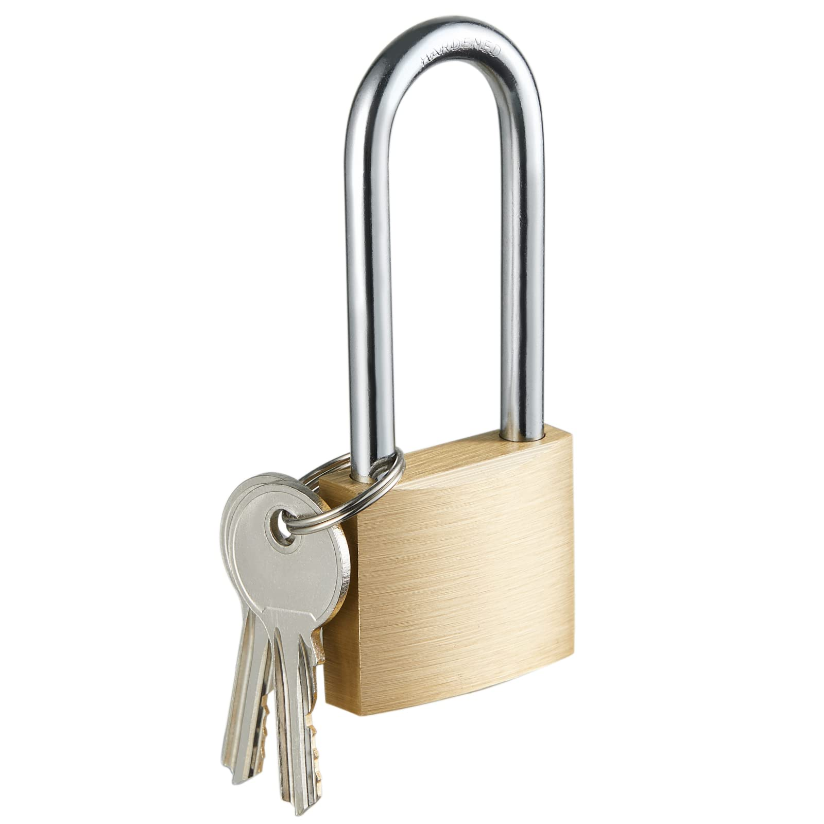


Expected/Unexpected Problem
Step Difference 2
Alright, lets adjust the taps at Station F
ALARMS!!!! We are Locked OUT!
Click…Click….Click…..Click……Click…….
ALARM!!
ALARM!!
Notes:
Adjusting the A phase by just 2 steps at Davidson, Pin Hook, and Wilson and 4 steps at Rutherford reduced voltage unbalance by 15% or greater at 107 delivery points around middle TN.

Slide 23
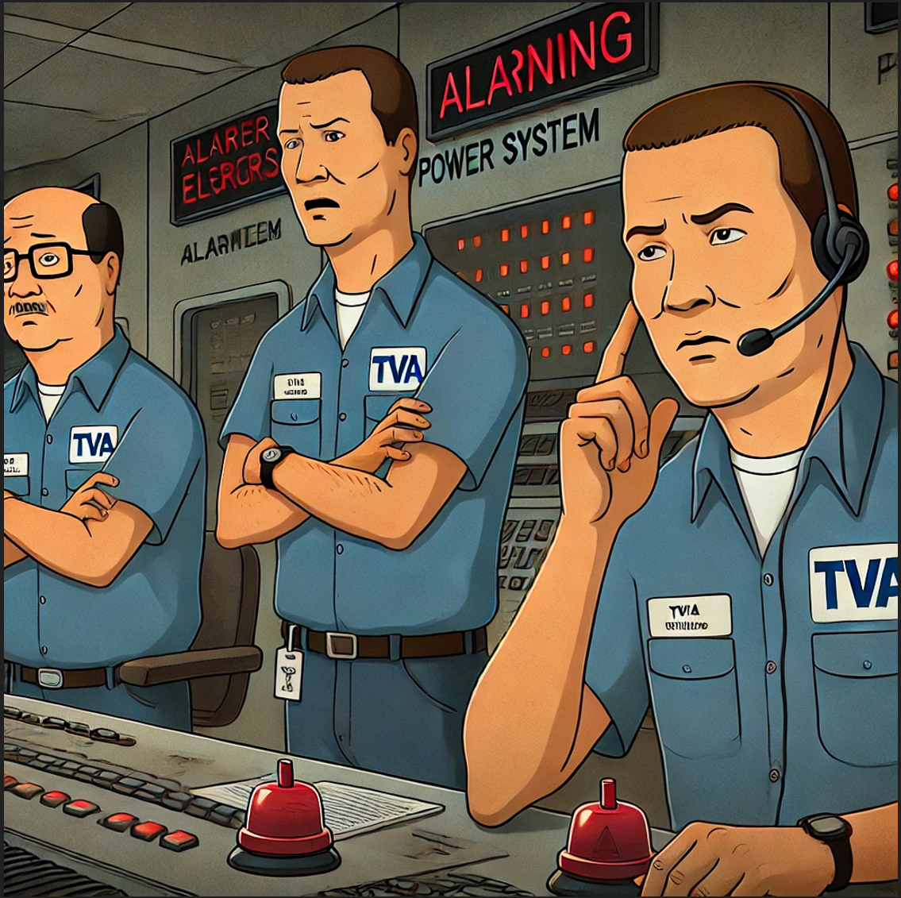
Operators Now Locked out of Station F
You told us this wouldn’t happen! What happened?!
You also said nothing would happen to the Salmon! I bet there is something happening to the Salmon isn’t there?
TVA
TVA
I am not sure yet about the alarm and I can assure you nothing is happening to the Salmon.
Notes:
Adjusting the A phase by just 2 steps at Davidson, Pin Hook, and Wilson and 4 steps at Rutherford reduced voltage unbalance by 15% or greater at 107 delivery points around middle TN.

Slide 24

Expected/Unexpected Problem
Notes:
Adjusting the A phase by just 2 steps at Davidson, Pin Hook, and Wilson and 4 steps at Rutherford reduced voltage unbalance by 15% or greater at 107 delivery points around middle TN.

Slide 25

Expected/Unexpected Problem
Step Difference 2
ALARM!!
ALARM!!
Notes:
Adjusting the A phase by just 2 steps at Davidson, Pin Hook, and Wilson and 4 steps at Rutherford reduced voltage unbalance by 15% or greater at 107 delivery points around middle TN.

Slide 26
Project Results
5/6/2025

Slide 27
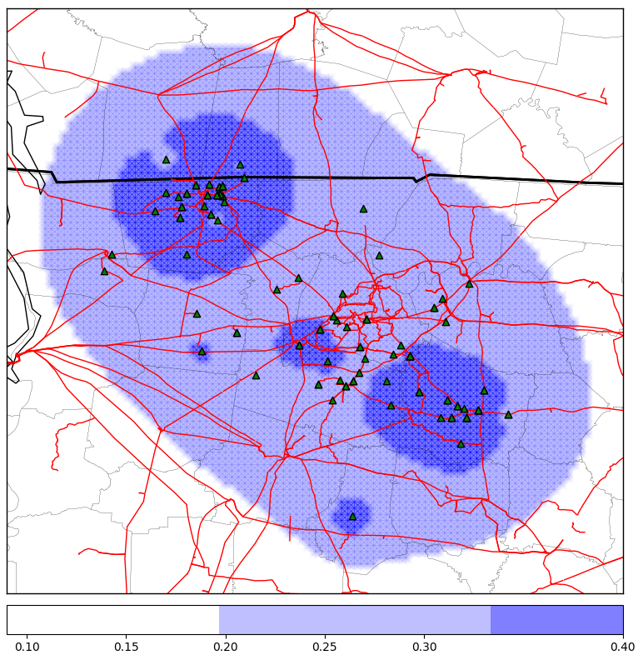
Regional Voltage Unbalance Pilot Project Results
Delivery Point | % Change
Almaville TN 25-T2 - V Neg-Seq Imb Total | 177.7901
West Creek TN 13-T1 - V Neg-Seq Imb Total | 324.7766
Murfreesboro TN 25-Total - V Neg-Seq Imb Total | 107.8753
New Providence TN 13-T2 - V Neg-Seq Imb Total | 167.4373
Gibbs Lane TN 13-T1 - V Neg-Seq Imb Total | 244.1674
Almaville TN 25-T1 - V Neg-Seq Imb Total | 150.6326
Grassland TN 25-T2 - V Neg-Seq Imb Total | 128.4296
New Providence TN 13-T1 - V Neg-Seq Imb Total | 167.8706
Cason Lane TN 13-T2 - V Neg-Seq Imb Total | 105.9048
Mimms Industrial TN 13-T2 - V Neg-Seq Imb Total | 196.9074
Triune TN 25-Total - V Neg-Seq Imb Total | 106.9724
Cason Lane TN 13-T1 - V Neg-Seq Imb Total | 93.9066
Jersey Miniere Zinc TN 13-T1 - V Neg-Seq Imb Total | 140.5726
Guthrie KY 161-T1 - V Neg-Seq Imb Total | 222.4056
Jersey Miniere Zinc TN 13-T2 - V Neg-Seq Imb Total | 204.0353
Guthrie KY 161-T2 - V Neg-Seq Imb Total | 216.1536
Hankook TN 161-Total - V Neg-Seq Imb Total | 196.6518
East Murfreesboro TN 46-Total - V Neg-Seq Imb Total | 73.39909
West Creek TN 13-T2 - V Neg-Seq Imb Total | 256.9963
Hemlock TN 161-T3 - V Neg-Seq Imb Total | 216.6229
Station A
Station B
Station C
Station D
Station E
Per Unit V₂/V₁ Difference
Notes:
Adjusting the A phase by just 2 steps at Davidson, Pin Hook, and Wilson and 4 steps at Rutherford reduced voltage unbalance by 15% or greater at 107 delivery points around middle TN.

Slide 28
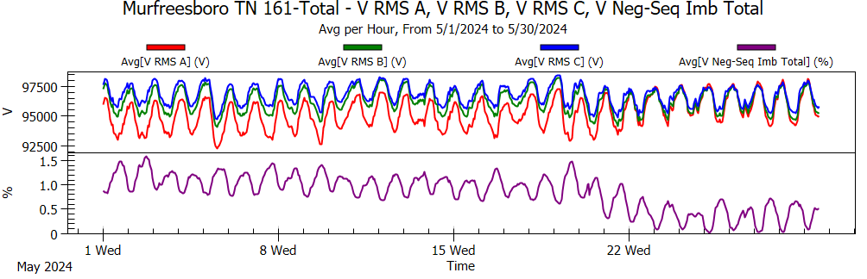

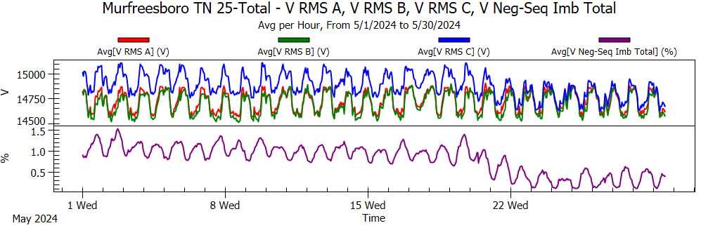
Regional Voltage Unbalance Pilot Project Results Cont.
LTC Pilot
LTC Pilot

Slide 29
Addressing Concerns With Results
Neutral Current increased on the 500kv side about 20-25A per step
Circulating Current in Tertiary increase varied for each step. Ended up at a max of 350A for a 4-step separation
Concluded if near by generation on the 500kV network wasn’t impacted, no 500kV loads, and the stations 500kV high voltage threshold wasn’t exceeded we could proceed
The VUB issue did not shift else where and was localized to the area around the transformer
First time for everything
Original test moved the wrong phase
Increased about 0.125% per step only at the local 500kV station
Well, you did it. Somehow. Good Job.
What about Salmon? How are they impacted?
20A/Step
40A-100A/Step
Bk1
20A/Step
Decreased about 0.125% per step for all DPs up to the first station
TVA
It’s not possible for this to impact Salmon or any aquatic life!
Decreased about 0.125% per step for all DPs up to the first Switching Station
Notes:
Adjusting the A phase by just 2 steps at Davidson, Pin Hook, and Wilson and 4 steps at Rutherford reduced voltage unbalance by 15% or greater at 107 delivery points around middle TN.

Slide 30
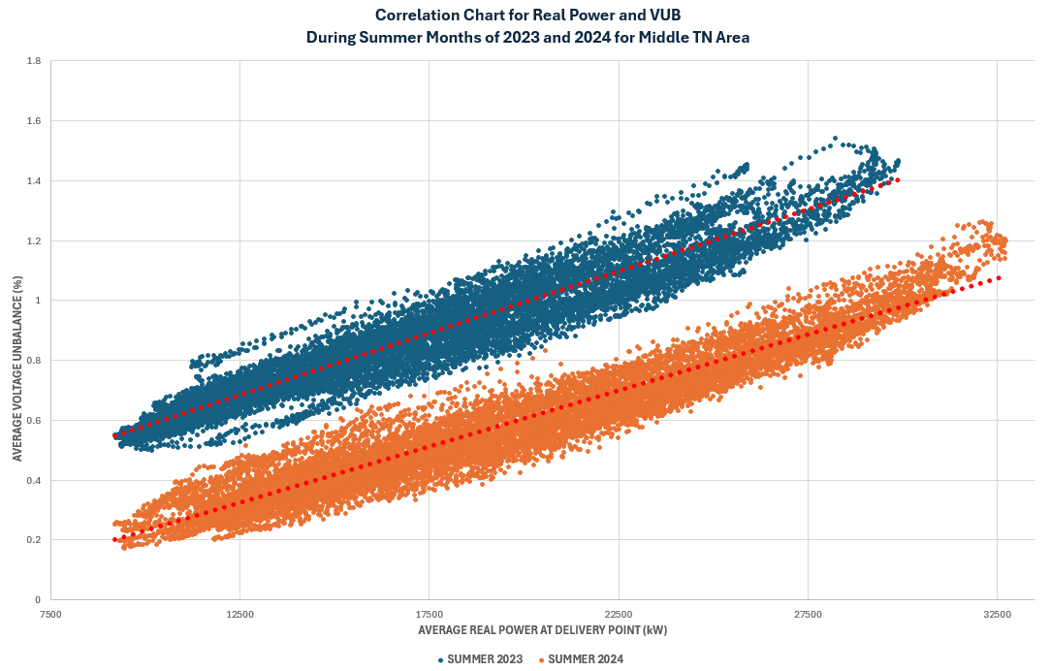
Middle TN Real Power and VUB Correlation Chart Results
Notes:
Adjusting the A phase by just 2 steps at Davidson, Pin Hook, and Wilson and 4 steps at Rutherford reduced voltage unbalance by 15% or greater at 107 delivery points around middle TN.

Slide 31
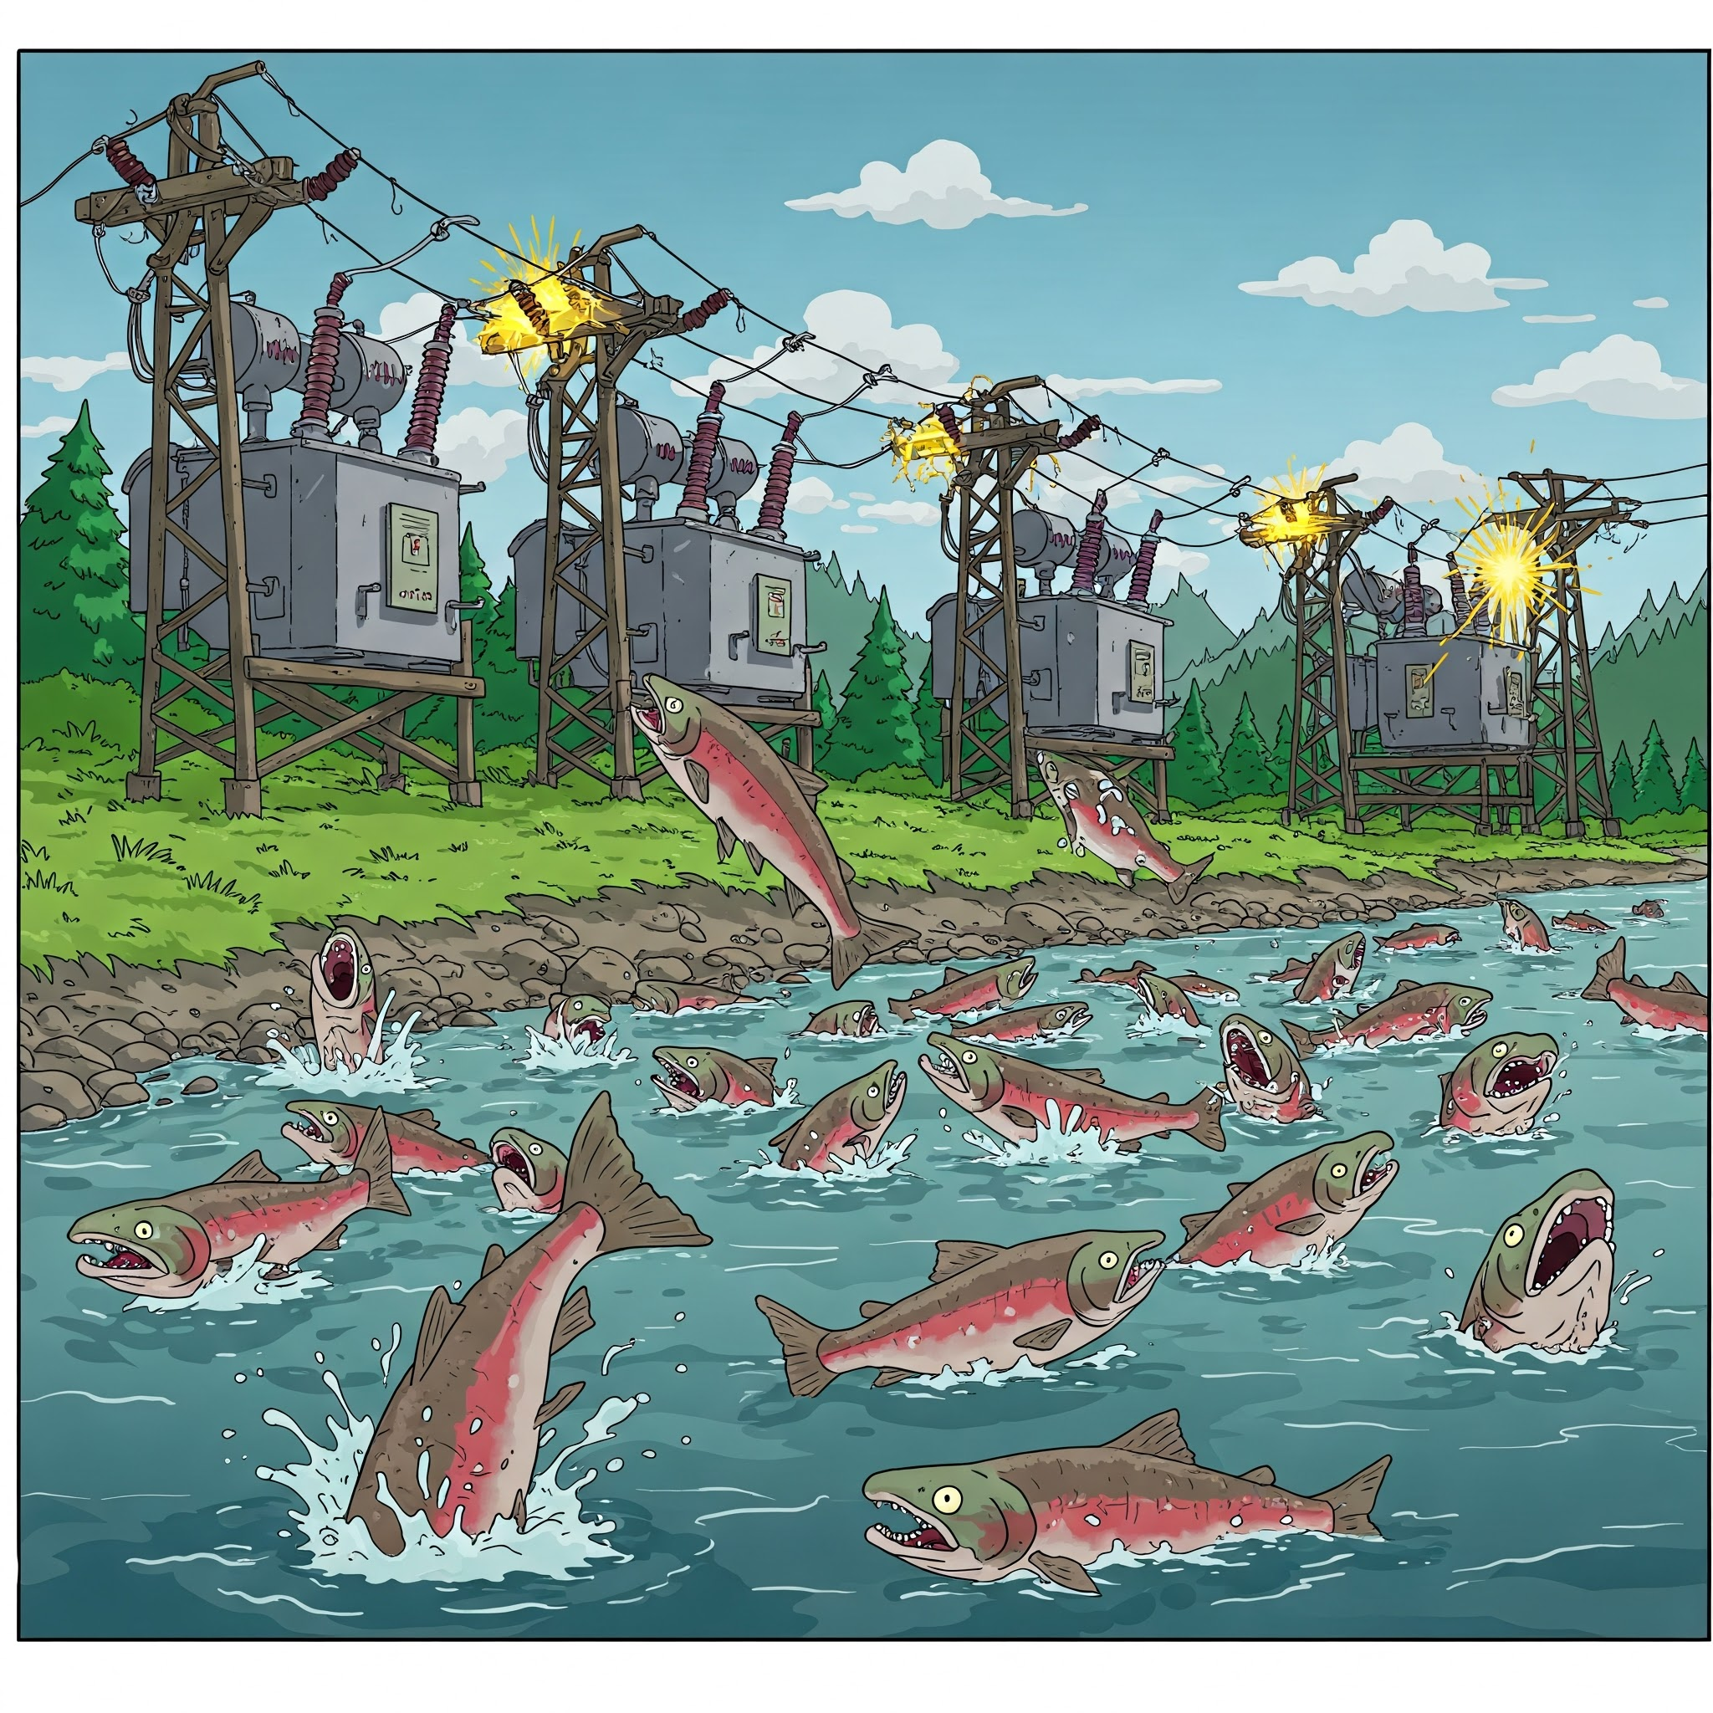

Questions?
What’s wrong with the Salmon!
TVA
TVA
TVA
TVA
TVA
Did you know the LTC is out of step?!
TVA

