Slide 1




VELCO & VEC Pilot Project on Novel High-Resolution Point-On-Wave Monitoring for Transmission Event Analysis & Model Validation
Dan Kopin, VELCO, U.S.A., dkopin@velco.com
Cyril Brunner, VEC, U.S.A., cbrunner@vermontelectric.coop
Kyle Thomas, Elevate Energy Consulting, U.S.A., kyle.thomas@elevate.energy
Ana Ospina, Elevate Energy Consulting, U.S.A., ana.ospina@elevate.energy
Ryan Quint, Elevate Energy Consulting, U.S.A., ryan.quint@elevate.energy

Slide 2
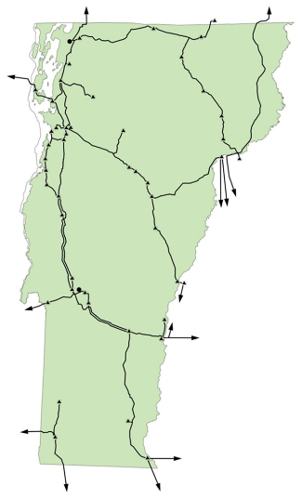
Vermont Electric Power Company (VELCO)
First U.S. transmission-only company (1956), delivering sustainable hydropower to Vermont
NERC Transmission Operator, Planner, and Owner
Owned by Vermont’s 17 distribution utilities (one is Vermont Electric Cooperative [VEC]) and a public benefits corporation
For-profit structured to deliver cooperative-like value to every grid connected customer
740 miles of transmission lines​
1,600+ miles fiber optic communication networks that monitor/control electric system and aid Vermonters’ high-speed data internet access
Adding 800+ more miles of fiber to connect 400 MW of distributed energy resources
Forecasted day-time minimum load in 2033 is -175 MW

Slide 3
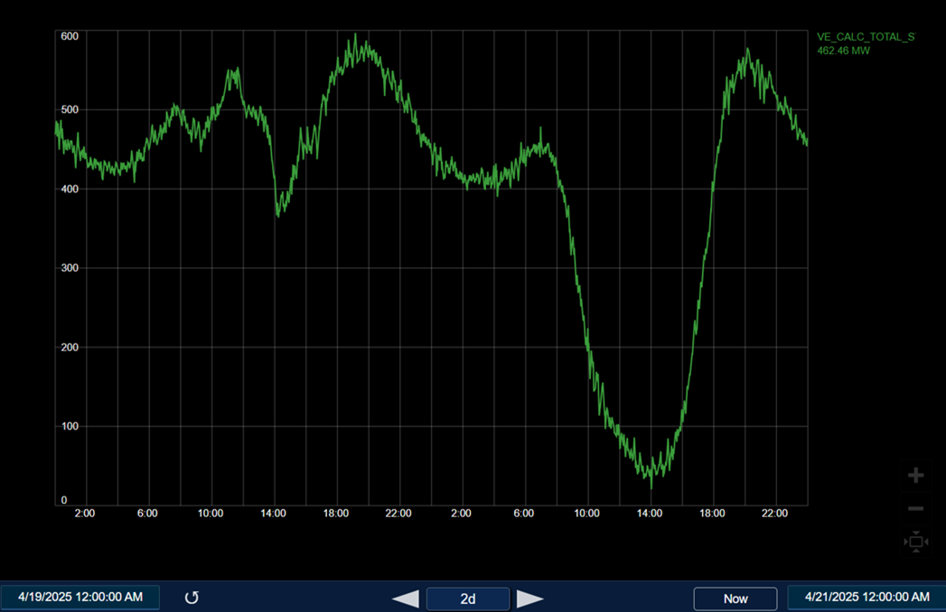
Vermont Net Load influenced by DER behavior on 4/19/2025 (cloudy) and 4/20/2025 (sunny)
4/19/2025
4/20/2025
20.772 MW!!

Slide 4
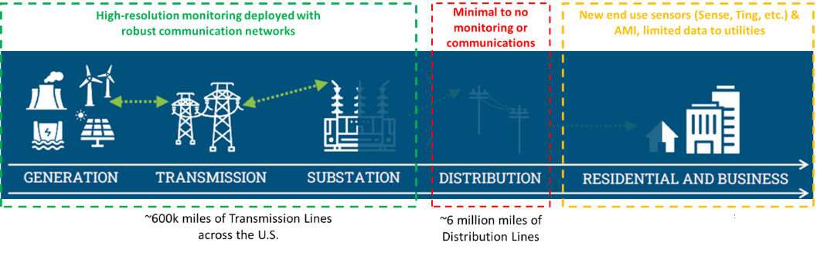
Distribution System has minimal to no monitoring outside the substations
Limited measurement data on the U.S. distribution system is primarily due:
Vast scale (10x the size of our Transmission system)
High cost of installing sensors down the distribution circuits (i.e., outside of substations, on poles, etc.)
Very high cost of installing high-speed communication networks across distribution circuits

Slide 5
Potential New Solution to the Distribution Monitoring Problem
New point-on-wave (POW) monitoring technology that takes advantage of existing communication broadband networks to provide high-resolution monitoring of the grid
Takes advantage of the existing broadband lines (cable, internet) going to every home and business that is typically built under the electric distribution lines
Broadband network has more than 600,000 existing universal power supply (UPS) devices across the country
Each UPS gets single-phase AC power from the electric distribution system
POW sensors can be installed inside the UPS enclosures to monitor the distribution system voltage and then transmit that data directly on the broadband communication network
Combines two infrastructures that run together to every home and business to provide extensive electric distribution monitoring

Slide 6
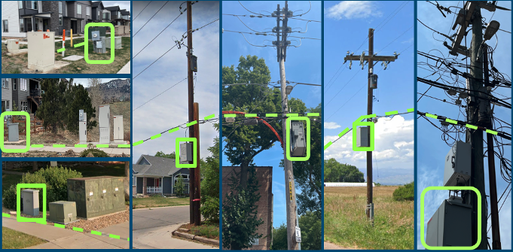
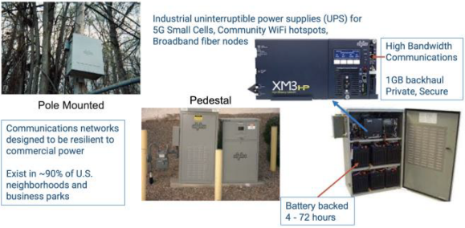
Point-On-Wave Monitoring Technology Leveraging the Existing Broadband Network
Broadband Network Adjacent to Electrical Distribution Network
Broadband Network Industrial UPSs
Source: “Synchro-Waveform Measurements and Data Analytics in Power Systems”, IEEE PES-TR127.
Images courtesy GridVisibility, inc.

Slide 7
Point-On-Wave Monitoring Technology Capabilities
Sensor Description
Capture voltage waveforms at 10,000 samples per second
GPS time synchronization
Built-in lightning and motion detection
Sensors stay active during outages due to UPS backup power
88% of U.S. homes within 1 km of a broadband UPS → wide potential coverage
Data streams to a central platform with low latency for near-instant monitoring and analysis

Slide 8
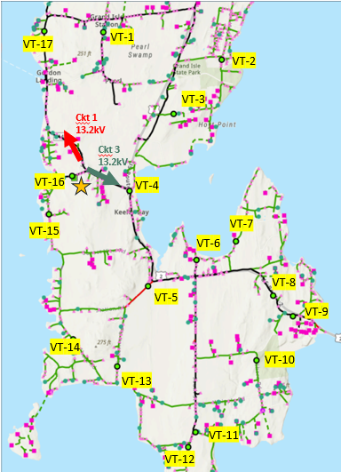
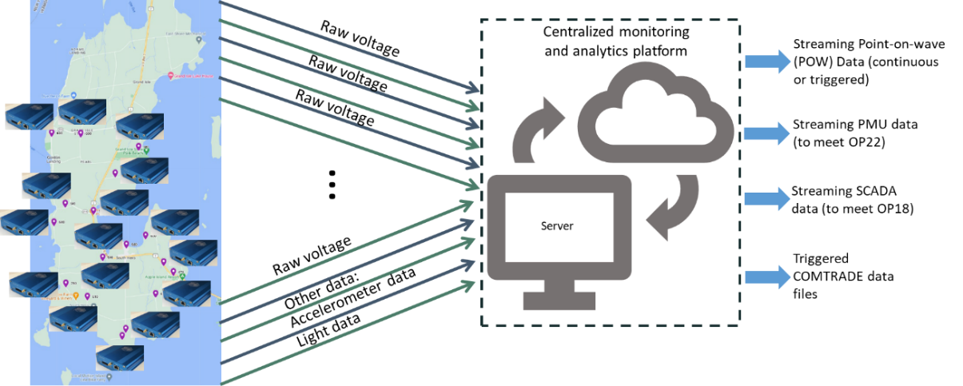
VELCO & VEC Pilot Project
March 2024
17 sensors installed in 6 hours
VELCO & VEC piloted the technology in Vermont on VEC’s distribution system
Installing 17 sensors on two VEC distribution circuits
Initially installed in time to capture the 2024 solar eclipse
Captured additional events: faults, switching events, harmonics

Slide 9
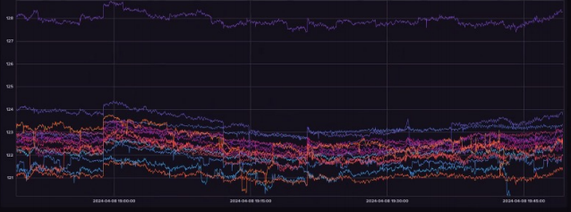
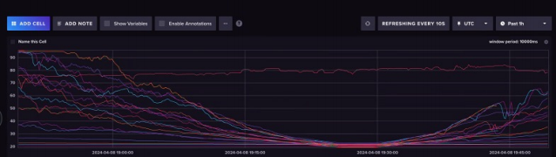
Solar Eclipse Captured
Distribution Voltages
Ambient Light at Sensors

Slide 10
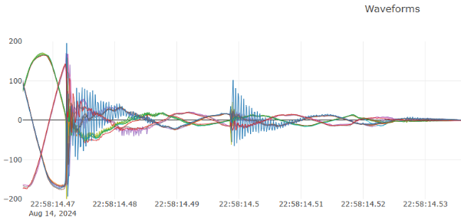
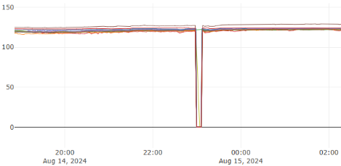
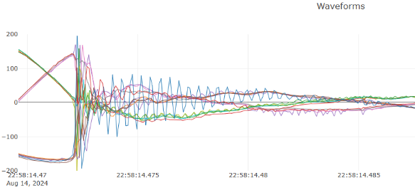
Lightning Strike causing 115kV 3-phase Fault
Fault as seen on the distribution system
Waveforms courtesy GridVisibility, inc.

Slide 11
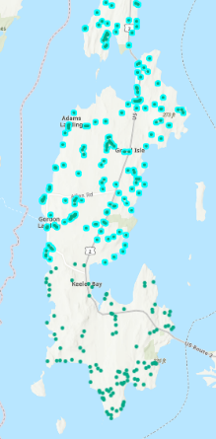
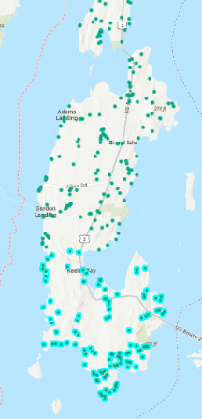
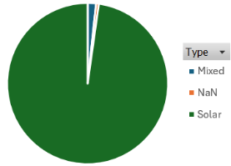
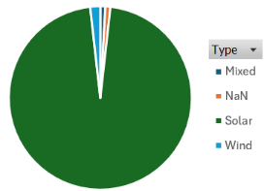
DER Penetration in the Pilot Area
Feeder 1
Feeder 3
Type of resource | Quantity | Capacity [kW]
No defined | 1 | 0
Mixed | 3 | 24.5
Solar | 175 | 6,829.36
Wind | 0 | 0
TOTAL | 179 | 6,853.86
Type of resource | Quantity | Capacity [kW]
No defined | 1 | 0
Mixed | 1 | 6.41
Solar | 109 | 817.59
Wind | 2 | 5
TOTAL | 113 | 829
Location of DERs Across Feeder 1 and Feeder 3 in the South Hero Area

Slide 12
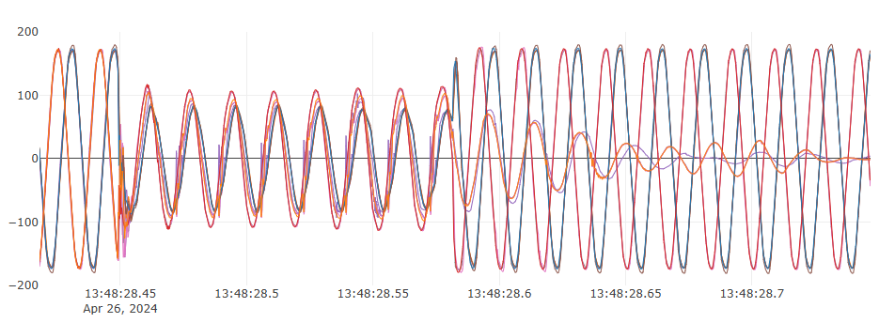
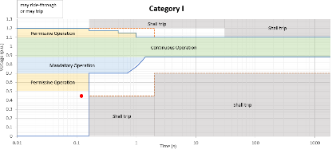
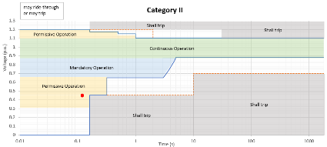
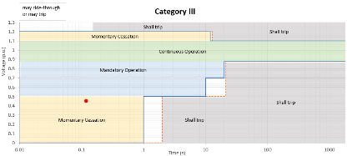
Nearby system fault allowing DER Ride-through performance against IEEE 1547
118 ms
246 ms
Waveforms courtesy GridVisibility, inc.

Slide 13
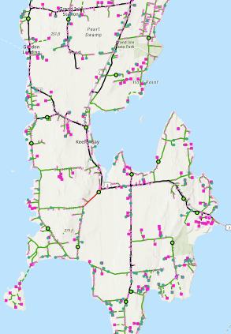
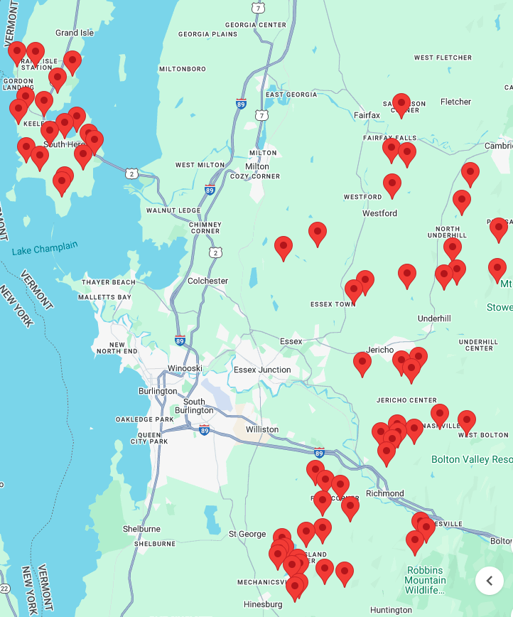
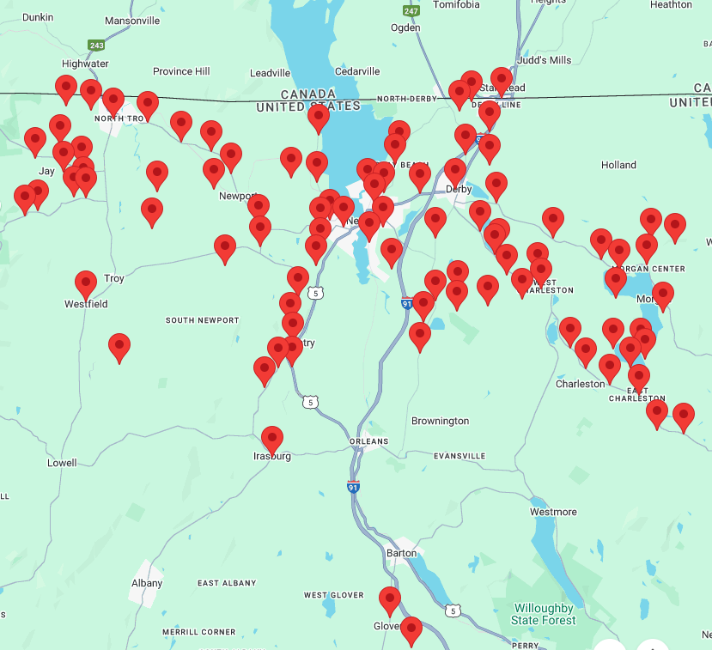
VELCO & VEC Pilot Project
March 2024
install 6 hours
October 2024
Install 2 days
December 2024
Install 5 days
VELCO piloted point-on-wave monitoring technology in South Hero, Vermont, installing 17 sensors on two distribution circuits
VELCO, with funding from Oak Ridge National Laboratory (ORNL), installed 34 additional sensors across multiple substations east of Burlington
VELCO funds 100 additional sensors surrounding Newport
Point-on-Wave Monitoring Sensors in South Hero (left) and additional Vermont Areas (right)

Slide 14

Once distribution monitoring becomes widely available, the Transmission use cases are endless
Grid frequency and ROCOF monitoring
System-wide voltage monitoring
Fault and transient event monitoring and detection
Performance comparison to ride-through curves
Near-real time grid event notifications
Aggregate DER dynamic model validation
Dynamic load model validation
System model validation
Time synchronization check across devices and systems
Early warning indicators & pre-event analysis
Wide area oscillation monitoring

Slide 15
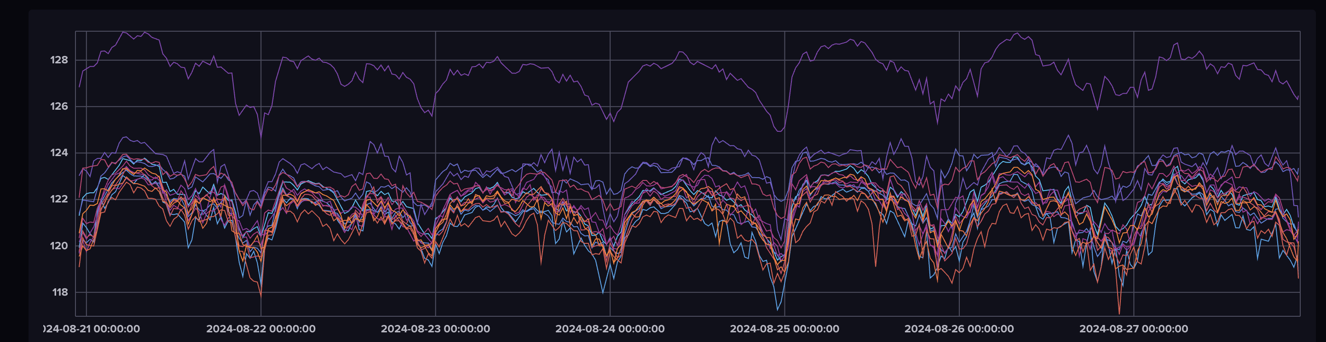
Conclusions
As distribution systems continue to evolve and change with the ever-increasing growth of DERs, monitoring of the distribution becomes critically important
New POW monitoring pilot project leveraging the broadband infrastructure helped rapidly improve grid visibility and support Transmission use cases, including distribution load model validation and DER model validation
Successful deployment requires overcoming challenges in proof-of-concept, hardware design, and cybersecurity
Future applications will continue to get developed and realized as we start to see the distribution system using high-resolution waveform data → real world training for AI, system wide frequency monitoring, and many more applications on the horizon

Slide 16
Thank you!
QUESTIONS?
Kyle Thomas, Elevate Energy Consulting, U.S.A. kyle.thomas@elevate.energy

